Slide 1

Windows Command Line Tutorial

Slide 2
Overview
Windows File System
Create folders and files
File Copy & Deletion
Networks
Search for information
Create a batch file

Slide 3
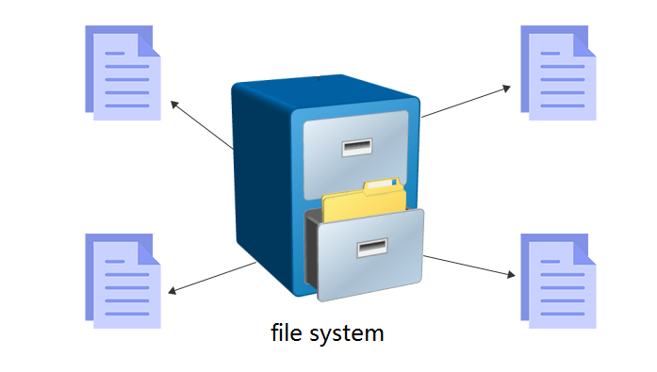
Windows File System

Slide 4
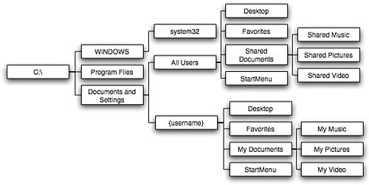
Windows System file structure (Tree-like)

Slide 5
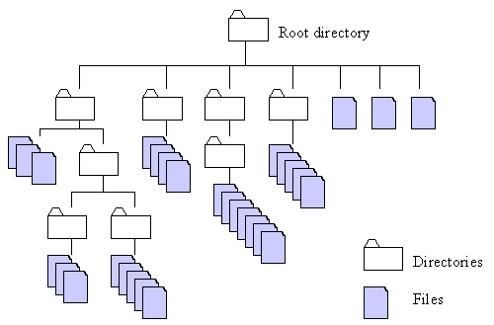



Absolute and relative paths
Absolute path
  a path is built starting from the system root
Relative path
  a path is built starting from the current location,
  as it is relative to the present position
current
location
how to access the file

Slide 6
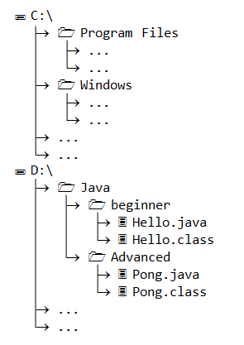
Example of paths
Write an absolute path to Hello.java
  D:\Java\beginner\Hello.java
Under Beginner folder, write path to Pong.java
  absolute path
    D:\Java\Advanced\Pong.java
  relative path
    ..\Advance\Pong.java

Slide 7
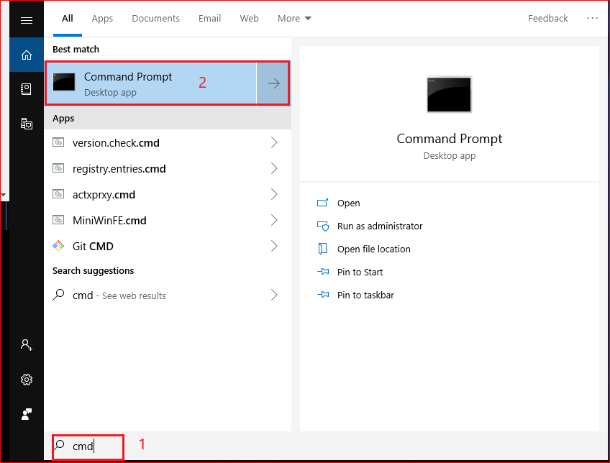
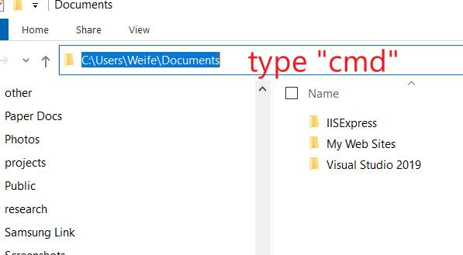
How to Open Command Prompt?
Method 1
Method 2

Slide 8
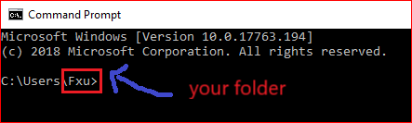

Absolute path example
Root directory
A volume or drive letter
C:
\Users
\Fxu

Slide 9

Change path using relative path
C:
C:
Change to an upper directory
\Users
\Users
\Fxu
Now you are here
You are here

Slide 10

C:
C:
Change to an upper directory/root
\Users

Slide 11


How does Windows find/run your applications?
Assume you want to open Notepad.
Search for the noteapp.exe in the current folder
if the notepad.exe in the current folder, execute it
otherwise search all paths defined by Windows

Slide 12
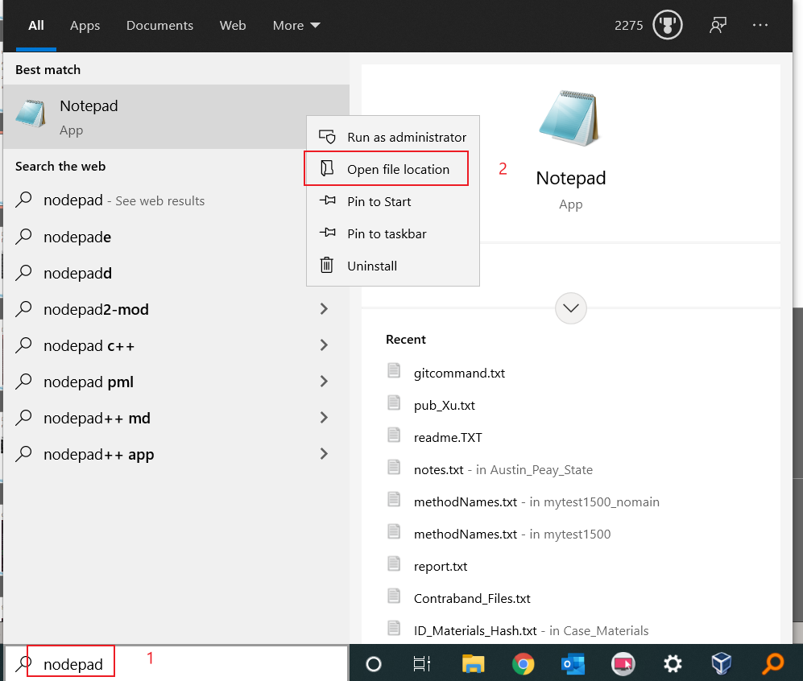

Slide 13
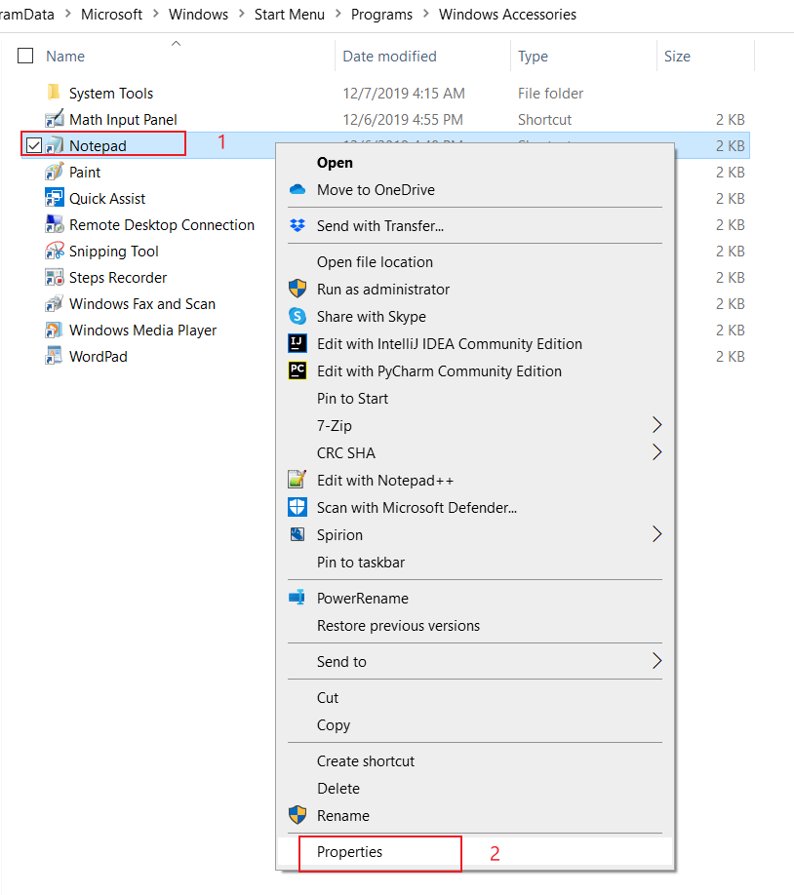
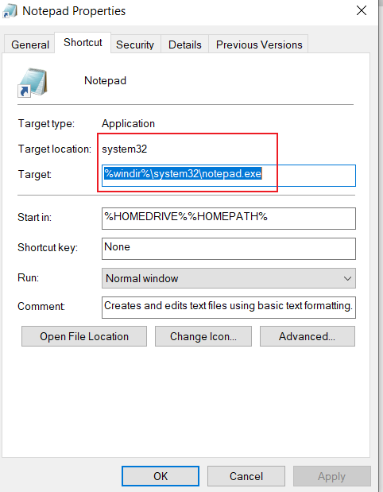
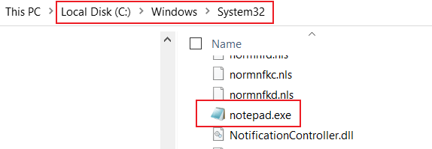

Slide 14
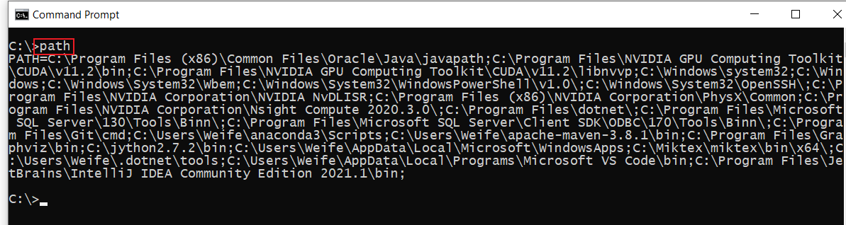
Displays or sets a search path for executable files

Slide 15
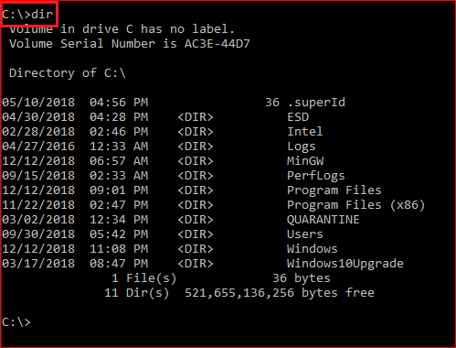
Display root

Slide 16
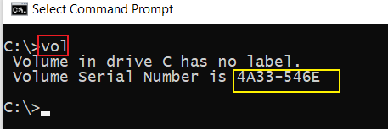
Displays a disk volume label and serial number

Slide 17
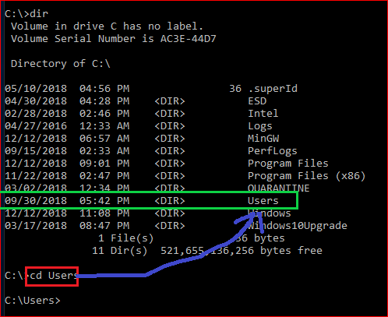
Change to \users directory
cls
Clears the screen

Slide 18
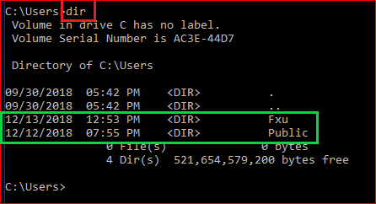
Show all files under the \Users

Slide 19
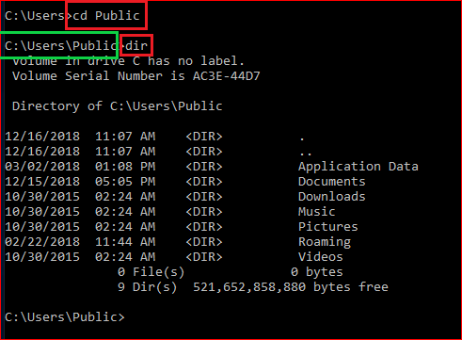
Change directory to \Public and display the content of the folder

Slide 20
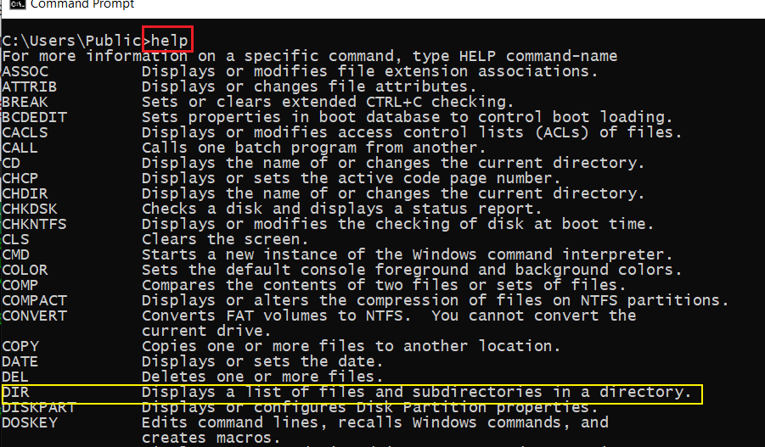
Help command

Slide 21
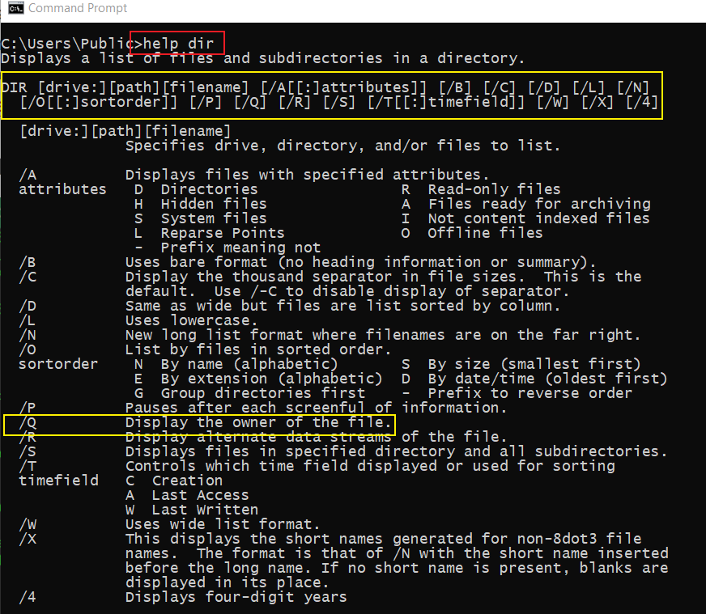
Get help when use dir

Slide 22
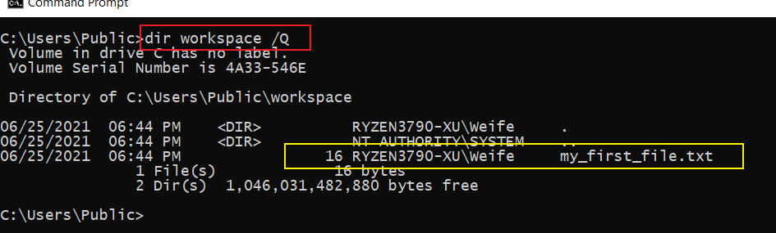
Find the owner of the file

Slide 23
Create folders and files

Slide 24
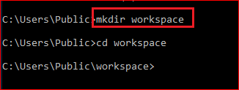
C:
C:
\Users
\Users
Create a folder
\Public
\Public
\workspace

Slide 25
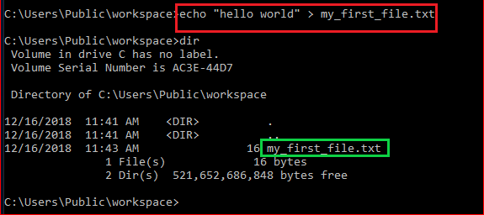
Create a new text file
C:
\Users
\Public
\workspace
hello world
my_first_file.txt

Slide 26
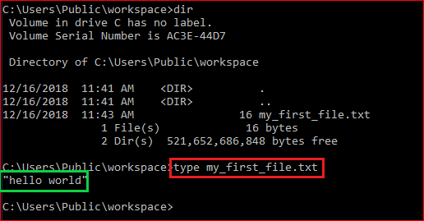
Show the content of the file: type

Slide 27
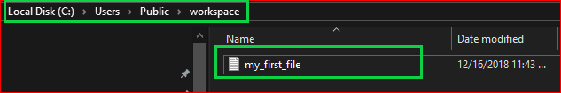

Show the content of the file

Slide 28
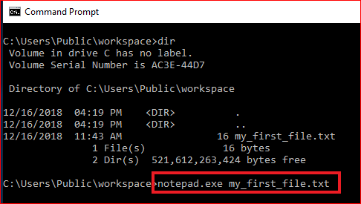
Show the content of the file: exe command

Slide 29

File Copy & Deletion

Slide 30
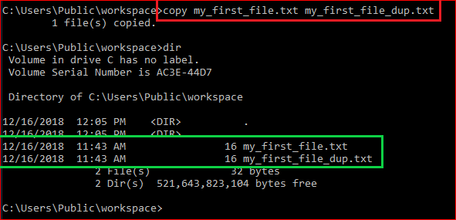
Duplicate files

Slide 31
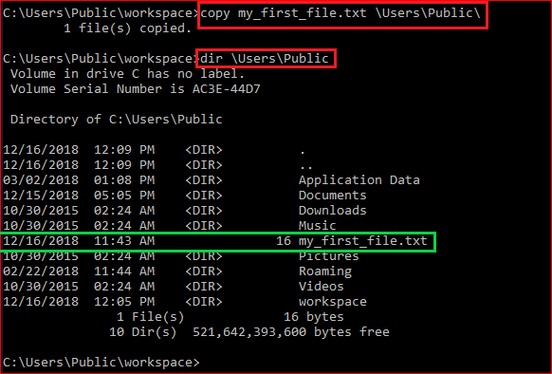
Copy a file to a different location

Slide 32
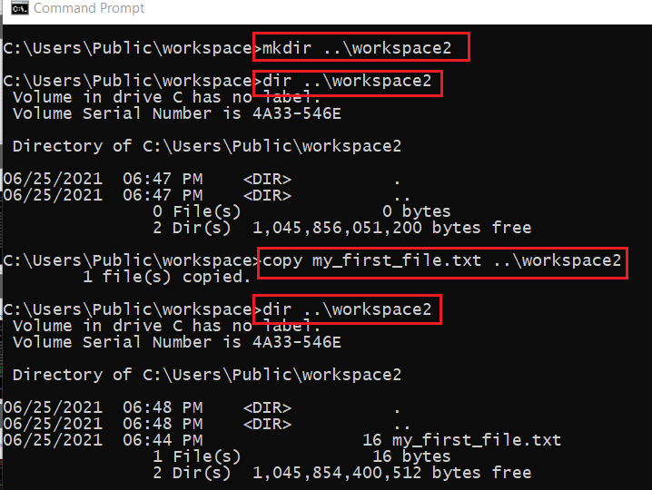

Copy a file to a new folder \workspace2 without using cd command
C:
create a folder
copy a file
.. parent folder
\Users
create a folder
copy a file
\Public
you are here
\workspace
\workspace2

Slide 33
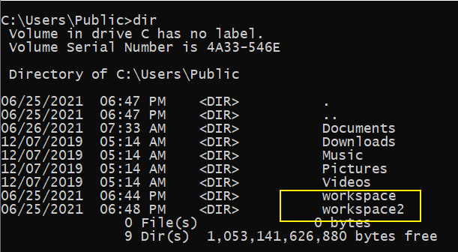
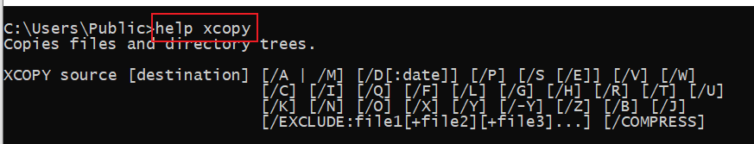
copy the whole folder to /workspace3
C:
\Users
\Public
you are here
\workspace
\workspace2
\workspace3
?

Slide 34
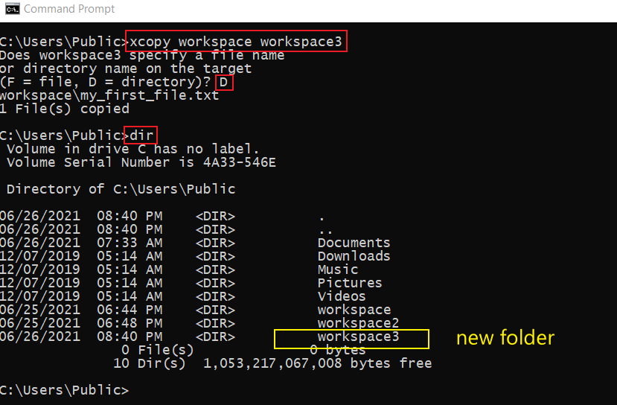

Slide 35
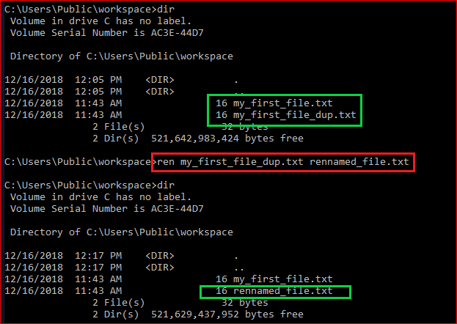
Rename a file

Slide 36
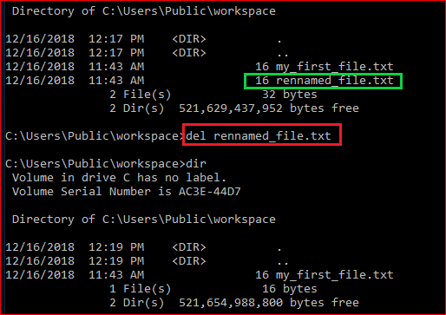
Delete a file

Slide 37
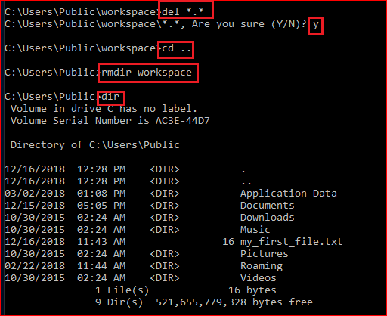
Delete a folder (rmdir/rd)

Slide 38
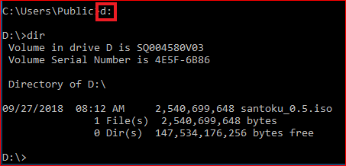
Change to a different drive

Slide 39

Networking

Slide 40
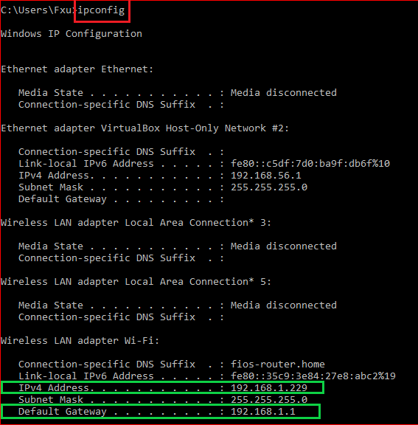
IP and default gateway

Slide 41
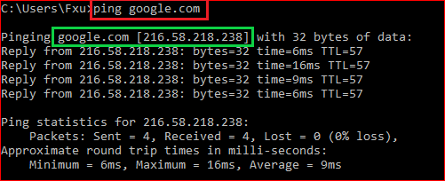
Test network connection

Slide 42
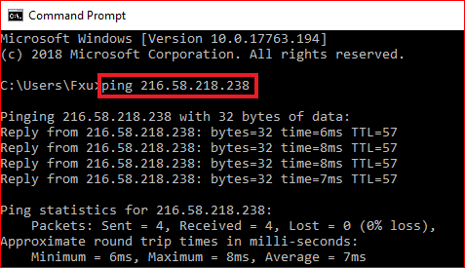
Test network connection

Slide 43

Search for information

Slide 44
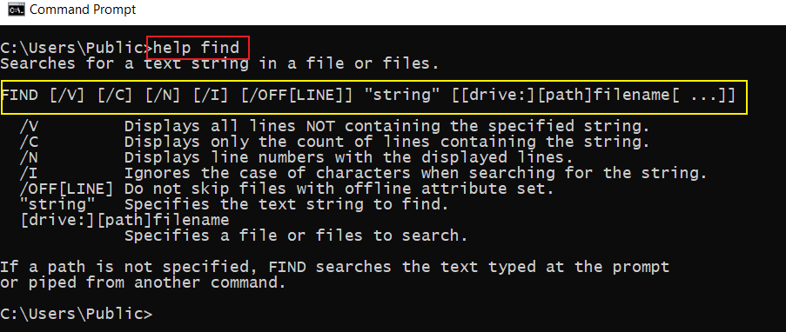
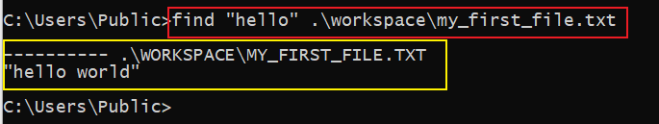
How to search for a string in a file?

Slide 45
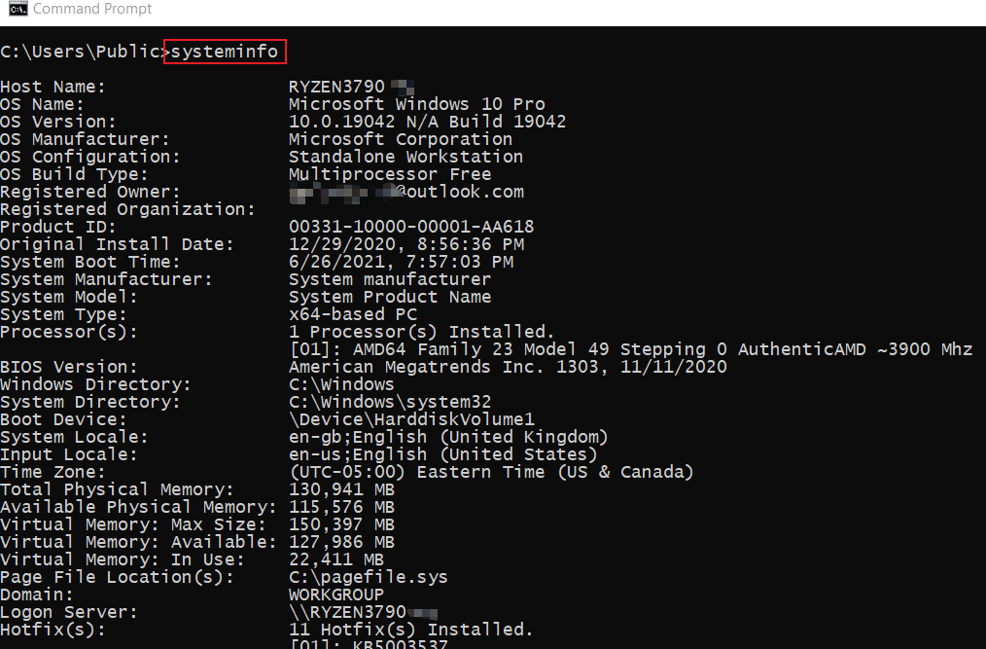
How to find system information?

Slide 46
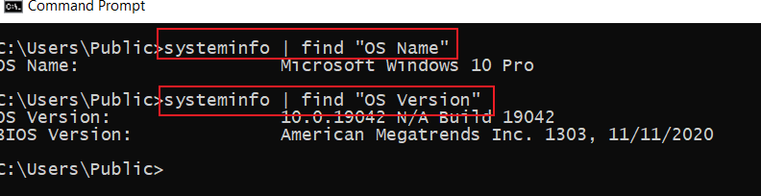
How to find specific system information using pipeline |

Slide 47
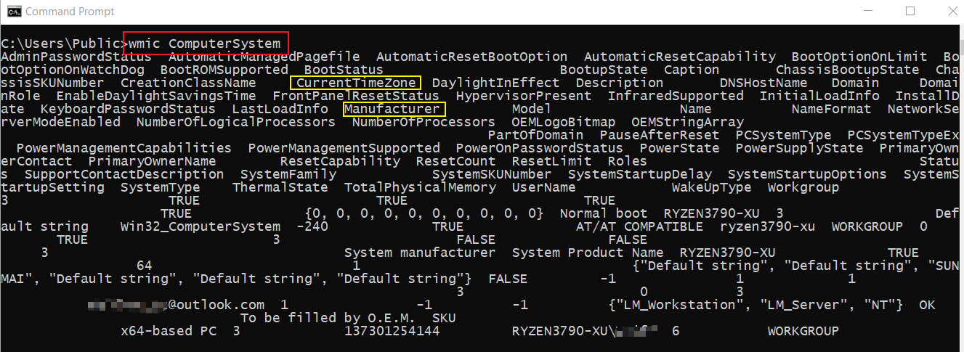
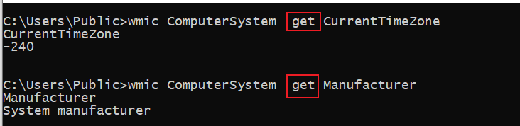
How to find system information using wmic?
Windows Management Interface Command
find property using get

Slide 48
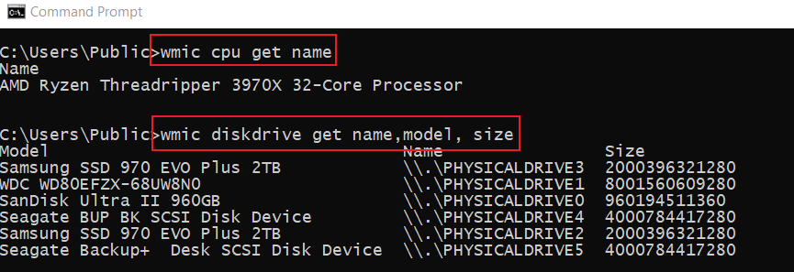
Find CPU/disk information

Slide 49
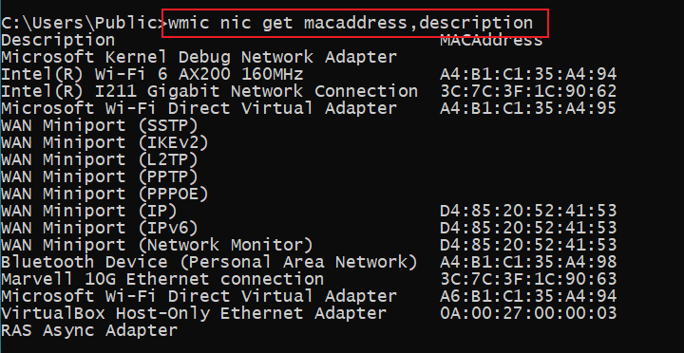
How to Find the MAC Address of Your Computer ?
Notes:
wmic nic get macaddress,description

Slide 50
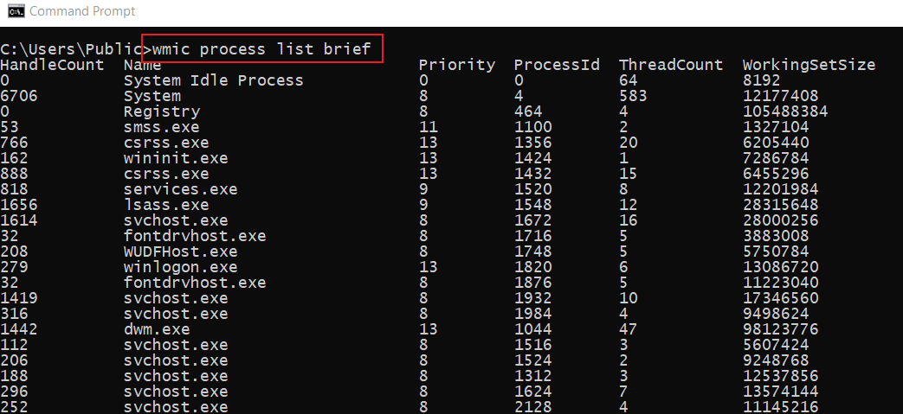
List Processes
Notes:
wmic process list brief

Slide 51
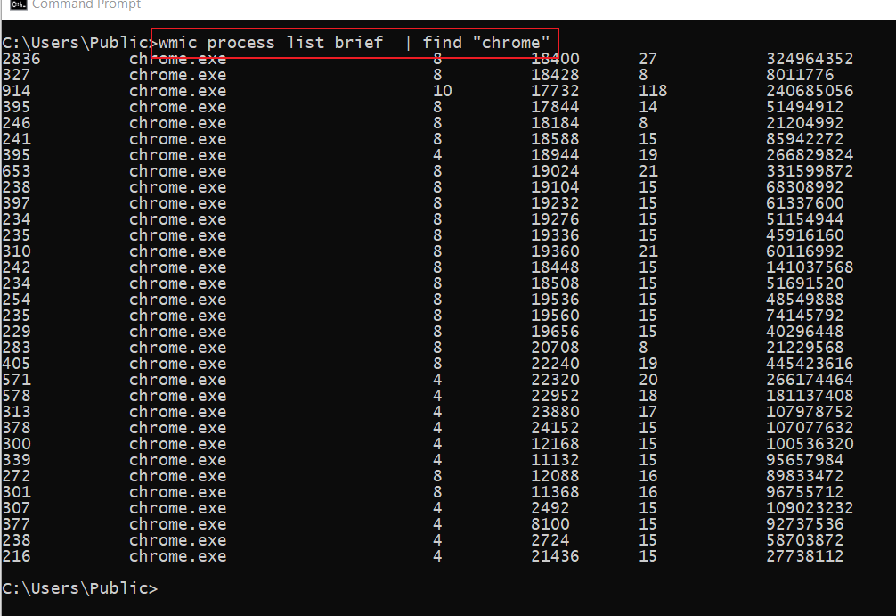
List all Chrome Browser process

Slide 52
Create a batch file

Slide 53
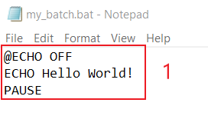
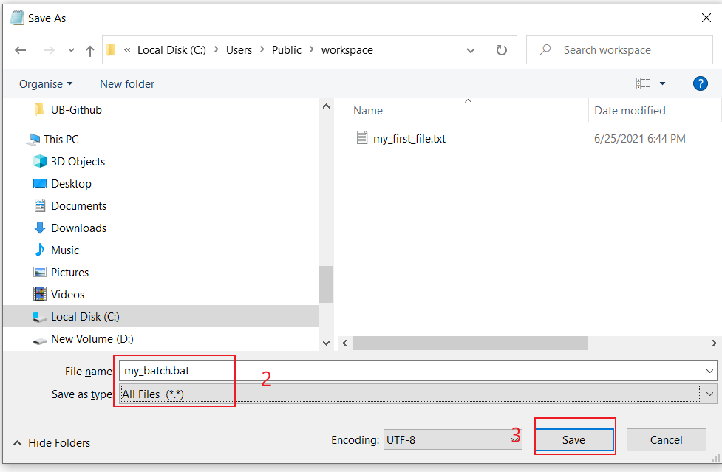
Create a “Hello world” batch
Notes:
@ECHO OFF
ECHO Hello World!
PAUSE

Slide 54

Execute “Hello World” batch

Slide 55


Batch for showing system information
Notes:
@ECHO OFF
:: This batch file details Windows 10, hardware, and networking configuration.
TITLE System Info
ECHO Please wait... Checking system information.
:: Section 1: Windows 10 information
ECHO ==========================
ECHO WINDOWS INFO
ECHO ============================
systeminfo | find "OS Name"
systeminfo | find "OS Version"
systeminfo | find "System Type"
:: Section 2: Hardware information.
ECHO ============================
ECHO HARDWARE INFO
ECHO ============================
systeminfo | find "Total Physical Memory"
wmic cpu get name
wmic diskdrive get name,model,size
:: Section 3: Networking information.
ECHO ============================
ECHO NETWORK INFO
ECHO ============================
ipconfig | findstr IPv4
START https://support.microsoft.com/en-us/windows/windows-10-system-requirements-6d4e9a79-66bf-7950-467c-795cf0386715
PAUSE

Slide 56


Execute the batch sys_info.bat
Where you are?
Show sys information

Slide 57
Assignment
Make the file sys_info.bat callable at any folder
  create a new folder, e.g., workspace4
  copy the .bat to the new folder
  modify the path variable to add the new folder
  make sure the .bat can be executed

