Slide 1
HTTP, Wireshark, and Digital Forensics
Part 1: HTTP traffic contains text information
Traffic files: https://github.com/frankwxu/digital-forensics-lab/tree/main/Illegal_Possession_Images/lab_files/traffic
Notes:
https://www.youtube.com/watch?v=6G3qm60dfA8&ab_channel=PrashantThombre

Slide 2
Overview
Observe HTTP traffic with curl
Review Open Systems Interconnection Model (OSI)
Is understanding HTTP enough for forensic investigations?
Exam HTTP traffics with Wireshark
Three-way handshake (TCP)
Communication (HTTP request/response)
Close connection (TCP)

Slide 3
Observe HTTP traffic

Slide 4
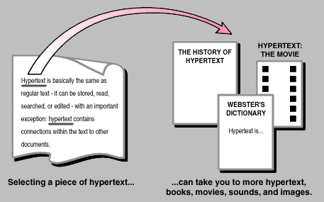
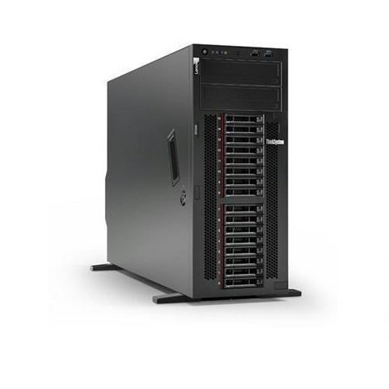
What is HTTP?
agreement
HTTP stands for hypertext transfer protocol and is used to transfer data across the Web
HTTP Request
HTTP Response
Notes:
https://www.kevcom.com/words/guide/guide.02.html

Slide 5
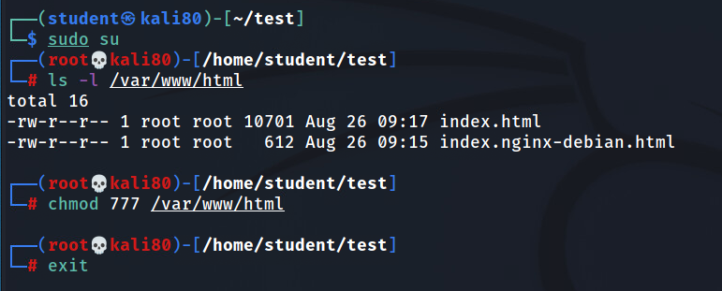
Create a simple html page to be observed in Wireshark
(optional) if you are logged in as a non-admin account, such as student, you must change the html folder permission

Slide 6
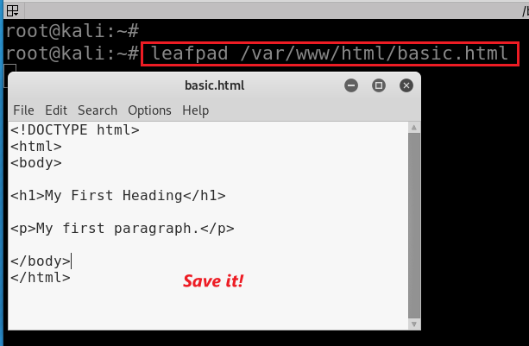
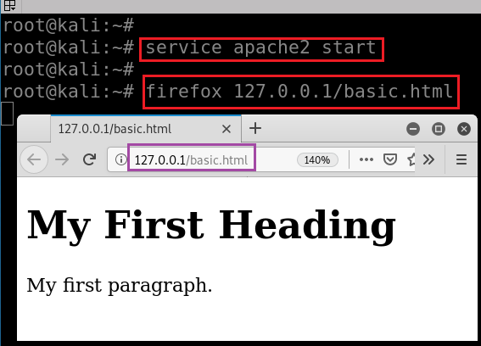
Create a simple webpage, named basic.html, and
Put it in the folder /var/www/html
Start web service
Show the webpage
service apache2 stop service apache2 restart
Notes:
<!DOCTYPE html>
<html>
<body>
<h1>My First Heading</h1>
<p>My first paragraph.</p>
</body>
</html>
https://www.w3schools.com/html/tryit.asp?filename=tryhtml_basic_document

Slide 7
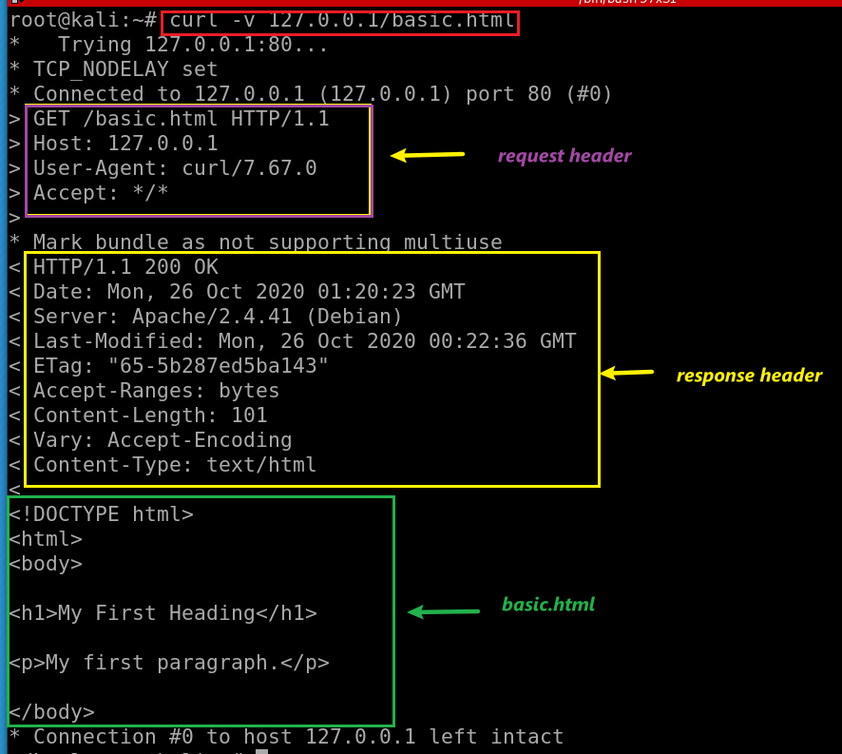
cURL (pronounced 'curl')
A command-line tool
Open source
Transferring data
Support many network protocols
-v: verbose, show headers
Method: Get, POST
Path: /basic.html

Slide 8
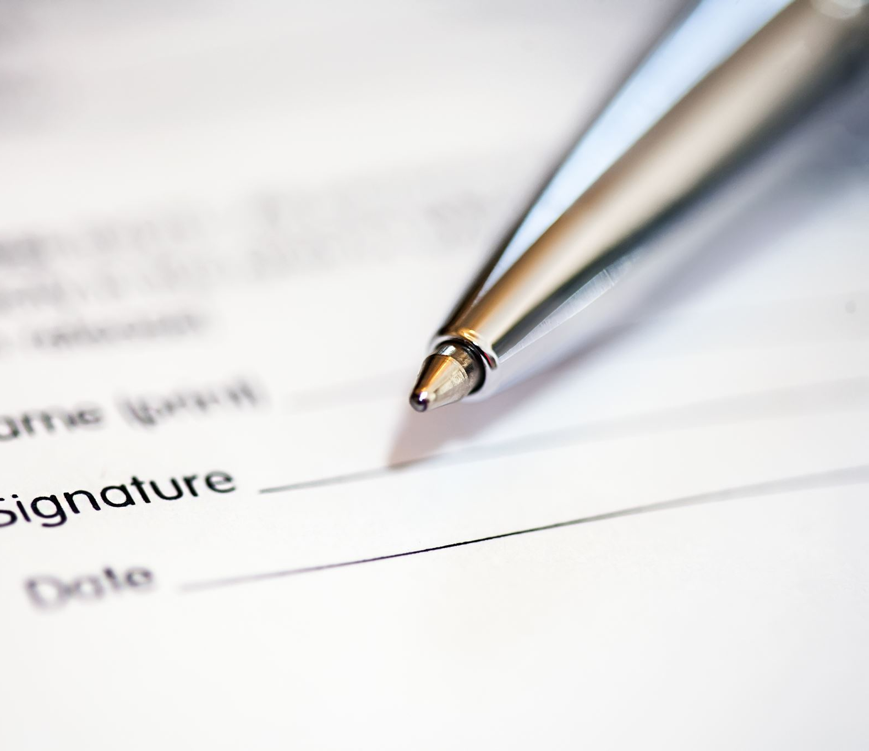
Review Open Systems Interconnection Model (OSI)
Is understanding HTTP enough for forensic investigations?

Slide 9
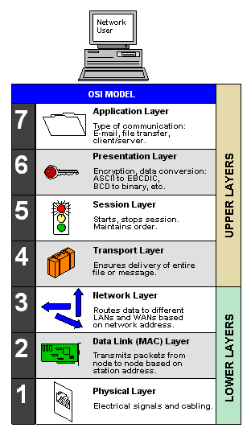
Importance of understanding underneath of HTTP
Many layers (OSI Model) are defined to form computer networks
HTTP is one protocol at an application layer
Forensic investigation focus on all layer
Malware analysis
Attack analysis
File extraction
The OSI Model (Open Systems Interconnection Model)
is a conceptual framework used to describe the functions of a networking system.

Slide 10
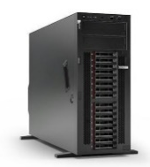
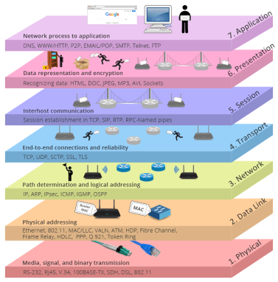
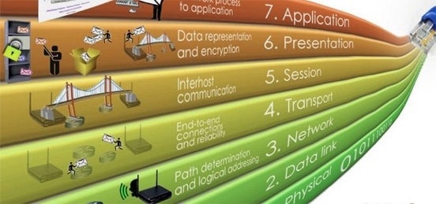
HTTP Request
HTTP Response

Slide 11
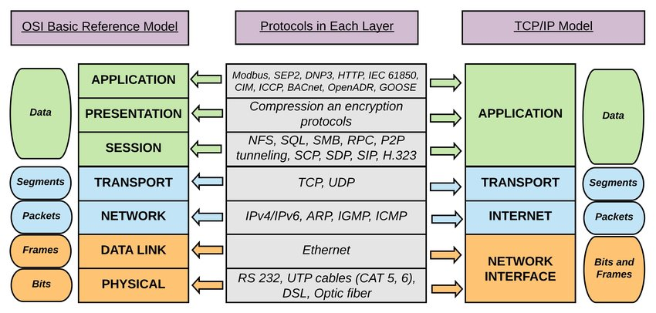

Slide 12
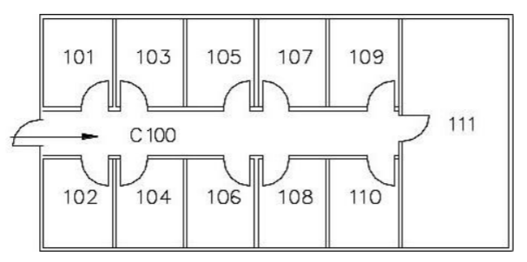
Building A
A->B
Building B
Mailroom
Mailroom
from: Building A 102
to: Building B 103
part 1
part 2
part 3
part 1
part 2
part 3
part 1
part 2
part 3
-> mailroom
-> mailroom
-> mailroom
-> 103
-> 103
-> 103

Slide 13
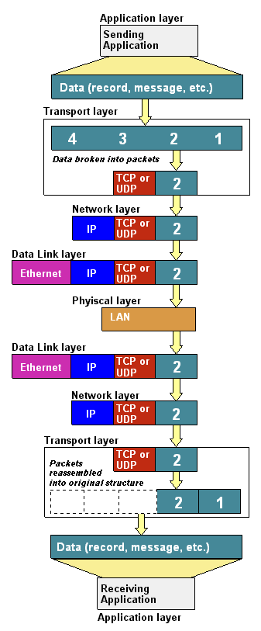
Data
Segment:
Packet
Frame
bit
Notes:
https://www.youtube.com/watch?v=-6Uoku-M6oY

Slide 14
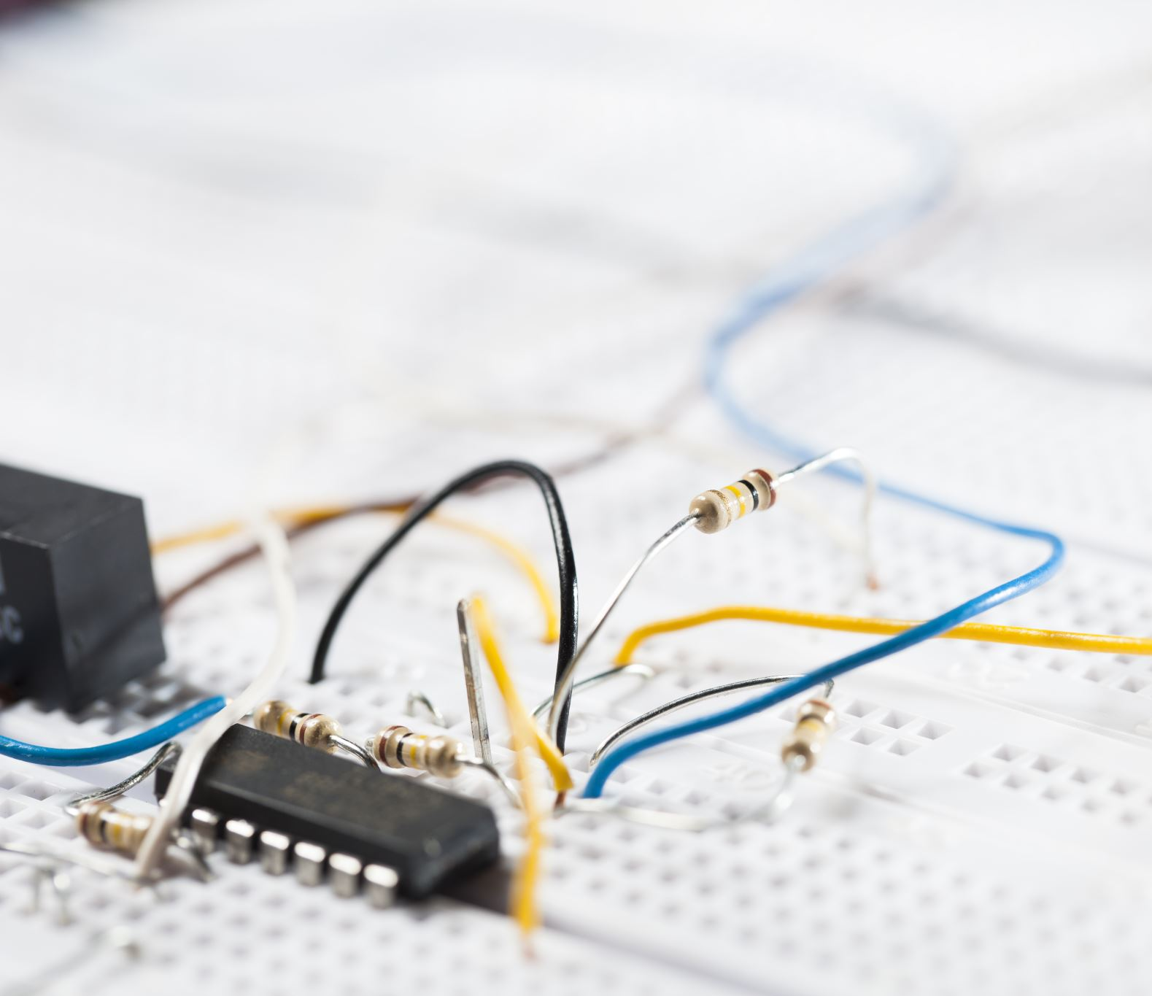
Capture HTTP traffic using wireshark

Slide 15
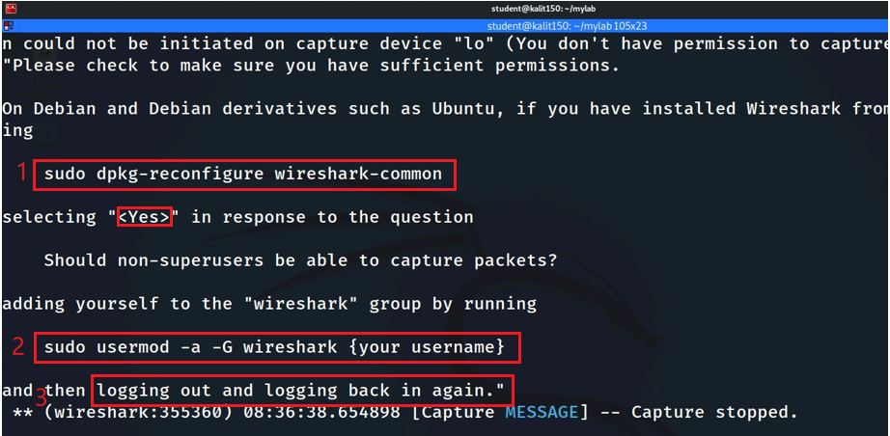
Reconfigure wireshark

Slide 16
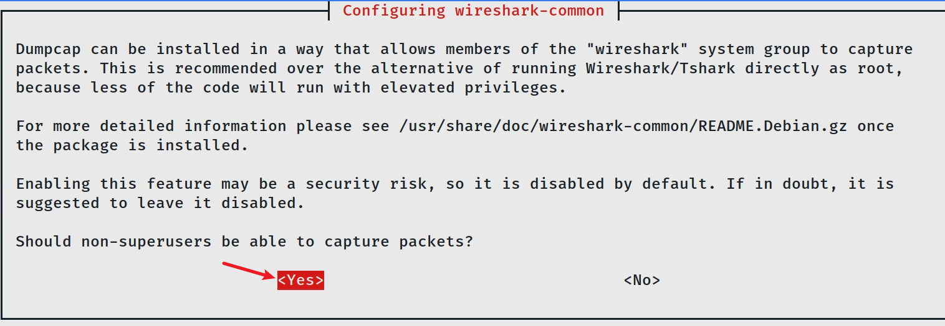
Reconfigure
Add student to wireshark group
Logout and log back in
Notes:
sudo dpkg-reconfigure wireshark-common
sudo usermod -a -G wireshark kali

Slide 17
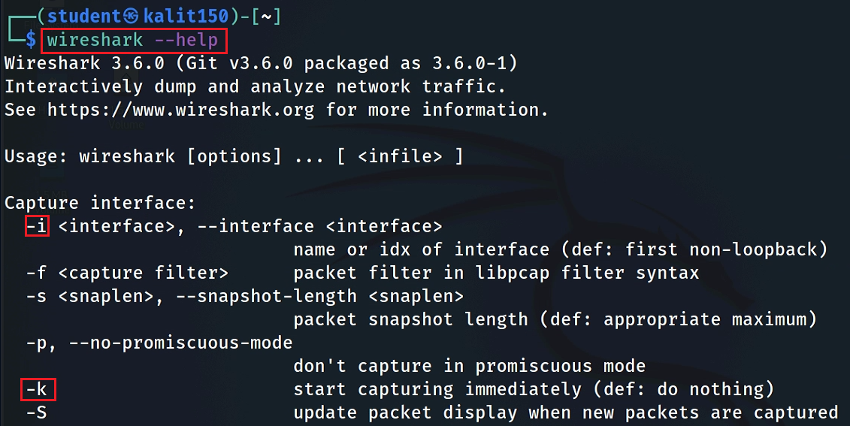

Slide 18
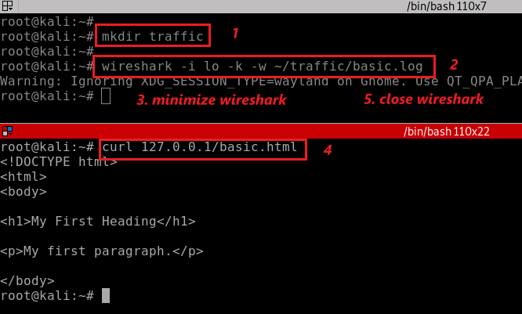
Clear browser cache
You don’t need to have root to capture traffic
change interface -i lo to eth0 if you need to capture live traffic
Notes:
rm -r ~/.cache/mozilla/firefox/*default* note: make sure the path is correct.
wireshark -i lo -k -w ~/traffic/basic.log
curl 127.0.0.1/basic.html

Slide 19
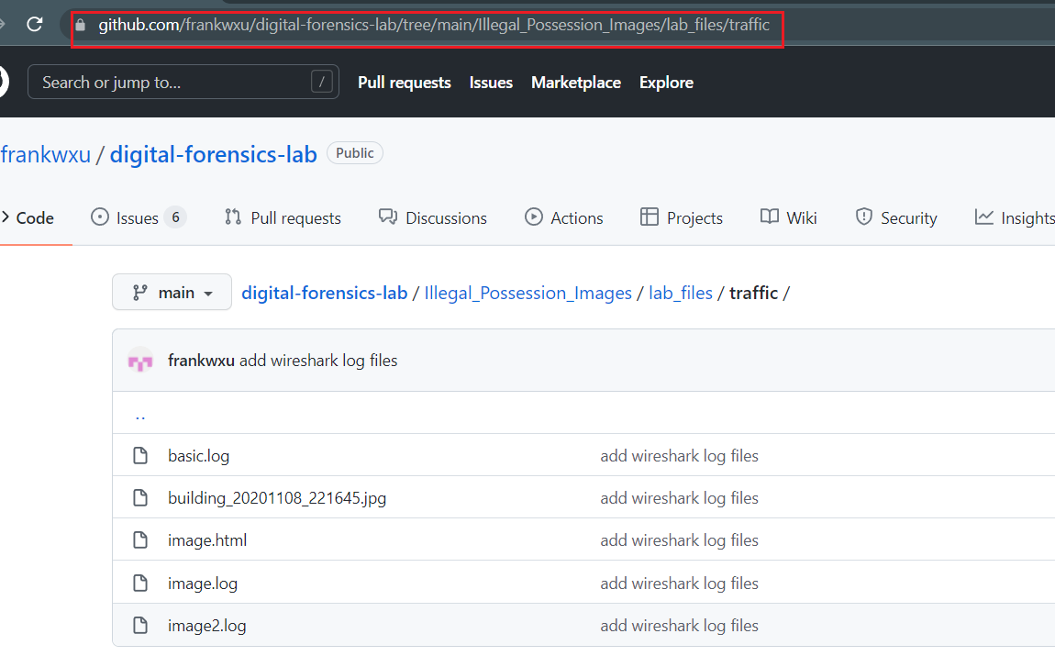
You can download recaptured traffic
Examle command to download basic.log file:
wget https://raw.githubusercontent.com/frankwxu/digital-forensics-lab/main/Illegal_Possession_Images/lab_files/traffic/basic.log

Slide 20
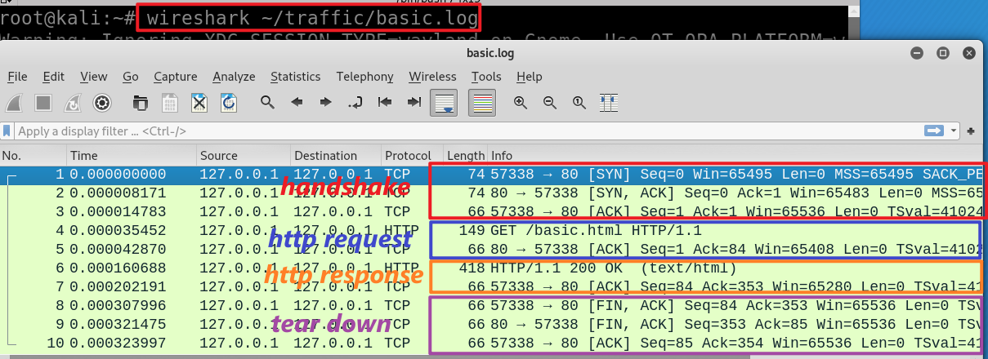
wget https://raw.githubusercontent.com/frankwxu/digital-forensics-lab/main/Illegal_Possession_Images/lab_files/traffic/basic.log
Notes:
wireshark ~/traffic/basic.log

Slide 21
Three-way handshake
No. 1, 2, and 3

Slide 23
6

Slide 24
6+1

Slide 25
141

Slide 26
141+1

Slide 27
SYN message
6
Sequence #: random

Slide 28
ACKnowledge
6+1
ACKnowledge with seq#
I’ve received your request with seq # 6
I expect to receive your next seq# 6+ 1

Slide 29
SYN message
141

Slide 30
ACKnowledge
141+1

Slide 31
Sequence #:
the byte number of the first byte of data in the TCP segement sent
beginning at random # or 0 (relative seq#)
ACKnowledge #: the sequence number of the next byte the receiver expects to receive.
Seq # + size of packet + 1
The receiver ack'ing sequence number x acknowledges receipt of all data bytes less than (but not including) byte number x
+1 for SYN
Port 57338
Port 80
client state
Server state
CLOSED
CLOSED
choose init seq num, m
1
SYN (seq =m)
LISTEN
SYN-SEND
SYN-RECEIVED
SYN (seq =n) , ACK (m+1)
2
received SYNACK
indicates server is live;
send ACK;
ACK (n+1)
3
ESTABLISHED
ESTABLISHED
n, m are in bytes
Notes:
https://www.freecodecamp.org/news/an-introduction-to-http-understanding-the-open-systems-interconnection-model-9dd06233d30e/
https://www.geeksforgeeks.org/tcp-3-way-handshake-process/
https://www.geeksforgeeks.org/tcp-connection-termination/

Slide 32
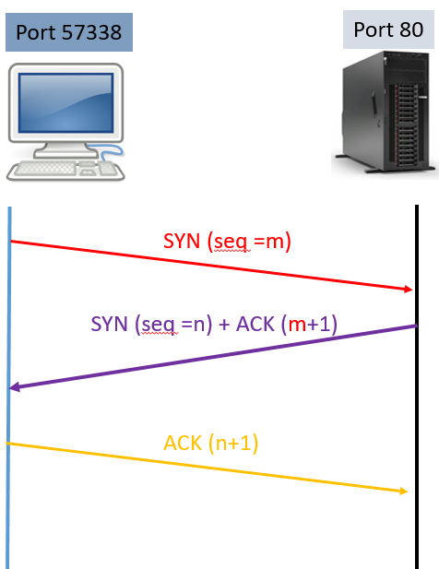
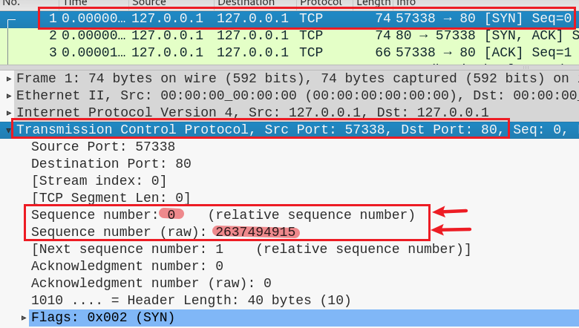
1
m
Client:
I am sending seq # m
I will use the seq # m to indicate the byte number of the first byte of data in the TCP segment sent

Slide 33
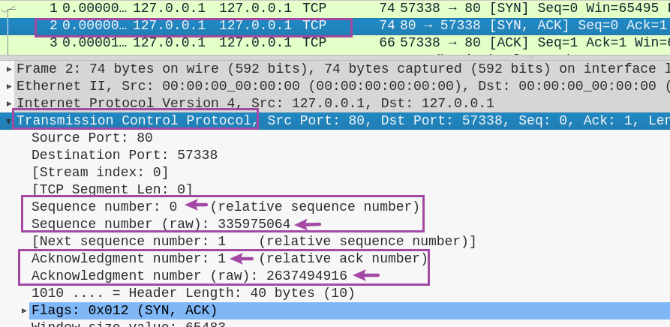
2
n
Server:
I’ve received your seq # m
I expect to receive your next seq# m+ 1
I’m sending seq # n and I will use it to indicate the byte number of the first byte of data in the TCP packet I am sending
m+ 1

Slide 34
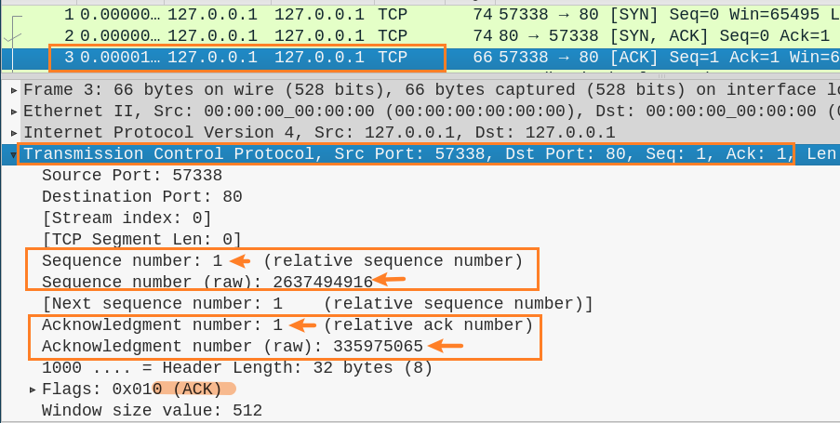
3
m+ 1
Client:
OK. I am sending seq # m+ 1 as you requested
I expect to receive seq # n +1
n +1

Slide 35
HTTP request protocol
No. 4

Slide 36
Port 57338
Port 80
1
SYN (seq =0)
SYN (seq =0) , ACK (0+1)
2
handshake
3
(seq =1) , ACK (0+1)
http request/TCP
4
(seq =1) , ACK (0+1), TCP len=t1
(seq =1) , ACK (1+t1), TCP len=0
5
Transfer
(seq =1) , ACK (1+t1), TCP len=t2
6
http response/TCP
7
(seq =1+t1) , ACK (1+t2), TCP len=0

Slide 37
Port 57338
Port 80
TCP length t1=83
TCP length t2=352
1
SYN (seq =0)
SYN (seq =0) , ACK (0+1)
2
handshake
3
(seq =1) , ACK (0+1)
http request/TCP
4
(seq =1) , ACK (0+1), TCP len=83
(seq =1) , ACK (1+83), TCP len=0
5
Transfer
(seq =1) , ACK (1+83), TCP len=352
6
http response/TCP
7
(seq =1+83) , ACK (1+352), TCP len=0

Slide 38
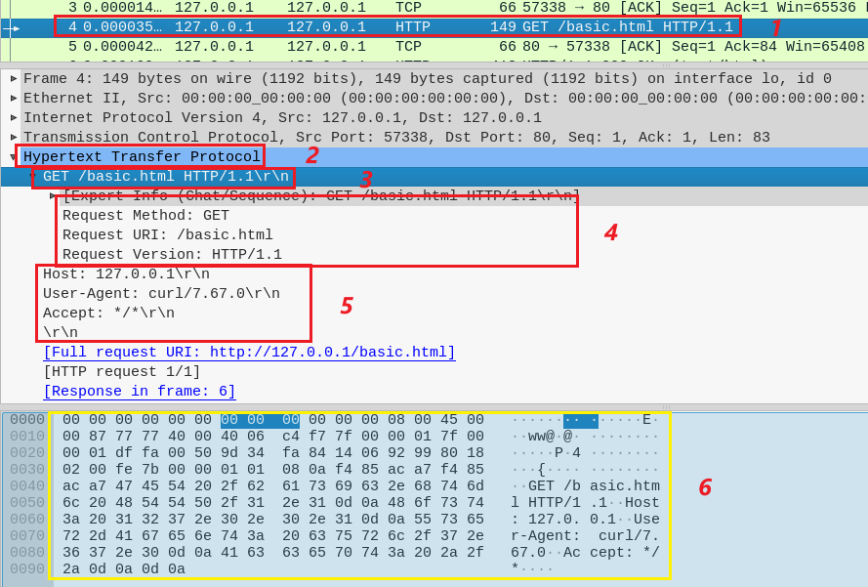
Show http request
4

Slide 39
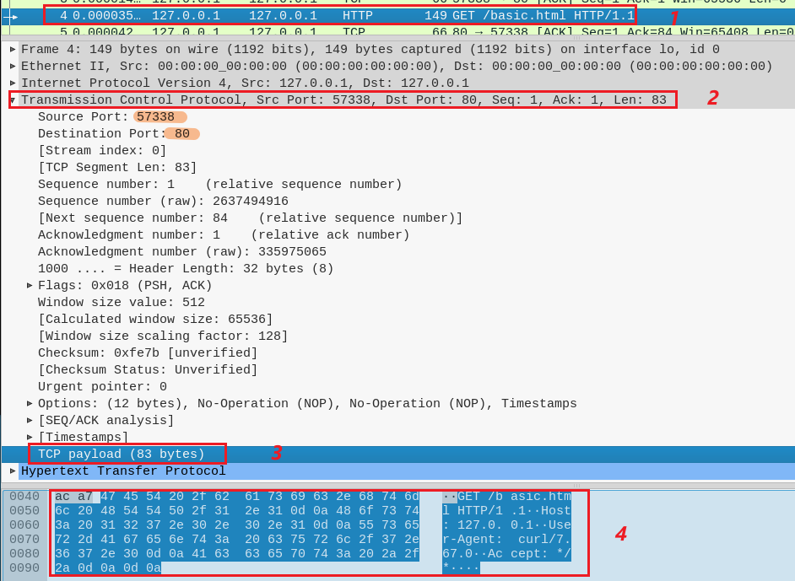
Show http request
4
Show TCP segment 4
Show TCP payload

Slide 40
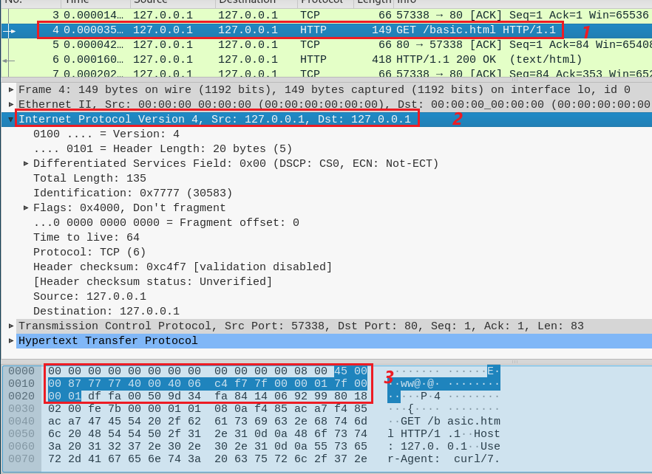
Show http request
4
Show IP packet 4

Slide 41
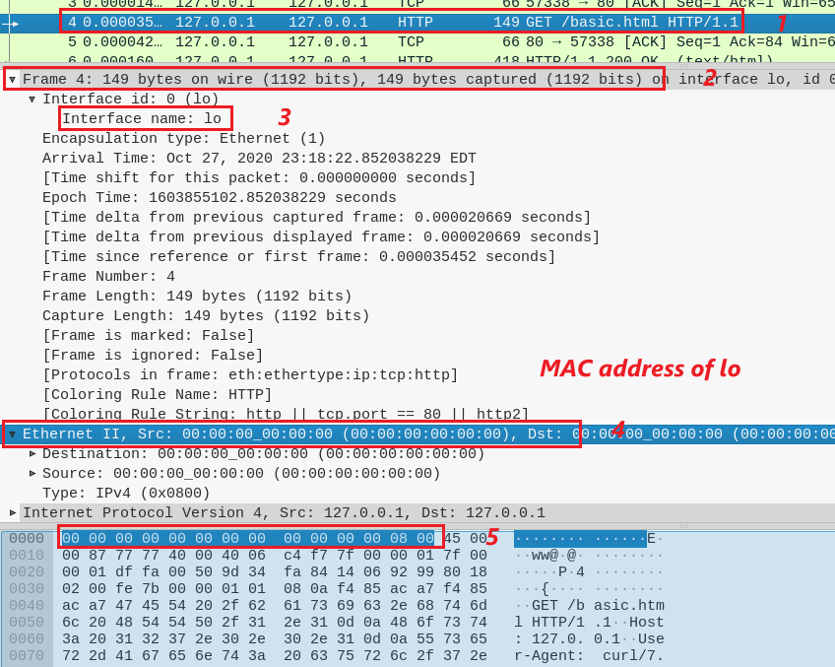
Show http request
4
Ethernet Frame 4
Show Ethernet 802.3
lo interface is not associated with a hardware network interface (it's a virtual loopback interface), it does not have an Ethernet hardware address (MAC address).
ARP (0x0806)

Slide 42
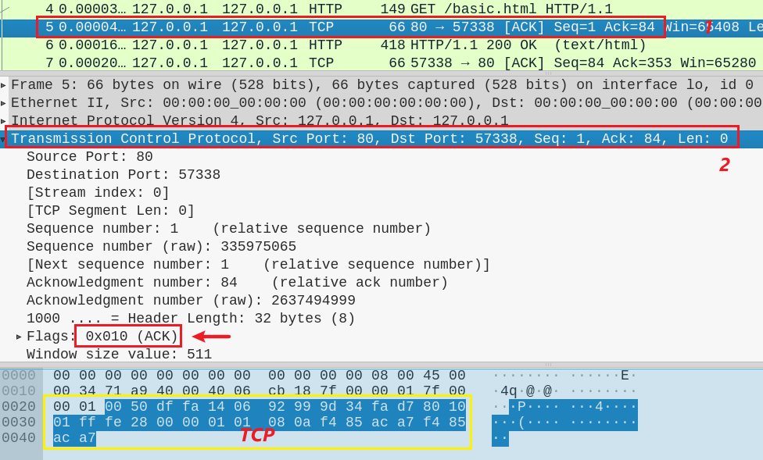
Server ACKnowledges the request
5
ACK 84 =1+ TCP length

Slide 43
HTTP response protocol
No. 5 and 6

Slide 44
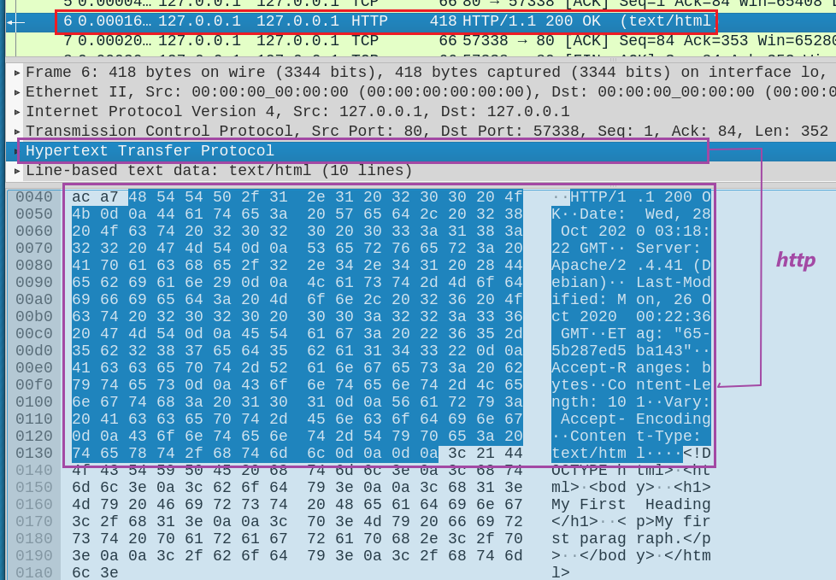
Server send HTTP response head
6
HTTP head

Slide 45
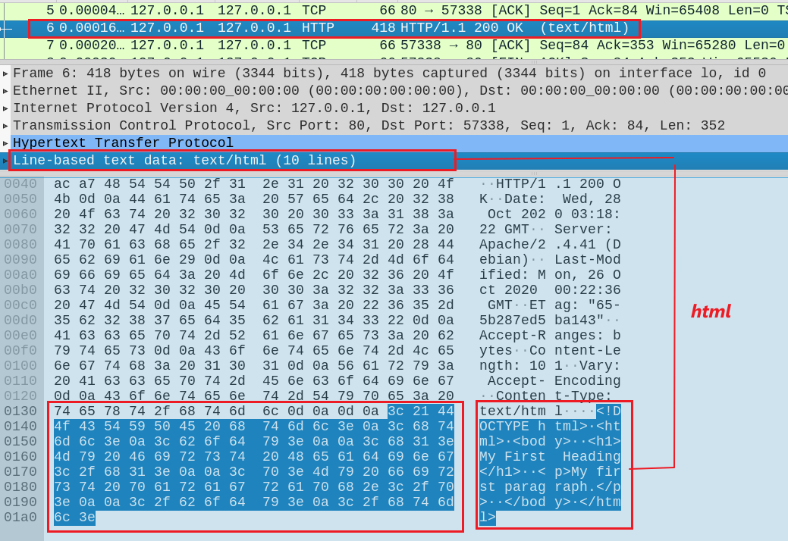
Server send HTTP response data (simple.html)
6
simple.html

Slide 46
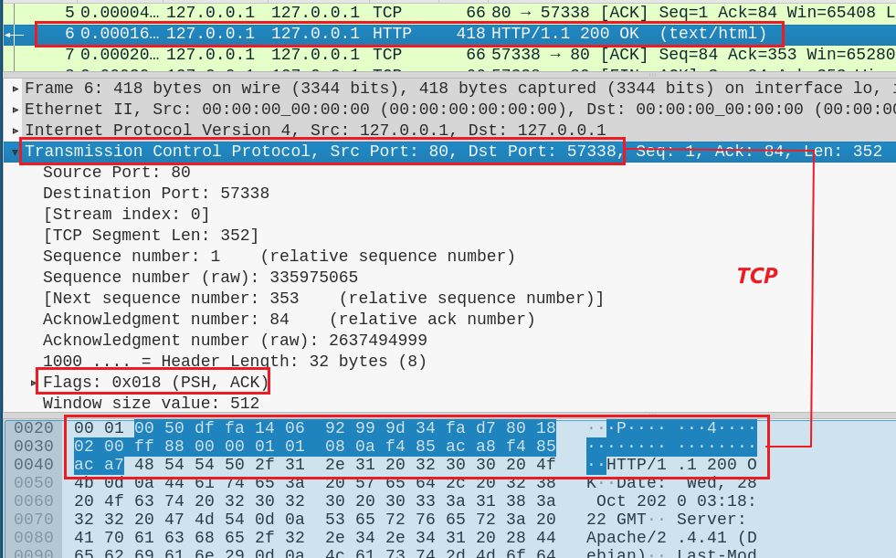
Server send HTTP response data (simple.html)
6
TCP
PSH: data must be transmitted promptly to the receiver

Slide 47
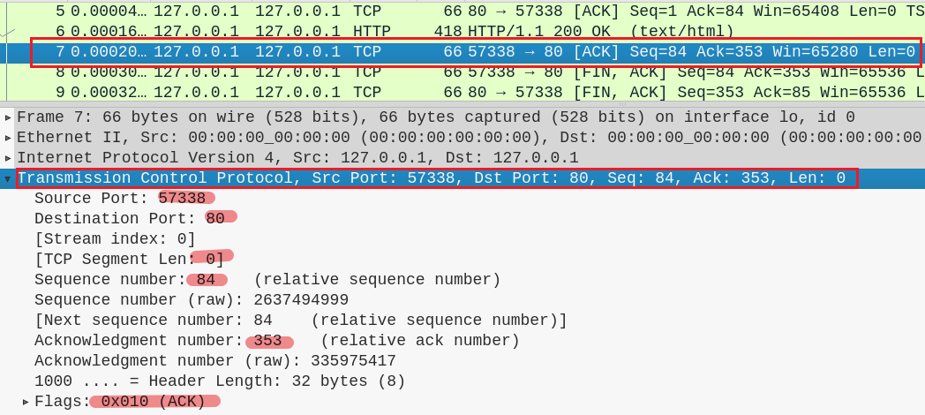
Client sends TCP acknowledgement
7

Slide 48
TCP Close connection

Slide 49
Port 57338
Port 80
client state
server state
ESTAB
ESTAB
8
FIN_WAIT_1
can no longer
send but can
receive data
FIN, ACK=353, seq=84
CLOSE_WAIT
ACK=84+1
can still
send data
FIN_WAIT_2
wait for server
close
9
LAST_ACK
FIN, ACK=84+1, seq=353
TIMED_WAIT
can no longer
send data
10
ACK=353+1
timed wait
for 2*max
segment lifetime
CLOSED
CLOSED

Slide 50
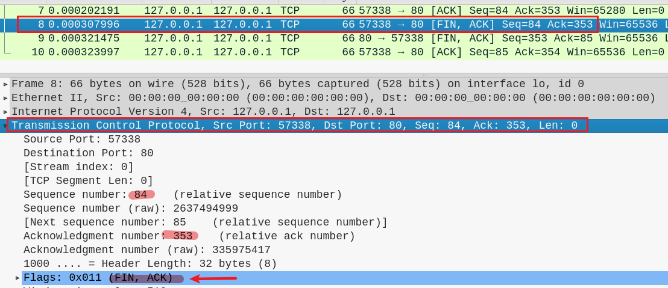
8

Slide 51
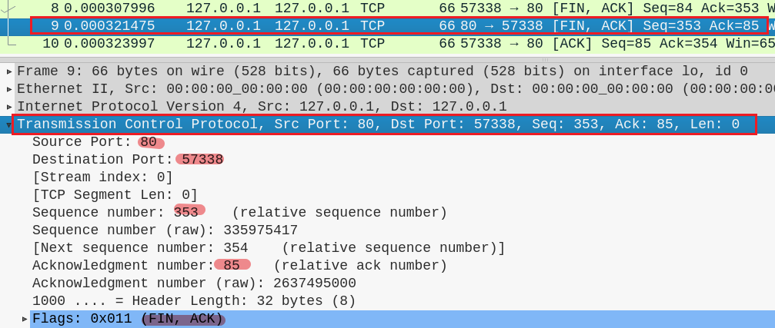
9

Slide 52
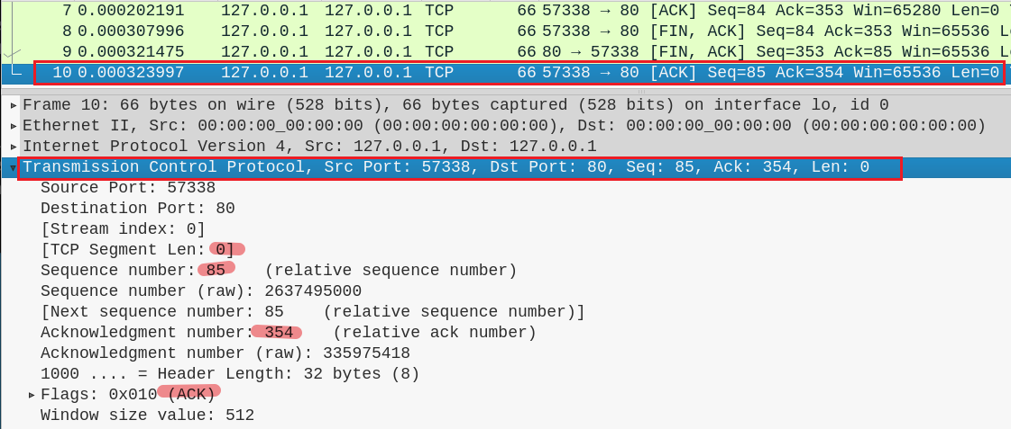
10

