Slide 1

Investigating the 3rd Party Android Apps
Kik
Notes:
https://digitalcorpora.s3.amazonaws.com/corpora/mobile/android_10/Non-Cellebrite%20Extraction/Pixel%203.zip

Slide 2
Background

Slide 3


What is 3rd Party Android Apps?
A third-party app is a software application made by someone other than the manufacturer of a mobile device or its operating system.
e.g., app development companies or individual developers create a lot of applications for Apple’s or Google’s operating systems.
Example
com.appgenix.bizcal
com.simplemobiletools.calendar
Notes:
https://android.googlesource.com/platform/packages/apps/
https://android-developers.googleblog.com/2019/03/aosp-application-updates.html

Slide 4

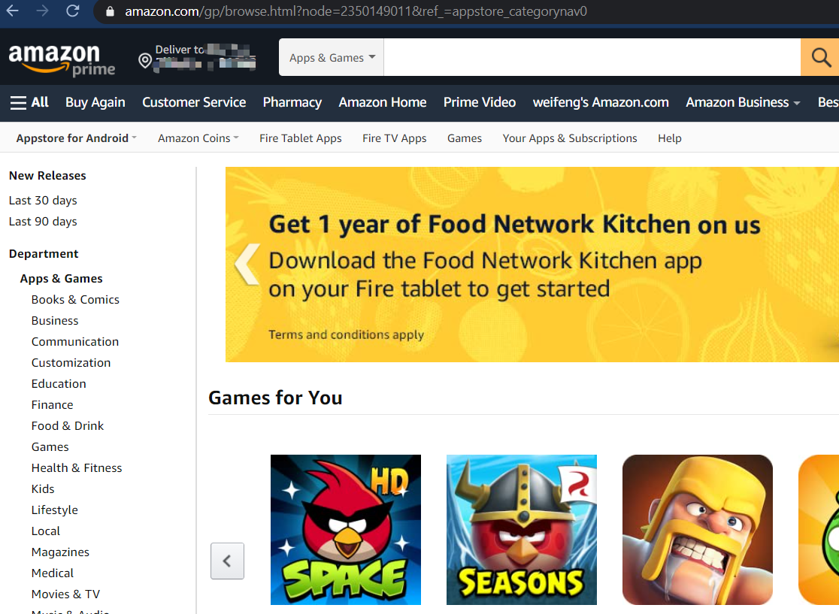
3rd Party App Store for Android
Amazon Appstore
APKMirror
APKPure
APKUpdater
Aptoide
F-Droid
Humble Bundle
QooApp
Samsung Galaxy Apps
Yalp Store

Slide 5
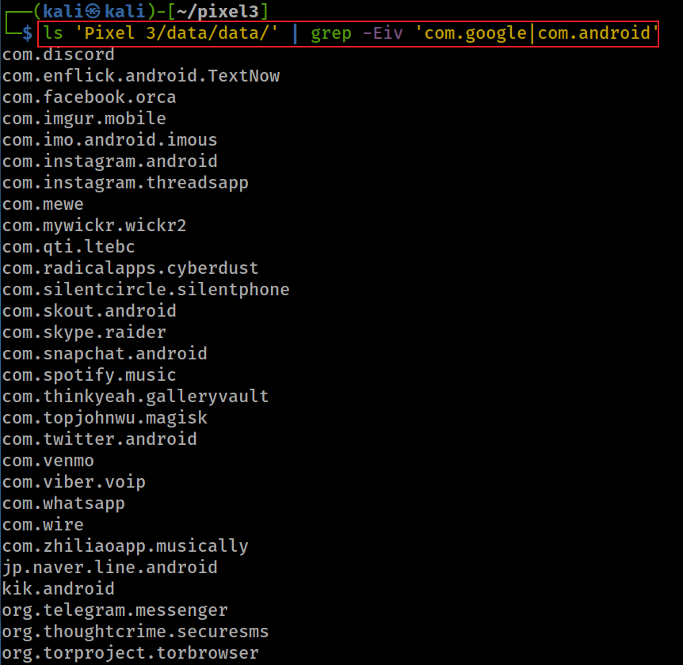
Show all 3rd apps ( apps except AOSP and Google apps)
-E: extended regular expressions
-v, --invert-match select non-matching lines
| : or
In basic regular expressions the characters ‘?’, ‘+’, ‘{’, ‘|’, ‘(’, and ‘)’ lose their special meaning; instead use the backslashed versions ‘\?’, ‘\+’, ‘\{’, ‘\|’, ‘\(’, and ‘\)’.
Notes:
ls 'Pixel 3/data/data/' | grep -Eiv 'com.google|com.android’
com.discord
com.enflick.android.TextNow
com.facebook.orca
com.imgur.mobile
com.imo.android.imous
com.instagram.android
com.instagram.threadsapp
com.mewe
com.mywickr.wickr2
com.qti.ltebc
com.radicalapps.cyberdust
com.silentcircle.silentphone
com.skout.android
com.skype.raider
com.snapchat.android
com.spotify.music
com.thinkyeah.galleryvault
com.topjohnwu.magisk
com.twitter.android
com.venmo
com.viber.voip
com.whatsapp
com.wire
com.zhiliaoapp.musically
jp.naver.line.android
kik.android
org.telegram.messenger
org.thoughtcrime.securesms
org.torproject.torbrowser

Slide 6



Goal: Analysis of 3 3rd Party Apps
Investigating Kik app
  com.kik.android
Investigating TextNow app
  com.enflick.android.textnow
Investigating whatsapp app
  com.whatsapp

Slide 7
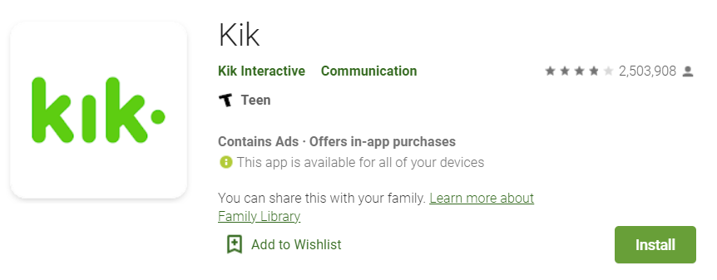
Investigating Kik app

Slide 8
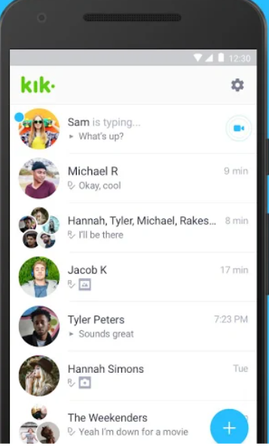
What is Kik app?
Kik is an instant messaging app
  One-on-one/in groups chat
  Share pics, videos, gifs, games etc
  Meet new friends with similar interests
Main attraction
  anonymity: no need a phone number
Evidence types
  Username
  Messages
  Last login time
  Email associated with app
  Install date
  Version

Slide 9
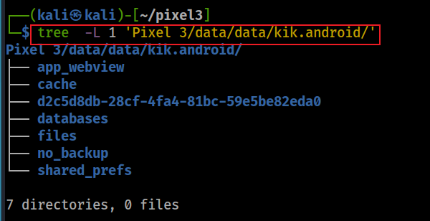
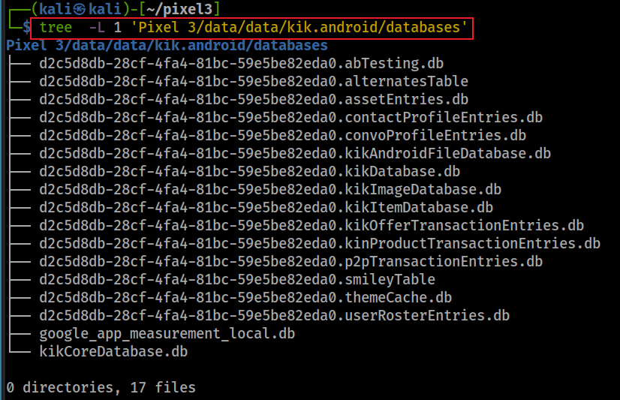
Location of kik
Notes:
tree -L 1 'Pixel 3/data/data/kik.android/’
tree -L 1 'Pixel 3/data/data/kik.android/databases'

Slide 10
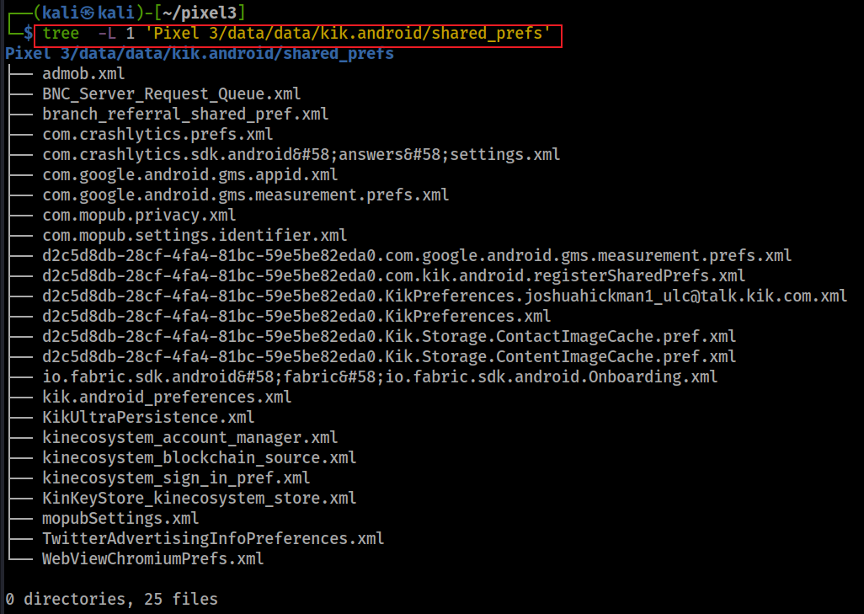

Slide 11
Scenario
A suspect installed Kik app
Questions
When was the app installed?
What is the version of the app?
What is the Kik username ?
What email is associated with Kik account?
When did the suspect last login into the app?
What are saved conversations?

Slide 12
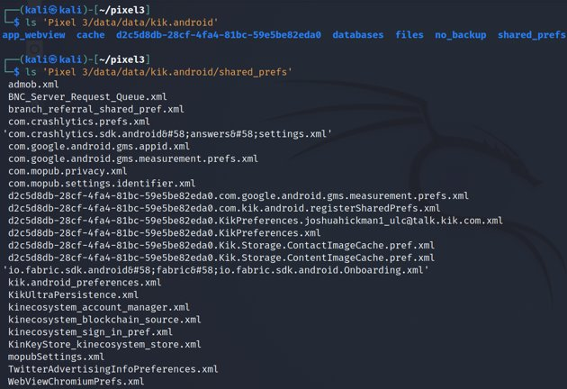
When was the app installed?
Find location of app
Find file that contains the installation timestamp
com.google.android.gms.measurement Contains classes that configure Firebase Analytics core services
Google Analytics is a free app measurement solution that provides insight on app usage and user engagement.
Notes:
Cmd: ls 'Pixel 3/data/data/kik.android' (directory)
Cmd: ls 'Pixel 3/data/data/kik.android/shared_prefs'

Slide 13
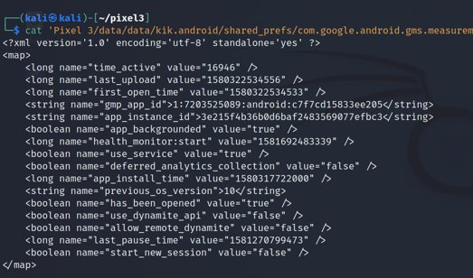
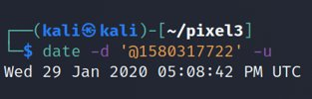
Search for installation timestamp
Notes:
Cmd: cat 'Pixel 3/data/data/kik.android/shared_prefs/com.google.android.gms.measurement.prefs.xml'
Date cmd: date –d '@1580317722' -u

Slide 14

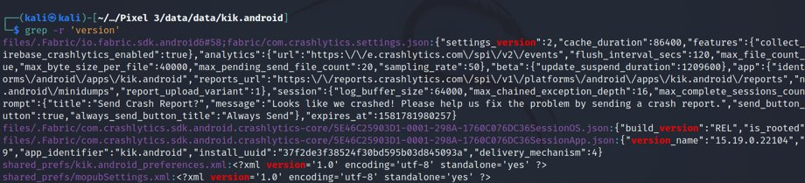
What is the version?
Go to the app directory
crash report contains the version information.
Note this is not the only way to find the version number.
Use the grep command to search for “version” key word
Notes:
Cmd: cd 'Pixel 3/data/data/kik.android/'
Grep cmd: grep –r 'version'

Slide 15
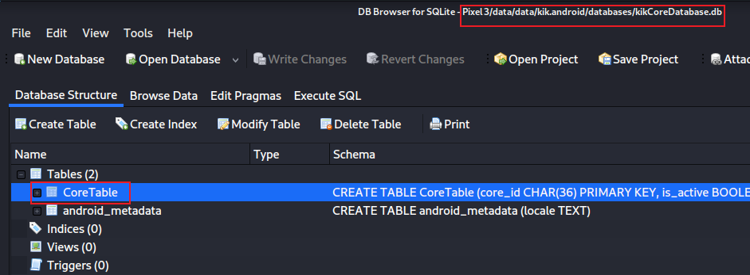
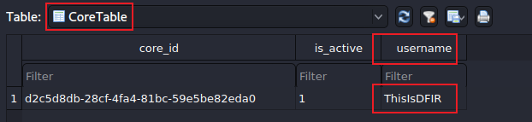
  What is the Kik username ?
Open kikCoreDatabase
Exam CoreTable
id for the user
Notes:
sqlitebrowser 'Pixel 3/data/data/kik.android/databases/kikCoreDatabase.db'
cd 'Pixel 3/data/data/kik.android/’
grep –r username
d2c5d8db-28cf-4fa4-81bc-59e5be82eda0

Slide 16
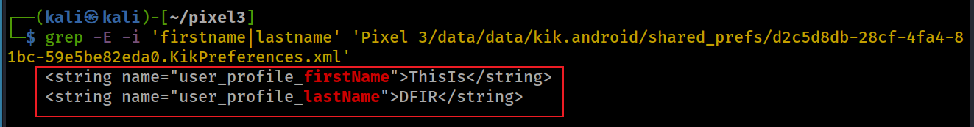
What name is associated with Kik account?
Search for name keyword using grep

Slide 17
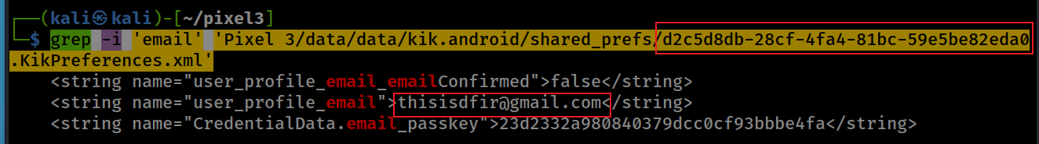
What email is associated with Kik account?
Search for email keyword using grep
Email: thisisdfir@gmail.com
Notes:
grep -i 'email' 'Pixel 3/data/data/kik.android/shared_prefs/d2c5d8db-28cf-4fa4-81bc-59e5be82eda0.KikPreferences.xml'

Slide 18
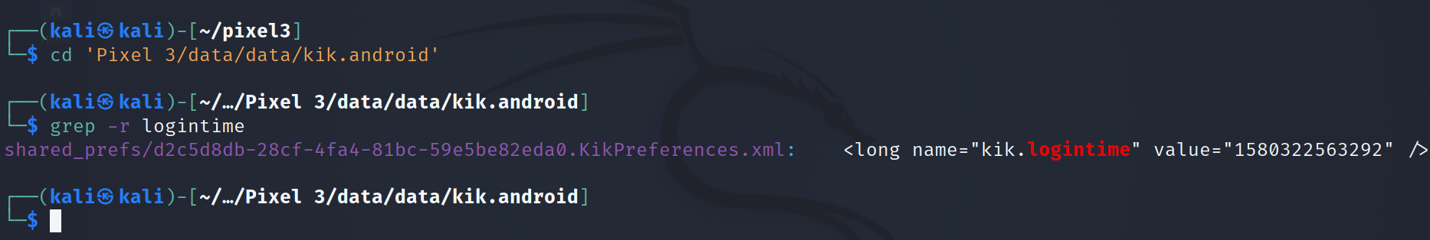
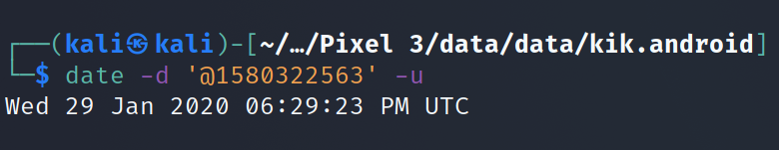
When did the user last log on?
Find the location of the package/folder
Search for keyword. Note we simply use grep to search all files in the directory
Notes:
Cmd: cd 'Pixel 3/data/data/kik.android'
Grep cmd: grep –r logintime
Date cmd: date –d '@1580322563' -u

Slide 19




What are saved conversations?
Approach to answer the question

Slide 20
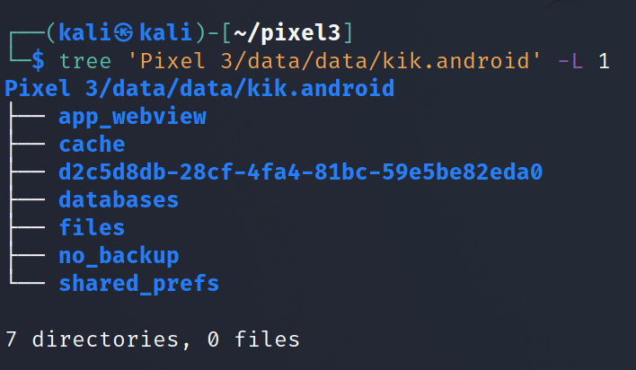
Step 1: find the potential location where conversations are stored
Find the java package
Notes:
Cmd: tree 'Pixel 3/data/data/kik.android' -L 1

Slide 21
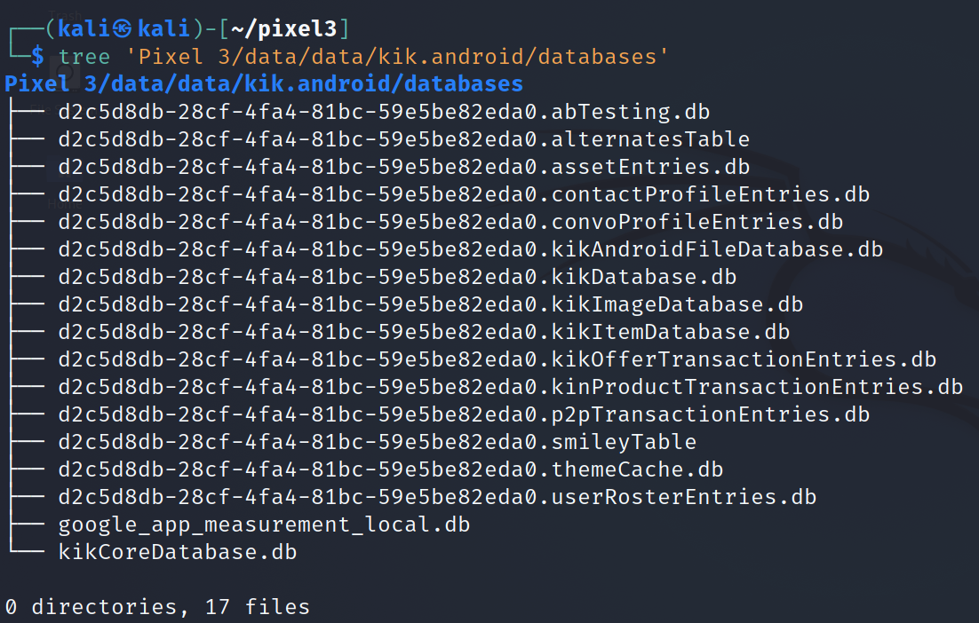
Step 2: find the database that contains messages
Look at the database list
Pay attention to the naming conversion:
coreID.otherdatabase.db
Notes:
Cmd: tree 'Pixel 3/data/data/kik.android/databases'

Slide 22
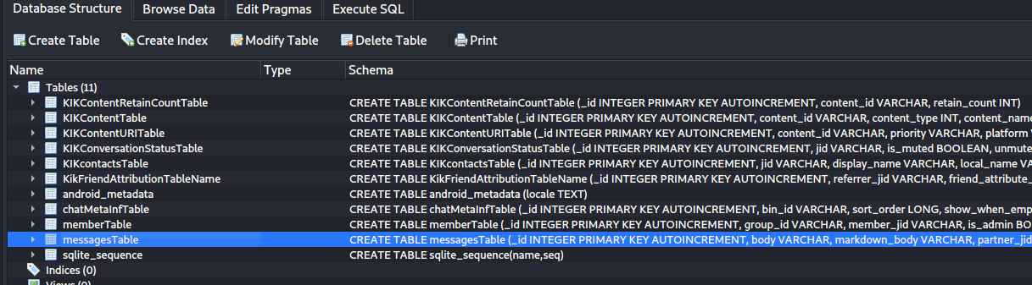
Step 3: Examine the database
Open KikDatabase.db to look at the tables

Slide 23
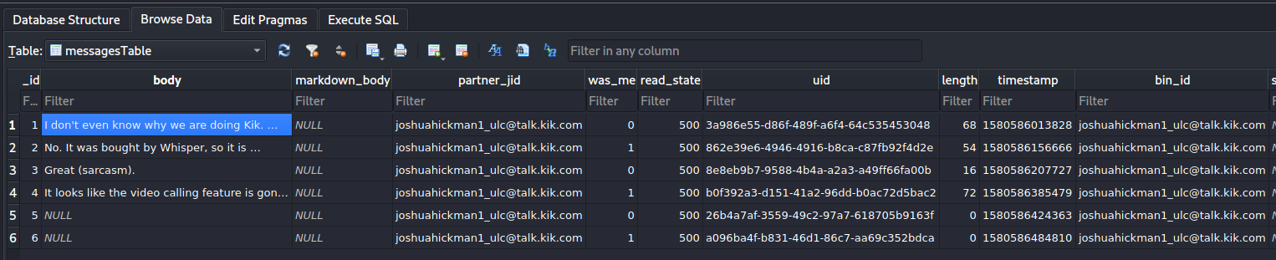
Step 4: find messages
Open messages table and look at the data in each column
communicating partner jabber id
indicates it was sent or received message
0: received from others
1: owner
500: read
400: unread
200: unknown
300:sent undelivered
message content
what are these? next slide

Slide 24
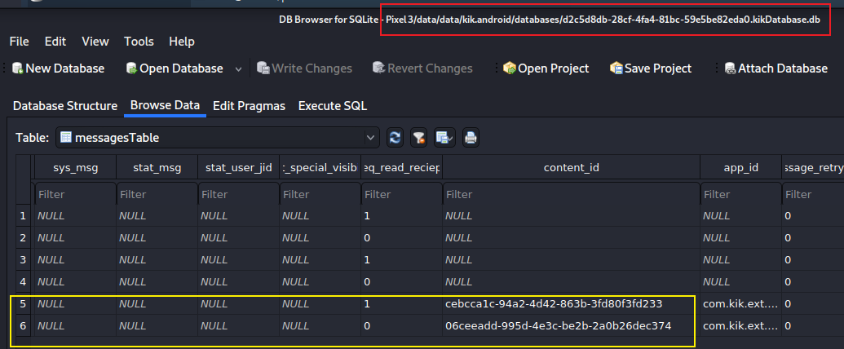
Step 4: find transferred files
Find content_id
Notes:
06ceeadd-995d-4e3c-be2b-2a0b26dec374.jpg
cebcca1c-94a2-4d42-863b-3fd80f3fd233.jpg

Slide 25
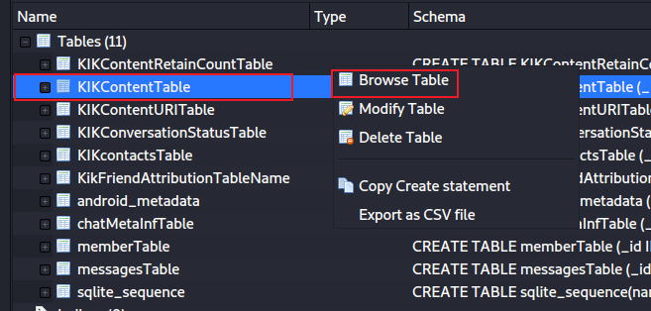
Find transferred file content based on content_id

Slide 26
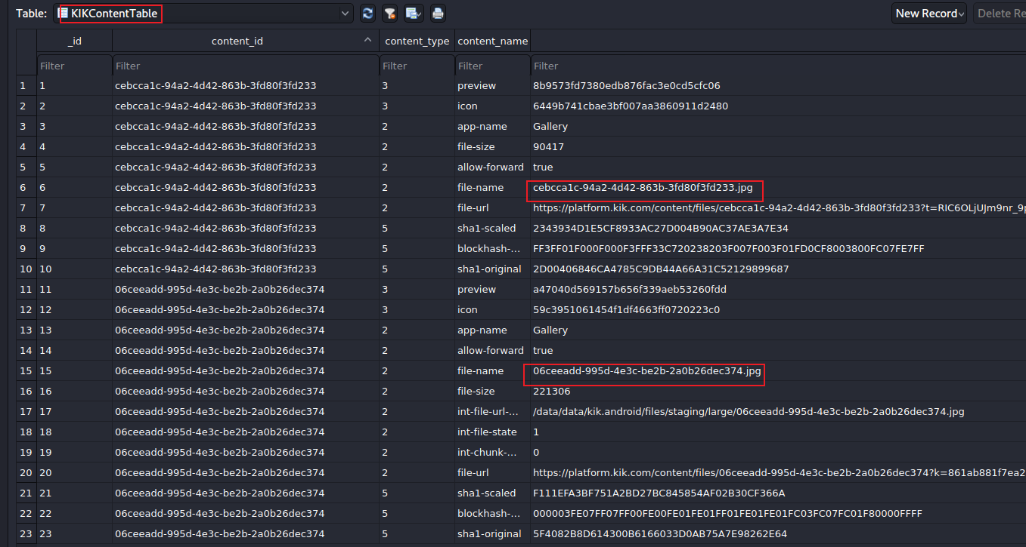
Find transferred jpg
can we retrieve images?
Notes:
/data/data/kik.android/files/staging/large/-I

Slide 27
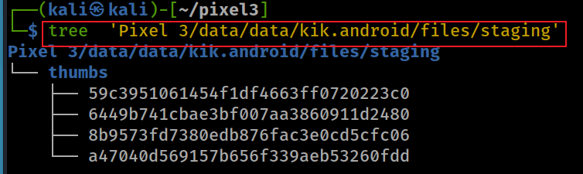
Can we retrieve images?
We checked the urls and local disk. Nothing were found.
Notes:
https://platform.kik.com/content/files/06ceeadd-995d-4e3c-be2b-2a0b26dec374?k=861ab881f7ea206f63d02586236b22b801af502b
https://platform.kik.com/content/files/cebcca1c-94a2-4d42-863b-3fd80f3fd233?t=RIC6OLjUJm9nr_9pRoRark_QO4Y1cR13CKjm8JRrP3ko0_0yywYhlAdzGYc4MEr6Ag183Hi_9JD69c1_lsCfzfNE51l0n-1O1c4g1n_sW2FSLVxodUGQ_jMSzc8vXjec

Slide 28
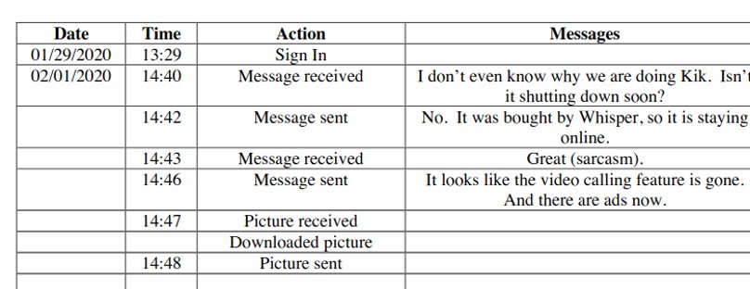
Results of messages

Slide 29
To summarize
Understand the application
1
Locate the app directory
2
Search the keywords username, logintime, email, version to get that info
3
Go to the databases directory
4
KikCoreDatabase.db has a unique ID for each user
other databases are generated based on ID
Go to shared prefs folder to find the install date of the app
5

