Slide 1
iOS Location Forensics
iOS 13

Slide 2
Overview
What is location data
How does iOS capture location data
Where is location data stored
Visualizing location data with Python
Frequent Locations
Where is Frequent Locations stored
Visualizing Frequent Locations with Python

Slide 3

What is Location Data

Slide 4
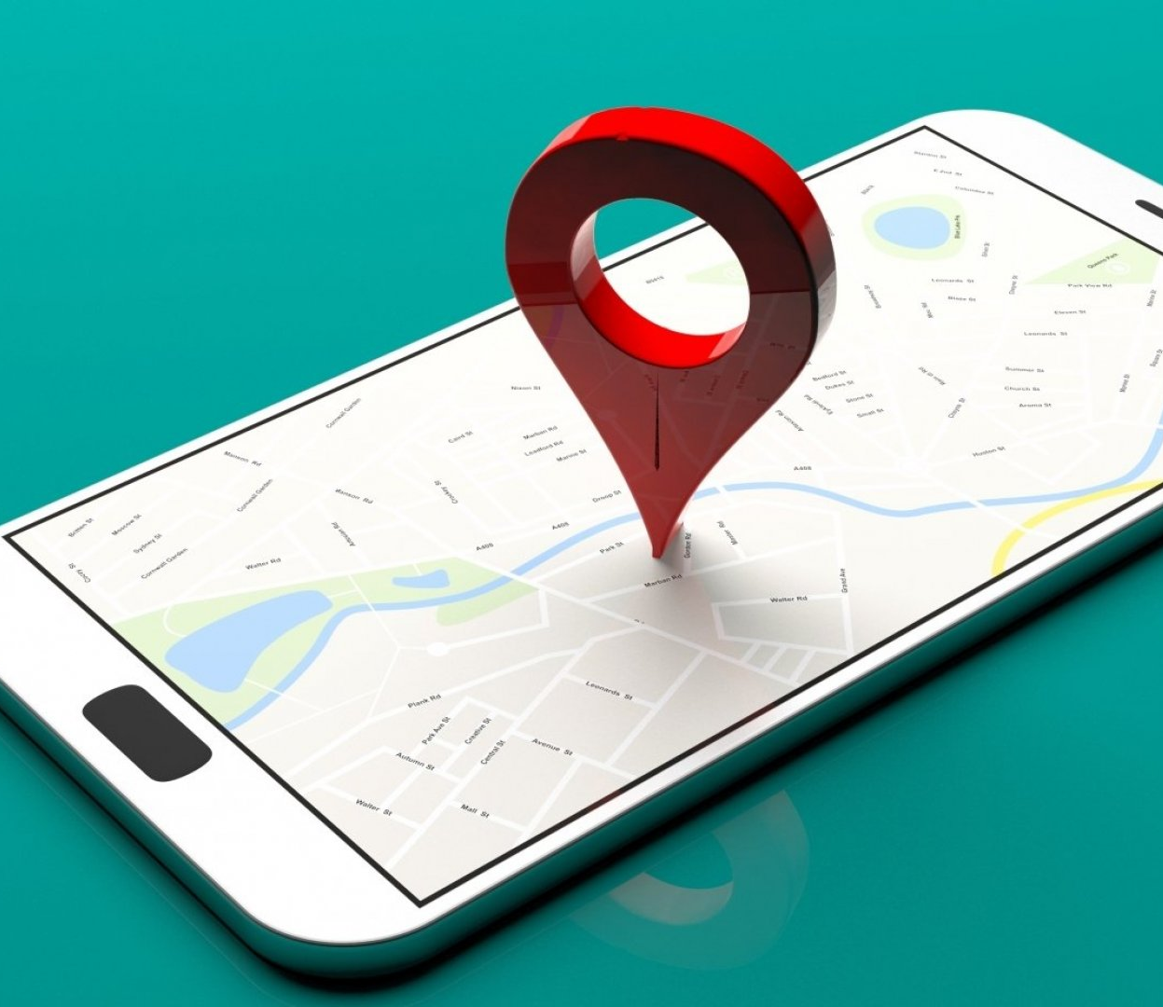
How Location Data is Created
Mobile devices are stuffed with sensors, usually including at least one accelerometer, a gyroscope, a magnetometer, a barometer, microphones, one or two cameras, a thermometer, a pedometer, and light sensor.
The Operating System & Applications are able to access these sensors to gather data about the User.
The most forensically valuable information gathered from these sensors are location data.

Slide 5
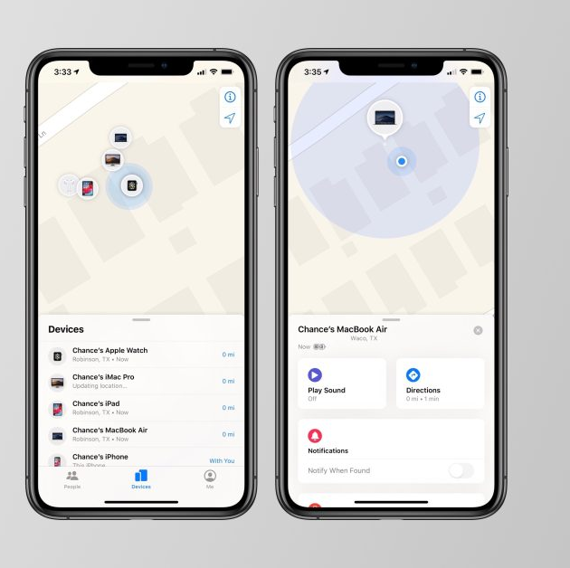
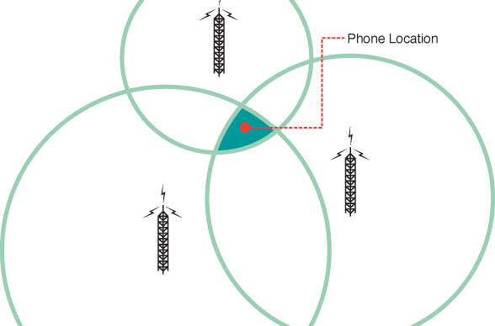
How Location Data is Created (2)
Location data is created from 2 sources on iOS:
  Mobile Signal Tracking from Towers
  Wi-Fi and Bluetooth Tracking

Slide 6
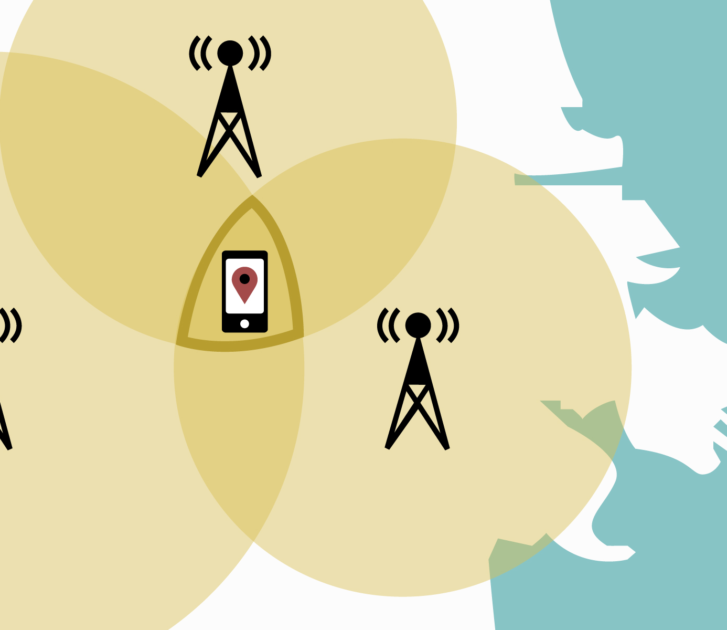
Mobile Signal Tracking — Towers
In all modern mobile networks, the operator can calculate where a particular subscriber's phone is located whenever the phone is powered on and registered within the network. The ability to do this results from the way the mobile network is built and is commonly called triangulation.
Notes:
Ssd.eff.org

Slide 7
How Triangulation Works
The tower operator can do this by observing the signal strength that different towers capture from a particular subscriber's mobile phone, and then calculate where that phone must be located in order to account for these observations. The accuracy with which the operator can figure out a subscriber's location varies depending on many factors, including the technology the operator uses and how many cell towers they have in an area. Usually, with at least 3 cell towers the operator can get down to ¾ of a mile or 1km.
Pros– No way to hide from this if the cell phone is powered and has a SIM card.
Cons – Not very accurate, usually within rough area.

Slide 8
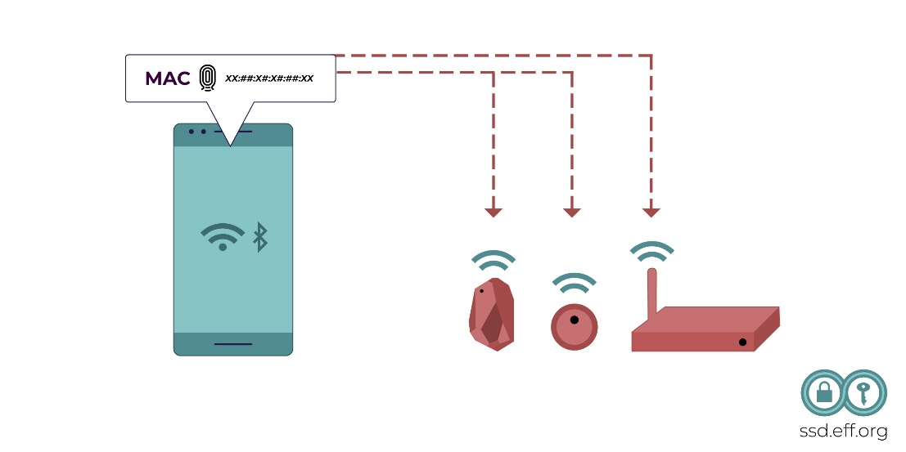
Wi-Fi and Bluetooth Tracking
Modern smartphones have other radio transmitters in addition to the mobile network interface. They also have Wi-Fi and Bluetooth support. These signals are transmitted with less power than a mobile signal and can normally be received only within a short range (such as within the same room or the same building). Both kinds of wireless signals include a unique serial number for the device, called a MAC address, which can be seen by anybody who can receive the signal.
Notes:
Ssd.eff.org

Slide 9
How MAC addresses are used to create location data
Whenever Wi-Fi is turned on, a typical smartphone will transmit occasional “probe requests” that include the MAC address and will let others nearby recognize that this particular device is present. Bluetooth devices do something similar. These identifiers have traditionally been valuable tools for passive trackers in retail stores and coffee shops to gather data about how devices, and people, move around the world.
Since iOS 3.2, Apple uses their own database (prior to that they used Skyhook Wireless) to track Wireless locations. This works by sending Wi-Fi MAC addresses to Apple by GPS-enabled iOS devices. So, if the device has a GPS fix, it automatically sends all Wi-Fi MAC addresses it sees alongside with the GPS-detected location to Apple.

Slide 10

Where is Location Data Stored?

Slide 11
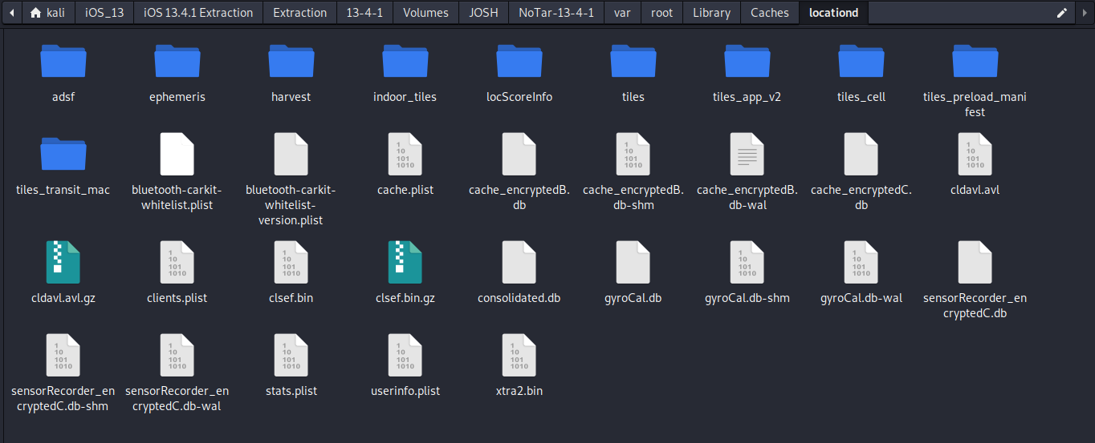
~/var/root/Library/Caches/locationd

Slide 12
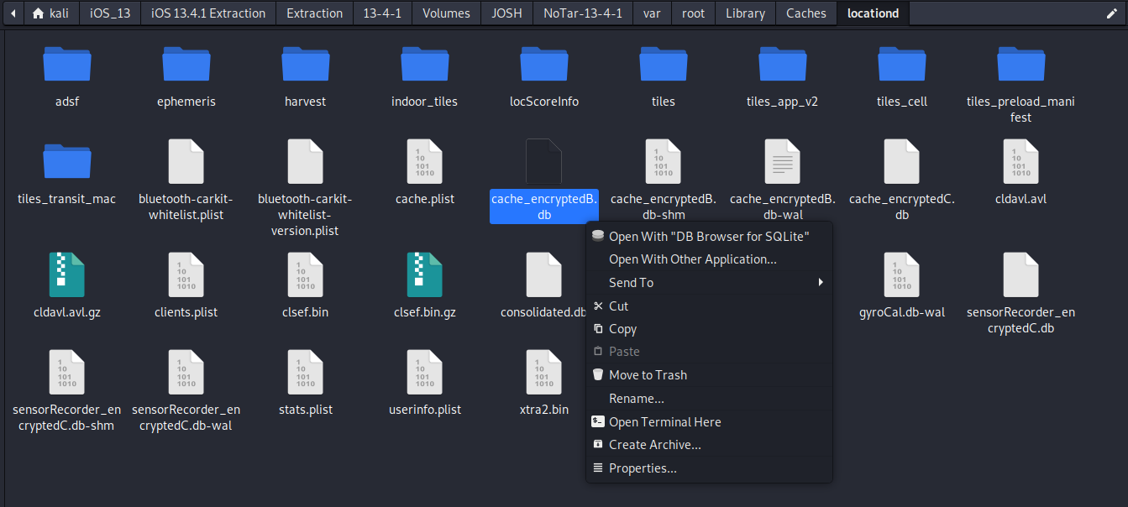
Open with DB Browser for SQLite

Slide 13
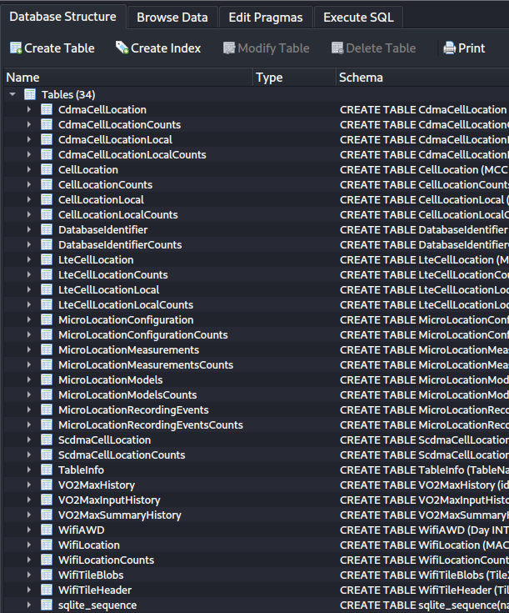
Tables of interest:

Slide 14

Visualizing the data with Python

Slide 15
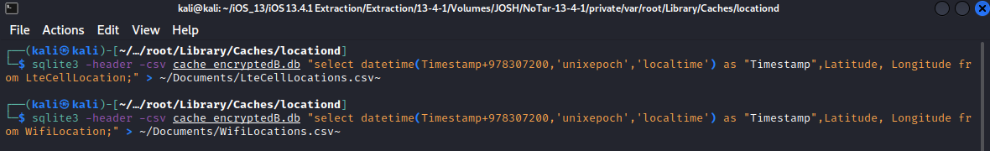
Prepare data by converting to CSV
Open terminal in ~/var/root/Library/Caches/locationd
sqlite3 -header -csv cache_encryptedB.db "select datetime(Timestamp+978307200,'unixepoch','localtime') as "Timestamp",Latitude, Longitude from LteCellLocation;" > ~/Documents/LteCellLocations.csv
sqlite3 -header -csv cache_encryptedB.db "select datetime(Timestamp+978307200,'unixepoch','localtime') as "Timestamp",Latitude, Longitude from WifiLocation;" > ~/Documents/WifiLocations.csv~

Slide 16
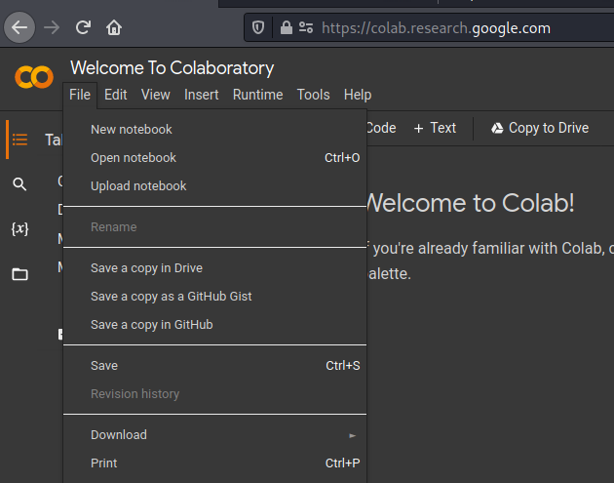
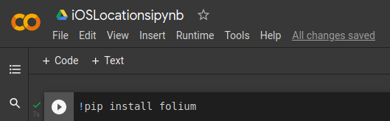
Prepare Google Colab Environment
https://colab.research.google.com/
Install folium by running
  !pip install folium
Run code with the Play Button

Slide 17
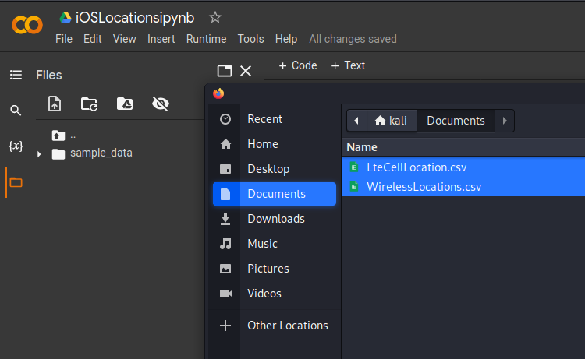
Import CSV Data

Slide 18
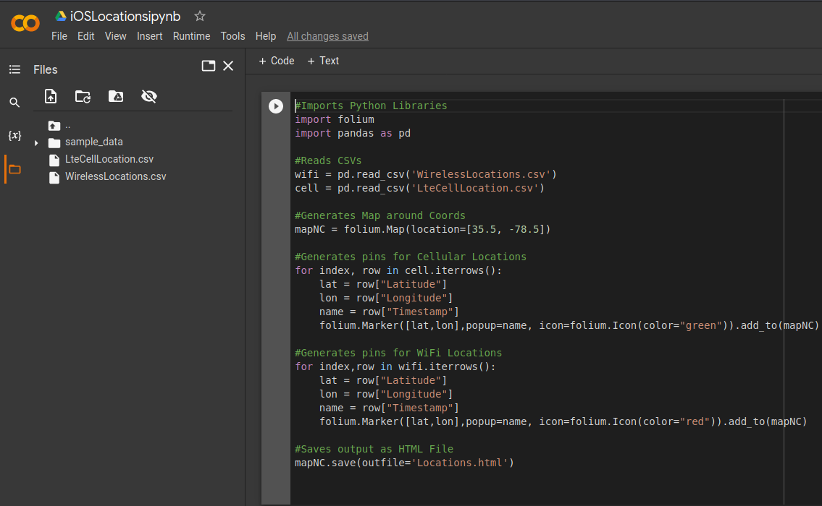
Input Code

Slide 19
Code:
#Imports Python Libraries
import folium
import pandas as pd
#Reads CSVs
wifi = pd.read_csv('WirelessLocations.csv')
cell = pd.read_csv('LteCellLocation.csv')
#Generates Map around Coords
mapNC = folium.Map(location=[35.5, -78.5])
#Generates pins for Cellular Locations
for index, row in cell.iterrows():
lat = row["Latitude"]
lon = row["Longitude"]
name = row["Timestamp"]
folium.Marker([lat,lon],popup=name, icon=folium.Icon(color="green")).add_to(mapNC)
#Generates pins for WiFi Locations
for index,row in wifi.iterrows():
lat = row["Latitude"]
lon = row["Longitude"]
name = row["Timestamp"]
folium.Marker([lat,lon],popup=name, icon=folium.Icon(color="red")).add_to(mapNC)
#Saves output as HTML File
mapNC.save(outfile='Locations.html')

Slide 20
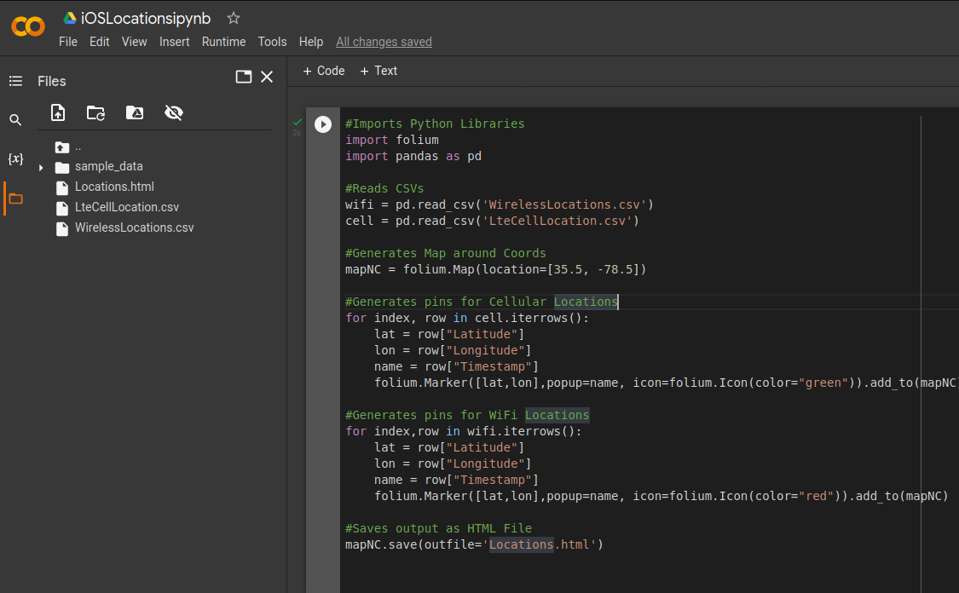
Press play to execute
Output is saved as HTML file

Slide 21
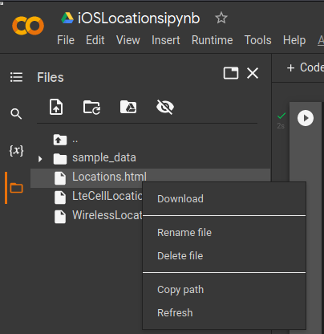
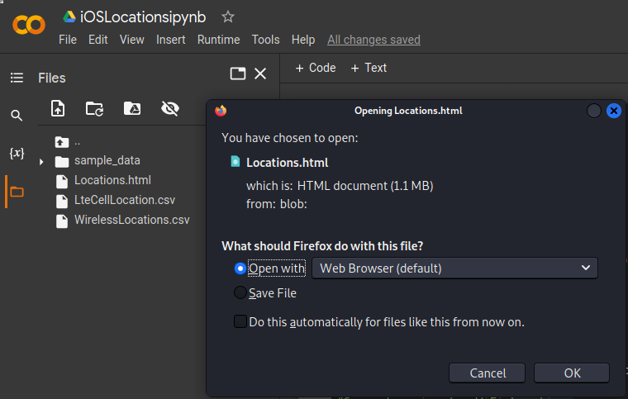
View results
Open in browser

Slide 22
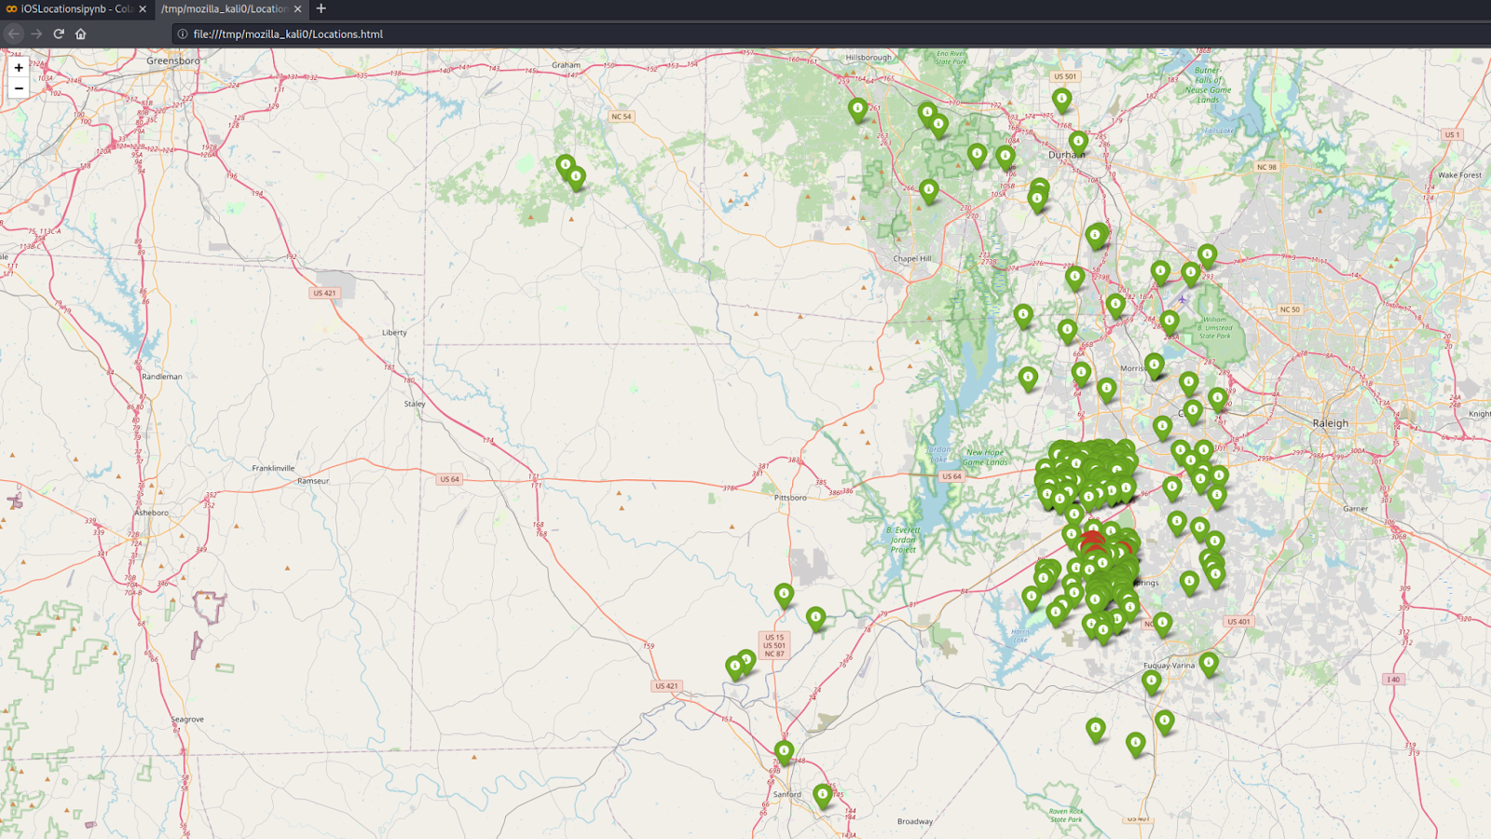
An interactive map with Location Pins will appear

Slide 23
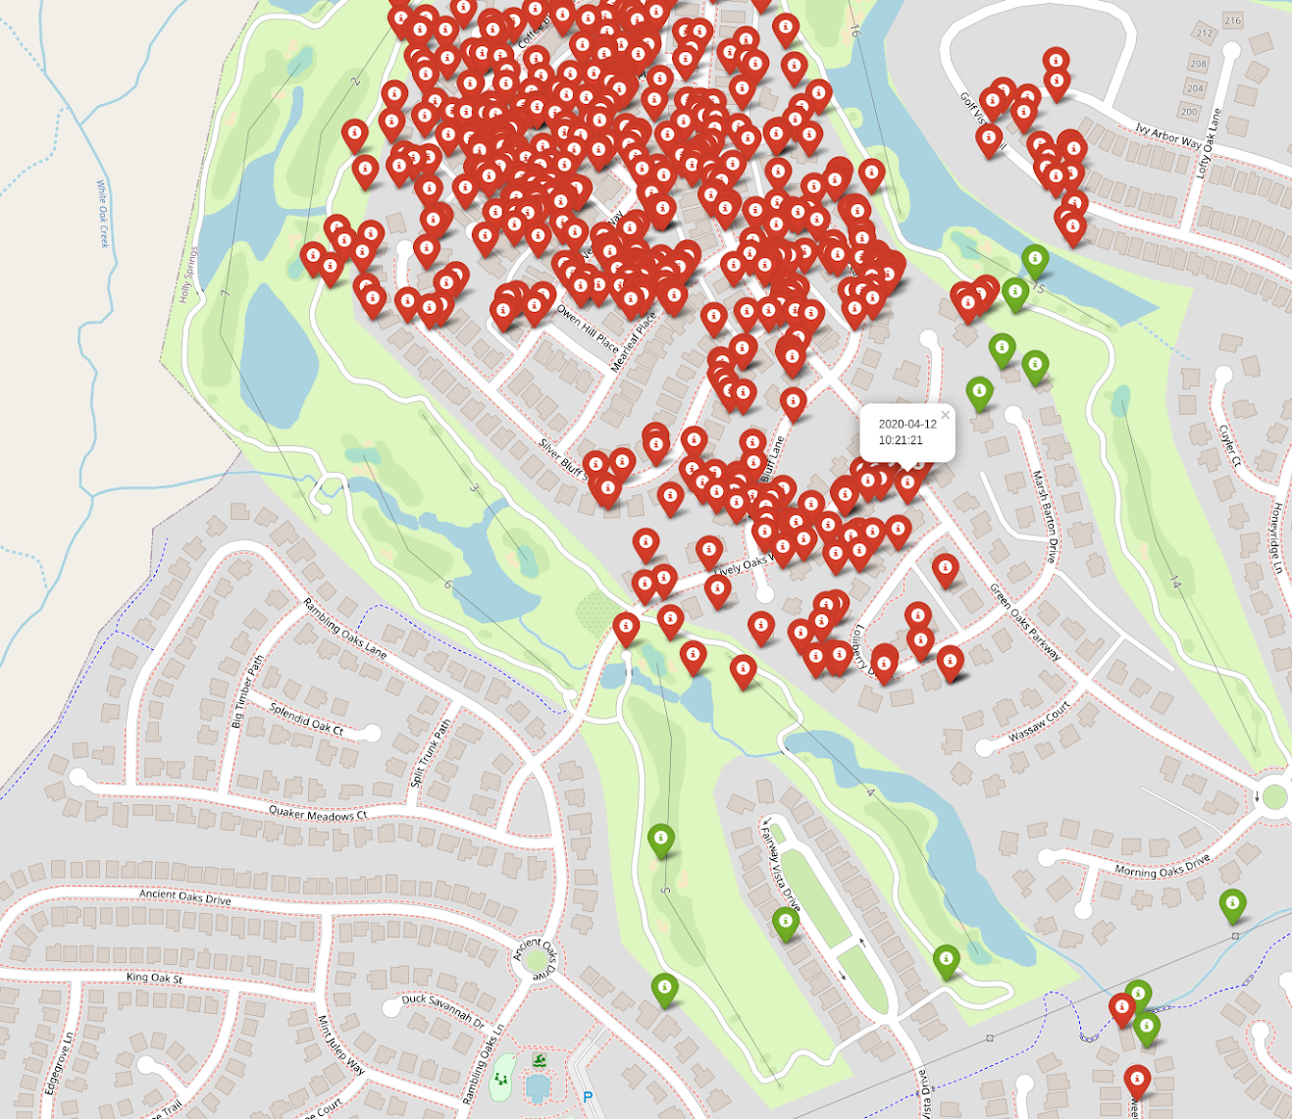
Pan, zoom, & click on the pins to see timestamp information.

Slide 24
Frequent Locations

Slide 25
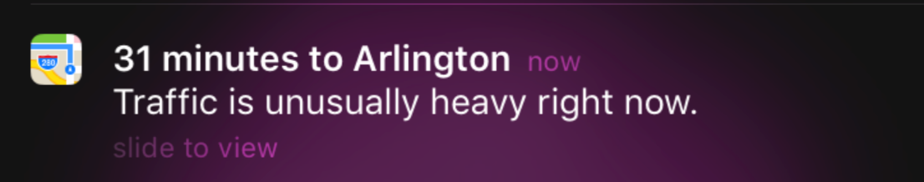
What is frequent locations?
Introduced in iOS 7, iPhone keeps a history of all the locations you’ve visited. This is a feature called “Frequent Locations”. iPhone keeps track of the dates you were at a specific location and even how long you were there.
As described in iOS, it “allows your iPhone to learn places you frequently visit in order to provide useful location-related information.”
It is used by iOS to predict the user's movement on a day-to-day basis. By learning the users’ routines, iOS can provide up to date GPS directions and estimated times to that location (i.e., going to work daily)

Slide 26
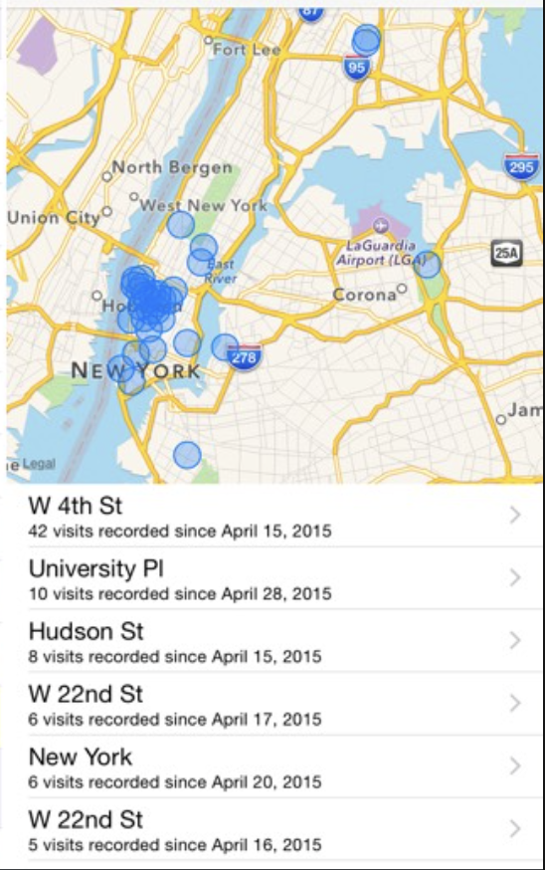
Example of a user’s frequent locations, how it would appear to the user.

Slide 27
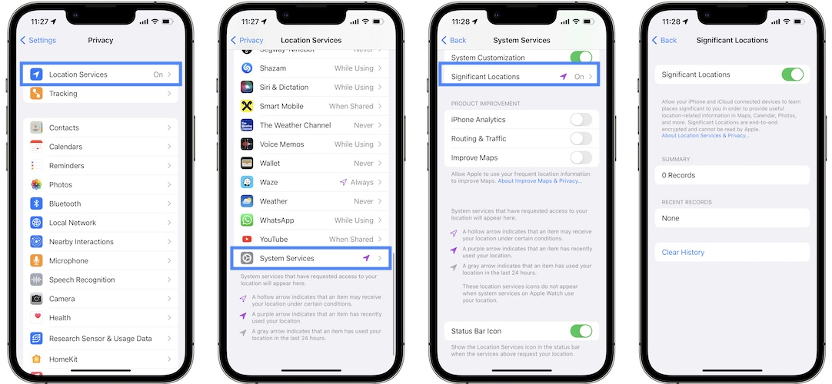
Try it yourself: Settings>Privacy

Slide 28
Where are Frequent Locations Stored?

Slide 29
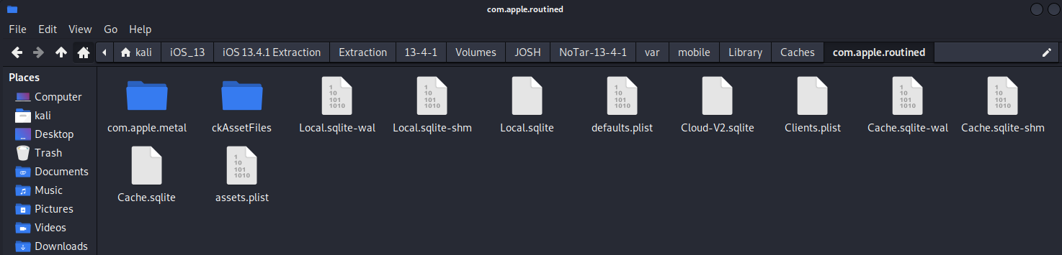
~/var/mobile/Library/Caches/com.apple.routined

Slide 30
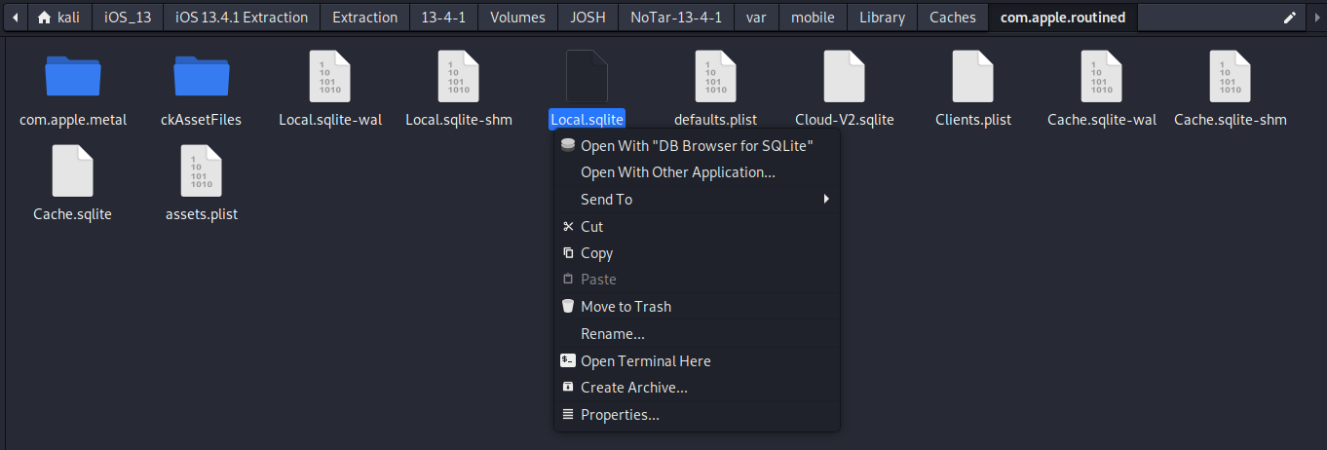
Open with DB Browser for SQLite

Slide 31
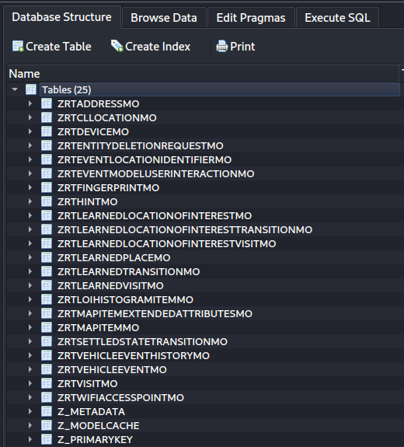
Table of interest:

Slide 32
Visualizing the data with Python

Slide 33
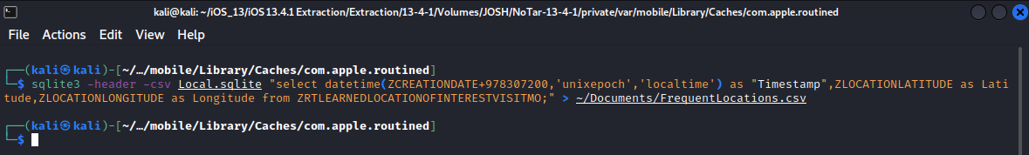
Prepare data by converting to CSV
Open terminal in ~/var/mobile/Library/Caches/com.apple.routined
sqlite3 -header -csv Local.sqlite "select datetime(ZCREATIONDATE+978307200,'unixepoch','localtime') as "Timestamp",ZLOCATIONLATITUDE as Latitude,ZLOCATIONLONGITUDE as Longitude from ZRTLEARNEDLOCATIONOFINTERESTVISITMO;" > ~/Documents/FrequentLocations.csv

Slide 34
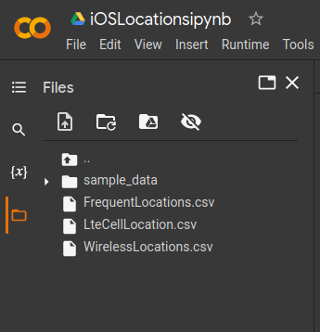
Revisit previous Google Colab Notebook
Upload new csv to Google Colab
Note: All CSVs need to be present. If the LTE and Wireless CSVs were deleted due to a Colab Runtime Timeout, they need to be re-uploaded.

Slide 35
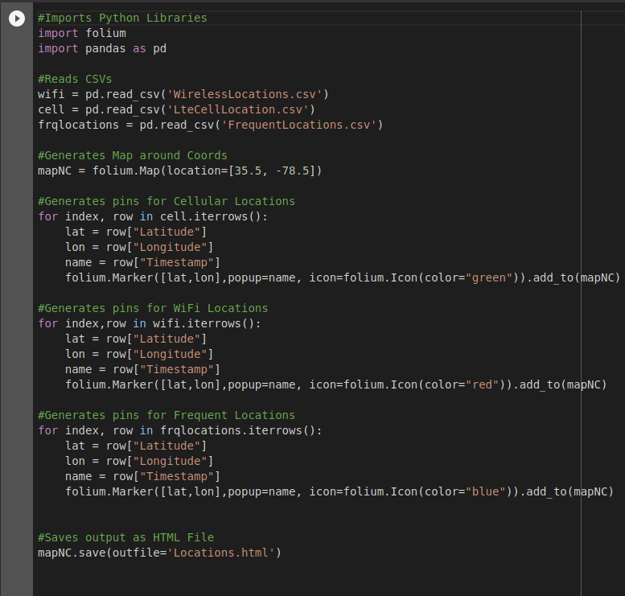
Input new code additions to display Frequent Locations

Slide 36
Code:
#Imports Python Libraries
import folium
import pandas as pd
#Reads CSVs
wifi = pd.read_csv('WirelessLocations.csv')
cell = pd.read_csv('LteCellLocation.csv')
frqlocations = pd.read_csv('FrequentLocations.csv')
#Generates Map around Coords
mapNC = folium.Map(location=[35.5, -78.5])
#Generates pins for Cellular Locations
for index, row in cell.iterrows():
lat = row["Latitude"]
lon = row["Longitude"]
name = row["Timestamp"]
folium.Marker([lat,lon],popup=name, icon=folium.Icon(color="green")).add_to(mapNC)
#Generates pins for WiFi Locations
for index,row in wifi.iterrows():
lat = row["Latitude"]
lon = row["Longitude"]
name = row["Timestamp"]
folium.Marker([lat,lon],popup=name, icon=folium.Icon(color="red")).add_to(mapNC)
#Generates pins for Frequent Locations
for index, row in frqlocations.iterrows():
lat = row["Latitude"]
lon = row["Longitude"]
name = row["Timestamp"]
folium.Marker([lat,lon],popup=name, icon=folium.Icon(color="blue")).add_to(mapNC)
#Saves output as HTML File
mapNC.save(outfile='Locations.html')

Slide 37
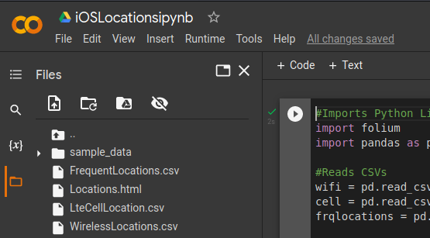
Press Play and Wait for Results

Slide 38
View results
Open in browser

Slide 39
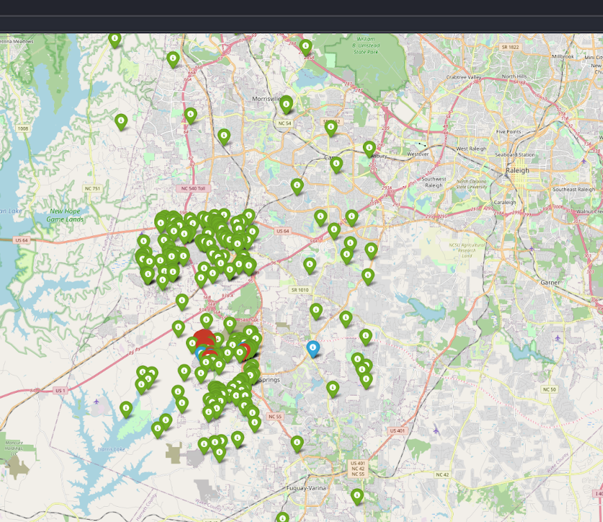
An interactive map with location pins will appear, notice the Blue Pins:

Slide 40
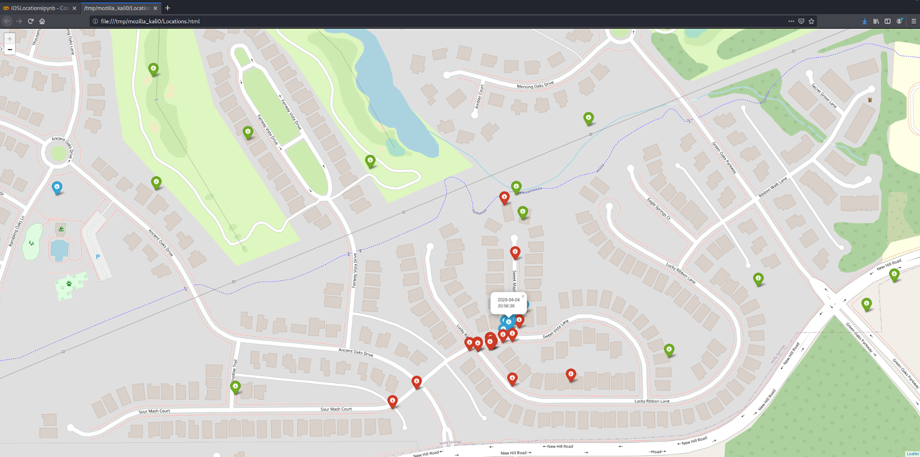
Pan, zoom, & click on the pins to see timestamp information.

Slide 41
Summary
What is location data
  How does iOS capture location data
Where is location data stored
Visualizing location data with Python
Frequent Locations
Where is Frequent Locations stored
Visualizing Frequent Locations with Python

