Slide 1


Investigate Data Leakage Case
Keywords: Update Sequence Number (USN) Journaling
If I delete a file from and change the file entry, no one will know which file I have deleted.
Notes:
http://xmlstar.sourceforge.net/doc/UG/

Slide 2
Overview
$MFT: Master File Table
USN Journal
Identify all traces related to changing of files in Windows Desktop

Slide 3

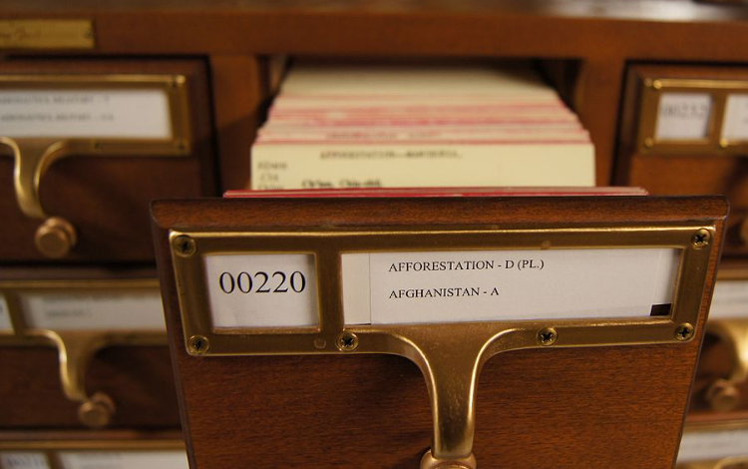
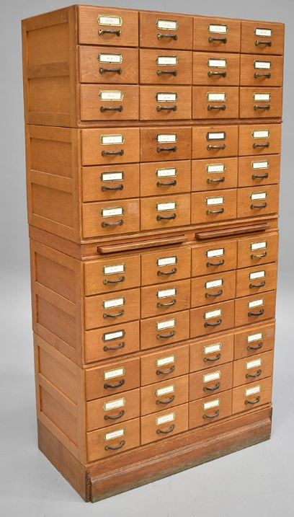
$MFT: Master File Table

Slide 4
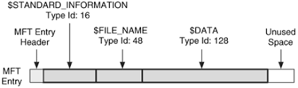
$MFT has many entries (records)
Entry (1k)
Entry (1k)
Entry (1k)
Entry (1k)
Entry (1k)
Entry (1k)
MFT starts as small as possible and expands when more entries are needed.
$MFT is file, $MFT has an entry for itself.
Reference #
Entry/Record # | Seq#
0x0000 0000 1421 | 0x0002
0x0000 0000 1422 | 0x0005
0x0000 0000 1423 | 0x000a
0x0000 0000 1424 | 0x0001

Slide 5
$MFT File Reference Number
MFT File Reference # =MFT sequence # + MFT entry #
MFT entry #
  Each represents one file
  ID starts from zero,
  zero being the MFT file itself.
MFT sequence #
  # of times that one existing MFT entry have been used
  e.g., a file is deleted and its MFT entry to be reused for a new file.
    its sequence number would be incremented from 1
  benefits: determine a crashed/corrupted state
    check different MFT sequence #
Notes:
https://www.andreafortuna.org/2018/06/04/using-mft-anomalies-to-spot-suspicious-files-in-forensic-analysis/

Slide 6
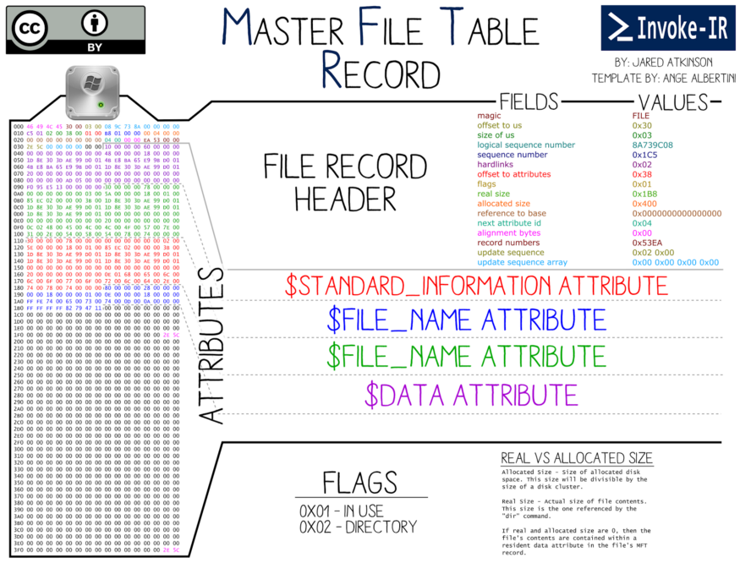
updated seq
Notes:
https://www.writeblocked.org/resources/NTFS_CHEAT_SHEETS.pdf

Slide 7
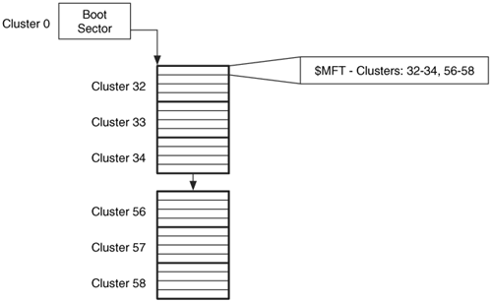
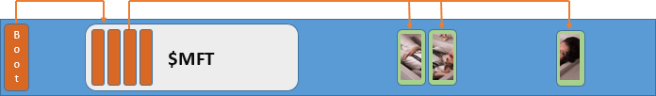
Boot sector and $MFT
https://flylib.com/books/en/2.48.1/mft_concepts.html
Notes:
https://www.raisedr.com/resources/general/recovery-chances/

Slide 8

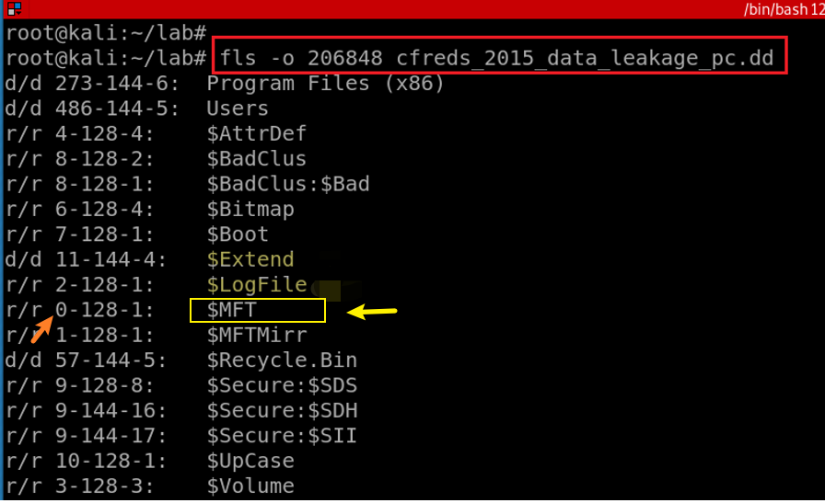
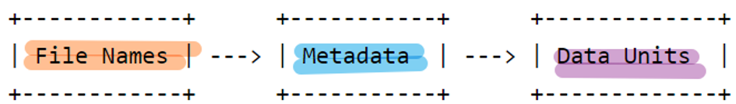
$MFT file is one of system metadata files
Contains the information about all files and directories
Notes:
fls -o 206848 cfreds_2015_data_leakage_pc.dd

Slide 9
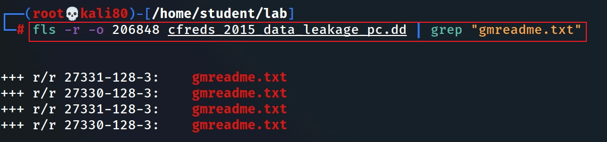
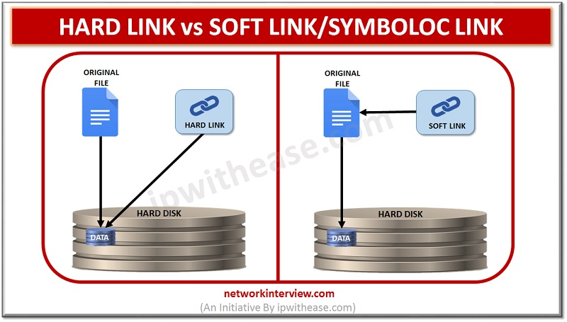
A MFT entry example: gmreadme.txt
four copies in different folders (different parents). Two point to the same inode (hard links)

Slide 10
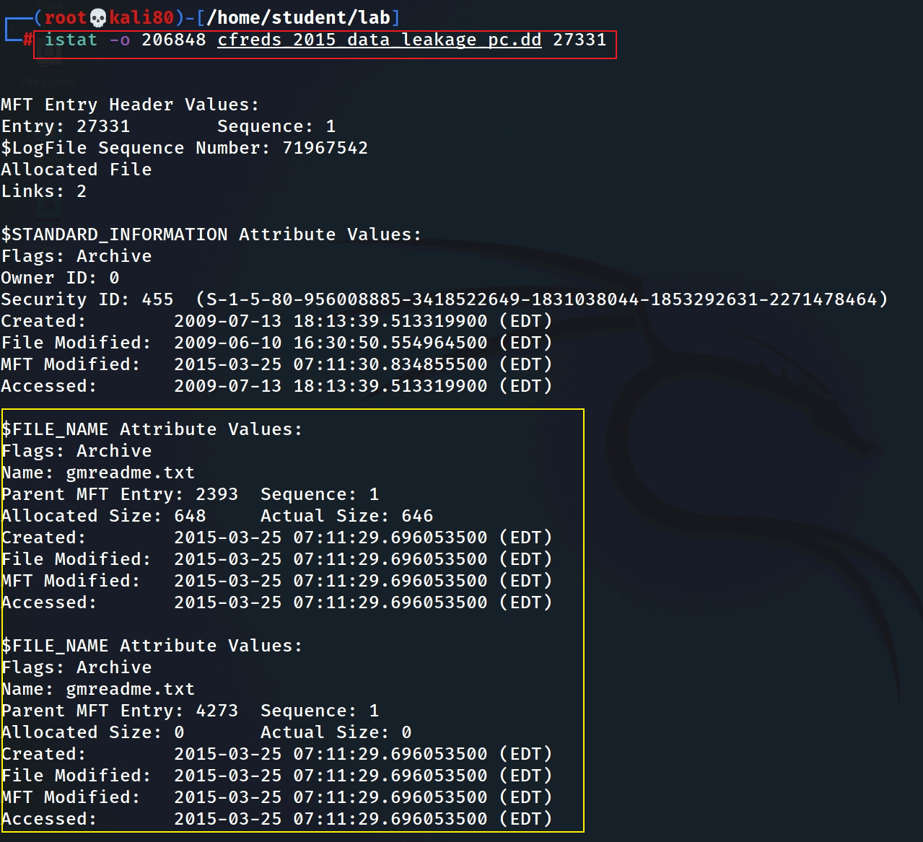
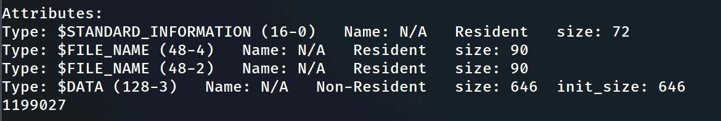



https://flatcap.github.io/linux-ntfs/ntfs/concepts/file_record.html
changed every time the record is modified.
MFT File Reference Number (8 bytes) =
MFT Entry (inode #, 6 bytes): 27331 +
MFT sequence (Number of times this mft record has been reused 2 bytes): 1
$STD timestamp
can be modified by user/application-level processes.
Easy to be changed for anti-forensics
collected by Windows explorer, fls, mactime, timestamp, find
B/created/birth: when a file a birth/created/Copied/Moved
File M/mtime: the last time the content $DATA a file has been changed
MFT M: the file’s metadata changes (C)
A/atime: access time of $DATA
$FILE_NAME timestamps
can only be changed by the system kernel.
Difficult to be modified by users/application.
More important
only create/copy/volume move change
Same files, two hard links
Long file name has two link
  DOS-compatible short name (EXTRE~1.TXT).
Anti-forensics indication: $FILE_NAME time occurs after the $STANDARD_INFORMATION Creation Time.
Notes:
A file with a single name has 12 timestamps: 4 timestamps come from the $STANDARD_INFORMATION attribute in a file record, 4 timestamps come from the $FILE_NAME attribute in the same file record, and 4 timestamps come from the $FILE_NAME attribute in an index record ($I30) of a parent directory.
https://dfir.ru/2021/01/10/standard_information-vs-file_name/#:~:text=A%20file%20with%20a%20single,I30)%20of%20a%20parent%20directory.

Slide 11
MACB timestamps for different file systems (from sleuthkit)
File System | M | A | C | B
Ext4 | Modified | Accessed | Changed | Created
Ext2/3 | Modified | Accessed | Changed | N/A
FAT | Written | Accessed | N/A | Created
NTFS | $Data Modified | Accessed | $MFT Modified | Created
UFS | Modified | Accessed | Changed | N/A
Note: Difference version many produce different BMAC timestamp changes
Notes:
https://forensixchange.com/posts/19_04_22_win10_ntfs_time_rules/#:~:text=The%20MACB%20timestamps%20are%20stored,%24STANDARD_INFORMATION%20and%20%24FILE_NAME%20attribute.&text=One%20important%20difference%20is%20that,changed%20by%20the%20system%20kernel.

Slide 12
General rules, but not always true because file operations may involve both app and system level APIs
Condition | Modified (is content modified?) | $MFT Modified? | Accessed (need to read file?) | Created (birth of a new file?)
When renaming a file | No | ? | No | No
When moving a file between folders | No | ? | No | No
When moving a file between disks or partitions | No | ? | Time of move | No
When copying a file | No | ? | Time of copy | Time of copy
When writing a new file | Time of creation | ? | Time of creation | Time of creation
When modifying an existing file | Time modified | ? | No | No
When accessing an existing file | No | ? | Updated within an hour if enabled, otherwise Preserved | No
On various operating systems the update of the access time can be disabled. This means when a file is accessed the atime in the corresponding file system entry is not updated.
HKEY_LOCAL_MACHINE\SYSTEM\CurrentControlSet\Control\FileSystem\NtfsDisableLastAccessUpdate
Notes:
https://forensicswiki.xyz/wiki/index.php?title=MAC_times#:~:text=The%20term%20MAC%20times%20refers,ctime)%20of%20a%20certain%20file.&text=The%20latter%20refers%20to%20the,MFT%20entry%20itself%20was%20modified.

Slide 13
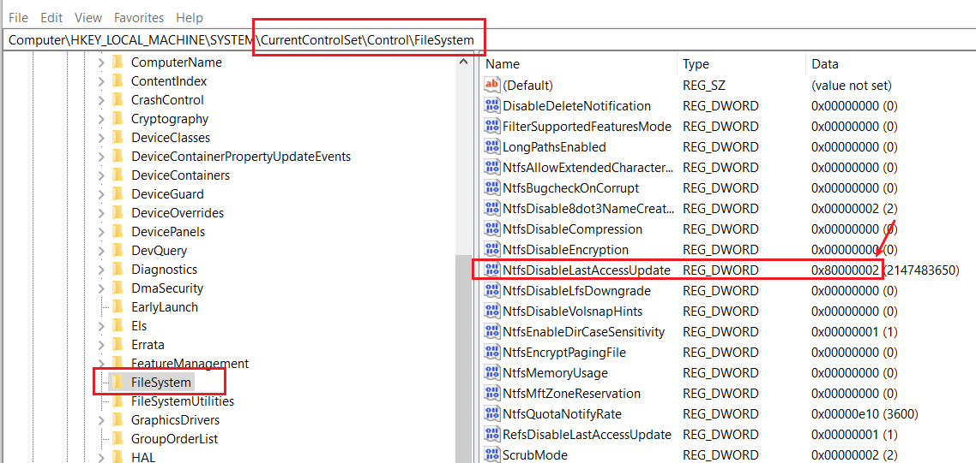
'User Managed’ mode
disabled: the last access time stamp remains unchanged during the boot, regardless of the volume size.
enabled: the OS changes it only when a user activity occur.
'System Managed' mode
disabled: completely disables the Last Access Time Stamp feature for NTFS
enabled: the last access time stamp is modified during the boot, once the OS mounts volumes. Windows 10 doesn't change it for large volumes (>128GB), it is a performance-maintenance trade off.
0 = User Managed, Last Access Updates Enabled
1 = User Managed, Last Access Updates Disabled
2 = System Managed, Last Access Updates Enabled (default)
3 = System Managed, Last Access Updates Disabled
Notes:
https://winaero.com/disable-ntfs-last-access-time-updates-in-windows-10/

Slide 14
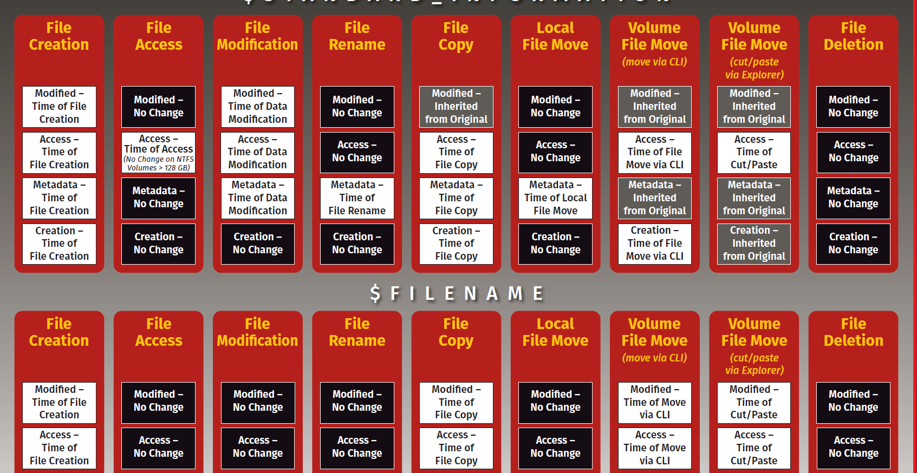
Notes:
https://www.sans.org/security-resources/posters/windows-forensic-analysis/170/download

Slide 15
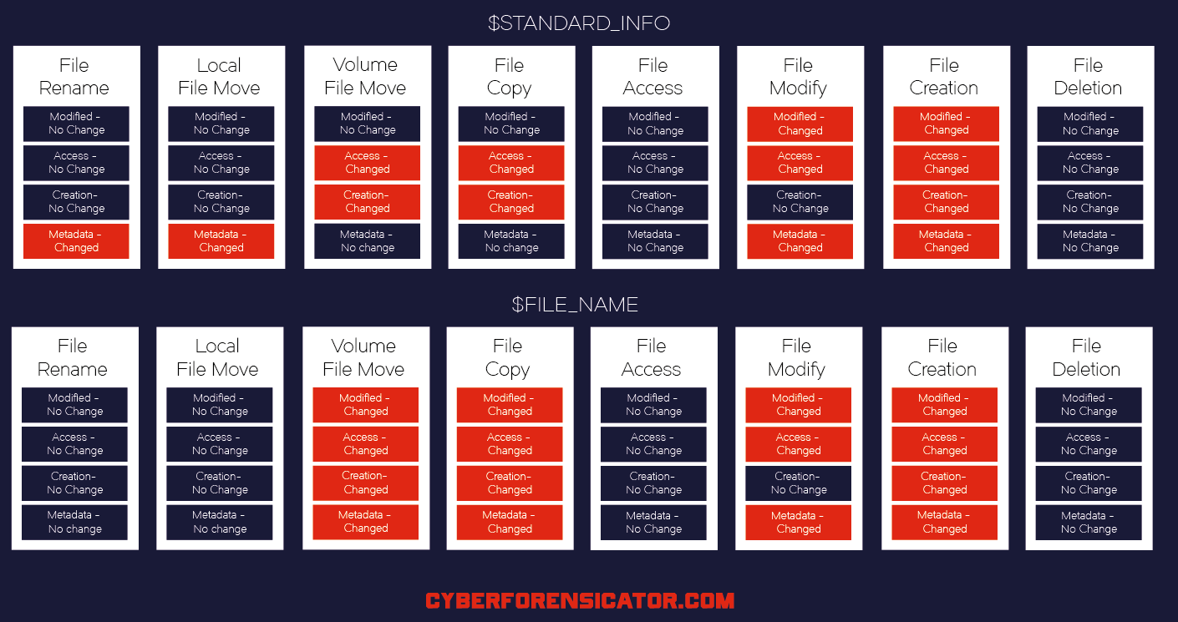
using .docx for experiments
Notes:
https://cyberforensicator.com/wp-content/uploads/2018/03/Windows-10-Time-Rules-Cyber-Forensicator_2.png
https://cyberforensicator.com/2018/03/25/windows-10-time-rules/

Slide 16
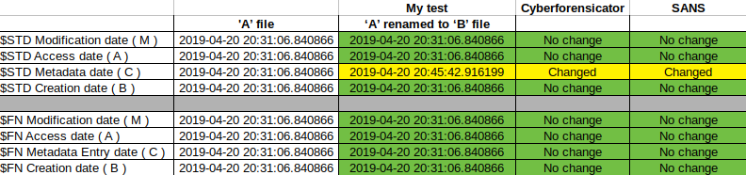
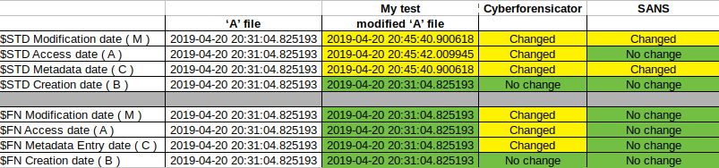
File Rename
using .txt for experiments
File Modification
Check here for comprehensive study results
Notes:
https://forensixchange.com/posts/19_04_22_win10_ntfs_time_rules/#:~:text=The%20MACB%20timestamps%20are%20stored,%24STANDARD_INFORMATION%20and%20%24FILE_NAME%20attribute.&text=One%20important%20difference%20is%20that,changed%20by%20the%20system%20kernel.

Slide 17
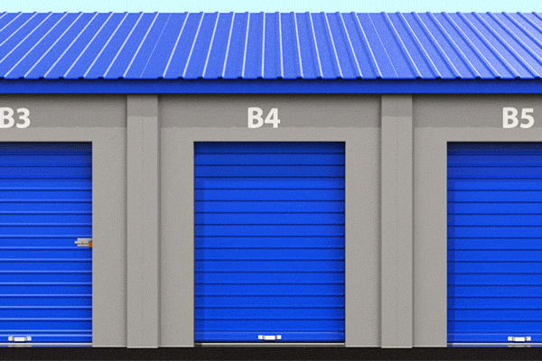
USN Journal
Box ID | Box Name | Reason for changes | Change Date
1 | My homework 1 | Change answer 2 | 10/18/2022
2 | My homework 2 | Throw away | 1/22/2023
3 | My homework 1 | Move to B5 | 10/2/2023
Update Sequence Number

Slide 18
Outlines
How to backup disks?
What is USN Journal?
The Structure of USN Journal
What information is included in USN Journal (Journal Record)?
How is the information used for digital forensics?

Slide 19
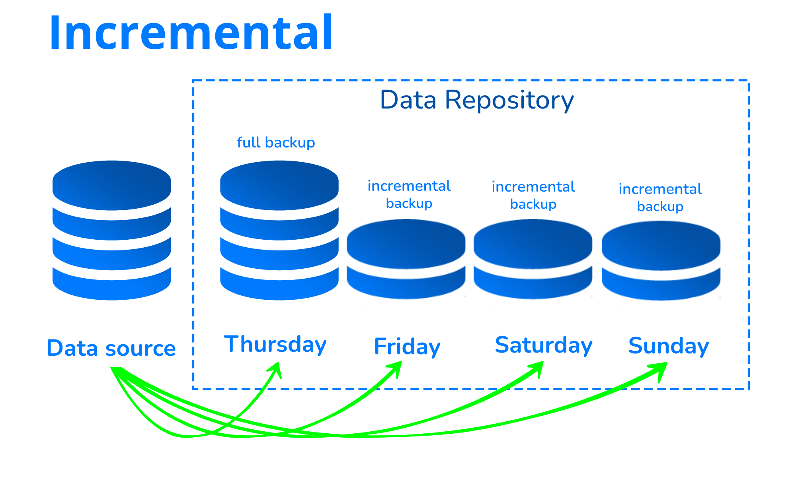
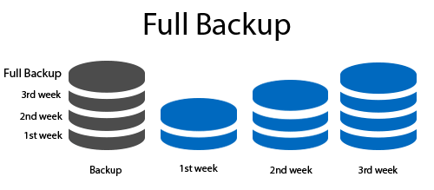
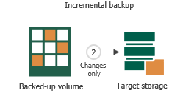





How to backup disks?
http://msbkffilerecovery.com/blog/wp-content/uploads/2019/01/1.png
https://www.virtualizor.com/sitepad-data/uploads//2022/08/virt_incremental.png

Slide 20




What is USN Journal?
USN (Update Sequence Number) Journal
keep tracking of changed files in volumes (e.g.., rename)
Is a feature of the Windows NT file system (NTFS)
Minimum Change information is saved
Doesn’t need to include the details of data changes
When and what was done to the various objects (not HOW).
Changes are described using bit flags
From Win7, Journal Function is activated by default
USN is a treasure trove of information for a forensic investigation.
Keep track of suspect’s behaviors to volumes
Notes:
https://en.wikipedia.org/wiki/USN_Journal#:~:text=The%20USN%20Journal%20(Update%20Sequence,the%20NTFS%20file%20system%20journaling.

Slide 21
Information of USN Journal Record
USN of the record
Time of change
Reason for the change
File/directory’s name
File/directory’s attributes
File/directory’s MFT reference number
File reference number of the file’s parent directory
Security ID to identifier of a user, user group
  "S-1-5-21-3623811015-3361044348-30300820-1013"
Information about the source of the change

Slide 22

















The Structure of USN Journal
$Max: Size of the USNs
$J: Content of USNs

Slide 23
The Details of Structure of USN Journal
"Sparse Area“ to preserve space efficiently: zero-filled
  the file effectively does not consume any more disk space than needed
  but can just seem to grow infinitely.
The structure allows OS to keep the same size of the log data
The new records are added at the end of the attribute.
unallocated
Sparse (preserved) Area | USN1 | USN2 | USN3 | USN4 | … | USNn
Lowest Valid USN

Slide 24
Grow of USN Journal
It begins as an empty file.
  Whenever a change is made to the volume, a record is added to the file.
  Each record is identified by a 64-bit Update Sequence Number (USN, for this reason Change Journals are sometimes called USN Journals).
  Each record in the Change Journal contains the USN, the name of the file, and information about what the change was.
It does not include all the data or details associated with the change.
  Cannot be used to undo operations on files within NTFS
Will be reused when journal reaches its maximum size
  Clusters of the journal’s disk space are marked unallocated by OS
  Unallocated space can be extremely valuable
Notes:
https://velociraptor.velocidex.com/the-windows-usn-journal-f0c55c9010e

Slide 25
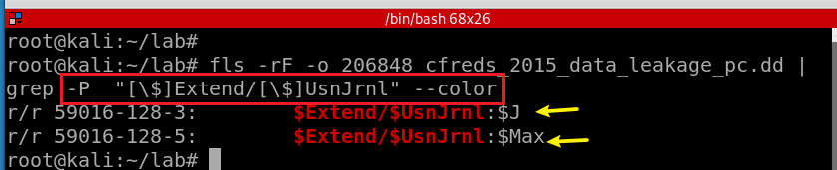
$Extend\$UsnJrnl contains two alternate data streams
Search for $Extend\$UsnJrnl
[ ]: Match a single character
$J: The actual change log records: the date and time of the change, the reason for the change, the Master File Table (MFT) entry, the parent entry and others.
$Max: The meta data of change log: e.g., the maximum size.
Notes:
fls -rF -o 206848 cfreds_2015_data_leakage_pc.dd | grep -P "[\$]Extend/[\$]UsnJrnl" --color
https://countuponsecurity.com/tag/ntfs-logfile/

Slide 26
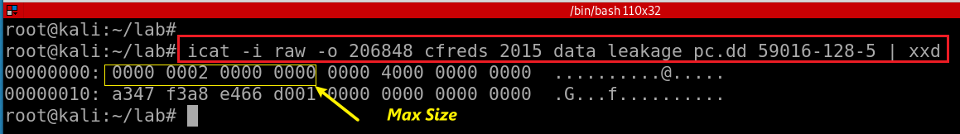
$Extend\$UsnJrnl: $Max attribute
Offset | Size | Stored | Information Detail
0x00 | 8 | Maximum Size | The maximum size of Journaling data
0x08 | 8 | Allocation Size | The size of allocated area when new log data is saved.
0x10 | 8 | Time | The creation time of "$UsnJrnl" file(FILETIME)
0x18 | 8 | Lowest Valid USN | The least value of USN in current records With this value, investigator can approach the start point of first record within "$J" attribute
Notes:
icat -i raw -o 206848 cfreds_2015_data_leakage_pc.dd 59016-128-5 | xxd
http://forensicinsight.org/wp-content/uploads/2013/07/F-INSIGHT-Advanced-UsnJrnl-Forensics-English.pdf

Slide 27
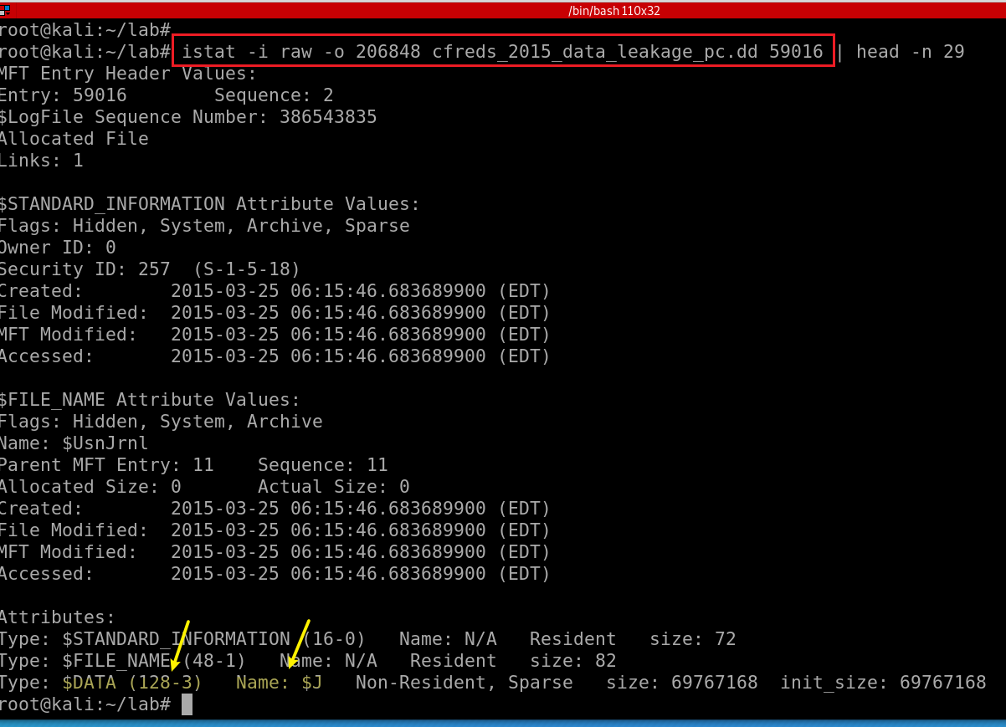
View $Extend\$UsnJrnl: $J $MFT Entry
MFT File Reference Number (8 bytes) =
MFT Entry (inode #, 6 bytes): 59016 +
MFT sequence (Number of times this mft record has been reused 2 bytes): 2
Notes:
istat -i raw -o 206848 cfreds_2015_data_leakage_pc.dd 59016 | head -n 29
https://jmharkness.wordpress.com/2011/01/27/mft-file-reference-number/
https://flatcap.org/linux-ntfs/ntfs/concepts/file_record.html
https://forensicswiki.xyz/wiki/index.php?title=MAC_times#:~:text=The%20term%20MAC%20times%20refers,ctime)%20of%20a%20certain%20file.&text=The%20latter%20refers%20to%20the,MFT%20entry%20itself%20was%20modified.

Slide 28
$J record format
Offset | Size | Stored Information | Explanation
0x08 | 8 | File Reference Number | The ordinal number of the file or directory for which this record notes changes.
0x10 | 8 | Parent File Reference Number | The ordinal number of the directory where the file or directory that is associated with this record is located.
0x18 | 8 | Usn | The USN of this record
0x20 | 8 | TimeStamp | The standard UTC time stamp (FILETIME) of this record, in 64-bit format.
0x28 | 4 | Reason flag | The flags that identify reasons for changes that have accumulated in this file or directory journal record since the file or directory opened.
0x34 | 4 | File Attributes | The attributes for the file or directory associated with this record, as returned by the GetFileAttributes function. Attributes of streams associated with the file or directory are excluded.
0x3A | 2 | FileNameOffset | The offset of the FileName member from the beginning of the structure.
0x3C | N | Filename | The name of the file or directory associated with this record in Unicode format.
Notes:
https://docs.microsoft.com/en-us/windows/win32/api/winioctl/ns-winioctl-usn_record_v2?redirectedfrom=MSDN

Slide 29
Reason Flag Examples
When a file or directory closes,
  A final USN record is generated with the USN_REASON_CLOSE flag set.
  The next change (for example, after the next open operation or deletion) starts a new record with a new set of reason flags.
A rename or move operation
  Generates two USN records, one that records the old parent directory for the item, and one that records a new parent.

Slide 30
Flag | Value | Description
0x00000100 | FILE_CREATE | The file or directory is created for the first time.
0x00000002 | DATA_EXTEND | The file or directory is extended (added to).
0x00002000 | RENAME_NEW_NAME | A file or directory is renamed, and the file name in the USN_RECORD_V2 structure is the new name.
0x00001000 | RENAME_OLD_NAME | The file or directory is renamed, and the file name in the USN_RECORD_V2 structure is the previous name.
0x00000200 | FILE_DELETE | The file or directory is deleted.
0x80000000 | CLOSE | The file or directory is closed.
0x00008000 | BASIC_INFO_CHANGE | A user has either changed one or more file or directory attributes (for example, the read-only, hidden, system, archive, or sparse attribute), or one or more time stamps.
0x00010000 | HARD_LINK_CHANGE | An NTFS file system hard link is added to or removed from the file or directory.
0x00000004 | DATA_TRUNCATION | The file or directory is truncated.
Hard link: you need a file stored in two different folders.

Slide 31

23. Identify all traces related to ‘renaming’ of files in Windows Desktop.

Slide 32
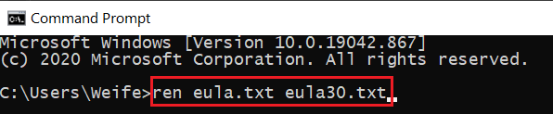
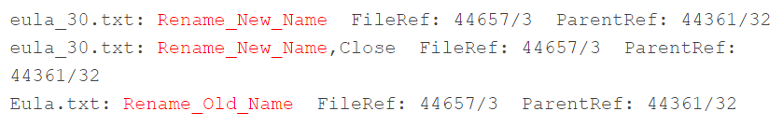

USN Journal when renaming a file
USN Journal
both files have the same reference numbers
Notes:
http://windowsir.blogspot.com/2014/07/file-system-ops-effects-on-mft-records.html

Slide 33


How to read $Extend\$UsnJrnl
(Scenario 1) If the change journal doesn’t reach its maximum size
  icat : extract binary or https://github.com/jschicht/ExtractUsnJrnl
  bless/xxd or UsnJrnl2Csv: convert to csv
(Scenario 2) As the change journal reaches its maximum size
  Clusters of the journal's disk space are marked unallocated by OS
  That space to be used when needed at a later time
  usncarve: usncarve records in unallocated space
  Usnparser: convert to csv

Slide 34
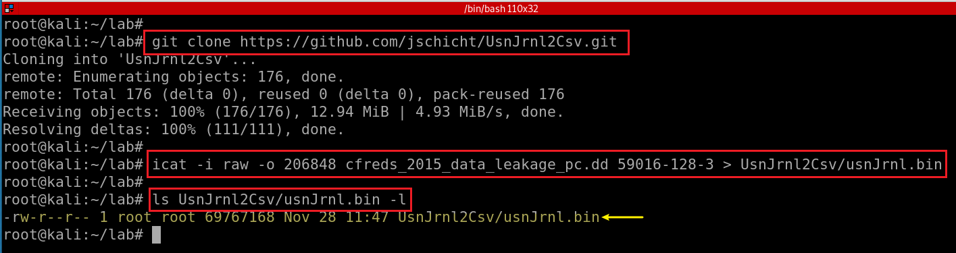
Scenario 1
Install UsnJrnl2Csv tool
Notes:
git clone https://github.com/jschicht/UsnJrnl2Csv.git
icat -i raw -o 206848 cfreds_2015_data_leakage_pc.dd 59016-128-3 > UsnJrnl2Csv/usnJrnl.bin

Slide 35
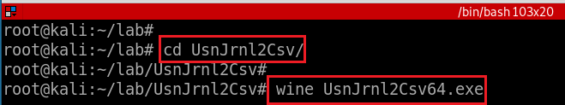
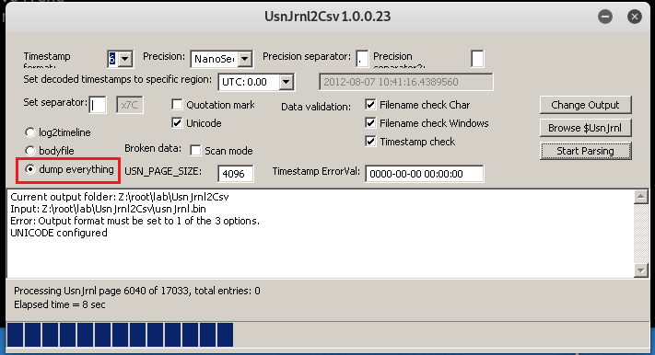

Run UsnJrnl2.exe to covert UsnJrnl.bin to .csv
Set configuration: Browser to usnJrnl.bin
Issue of using usnJrnl.bin extracted from icat
$J may be sparse, which would mean parts of the data is just 00's.
This may be a significant portion of the total data, and most tools will extract this data stream to its full size (which is annoying and a huge waste of disk space).
Consider using the tool https://github.com/jschicht/ExtractUsnJrnl
1.inputs:usnJrnl.bin
2.
3
This process might take 25 minutes
https://raw.githubusercontent.com/frankwxu/digital-forensics-lab/main/NIST_Data_Leakage_Case/NIST_Answers/lab_generated_file/UsnJrnl_2021-10-12_12-36-58.zip
Notes:
processed file
https://www.dropbox.com/sh/3lyzpi7vyod0pfs/AADh2b3Tn-mMqWZHB1Uzv9_ma?dl=0
https://ubalt-my.sharepoint.com/:f:/g/personal/id31ga53_ubalt_edu/EoJThlUPE85Hm7592HB5sjIBGo4Ht9drLxt9XnwDdnf3PA?e=4Okj4m

Slide 36
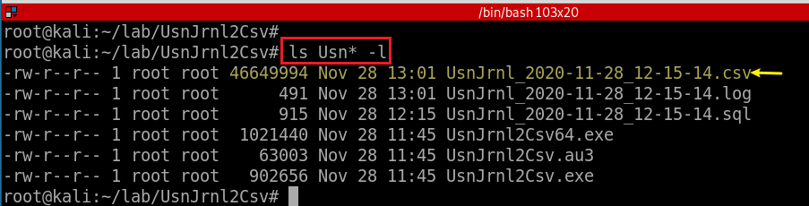
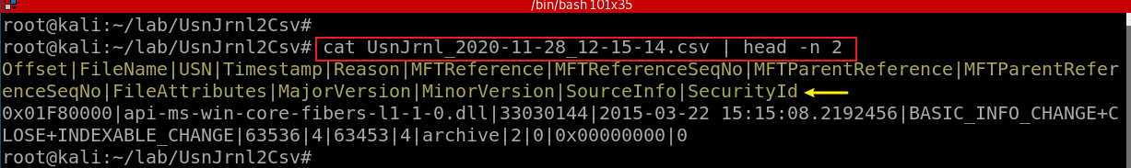
Show the extracted USN journal file

Slide 37
Value | Description
0x01 | A file that is read-only.
0x02 | The file or directory is hidden
0x04 | A file or directory that the operating system uses a part of, or uses exclusively.
0x10 | The handle that identifies a directory.
0x20 | An archive file or directory.
0x40 | This value is reserved for system use
0x80 | A file that does not have other attributes set.
0x100 | A file that is being used for temporary storage.
0x200 | A file that is a sparse file.
0x400 | A file or directory that has an associated reparse point, or a file that is a symbolic link.
0x800 | A file or directory that is compressed
0x1000 | This attribute indicates that the file data is physically moved to offline storage.
0x2000 | The file or directory is not to be indexed by the content indexing service
0x4000 | A file or directory that is encrypted.
0x8000 | The directory or user data stream is configured with integrity (only supported on ReFS volumes).
0x10000 | This value is reserved for system use
0x20000 | The user data stream not to be read by the background data integrity scanner (AKA scrubber).
Notes:
http://forensicinsight.org/wp-content/uploads/2013/07/F-INSIGHT-Advanced-UsnJrnl-Forensics-English.pdf

Slide 38
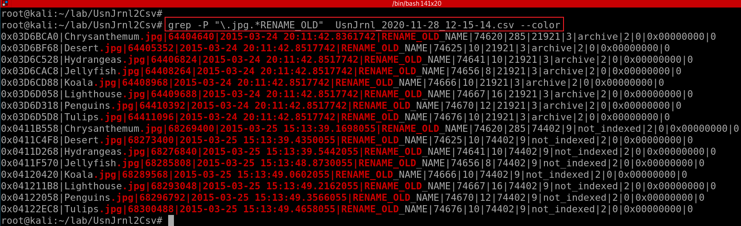
the name is confusing: it is MFT entry ID/inode
Offset|FileName|USN|Timestamp|Reason|MFTReference|MFTReferenceSeqNo|MFTParentReference|MFTParentReferenceSeqNo|FileAttributes|MajorVersion|MinorVersion|SourceInfo|SecurityId
Only show “RENAME_OLD” information of any .jpg files
Timestamps are written UTC 0.00 by default. You have to configure it.
With NTFS journal file only, it may be hard to find full paths.
(+ $MFT for identifying full paths of files)
You can consider the Registry ShellBags for further information.
Notes:
grep -P "\.jpg.*RENAME_OLD" UsnJrnl_2020-11-28_12-15-14.csv --color

Slide 39
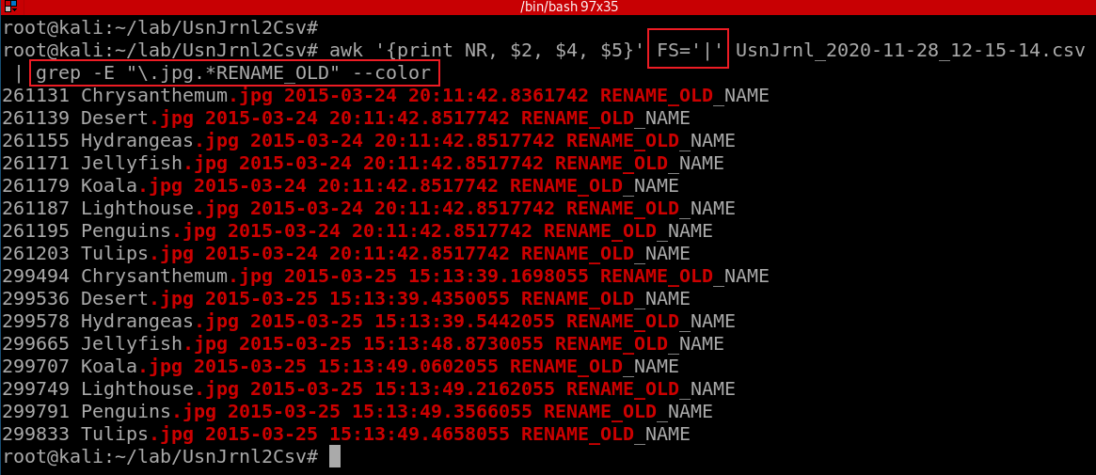
Offset|FileName|USN|Timestamp|Reason|MFTReference|MFTReferenceSeqNo|MFTParentReference|MFTParentReferenceSeqNo|FileAttributes|MajorVersion|MinorVersion|SourceInfo|SecurityId
Only show “RENAME_OLD” information of any .jpg files. Only show three columns, FileName, Timestamp, Reason
How to find the new file name?

Slide 40
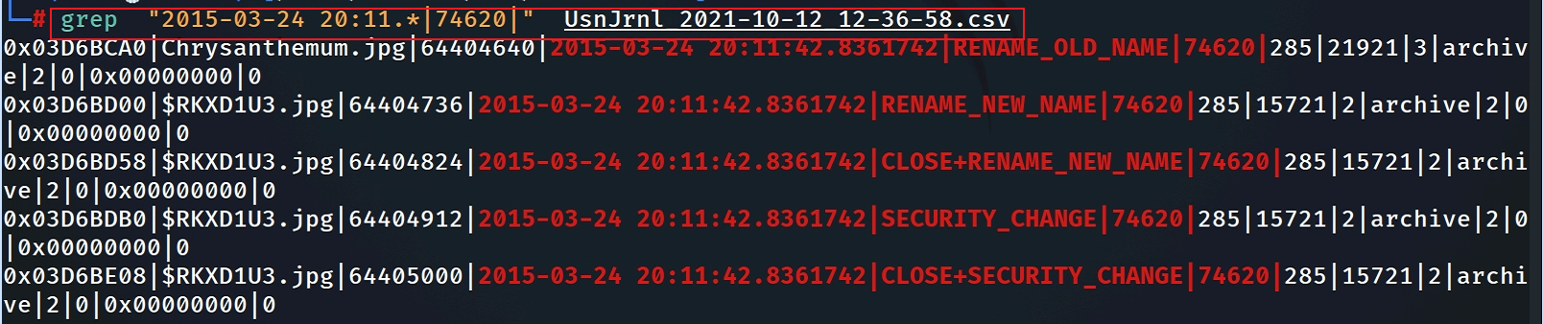
Show what has happened around a specific time with the same MFT reference #

Slide 41
Notes: USN and malware infection
The use of the USN change journal can also be useful in identifying activity that occurs during a malware infection. For example, in some cases, malware may create a downloader, use that to download another bit of malware, and then delete the original downloader. The USN change journal can help you identify that activity, even if the MFT record for the original downloader has been reused and overwritten.
Notes:
http://windowsir.blogspot.com/2014/07/file-system-ops-effects-on-mft-records.html
could be a research topic

Slide 42
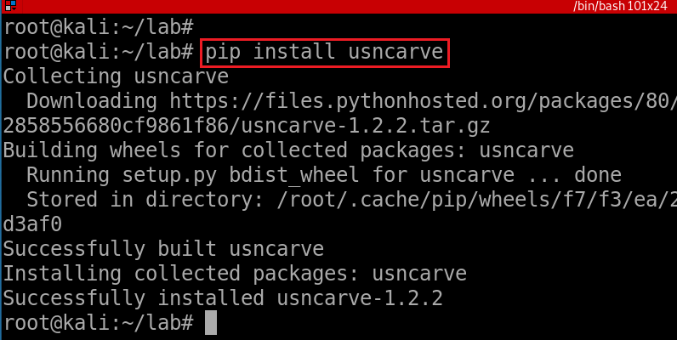
Scenario 2
Install usncarve tool (note we have changed the path)
Notes:
pip install usncarve

Slide 43
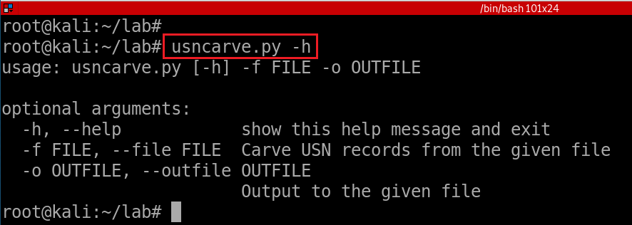
Verify installation
Notes:
usncarve.py -h

Slide 44
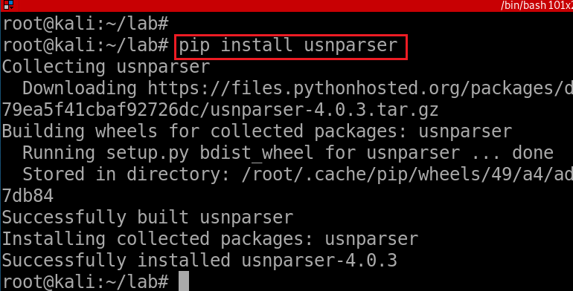
Install usnparser tool
Install via pip
Notes:
pip install usnparser

Slide 45
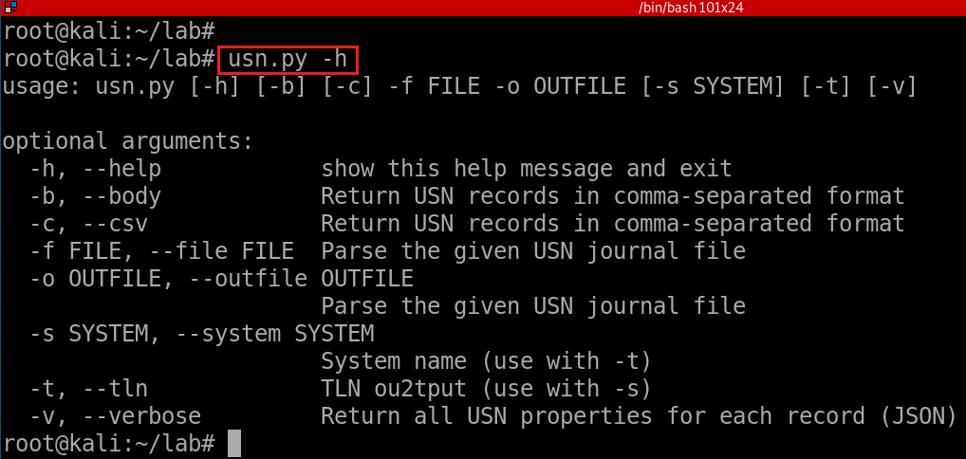
Verify installation
Notes:
usn.py -h

Slide 46
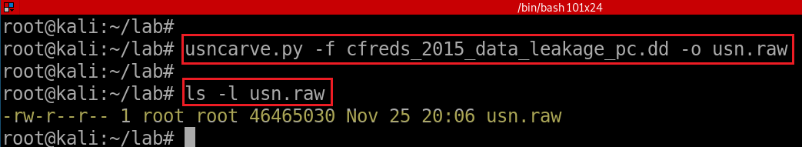
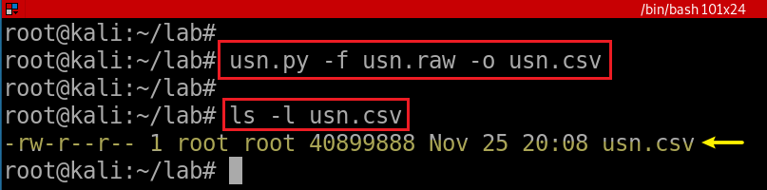
usncarve.py -f input file -o output file
usn.py -f input file -o output file
Notes:
usncarve.py -f cfreds_2015_data_leakage_pc.dd -o usn.raw
usn.py -f usn.raw -o usn.csv

Slide 47
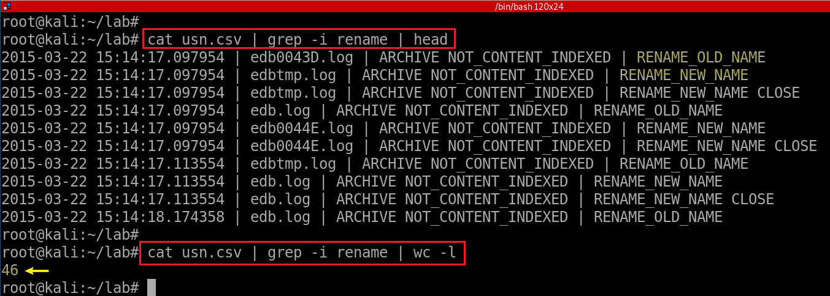
View renamed files
- NTFS journal file analysis (→ $UsnJrnl)
- \$Extend\$UsnJrnl·$J (+ $MFT for identifying full paths of files)
- You can also consider the Windows Search database. (See Questions 46)

Slide 48
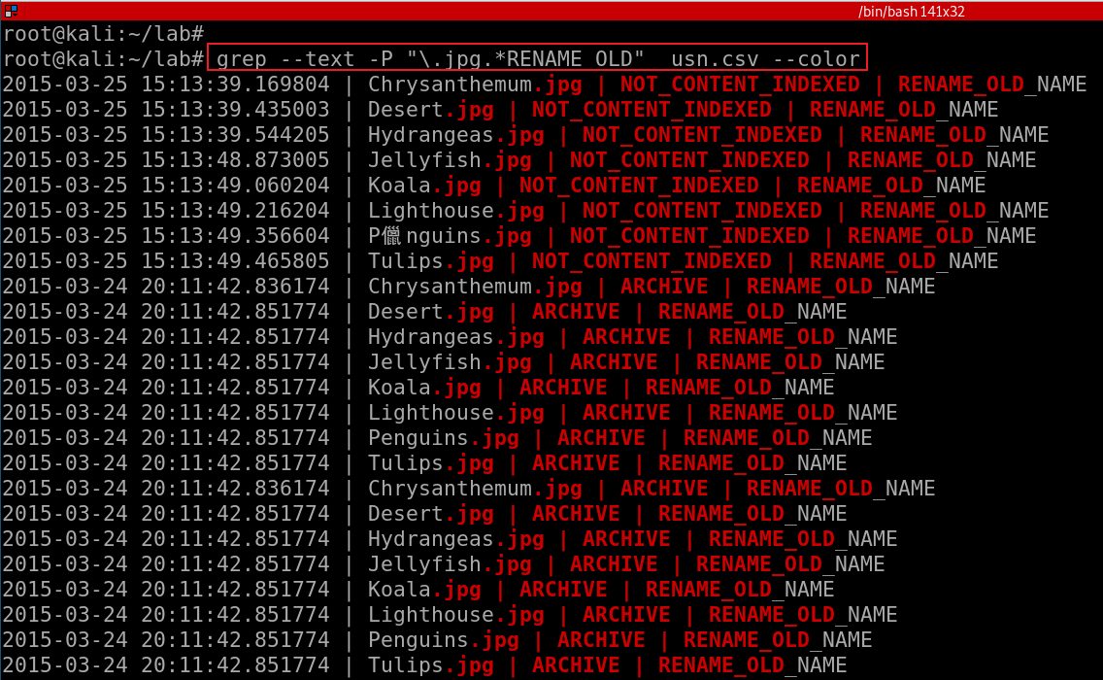
--text: equivalent to --binary-files=text
Notes:
grep --text -P "\.jpg.*RENAME_OLD" usn.csv –color
Without --text, it will show “binary file .cvs matches”

Slide 49
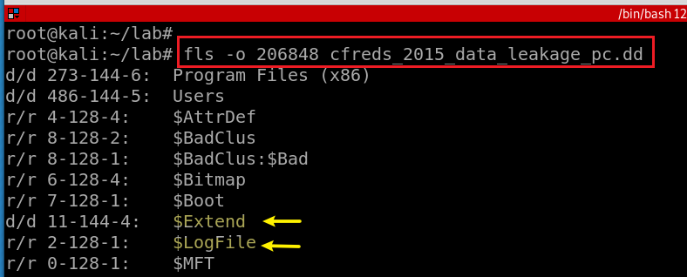
USN Journal vs. NTFS file system journaling
NTFS file journaling uses the NTFS Log ($LogFile) to record metadata changes to the volume.
  USN Journal only has change flags, no metadata.
NTFS file journaling ensures that its complex internal data structures will remain consistent in case of
  system crashes or data moves performed by the defragmentation API,
NTFS file journaling allows easy rollback of uncommitted changes to these critical data structures when the volume is remounted.

