Slide 1
Computer System Introduction

Slide 2
Overview
Computer systems
How do computers work?
Why computer forensics is hard?
Hard disk drives
Calculate disk partitions
PC boot process
File Systems

Slide 3
Computer systems

Slide 4
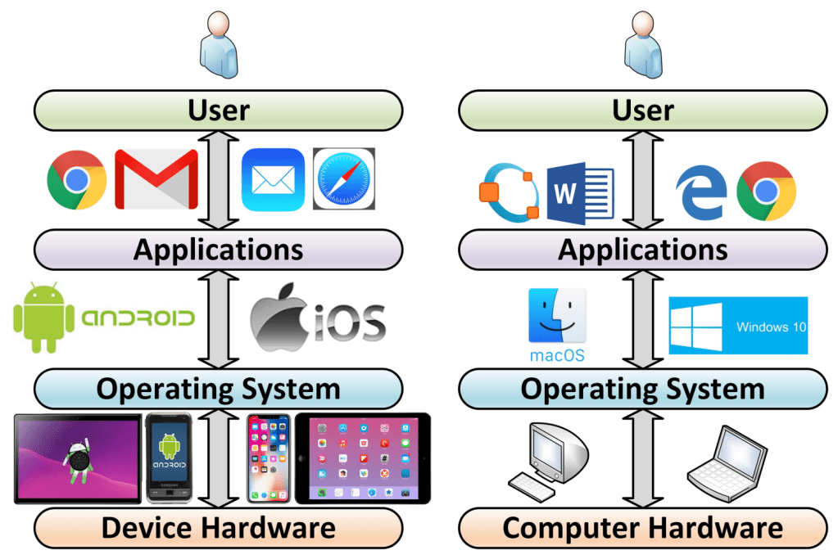
Layers of a computer system
Evidence is generated from each layer
User activities= Applications+ OS+ Disk/Memory
https://windsongtraining.ca/the-technology-layer-cake-users-apps-os-and-hardware/

Slide 5
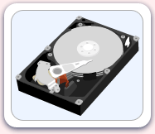
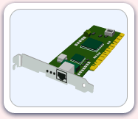
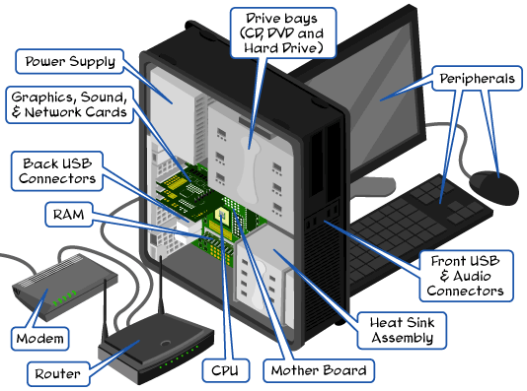
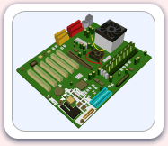
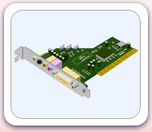
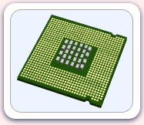
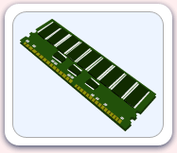
Parts of the computer
http://www.carnegiecyberacademy.com/facultyPages/computer/computers.html

Slide 6
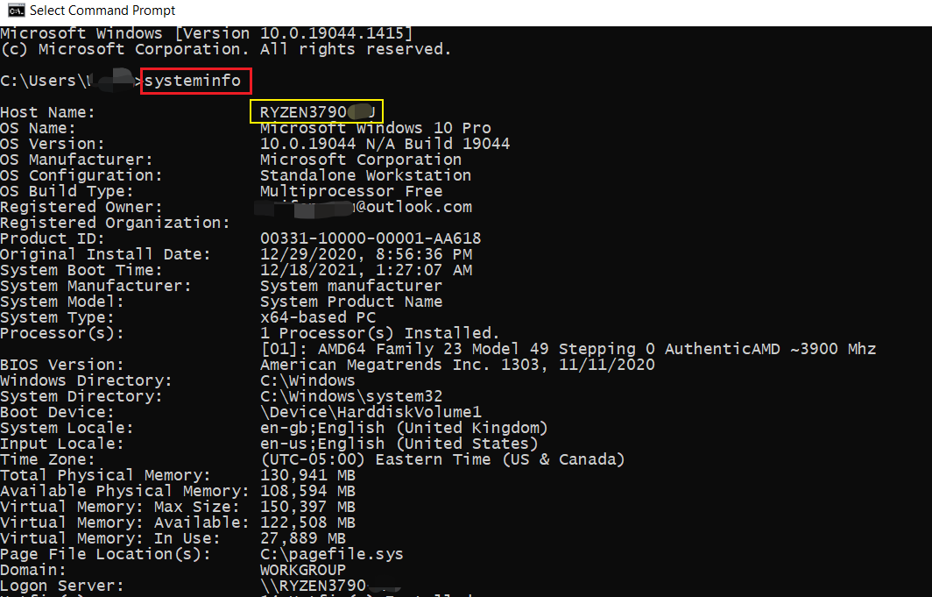
Check system specification

Slide 7
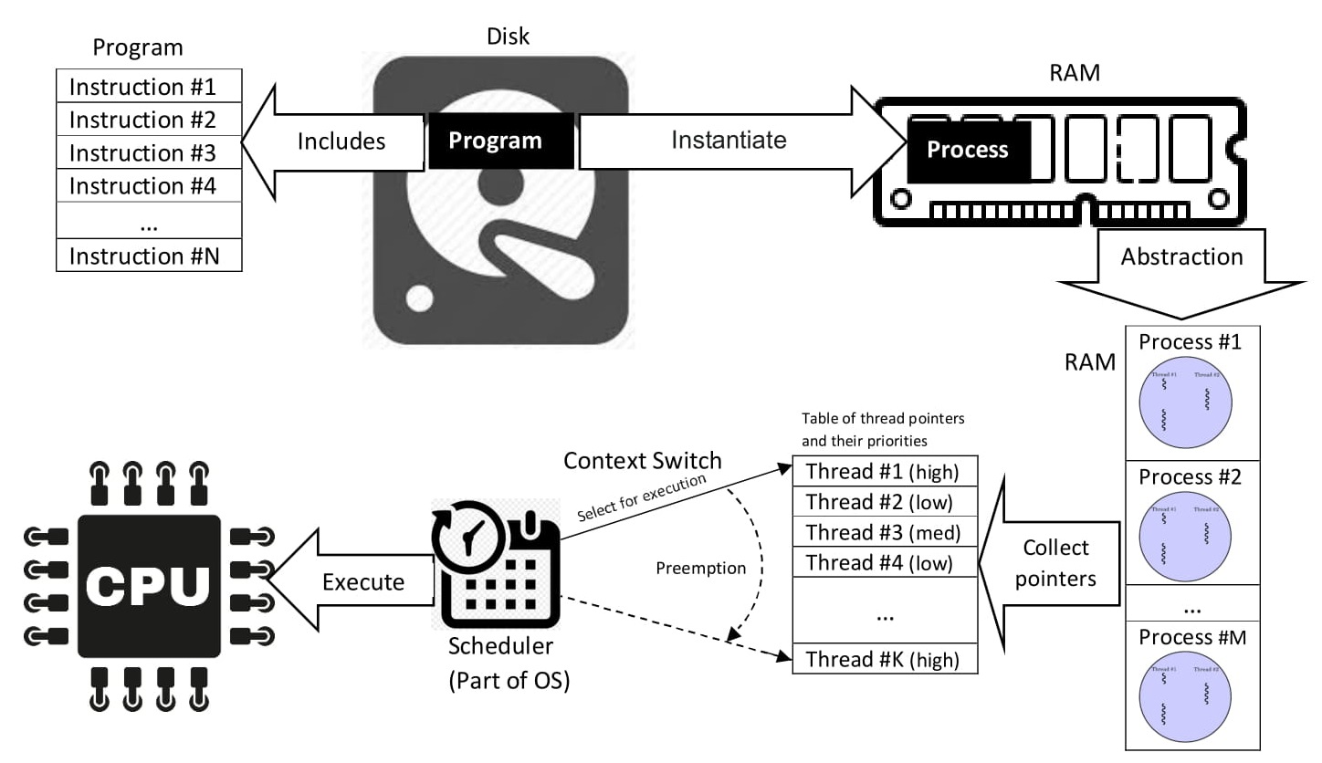
How do computers work?
Program vs. Process vs. Thread
a process is the instance of a computer program
a process may be made up of multiple threads of execution that execute instructions concurrently.
Malware Analysis
https://en.wikipedia.org/wiki/Process_(computing)

Slide 8
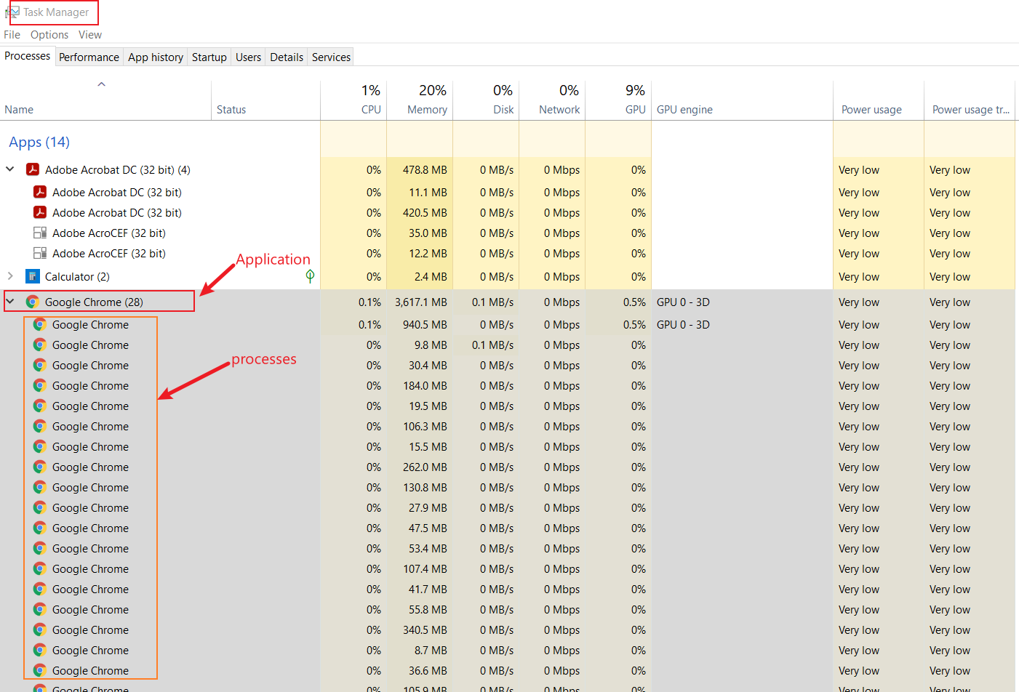

Slide 9
Why computer forensics is hard?
Technical difficulties
OS: different OS types, versions, complexity of OS
Applications: many applications, different version of applications
Hardware: CPU, GPU, camera
Ever-advancing technology: e.g., database changes, SSD vs HDD, EV car
A complex and connected world
IoT devices: Alex, Camera, Fitbit, Smart Phone
Information explosion
too much information, different type of evidence
how to collect, analyze, validate them systematically?
Computer forensics is NOT only a computer science discipline
criminal justice, law, computer science, security

Slide 10
Low level Analysis: malware
OS logs, Application logs,
Memory forensics
CPU execution analysis
Dynamical Analysis:
Application PID

Slide 11
Hard disk drives

Slide 12
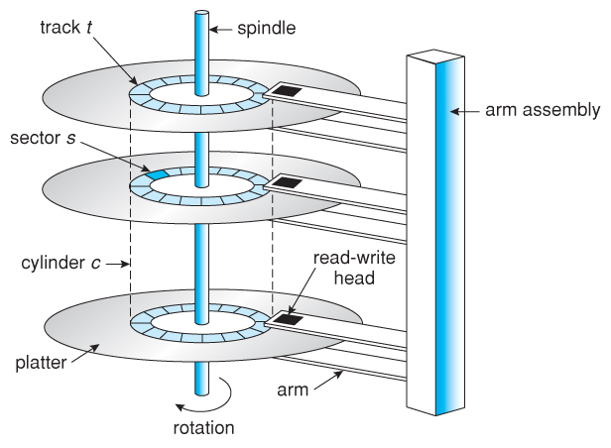
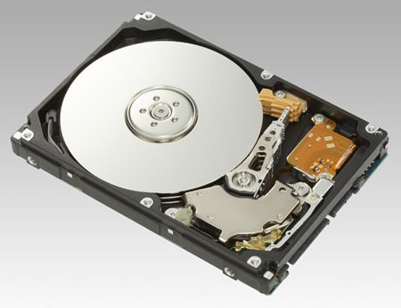
Understand disk drives
https://regmedia.co.uk/2006/12/12/fujitsu_300gb_1.jpg
Abraham Silberschatz, Greg Gagne, and Peter Baer Galvin, "Operating System Concepts, Ninth Edition "

Slide 13
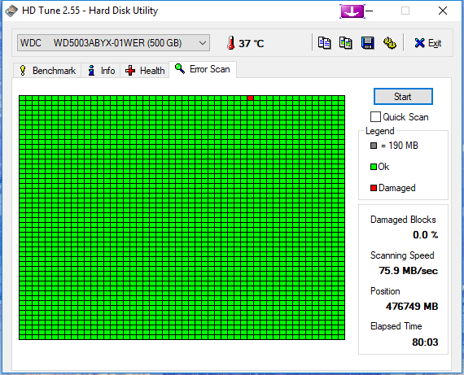
What is a disk sector?
The sector is the minimum storage unit of a hard drive.
Files occupy an integral number of sectors regardless of the file's actual size.
# bytes per sector =512 Bytes
one byte = one character (ASCII)
https://i.imgur.com/26BalHW.png

Slide 14
Calculate the total sectors
#sectors per track
# tracks (cylinders)
# headers
#Size of disk=# tracks (C) x #Heads x #Sectors per track (CHS)
no of sectors: 400
no of heads: 12
cylinders: 17000
=81600000 sectors

Slide 15
Calculate the size of a disk
1024 Bytes=1K
1024 K=1M
1024 M=1G
How to compute the size of the disk
81600000 sectors * 512 bytes= 41779200000 bytes
=40800000 KB
=39843.75MB
=38.91G

Slide 16
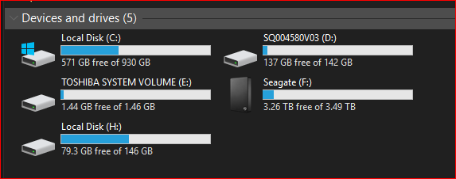
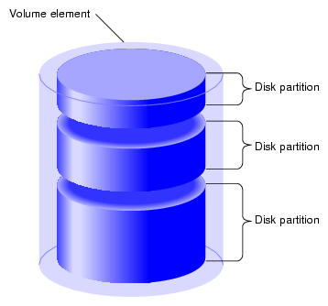
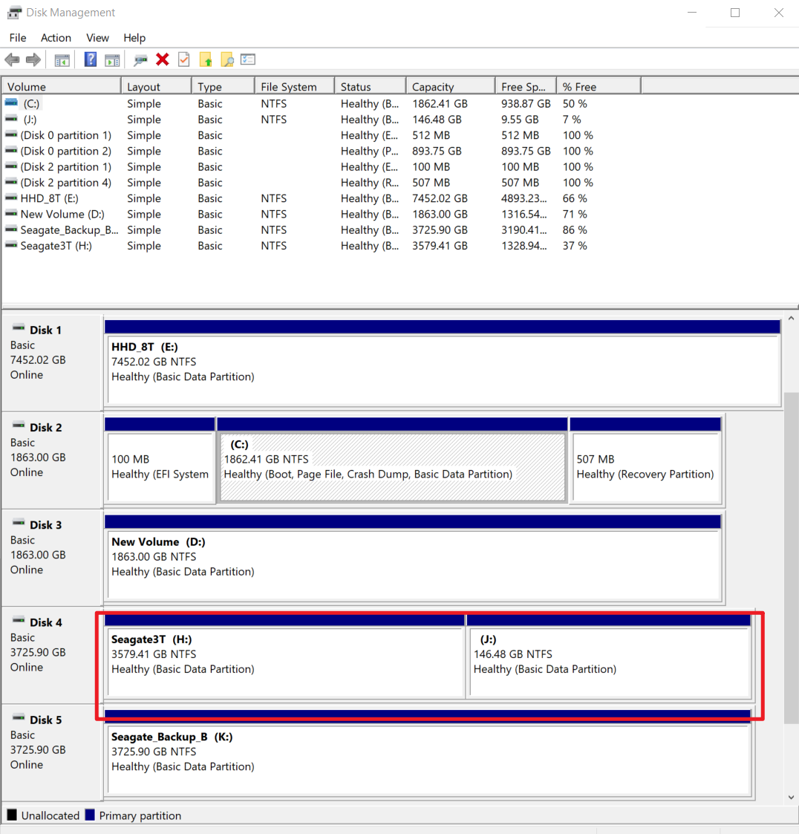
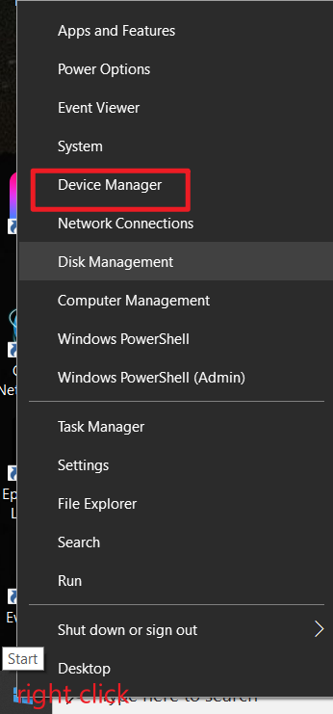
What is a partition
https://www.maketecheasier.com/assets/uploads/2012/05/partitions-partition-diagram.png

Slide 17
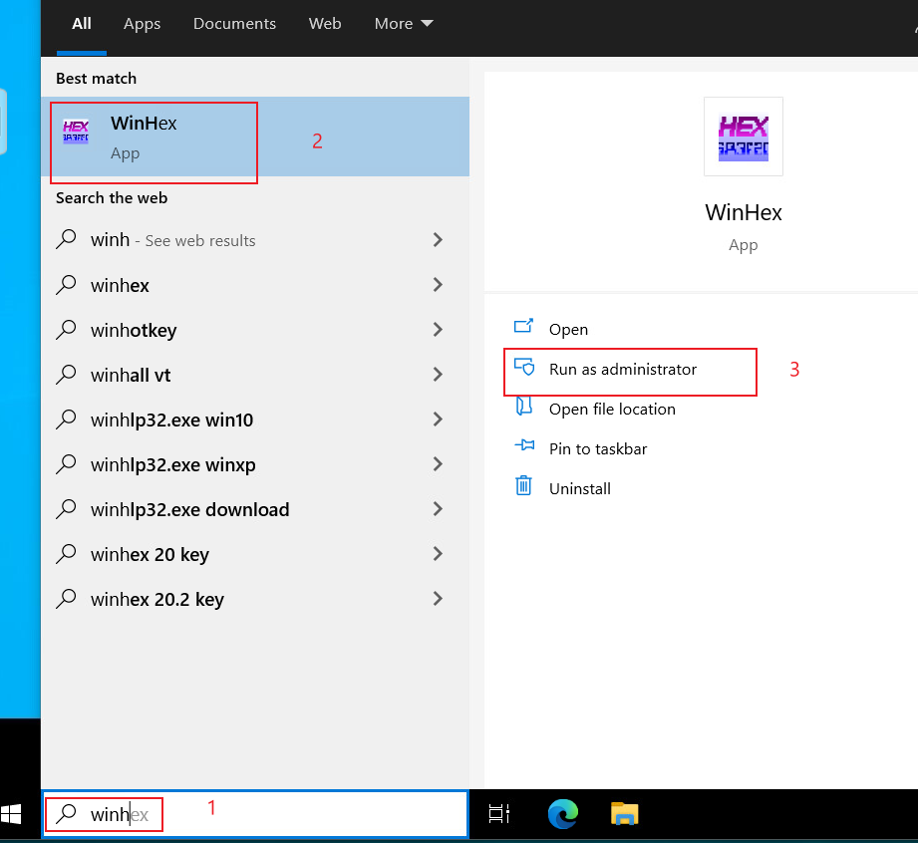
Calculate the size of partitions
Open Winhex

Slide 18
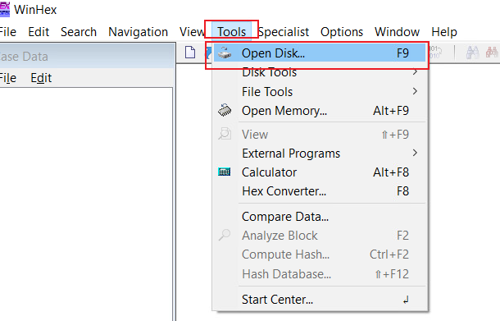
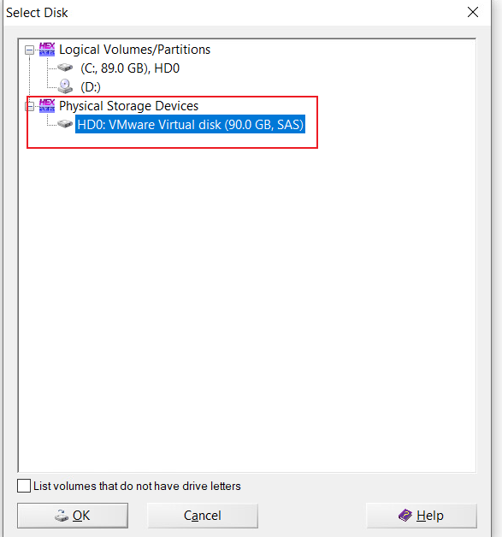
List Physical Storage Devices

Slide 19
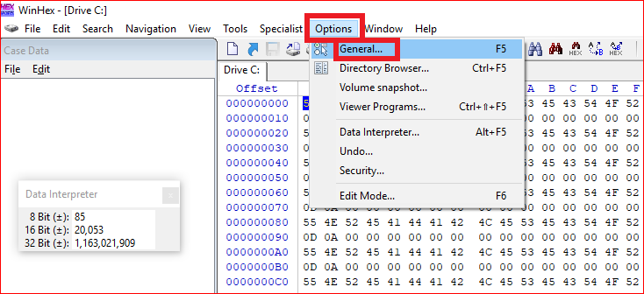
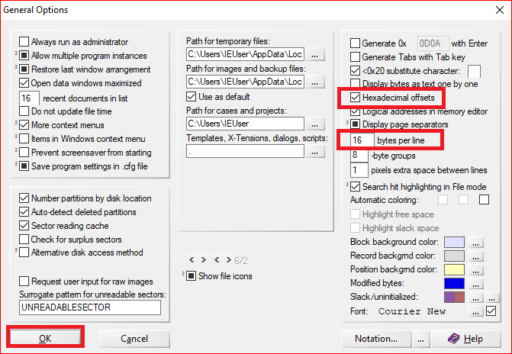
Winhex option setting

Slide 20
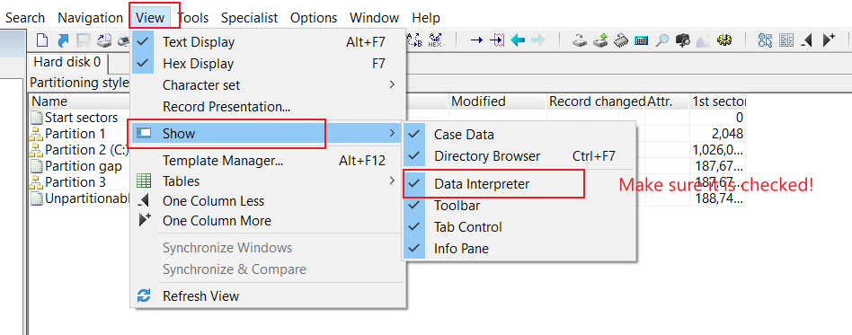
Enable Data Interpreter

Slide 21
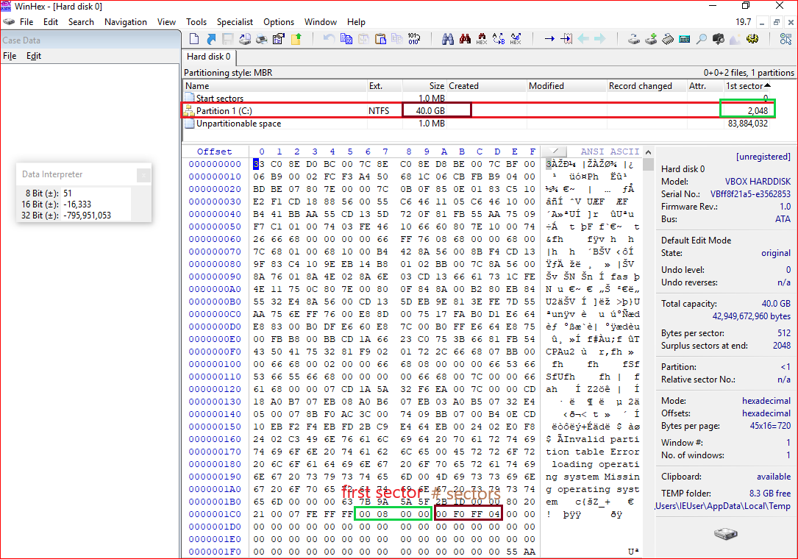
Master Boot Record:
1980s
Allow up to a maximum of 2 TB
Show the position of
the first sector

Slide 22
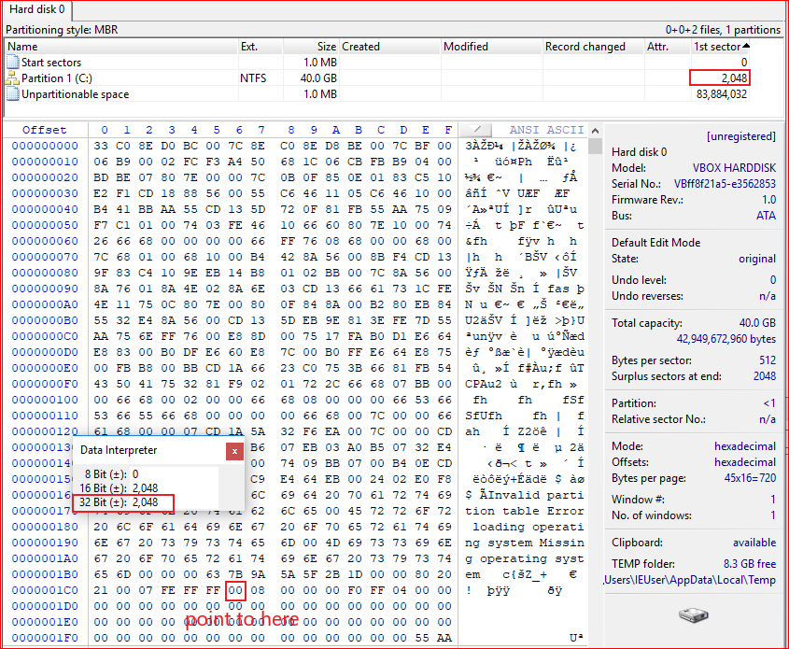
Covert Hex to decimal
(00000800)₁₆=(2048)₁₀

Slide 23
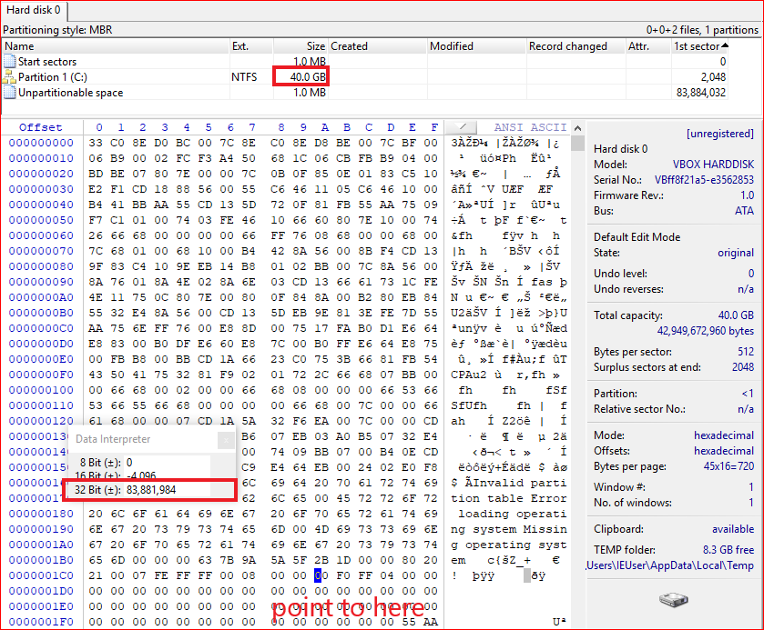
Show the size of the
total sectors in decimal
ox01CA
Compute the partition
size
83881984 sectors *512 bytes per sector = 39.99 G
Notes:
1024000*512/1024/1024=500
echo $((16#04fff000))

Slide 24
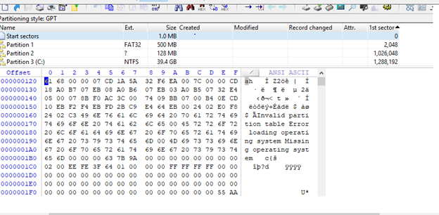
GUID Partition Table: GPT

Slide 25
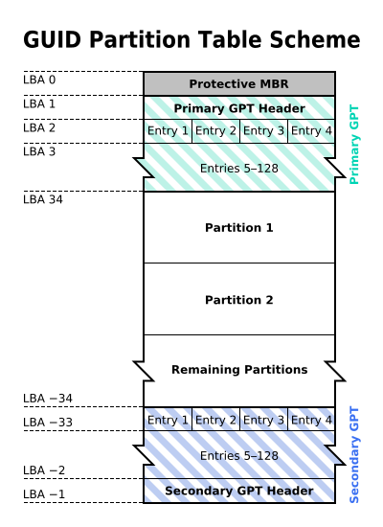
Why GPT
MBR: 1980s
Allow up to a maximum of 2 TB
GPT: maximum size is 9.4 ZB
1ZB=1024TB
logical block addressing (LBA)
Replace CHS
By The original uploader was Kbolino at English Wikipedia. - Transferred from en.wikipedia to Commons. Transfer was stated to be made by User:Kbolino., CC BY-SA 2.5, https://commons.wikimedia.org/w/index.php?curid=3036588

Slide 26
backward compatibility for MBR
Describe each partition
Backup of the primary GPT header and entries

Slide 27
Starting LBA of array of partition entries (always 2 in primary copy)
Why 0x400?

Slide 28
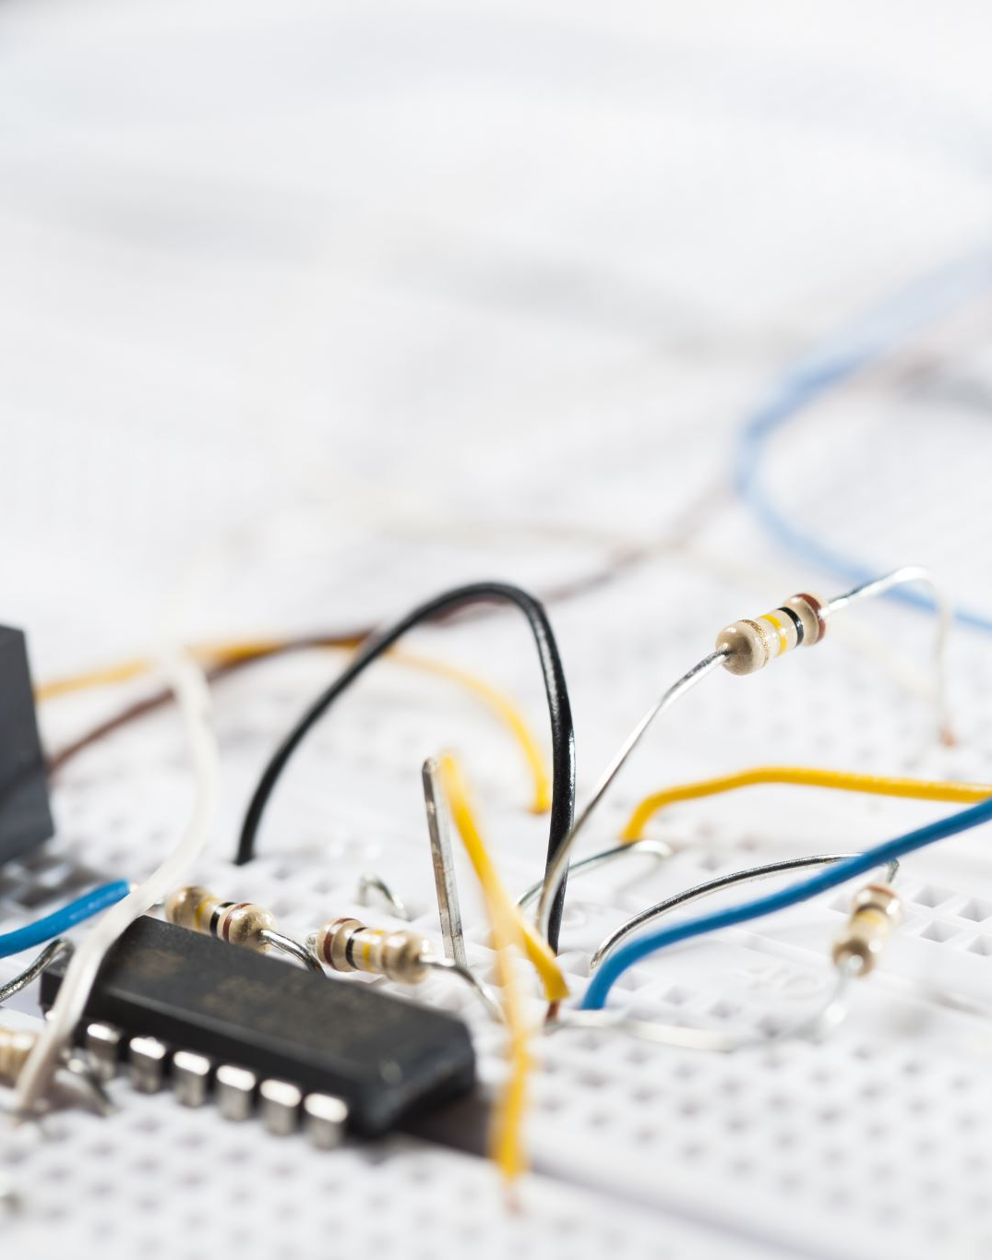
PC booting process

Slide 29
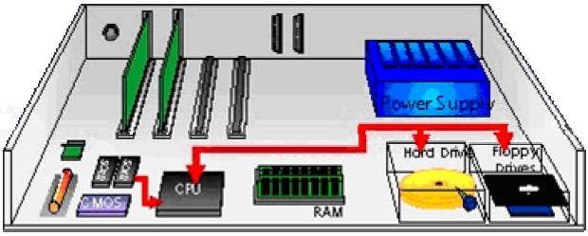
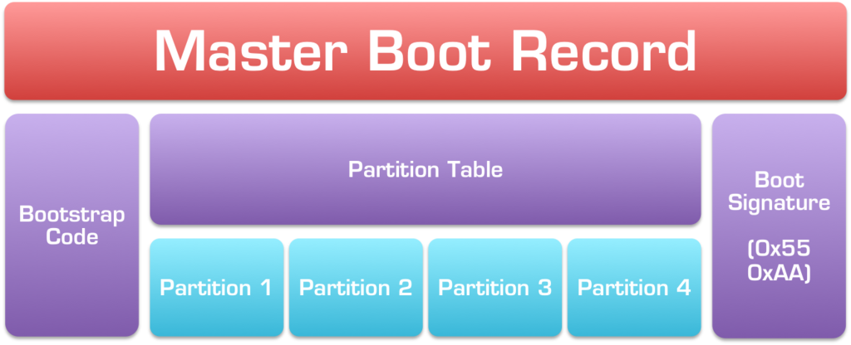
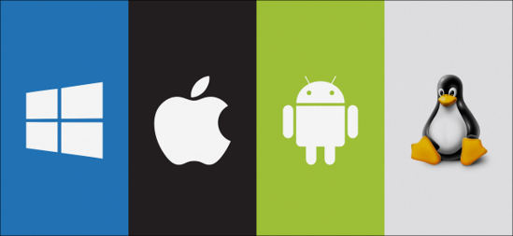
Booting a computer
Power up; computer runs power-on self-test (POST)
Boot sequence governed by (Basic input/output system) BIOS ROM
BIOS parameters stored in CMOS
Control passes to the Master Boot Record (MBR)
MBR points to boot record of selected operating system
“system” volume = pre-load OS
"boot" volume = load OS
Operating system takes control
Jump to bootable partition
http://www.c-jump.com/CIS24/Slides/Booting/Booting.html
https://i2.wp.com/neosmart.net/wiki/wp-content/uploads/sites/5/2015/01/Master-Boot-Record.png?resize=1024%2C416&ssl=1

Slide 30
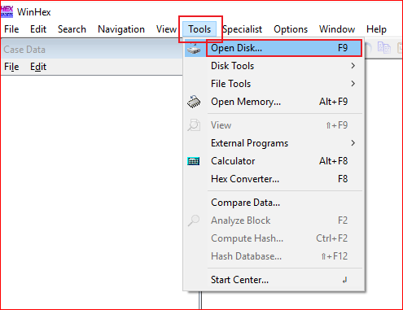
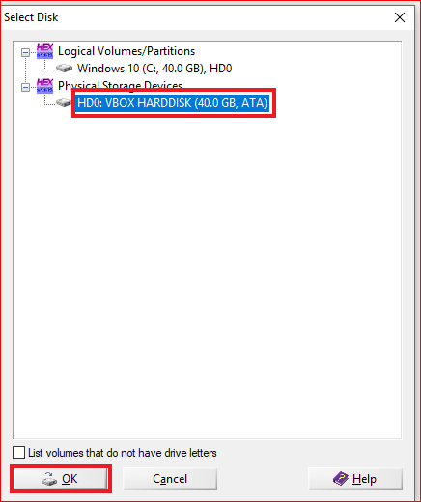
Open Physical Devices

Slide 31
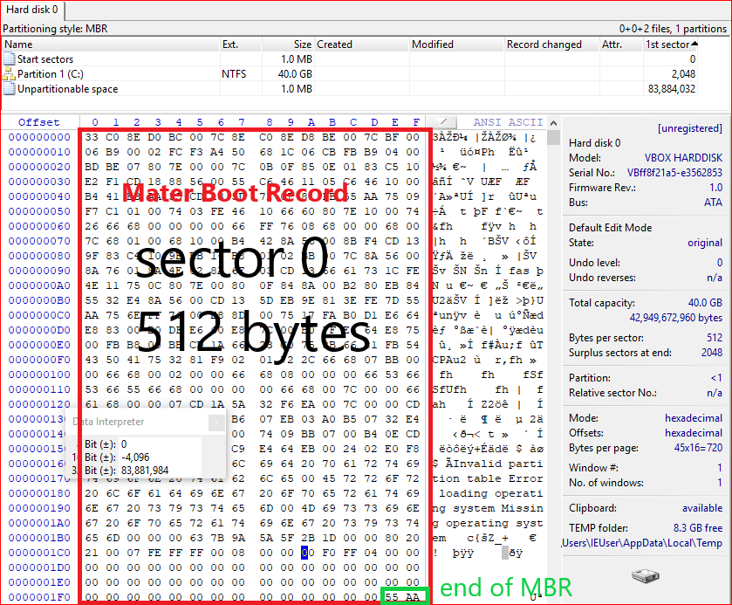
Show MBR

Slide 32
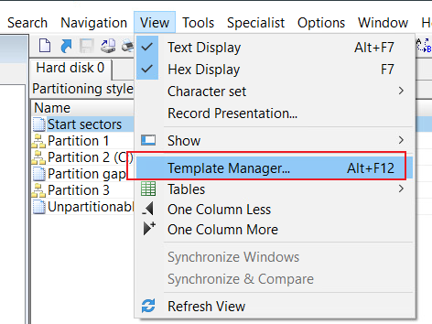
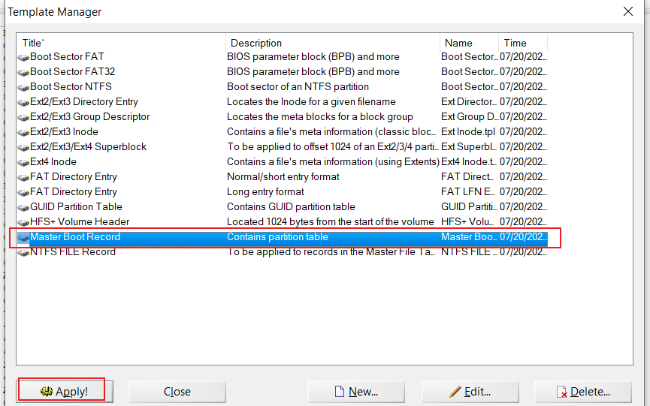
Show MBR details using template

Slide 33
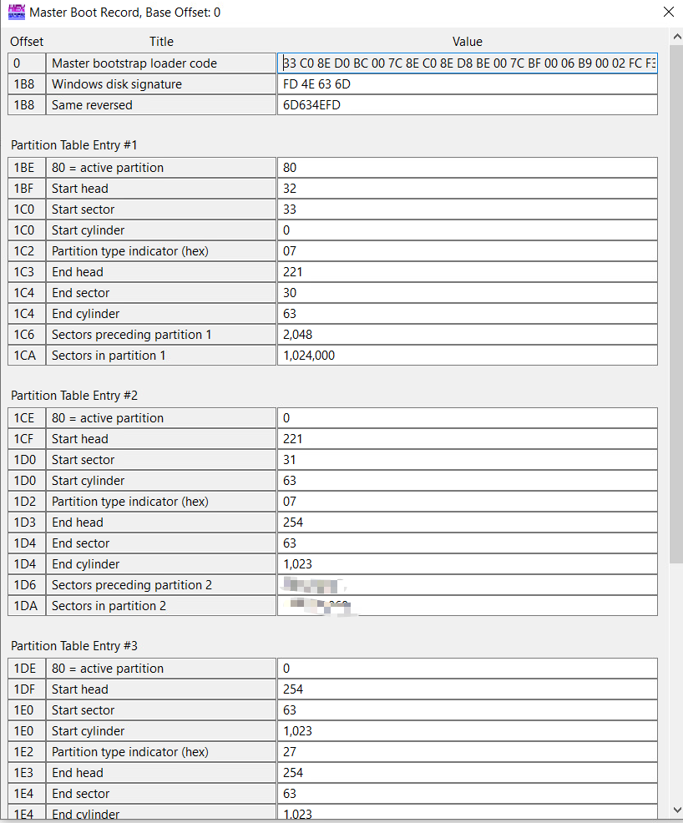
Another example of MBR details using template, which contains multiple partitions

Slide 34
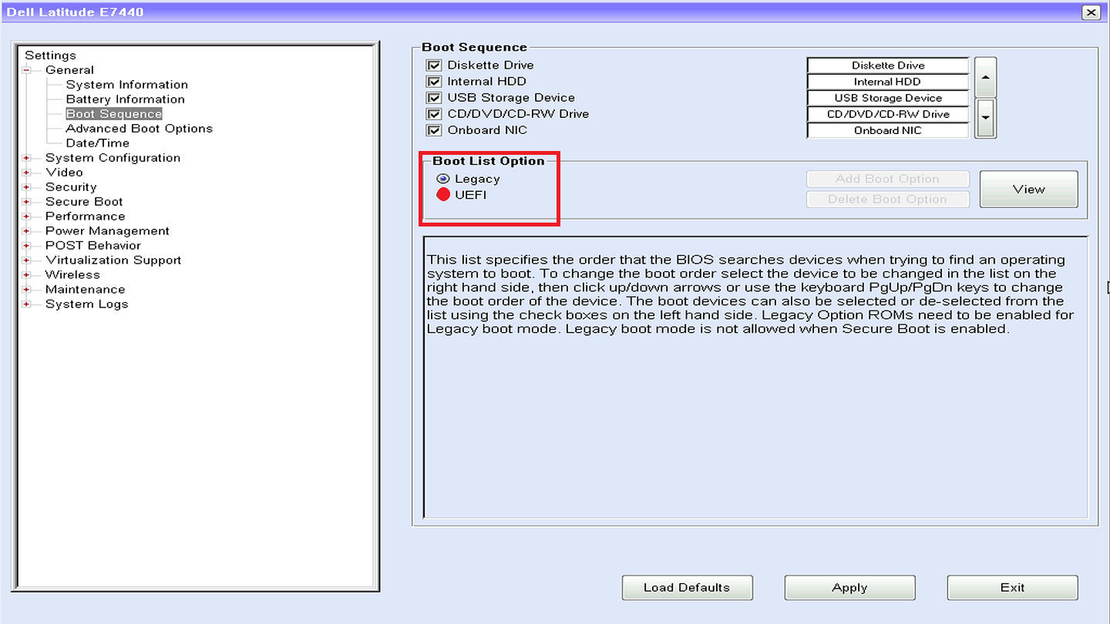

Slide 35
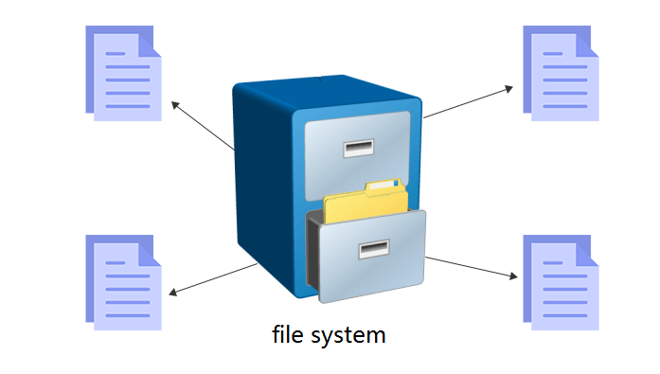
File Systems

Slide 36
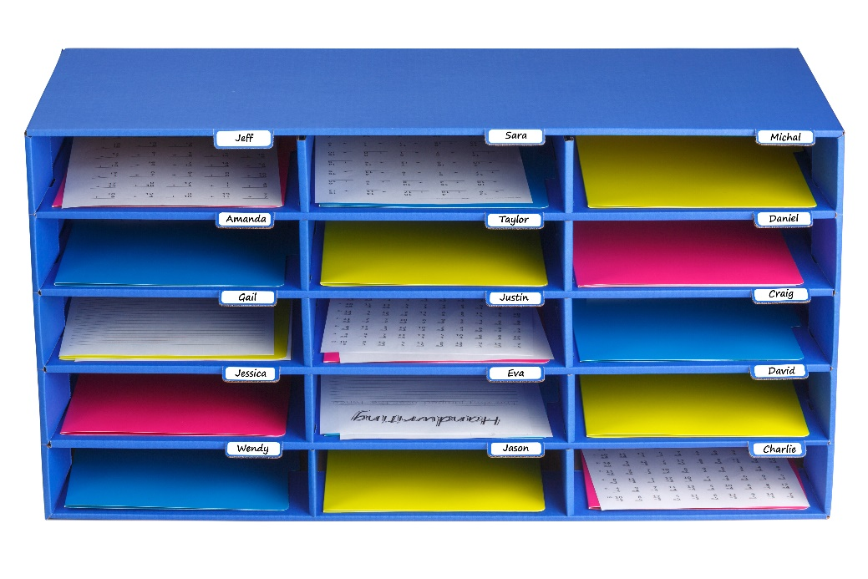
Files and File Systems
A file
is a collection of correlated information
which is recorded on secondary or non-volatile storage like magnetic disks, optical disks, and tapes.
A file system
defines how files are named, stored, and retrieved from a storage device.

Slide 37
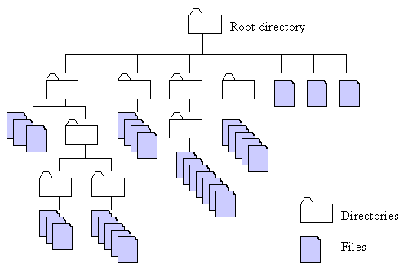
http://home.easy-key.info/images/stories/file_structure.gif

Slide 38
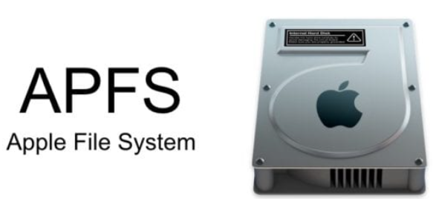
File systems and operating systems
Unix and Unix-like operating systems
Linux: XFS, JFS, and btrfs.
Solaris
macOS:
Hierarchical File System (HFS) + : No support for dates beyond February 6, 2040
Microsoft Windows
FAT: File Allocation Table
NTFS: New Technology File System
extended file system

Slide 39
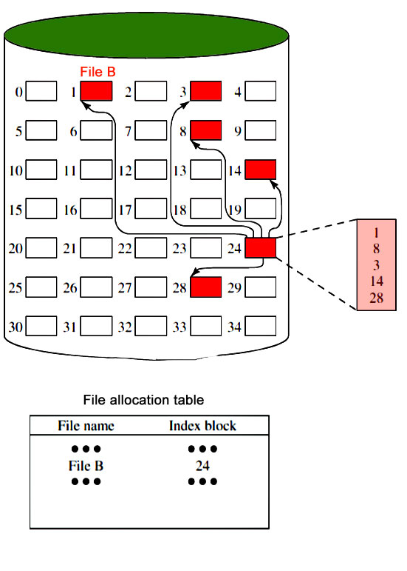
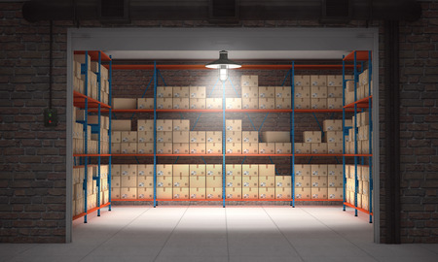
Notes:
https://www.geeksforgeeks.org/file-systems-in-operating-system/

Slide 40
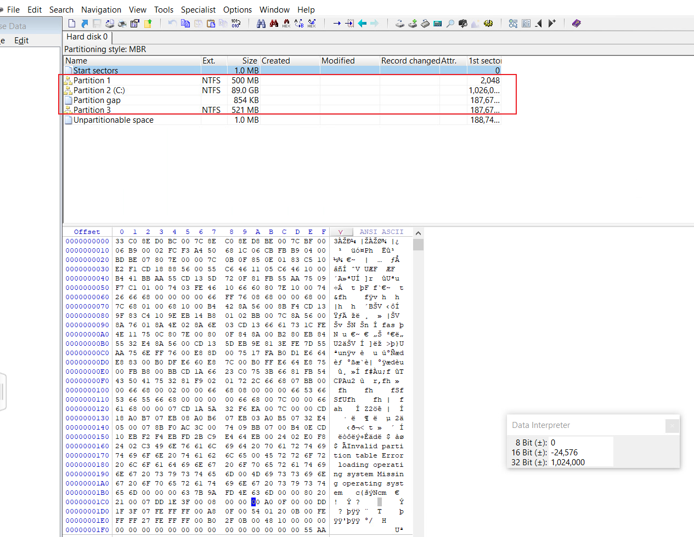
Assignment
Verify the size of the partition 1 and 2
Record your verification process
Requirements:
Without using templates
Compute size in GB
Notes:
ID6, 1026048,186646868

