Slide 1
Investigating iPhone
iOS 13
Notes:
https://digitalcorpora.s3.amazonaws.com/corpora/mobile/android_10/Non-Cellebrite%20Extraction/Pixel%203.zip

Slide 2
Introduction to iOS

Slide 3
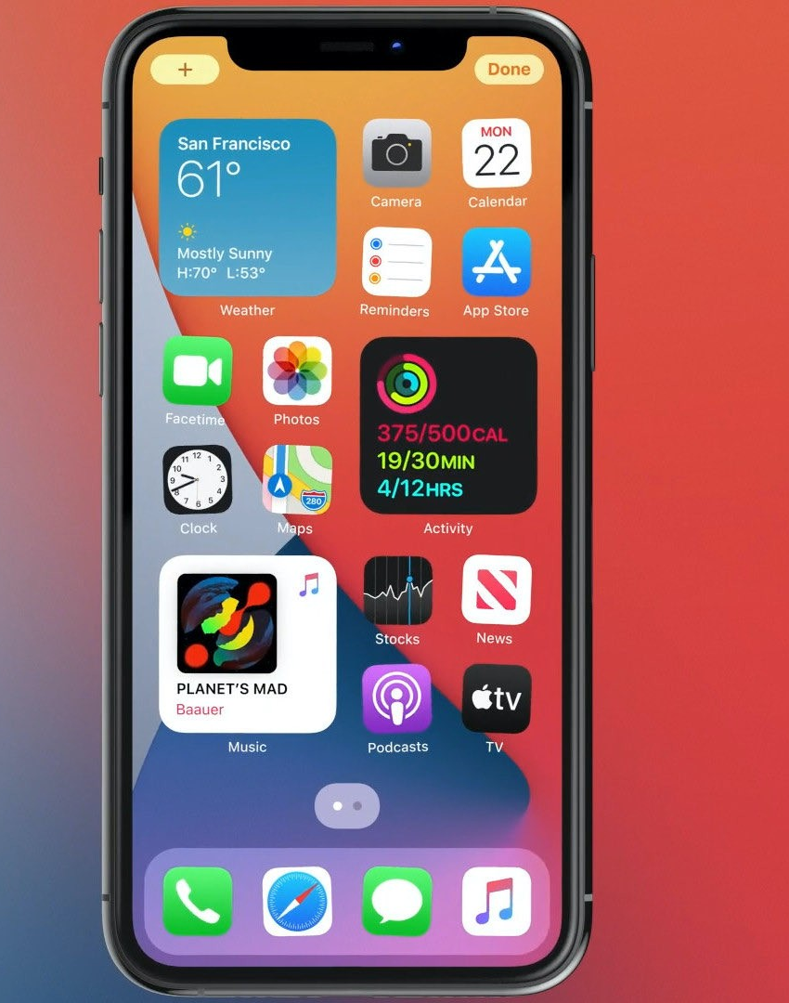
What is iOS?
iOS is a mobile operating system developed by Apple Inc. for iPhones, iPads, and other Apple mobile devices.
  Based on the XNU kernel of Darwin OS
  Was first unveiled in June 2007
XNU is open-source software
  Since XNU is based on the BSD kernel, it is open source.
  Licensed under Open-source initiative.
All iOS devices ship with additional proprietary software pre-installed.
  Including Mail, Maps, TV, Music, FaceTime, Wallet, Health, and more.
Notes:
https://en.wikipedia.org/wiki/Android_(operating_system)
https://en.wikipedia.org/wiki/Google_mobile_services

Slide 4
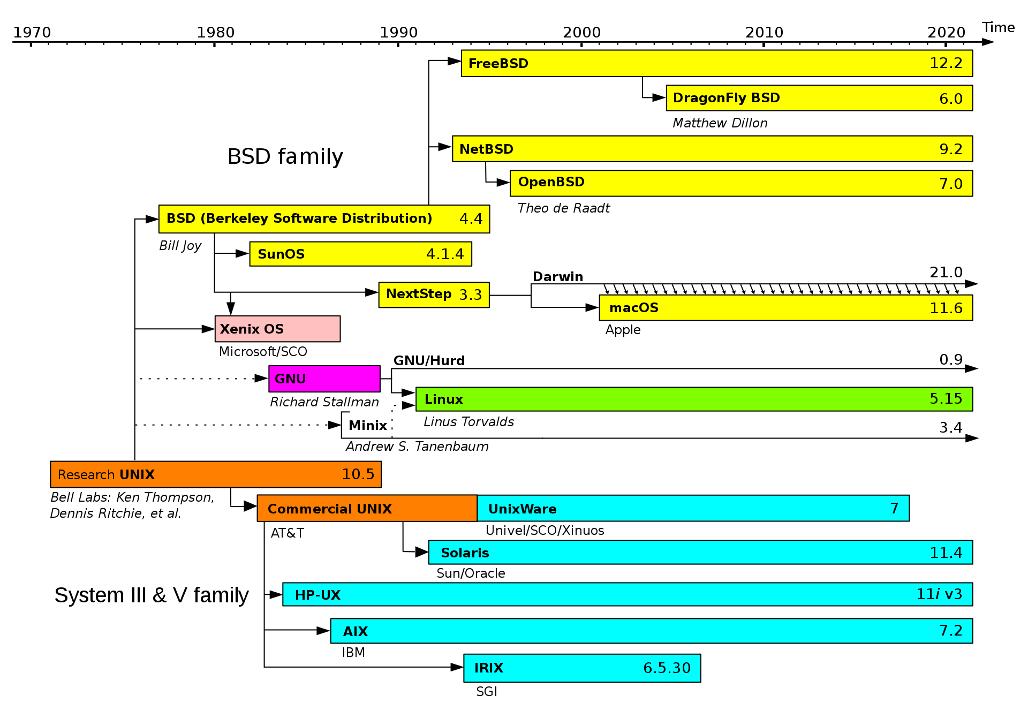
Notes:
https://en.wikipedia.org/wiki/Darwin_(operating_system)#/media/File:Unix_timeline.en.svg

Slide 5
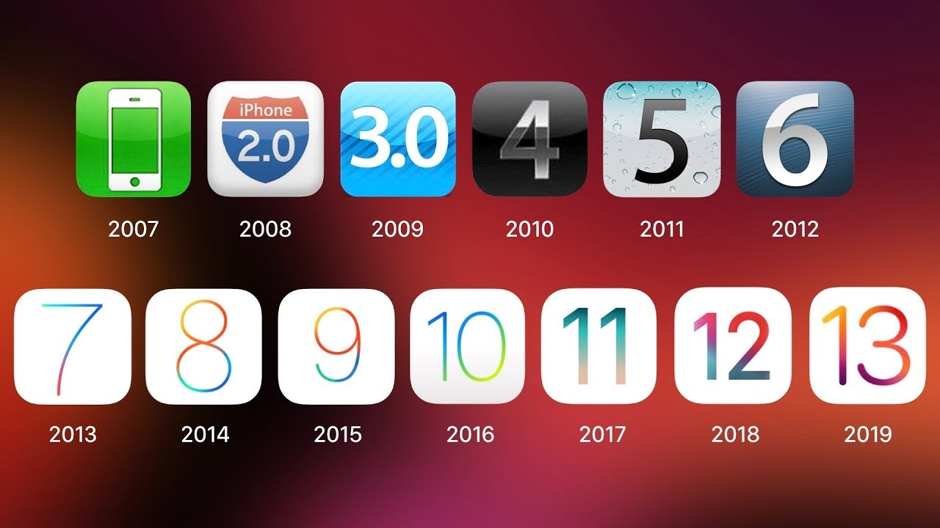
History of iOS

Slide 6
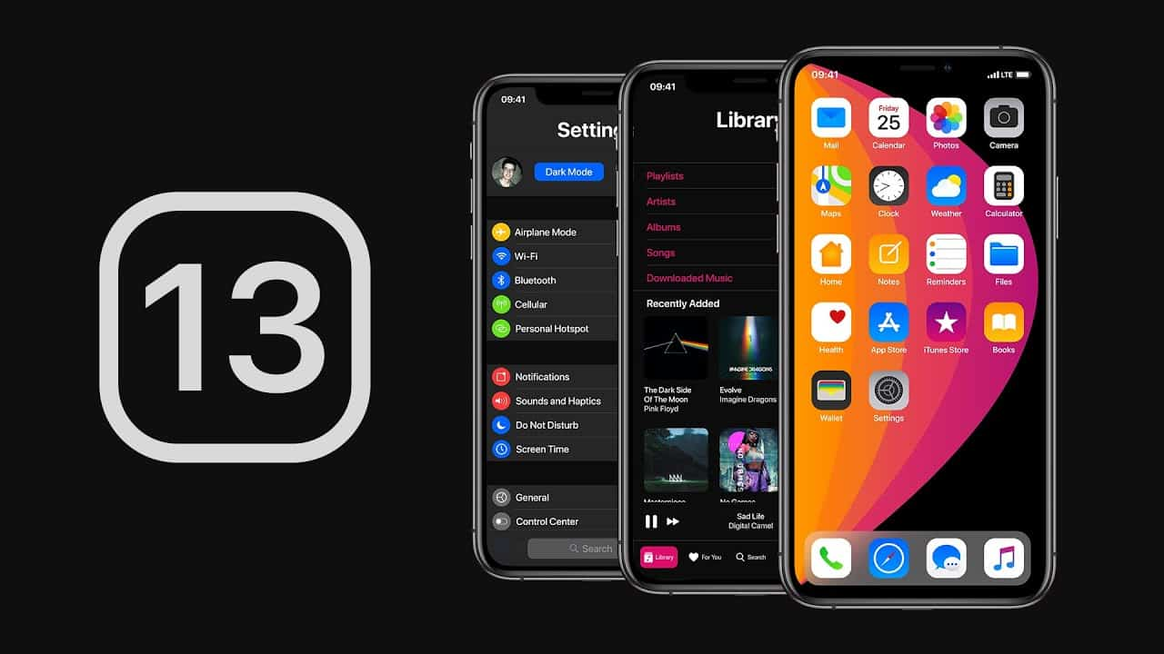
History of iOS 13
Launched in September 2019
The most significant changes revolve around privacy.
  When an app requests access to location, the user chooses whether to grant access whenever they are using the app, never, or only once.
  The user would receive similar prompts for background location access, requests for Bluetooth, or Wi-Fi

Slide 7
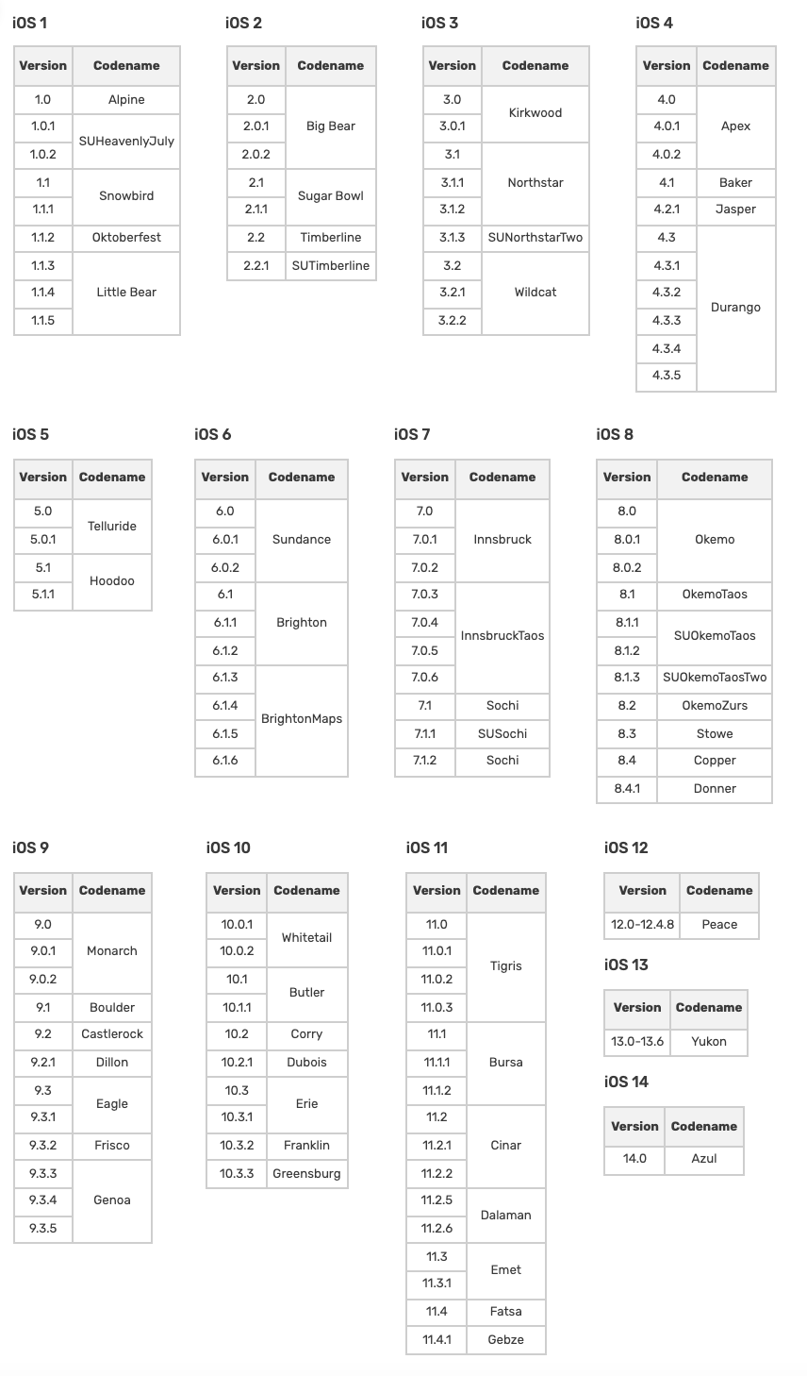
Apple iOS Codenames
Given by Apple during development.
Mostly used for internal secrecy purposes.
Based on Ski Resorts.

Slide 8
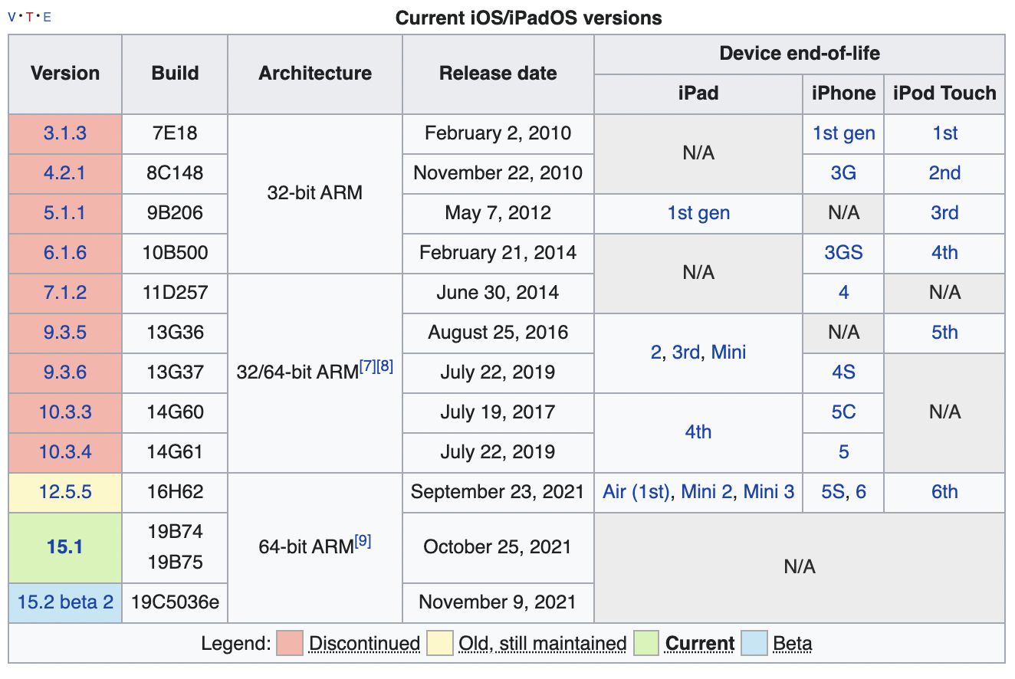
iOS Builds
Apple build numbers have 3 Parts.
  Major version, minor version, daily build version.
    Example: iOS 13.1.3, Build 17A878
  For iOS 13, the Major build number was 17
    Every version of iOS has a Major build number, except iOS 1 which took up Major builds 1-4.
  Minor build version usually changes for each X.1 OS release. Always a Letter, not a number. Goes alphabetically.
    From the example of iOS 13.1.3, Build 17A878 we can assume the A means either iOS 13.0 or 13.1.
  Daily build version goes up numerically when a new build is tested. Most daily builds are not pushed out to the public.
The first shipment of iOS 13.0 was 17A577, which means Apple
made 577 builds of iOS13 before the first copy was shipped
out to users.
Notes:
https://tidbits.com/2020/07/08/how-to-decode-apple-version-and-build-numbers/

Slide 9
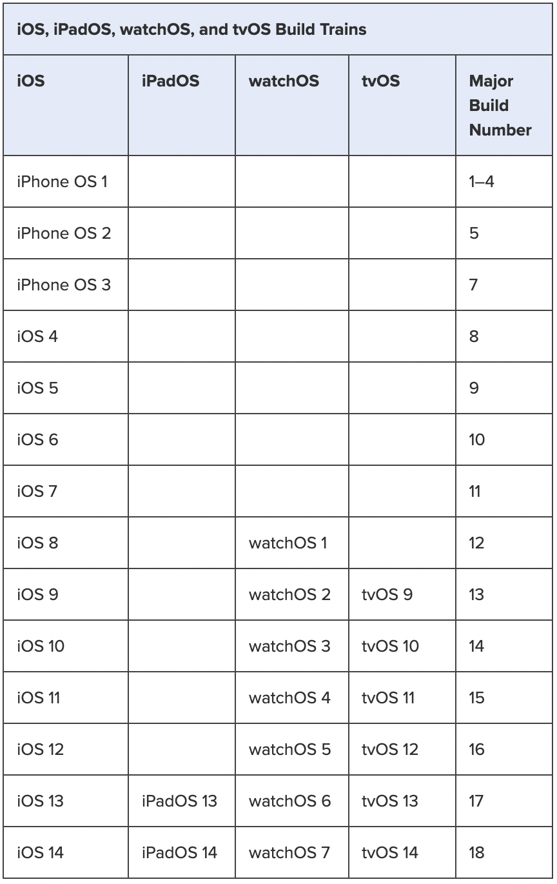
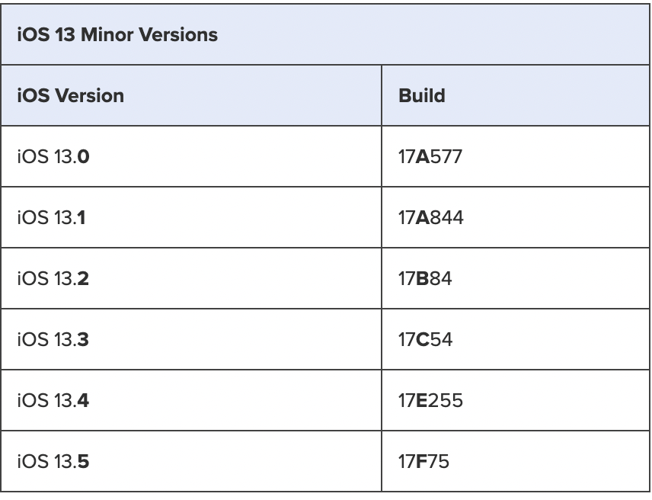
iOS Builds (Continued)
Major Build Numbering:
Minor Build Lettering:
Daily Build Numbering:

Slide 10
Interfacing with iOS

Slide 11

Intro to Interfacing with iOS
In 2007, Steve Jobs introduced the original iPhone. The most notable feature was that the display had a capacitive multi-touch display.
  In computing, multi-touch is technology that enables a surface (a touchpad or touchscreen) to recognize the presence of more than one point of contact with the surface at the same time.
The display is the largest point of interfacing with an iPhone. Most all user interaction is handled by using the screen.

Slide 12
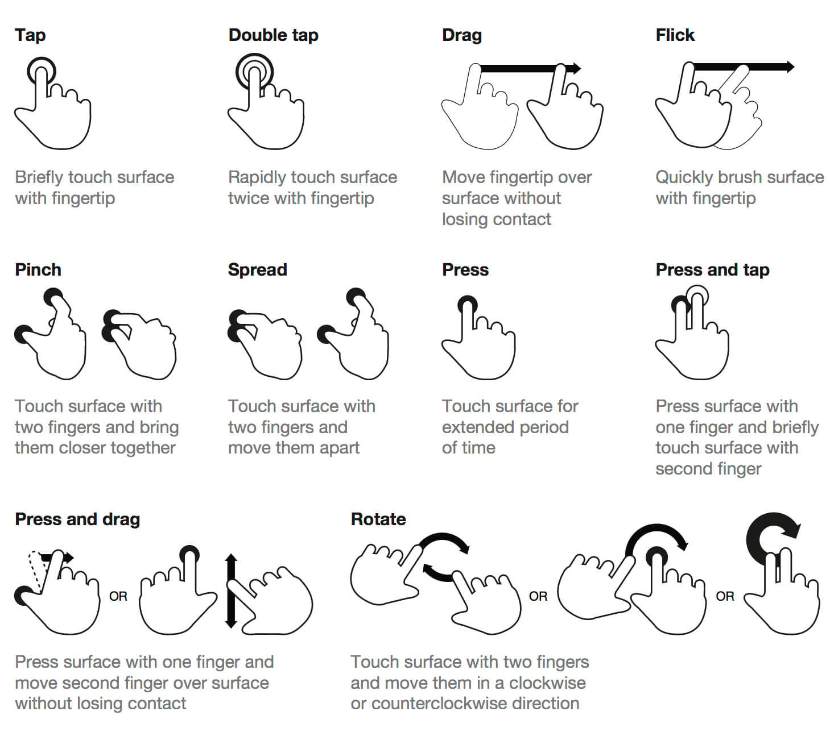
iOS Gestures
Notes:
https://support.apple.com/guide/iphone/learn-gestures-for-iphone-models-with-face-id-iphfdf164cac/13.0/ios/13.0

Slide 13
iOS Architecture

Slide 14
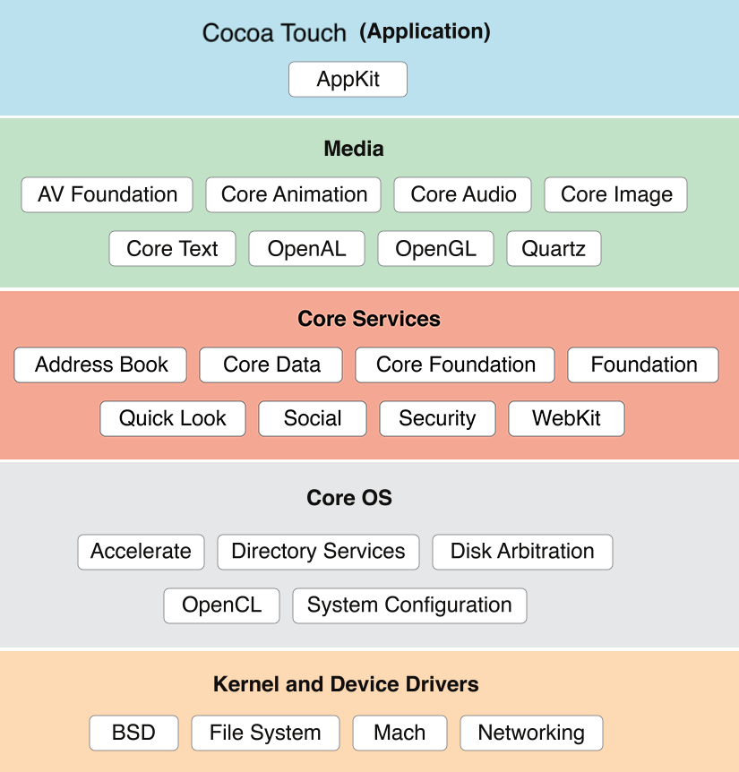

Slide 15

Cocoa Touch is Apple’s native object-oriented application programming interface (API)
The frameworks and services in this layer directly support applications in iOS. They include frameworks such as Game Kit, Map Kit, and iAd.
This layer is what the everyday user interfaces with to control the iPhone.
Notes:
https://developer.apple.com/library/archive/documentation/Cocoa/Conceptual/CocoaFundamentals/WhatIsCocoa/WhatIsCocoa.html

Slide 16
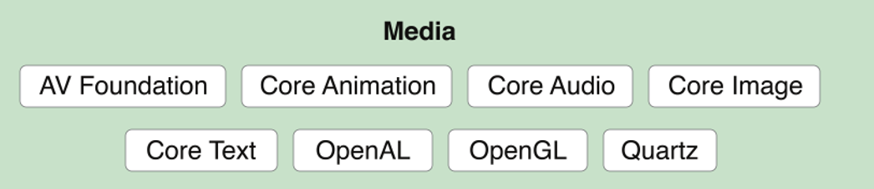
The Media layer incorporates 2D and 3D graphics, animations, image effects, audio, and video into iOS.
Notes:
https://developer.apple.com/library/archive/documentation/MacOSX/Conceptual/OSX_Technology_Overview/MediaLayer/MediaLayer.html

Slide 17
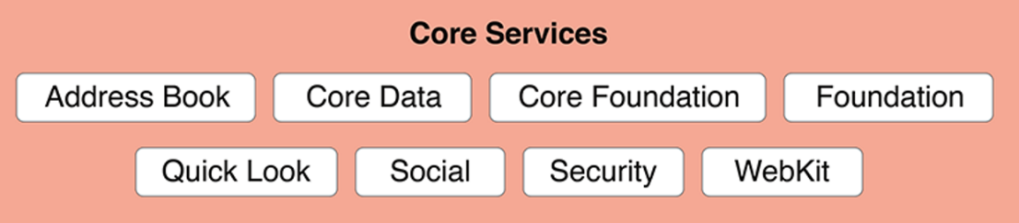
The technologies in the Core Services layers are called core services because they provide essential services to apps but have no direct bearing on the app-facing user experience.
This layer is dependent on frameworks and technologies in the two lowest layers – Core OS & Kernel.

Slide 18
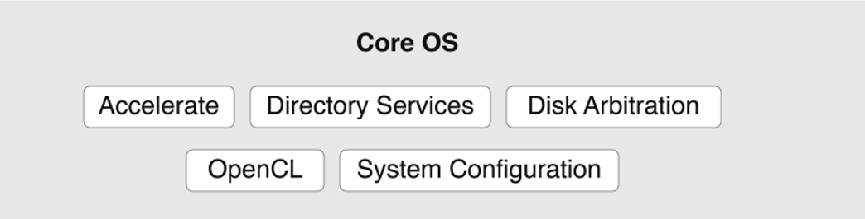
The technologies and frame works in the Core OS layer provide low-level services related to hardware and networks. These services are based on facilities in the Kernel and Device Drivers layer.
Core Bluetooth Framework
Accelerate Framework
External Accessory Framework
Security Services Framework
Local Authentication Framework

Slide 19

The lowest layer of iOS includes the kernel, drivers, and Berkeley Software Distribution (BSD) portions of the system and is based primarily on open-source technologies.
Mach is the heart of Darwin because it provides some of the most critical functions of the operating system.

Slide 20
iPhone Booting Process

Slide 21
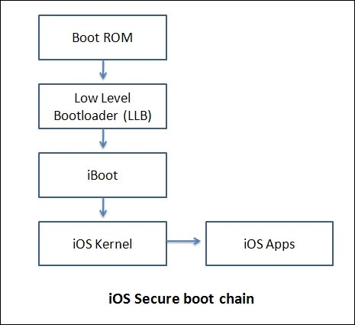
The Boot Chain:
Each step of the startup process contains components that are cryptographically signed by Apple to enable integrity checking so that boot proceeds only after verifying the chain of trust. These components include the bootloaders, the kernel, kernel extensions, and cellular baseband firmware. This secure boot chain is designed to verify that the lowest levels of software aren’t tampered with.
Notes:
https://support.apple.com/guide/security/boot-process-for-ios-and-ipados-devices-secb3000f149/web

Slide 22
Boot ROM
When an iOS or iPadOS device is turned on, its Application Processor immediately executes code from read-only memory referred to as Boot ROM. This immutable code, known as the hardware root of trust, is laid down during chip fabrication and is implicitly trusted. The Boot ROM code contains the Apple Root certificate authority (CA) public key—used to verify that the iBoot bootloader is signed by Apple before allowing it to load. This is the first step in the chain of trust, in which each step checks that the next is signed by Apple.

Slide 23
Low Level Bootloader (LLB)
The low-level bootloader, also referred to as iBoot first-stage loader. It runs several setup routines and checks the signature of iBoot before jumping to it.

Slide 24
iBoot (Bootloader)
iBoot, also referred to as iBoot second-stage loader. Is Apple’s stage 2 bootloader for iOS devices. It runs what is known as Recovery mode, which has an interactive interface which can be used over USB. iBoot also checks for Apple signatures before starting the Kernel.

Slide 25
iOS Kernel
The final step of the iOS boot process is the iOS Kernel, which executes the most core services of the operating system.

Slide 26
iOS partition layout

Slide 27
iOS partition
iOS partitions are different from PC partition table.
  Partitions are logical storage units made inside the device's persistent storage
  Logically divide the available space into sections that can be accessed independently of each other
  Each partition has a distinct role in the functionality of the device
Common partitions
  /private: For some reason, Apple decided to place /etc and /var under /private and symlink them from their correct locations to their actual locations. The purpose for this is unknown as it doesn't offer any advantages; the second partition is mounted at /private/var (/private/etc is still on the root partition).
  /system: This folder contains the bulk of the root partition. It contains Frameworks among many other things.
  /sbin: This folder is where ramdisks are uploaded. It contains important files like mount, launchd, and fsck. Used during boot.
Notes:
https://www.theiphonewiki.com/wiki//

Slide 28
Common partitions (continues)
/tmp: Directory for temporary files.
/usr: Second major hierarchy, includes subdirectories that contain information, configuration files, and other essentials used by the operating system.
/var: Variable data, contains files whose contents change as the operating system runs.
/User: This is the home directory of the non-root user (mobile). User data and media are stored in this directory.
  Symlink to /private/var/mobile

Slide 29
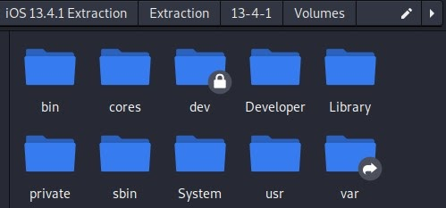
Visualization of Root Level Folder View:
The lock icon means that a file or folder is owned by a privileged user, such as root
Symbolic Link to User Data ~/private/var

Slide 30

Acquisition

Slide 31
Mobile Forensics Steps
Preparation
01
Seizure
02
Acquisition
03
Analysis
04
Report
05

Slide 32
Acquisition
Physical acquisition
Bit-by-bit copy or disk imaging, tricky to perform.
Logical acquisition
Extracting the logical storage objects, such as files and directories
Data may be modified
Evidence only (Logical acquisition)
message, call log, contacts, social apps, GPS, images, videos, and
other common activates, browser history

Slide 33
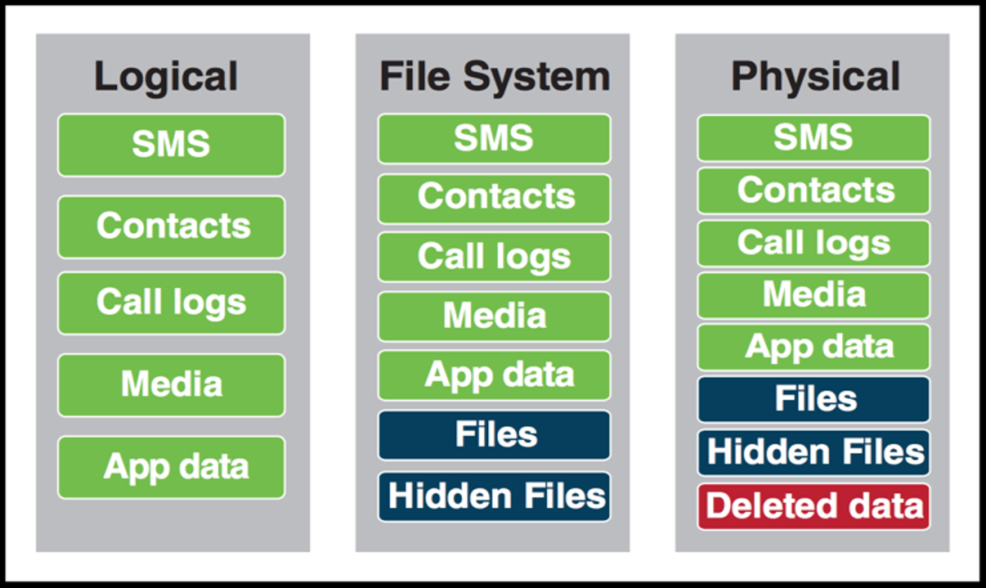
Visualization

