Slide 1
Linux for Digital Forensics

Slide 2
Overview
Introduction to OS and file Systems
Linux for digital forensics - Good and Bad
Virtual file system
File structure
Path and path variable
Linux commands
Create folders and files, File copy & deletion, Search for information, Networks, Create a batch file, Update/install software

Slide 3
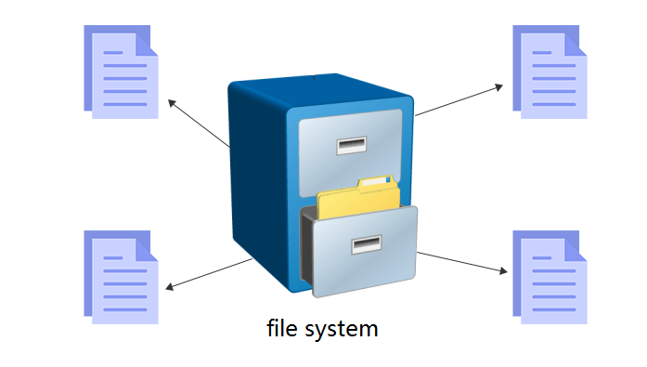
OS and File Systems

Slide 4
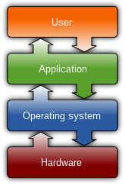
Common features of OS
Process management
Interrupts
Memory management
File system
Device drivers
Networking
Security
I/O
https://en.wikipedia.org/wiki/Operating_system

Slide 5
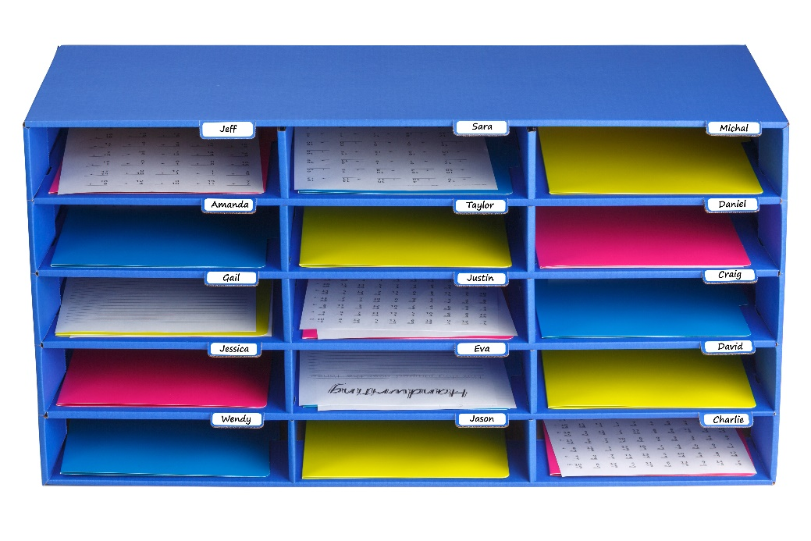
Files and File Systems
A file
is a collection of correlated information
which is recorded on secondary or non-volatile storage like magnetic disks, optical disks, and tapes.
A file system
defines how files are named, stored, and retrieved from a storage device.

Slide 6
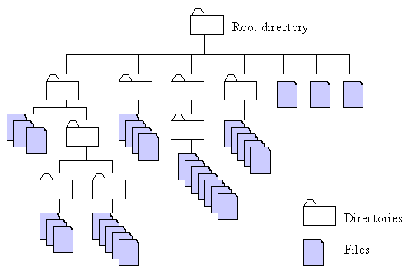
http://home.easy-key.info/images/stories/file_structure.gif

Slide 7
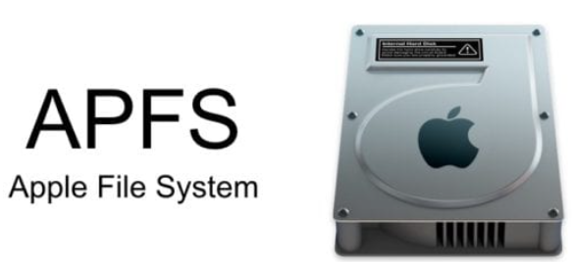
File systems used by operating systems
By Unix and Unix-like operating systems
Linux: XFS, JFS, and btrfs.
Solaris
macOS:
Hierarchical File System (HFS) + : No support for dates beyond February 6, 2040
By Microsoft Windows
FAT: File Allocation Table
NTFS: New Technology File System
extended file system

Slide 8
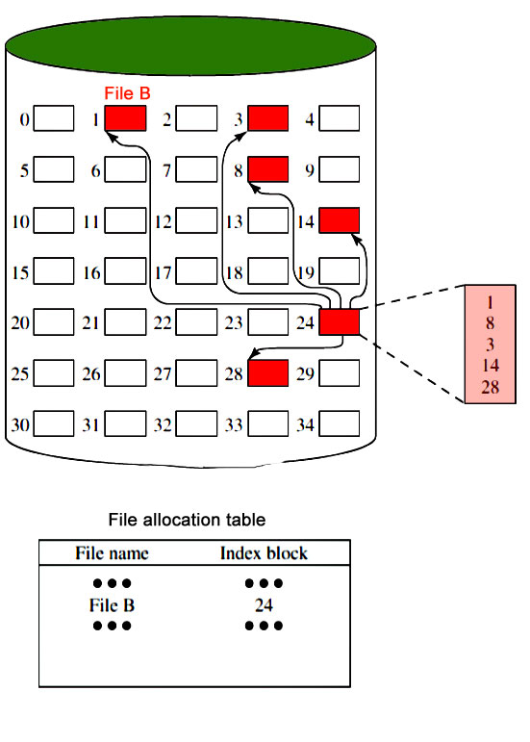
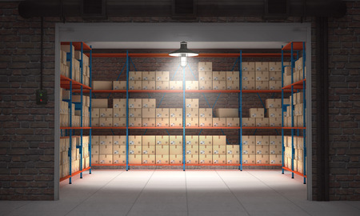
The simplest file system: FAT (think about an index card)
Notes:
https://www.geeksforgeeks.org/file-systems-in-operating-system/

Slide 9
Linux for digital forensics- Good and Bad
Pro
widely support for many file systems (Virtual file system)
advanced and powerful tools available
free and open-source
compile source code
flexibility
Con
learning curve, e.g., no graphic interface
trustworthiness of open-source tools

Slide 10
Virtual file system (VFS)

Slide 11
Without an interpreter
With an interpreter
File Systems
Virtual file system

Slide 12
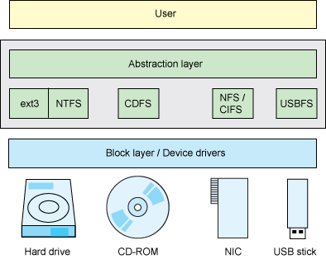
Linux is a VFS
VFS allows client applications to access different types of concrete file systems in a uniform way
provides an abstract layer for upper-layer applications
Each and everything in Linux is a file (Everything appears somewhere in the filesystem)
file, directory, Hard disks, CD/DVD, NIC, USB
Devices can be represented as file-like object under /dev/ filesystem.
OS recognizes files by
inode (index node)
https://developer.ibm.com/technologies/linux/tutorials/l-virtual-filesystem-switch/
Notes:
The "Everything is a file" phrase defines the architecture of the operating system. It means that everything in the system from processes, files, directories, sockets, pipes, ... is represented by a file descriptor abstracted over the virtual filesystem layer in the kernel
Devices can be represented as file-like object under /dev/ filesystem.
Unix has no direct equivalent of the Windows registry. The same information is scattered through the filesystem, largely in /etc, /proc and /sys.

Slide 13
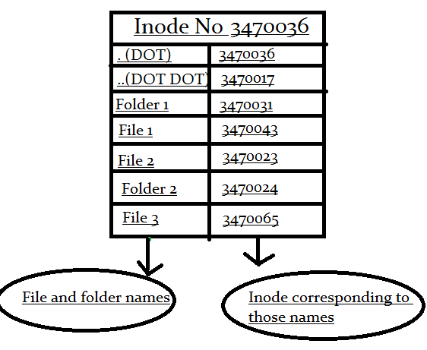
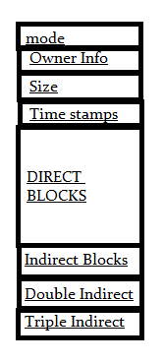
What is inode?
inode is an ID of a file/folder
unique number
inode is a data structure of a file
You store your information in a file, and the operating system stores the information/metadata about a file in an inode
inode points to the content of a file
How to access to a file?
inode ID
file name=>inode ID
permission information
block pointers
https://www.slashroot.in/inode-and-its-structure-linux

Slide 14
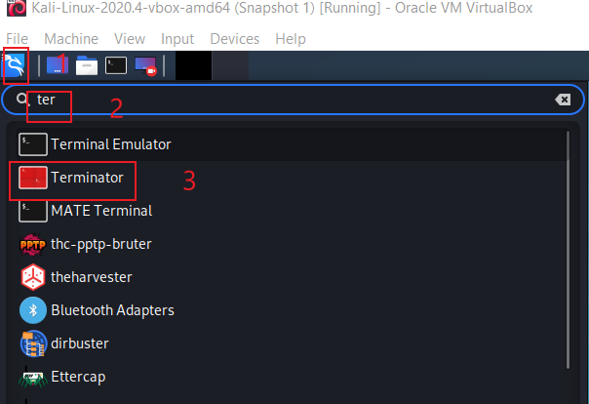
Open a Linux Terminator

Slide 15
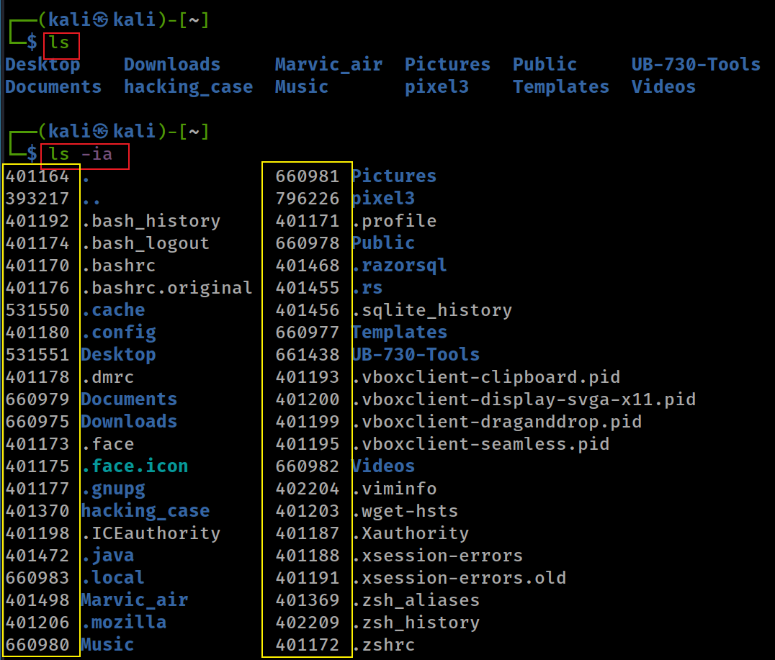
File inode
-i, --inode print the index number of each file
-a, --all do not ignore entries starting with . (hidden file)

Slide 16
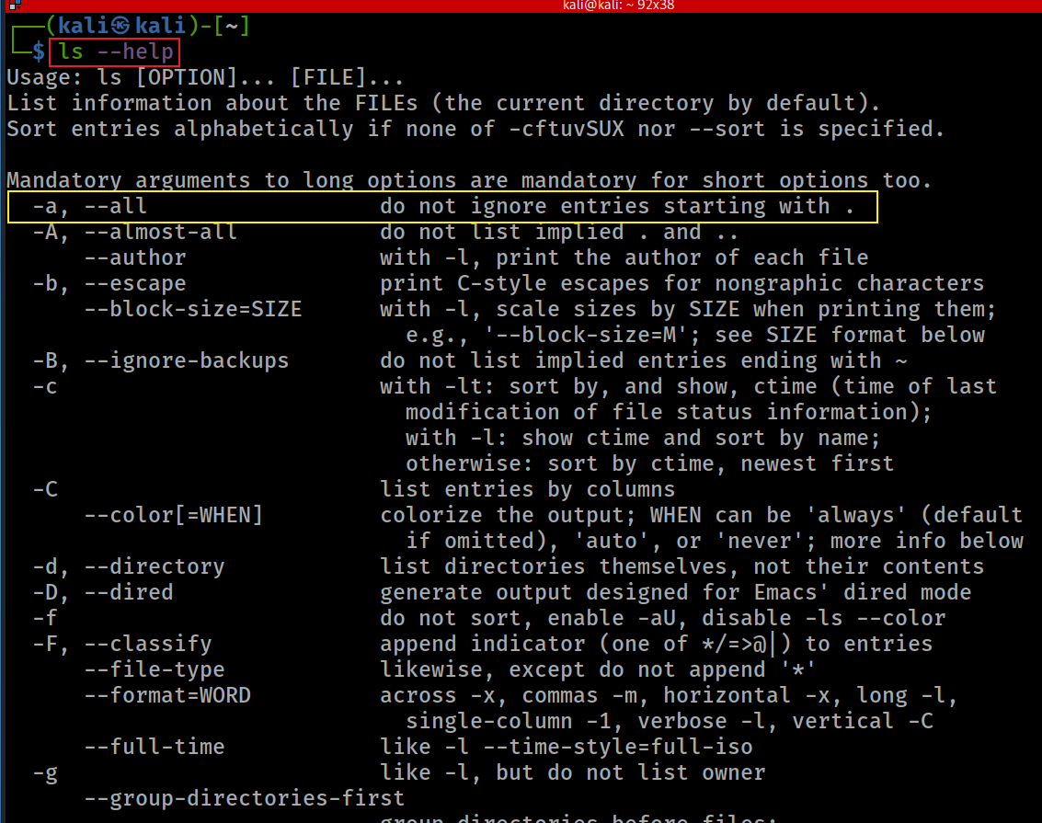

Slide 17
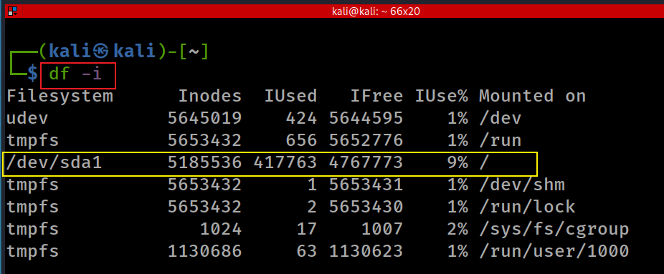
Disk free information (df) inode
-i, --inodes list inode information

Slide 18
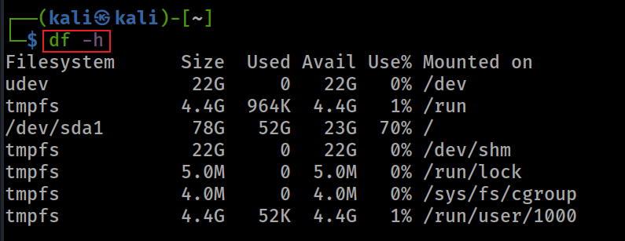
Show human readable format

Slide 19
File Structure

Slide 20
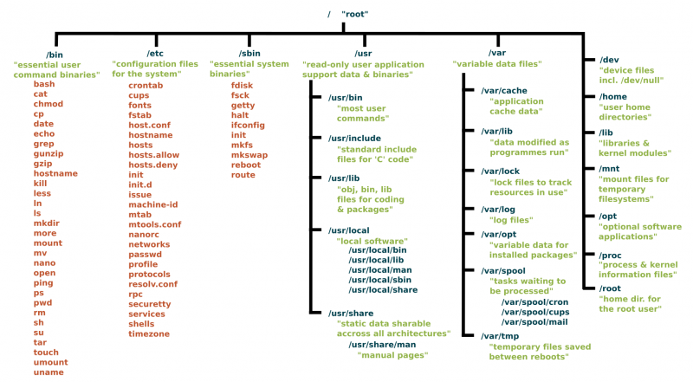
Unix has no direct equivalent of the Windows registry. The same information is scattered through the filesystem, largely in /etc, /proc and /sys.
https://www.linux.com/sites/lcom/files/styles/rendered_file/public/standard-unix-filesystem-hierarchy.png?itok=CVqmyk6P

Slide 21
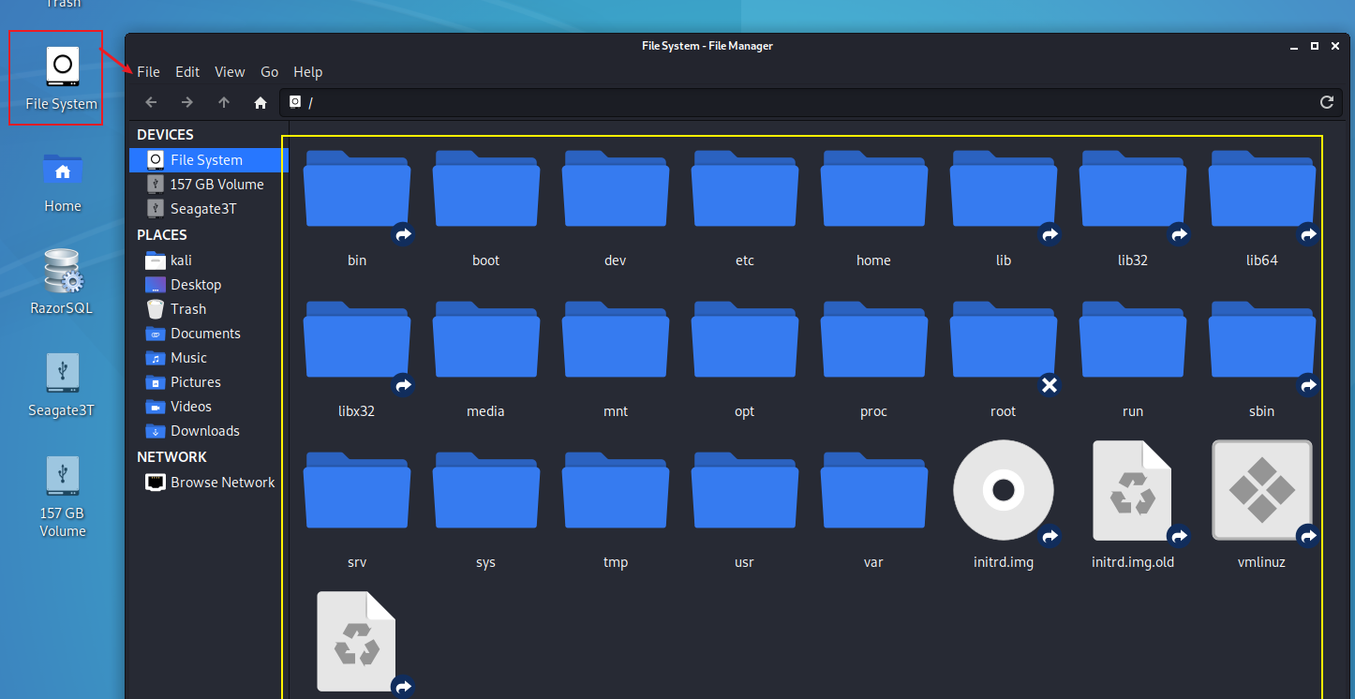

Slide 22
Show Linux file system from root /
Check where you are (impact all the commands you entered)
Clear screen

Slide 23
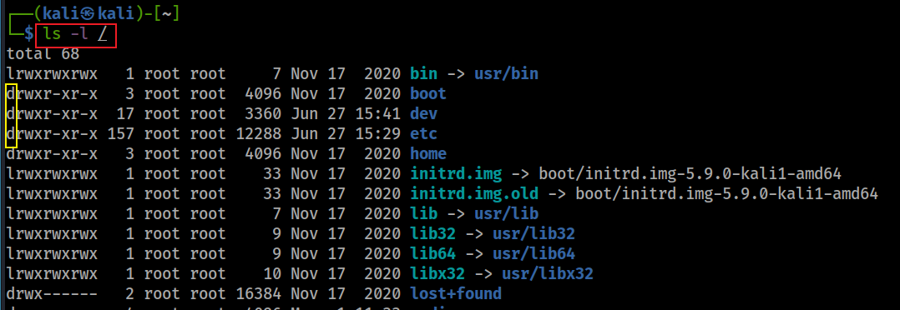
Show details of file/directory

Slide 24
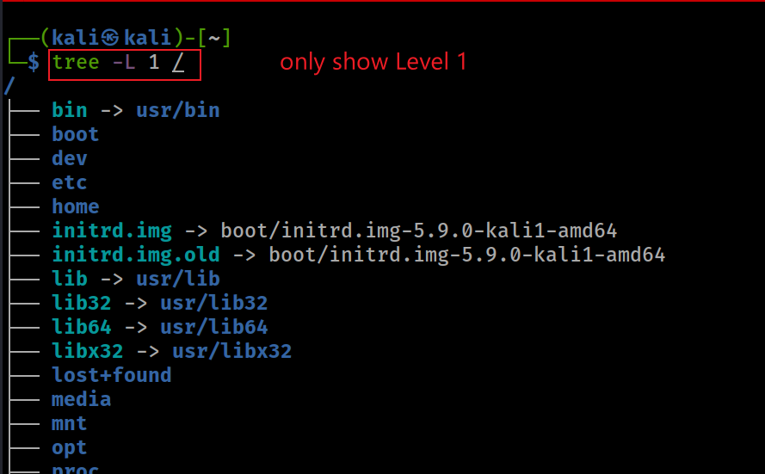
Show Linux file system from root with tree
Remember use following command for help
tree --help

Slide 25
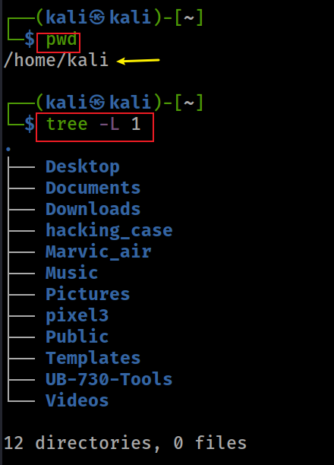
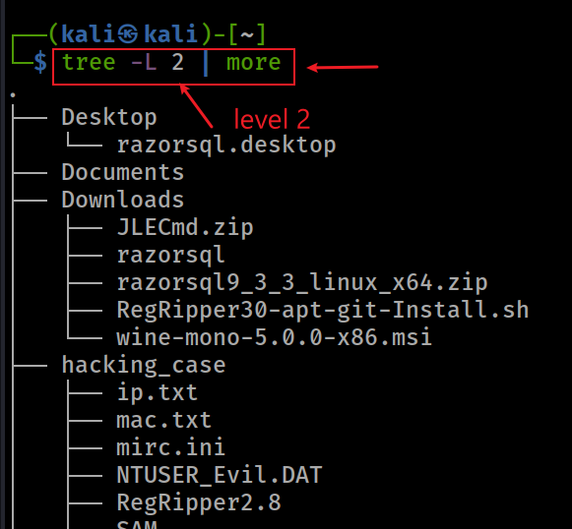
Show current working directory (pwd) with tree

Slide 26
Display ls command under /bin
Why can ls be executed in any folder?

Slide 27
Path and Path variable

Slide 28
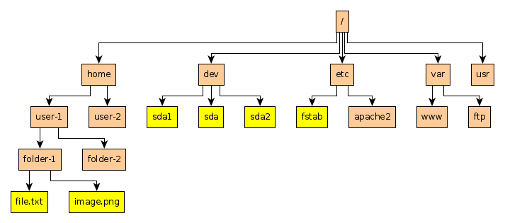
Example of paths
Absolute path to file.txt: /home/user-1/folder-1/file.txt
Relative path to file.txt (Under folder-2): ../folder-1/file.txt

Slide 29
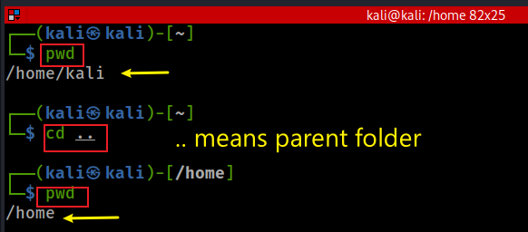
Change to parent path using relative path

Slide 30
Path variable
How does OS execute a command?
search command in current directory
if can’t find it, search for command in each path defined in path variable
if can’t find it, OS throws command not found error message

Slide 31
Adding a new path
Notes:
export PATH=/some/new/path:$PATH

Slide 32
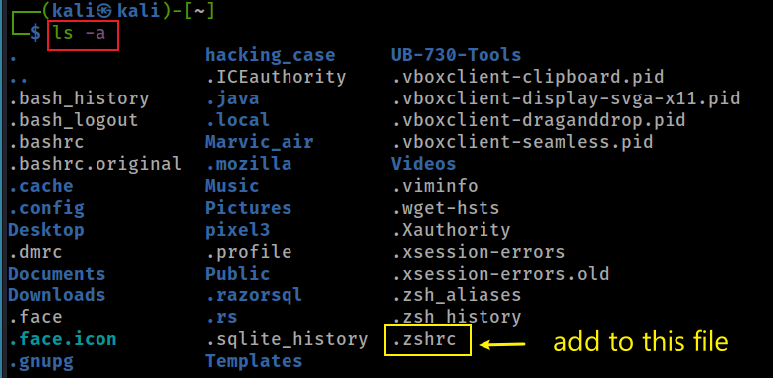
Persisting the new path
we discuss the details later

Slide 33
Create folders and files

Slide 34
Create folders
home
\myfolder
\mysubfolder

Slide 35
Delete folders

Slide 36
Create a new text file
\user home
\myfolder
Show the content of the file
hello world
my_first_file.txt

Slide 37
Show the content of the file

Slide 38
File Copy & Deletion

Slide 39
Copy (cp) a file

Slide 40
Copy (cp) a file to a different location

Slide 41
Remove a file: rm

Slide 42
Rename a file (mv)

Slide 43
Search for information

Slide 44
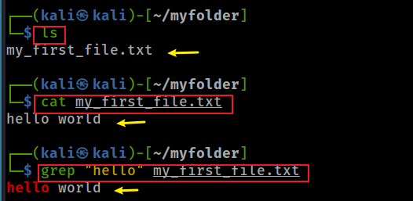
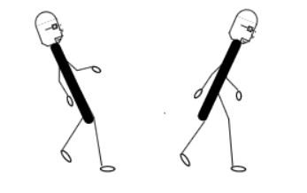
Search for a string in a text file
grep search
backslash/Wins
forward slash/Linux
Show line number while displaying the output
Notes:
cat my_first_file.txt
grep "hello" my_first_file.txt
https://sites.cs.ucsb.edu/~pconrad/topics/BackslashVsForwardSlash/

Slide 45
Search for file names that that contains the given string/pattern
grep help
Search for file contains “hello”

Slide 46
Networking

Slide 47
Test network connection using domain name

Slide 48
Test network connection using IP

Slide 49
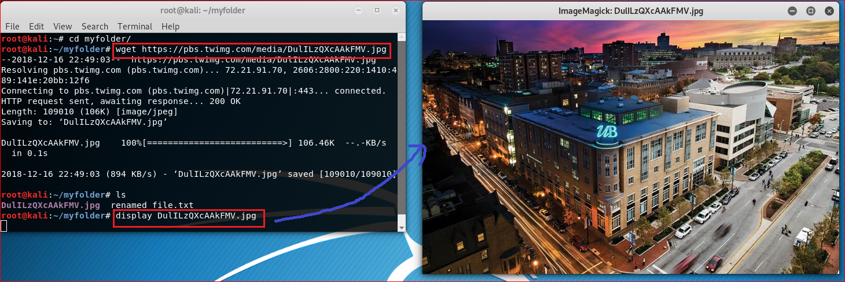
Download a file
https://pbs.twimg.com/media/DulILzQXcAAkFMV.jpg

Slide 50
Create a script file

Slide 51
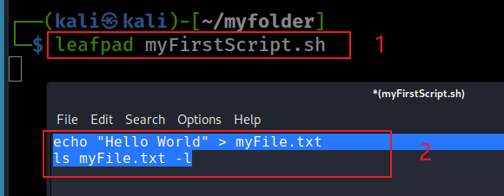
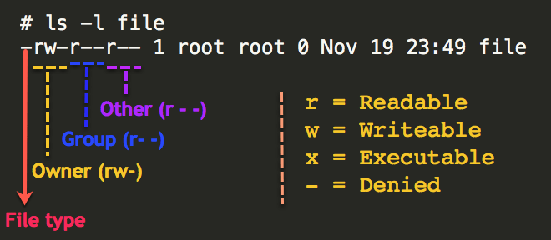
Create a simple script file
Create a script using leafpad
#!/bin/sh
remember
Check permission of files
Notes:
#!/bin/sh
echo "Hello World" > myFile.txt
ls myFile.txt -l

Slide 52
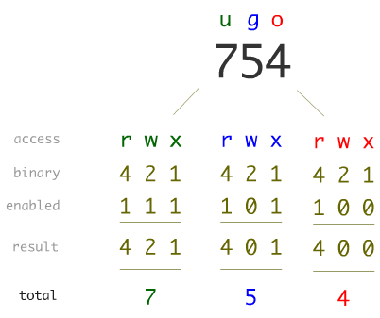
Linux Permissions

Slide 53
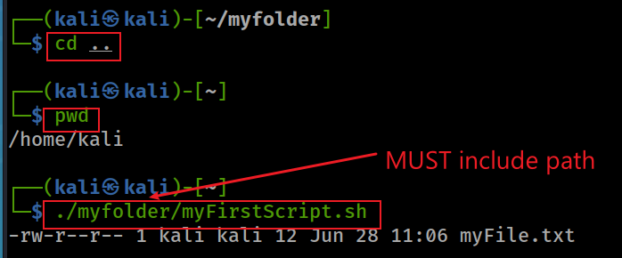
Execute script in a different folder

Slide 54
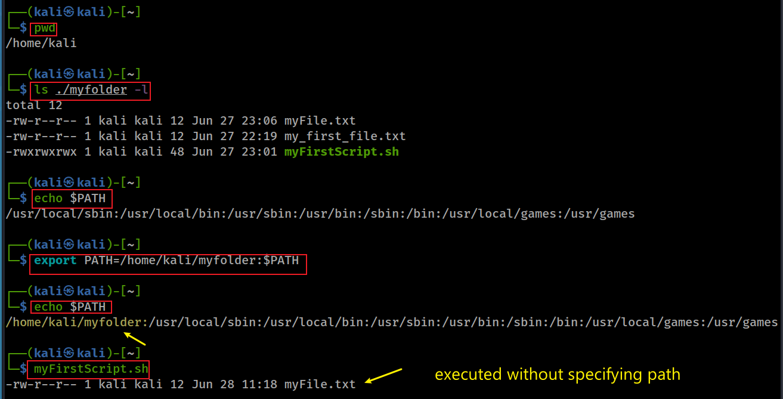
Add a path to the path variable
Notes:
export PATH=/home/kali/myfolder:$PATH

Slide 55
Update/Install software

Slide 56
Update software

Slide 57
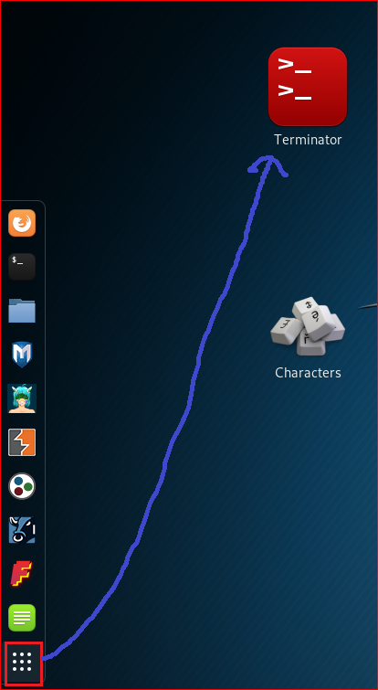
Install terminator

Slide 58
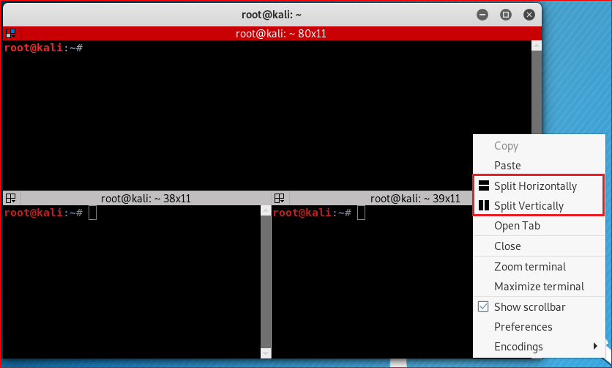

Slide 59
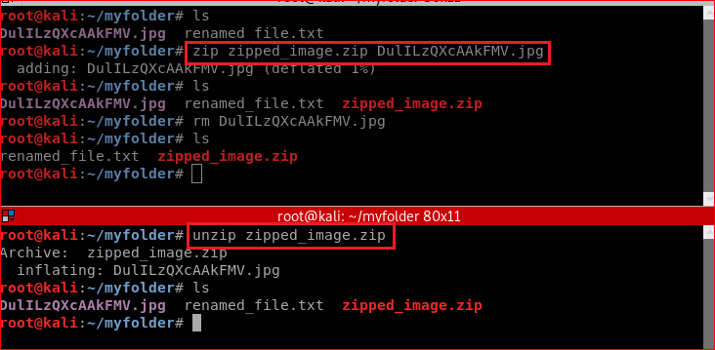
Zip/unzip files

