Slide 1
Knowledge Investigation
iOS 13

Slide 2
Overview
Introduction to KnowledgeC.db
Understanding KnowledgeC.db
Querying within KnowledgeC.db

Slide 3

Intro to KnowledgeC.db

Slide 4
What is KnowledgeC?
KnowledgeC.db is an SQLite database that was introduced in iOS 11 that tracks lots of different activity on the device ranging from Battery Level and Bluetooth connections to which speaker is in use and what it is playing at any given time. Because of the vast amount of data stored, the database is only stored for a couple of months before it appears to purge records on a first in/first out basis.
The database is located at ~/private/var/mobile/Library/CoreDuet/Knowledge/knowledgeC.db and is made up of 16 tables.

Slide 5
What is KnowledgeC? (2)
The knowledgeC database stores an event log of multiple processes that run within an Apple device ranging from application usage to speaker output switching. Which is a goldmine for digital forensic investigators.
The knowledgeC database can become a digital intelligence goldmine as it opens a window into a phone owner’s actual usage. Investigators can then take a closer look at application activity that includes when an app was installed, opened, and all of the spotlight searches performed.
The purpose behind the KnowledgeC.db in iOS is meant to synchronize states between apple products.

Slide 6
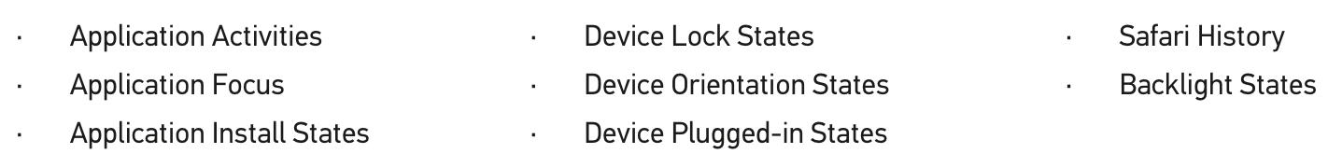
Kinds of data gathered from KnowledgeC.db
These are referred to ZSTREAMNAMES within the database

Slide 7
Understanding KnowledgeC.db

Slide 8
ZSTREAMNAMES & Meanings
ZSTREAMNAME | Value Field | Description
/device/batteryPercentage | ZVALUEDOUBLE | This is the battery percentage that the user is shown. The Start and End times show how long the battery was at that level.
/device/isPluggedIn | ZVALUEINTEGER or ZVALUEDOUBLE | Indicates if the device was plugged in/charging or not. 0 = unplugged 1 = plugged in *Note that wireless charging shows as being "Plugged In".
/displayIsBacklit | ZVALUEINTEGER or ZVALUEDOUBLE | Indicates if the device backlight was lit or not. 0 = Backlight off 1 = Backlight on

Slide 9
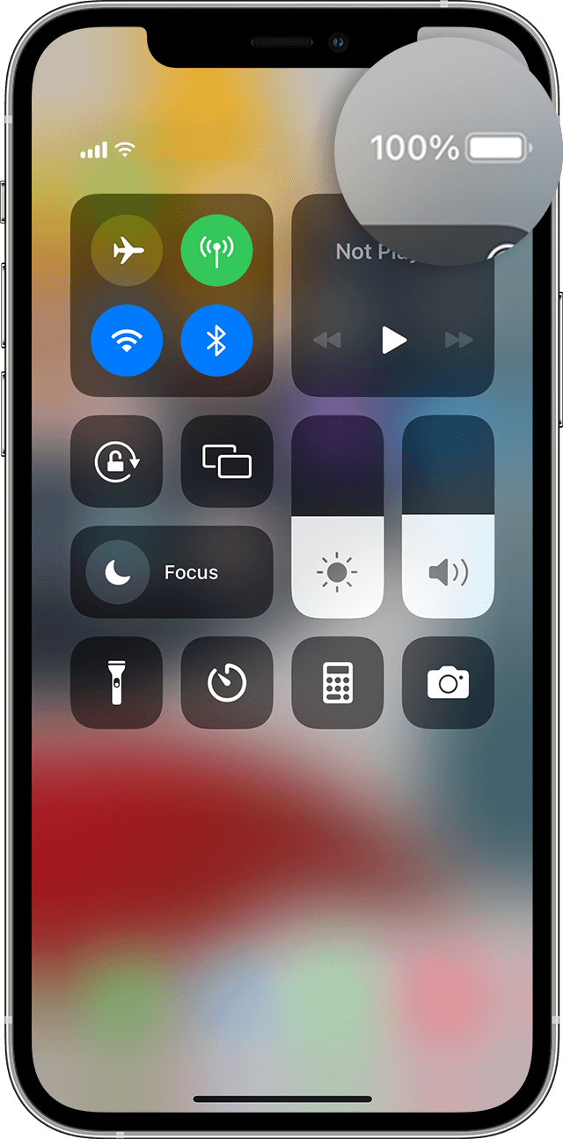
/device/batteryPercentage
A visualization of the battery percentage that the user is shown.
The Start and End times show how long the battery was at that level.

Slide 10
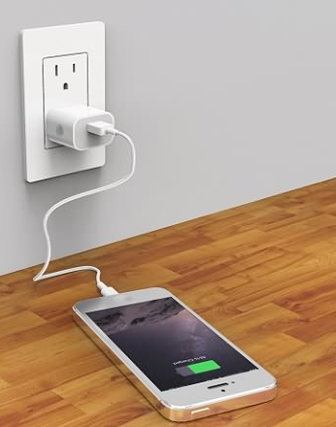
/device/isPluggedIn
Right: A visualization of the device if it was plugged in/charging or not.
0 = unplugged
1 = plugged in
*Note that wireless charging shows as being "Plugged In".

Slide 11

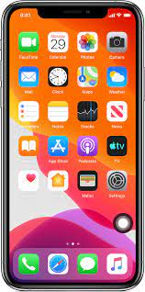
/displayIsBacklit
Indicates if the device backlight was lit or not.
0 = Backlight off (LEFT)
1 = Backlight on (RIGHT)

Slide 12
ZSTREAMNAMES & Meanings (2)
ZSTREAMNAME | Value Field | Description
/keybag/isLocked | ZVALUEINTEGER or ZVALUEDOUBLE | Indicates if the device keybag was locked or not. 0 = Keybag is locked 1 = Keybag is unlocked
/device/isLocked | ZVALUEINTEGER or ZVALUEDOUBLE | Indicates if the device is passcode locked or not. 0 = Device is locked 1 = Device is unlocked
/media/nowPlaying | ZVALUESTRING & ZHASSTRUCTUREDMETADATA & ZSTRUCTUREDMETADATA | ZVALUESTRING records information such as if the media is playing from YouTube, Music or Safari etc. ZHASSTRUCTUREDMETADATA is 1 if more information is available about this record.

Slide 13
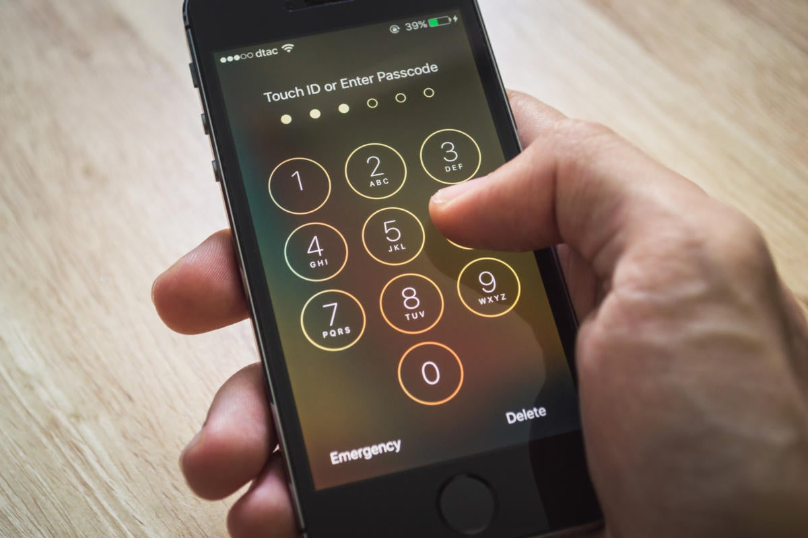
/keybag/isLocked
&
/device/isLocked
What is keybag?
The device keybag is used to store the encryption keys used for operations involving device-specific data.
Since iOS devices are configured for use by a single user (the default configuration), the device keybag and the user keybag are one and the same and are protected by the user’s passcode.
If the device keybag was locked or not.
0 = Keybag is locked
1 = Keybag is unlocked
If the device is passcode locked or not.
0 = Device is locked
1 = Device is unlocked

Slide 14
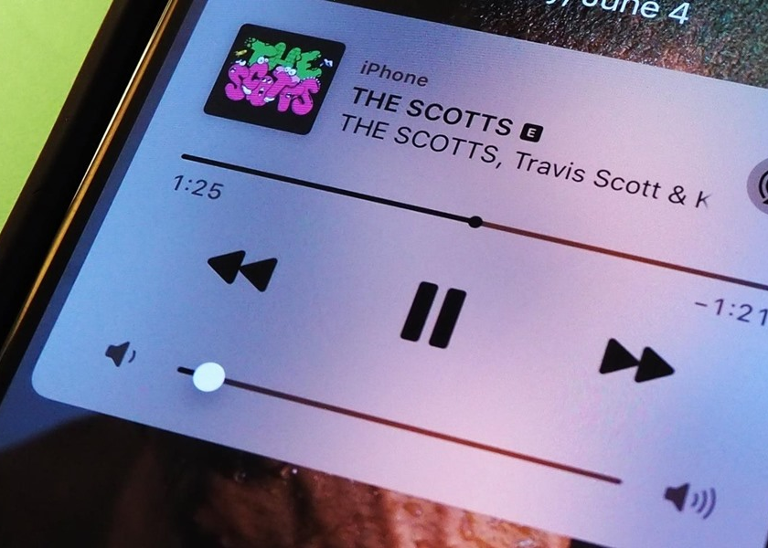
/media/nowPlaying
Indicates information such as if the media is playing from YouTube, Music or Safari etc.

Slide 15
ZSTREAMNAMES & Meanings (3)
ZSTREAMNAME | Value Field | Description
/app/activity | ZVALUESTRING & ZHASSTRUCTUREDMETADATA & ZSTRUCTUREDMETADATA | ZVALUESTRING records which application is using resources (not necessarily the app in the foreground) ZHASSTRUCTUREDMETADATA is 1 if more information is available about this record.
/app/inFocus | ZVALUESTRING & ZHASSTRUCTUREDMETADATA & ZSTRUCTUREDMETADATA | ZVALUESTRING = which application is in the foreground. ZHASSTRUCTUREDMETADATA is 1 if more information is available about this record.
/app/intents | ZVALUESTRING & ZSTRUCTUREDMETADATA | ZVALUESTRING is the application the phone is preparing. ZSTRUCTUREDMETADATA shows metadata ID reference. METADATA includes data such as the action the phone is preparing for.

Slide 16
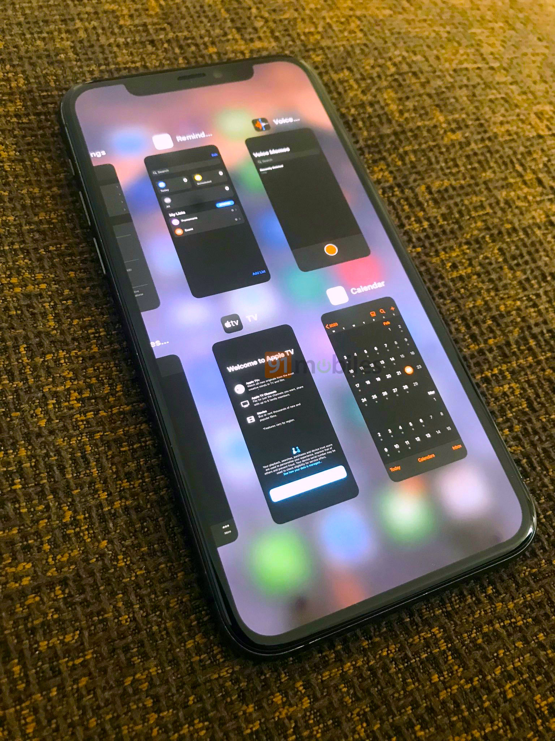
/app/activity
Indicates which application(s) is using resources (not necessarily the app in the foreground)

Slide 17
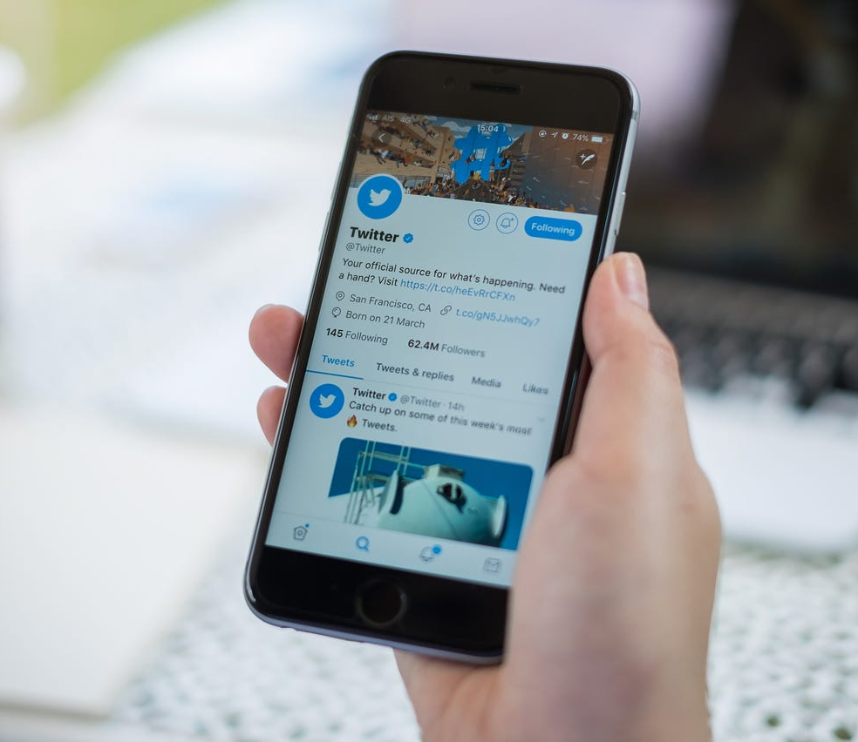
/app/inFocus
Indicates which application is in the foreground (currently in front of the user).

Slide 18
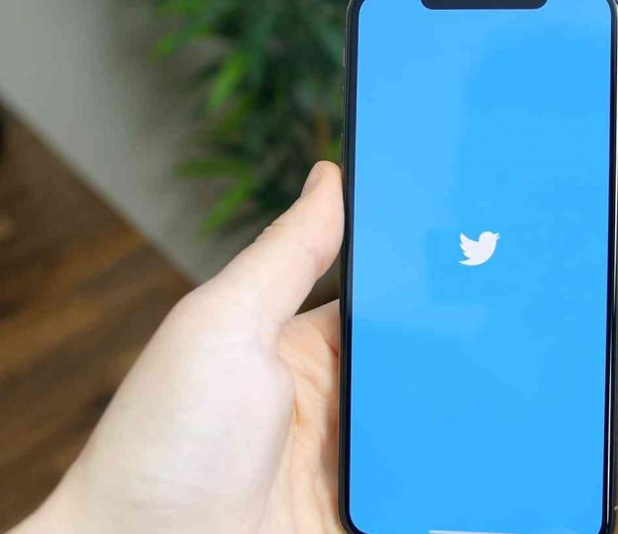
/app/intents
Indicates which application the phone is preparing to launch. Appears as a launch screen for the user.

Slide 19
ZSTREAMNAMES & Meanings (4)
ZSTREAMNAME | Value Field | Description
/app/Usage | ZVALUESTRING | ZVALUESTRING is the app being used.
/audio/outputRoute | ZVALUEINTEGER & ZHASSTRUCTUREDMETADATA & ZSTRUCTUREDMETADATA | ZVALUEINTEGER is 1 if Audio is playing. ZHASSTRUCTUREDMETADATA is 1 if more information is available about this record. ZSTRUCTUREDMETADATA shows metadata ID reference. METADATA includes data such as which speaker was being used (Internal/ Bluetooth/ USB)
/app/webUsage | ZVALUESTRING & ZHASSTRUCTUREDMETADATA & ZSTRUCTUREDMETADATA | ZVALUESTRING is the app using the internet connection ZHASSTRUCTUREDMETADATA is 1 if more information is available about this record. ZSTRUCTUREDMETADATA shows metadata ID reference. METADATA includes data such as the URL being visited.

Slide 20
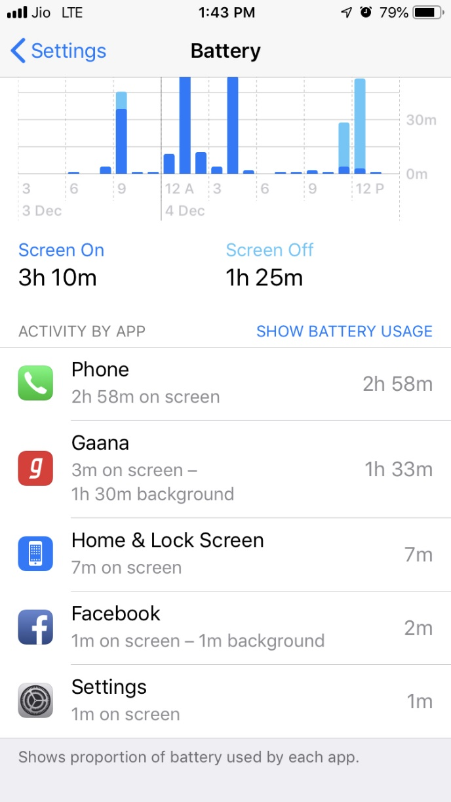
/app/Usage
Indicates which app is being used by the user includes foreground and background usage.

Slide 21
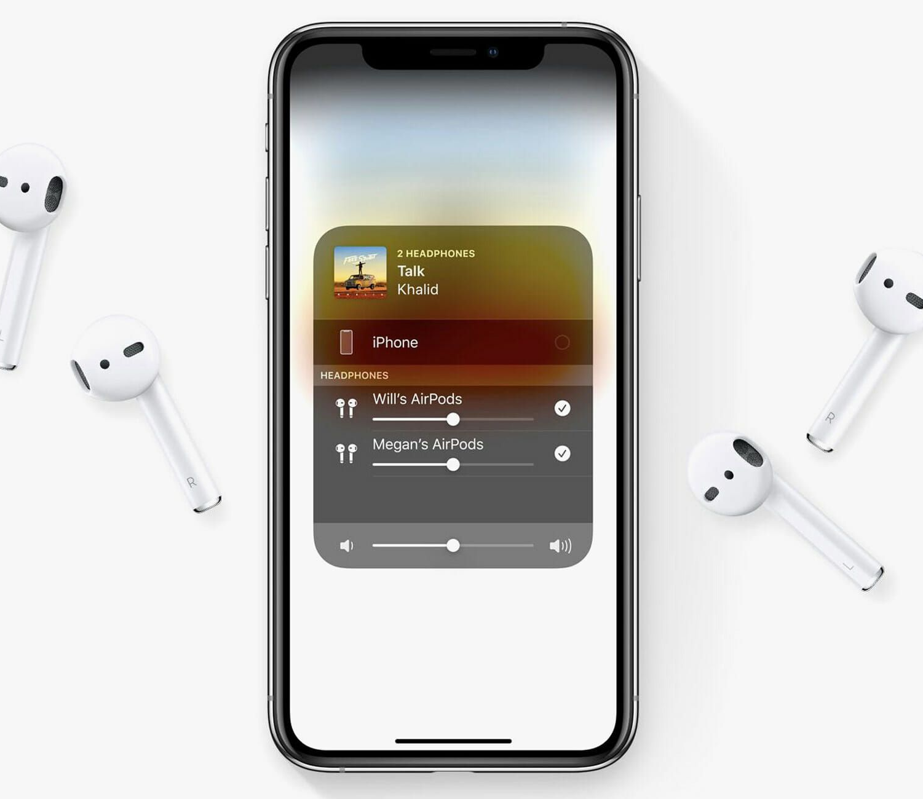
/audio/outputRoute
Indicates data such as which speaker was being used (Internal/ Bluetooth/ USB

Slide 22
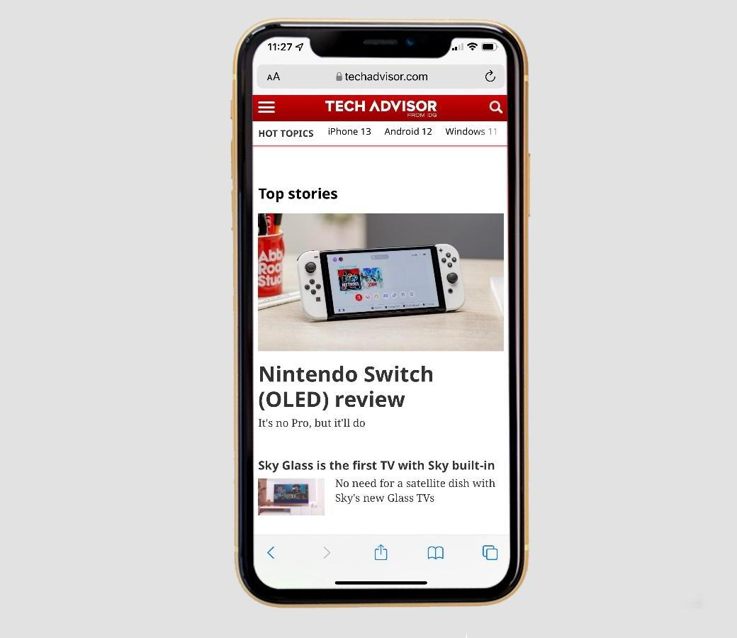
/app/webUsage
Data includes which apps are using an active internet connection, metadata may include visited URL.

Slide 23
ZSTREAMNAMES & Meanings (5)
ZSTREAMNAME | Value Field | Description
/bluetooth/isConnected | ZHASSTRUCTUREDMETADATA & ZSTRUCTUREDMETADATA | ZHASSTRUCTUREDMETADATA is 1 if more information is available about this record. ZSTRUCTUREDMETADATA shows metadata ID reference. METADATA includes data such as the bluetooth device MAC Address and Name.
/notification/usage | ZVALUESTRING & ZHASSTRUCTUREDMETADATA & ZSTRUCTUREDMETADATA | ZVALUESTRING is the type of notification. ZHASSTRUCTUREDMETADATA is 1 if more information is available about this record. ZSTRUCTUREDMETADATA shows metadata ID reference. METADATA includes data such as the application that caused the notification.

Slide 24
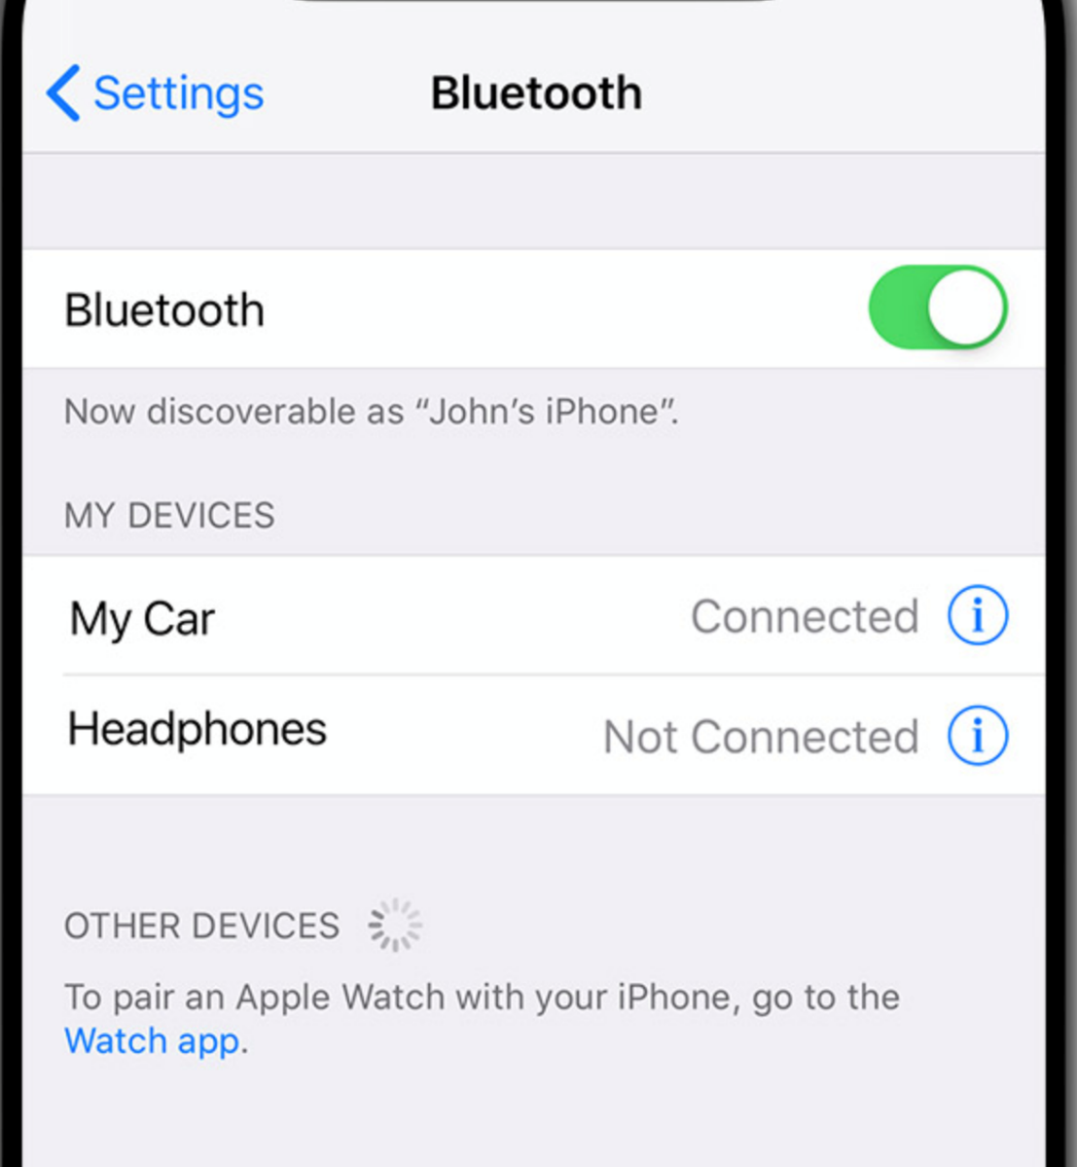
/bluetooth/isConnected
Indicated as a 0 or 1 if a Bluetooth device is connected. Metadata includes Bluetooth device name & MAC address.

Slide 25
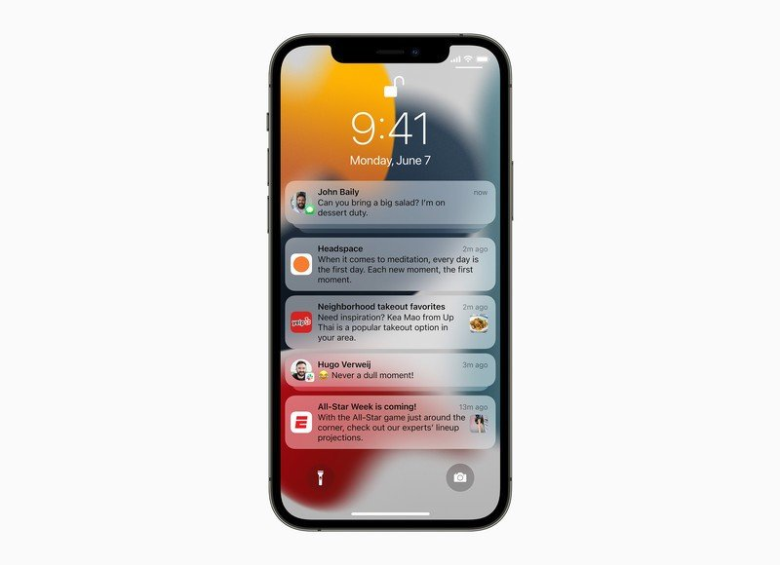
/notification/usage
Indicated as a 1 if a notification was received. Metadata includes the type of notification and application that sent the notification.

Slide 26
Querying within KnowledgeC.db

Slide 27
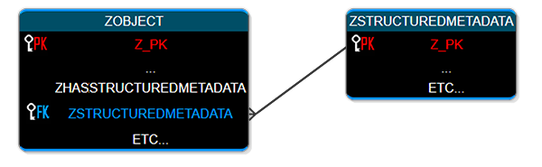
Understanding KnowledgeC.db Key Correlation
ZOBJECT is the main table within the database and contains the most records on. Typically, in the tens of thousands or so depending on usage.
ZSTRUCTUREDMETADATA table holds additional information about many of the records in the ZOBJECT table.
  Within the ZSTRUCTUREDMETADATA column the value here is a foreign key for table ZSTRUCTUREDMETADATA.

Slide 28
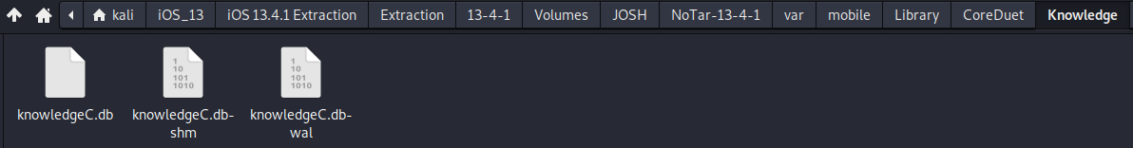
Database Location
Navigate to ~/var/mobile/Library/CoreDuet/Knowledge
Right click on knowledge.db and open with DB Browser for SQLite

Slide 29
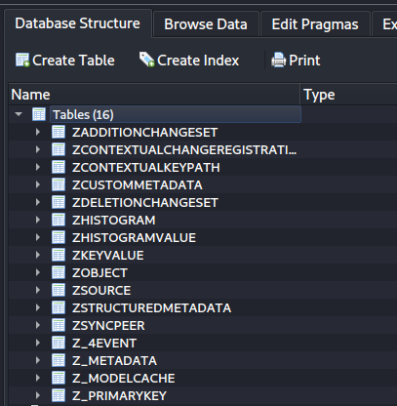
Database structure
Main table which holds most of the device records
Secondary table which holds additional information on the entries from ZOBJECT

Slide 30

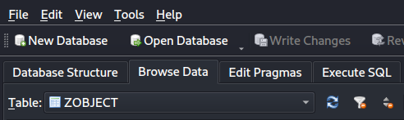
Querying with SQL
The ZOBJECT table is massive, with over 21,000 entries. It would be too time consuming to parse manually.
We can set up a simple SQL Statement to filter on the most important columns. Head to Execute SQL tab.

Slide 31
SQL Statement
SELECT
datetime(ZOBJECT.ZCREATIONDATE+978307200,'UNIXEPOCH', 'LOCALTIME') as "ENTRY CREATION",
CASE ZOBJECT.ZSTARTDAYOFWEEK
WHEN "1" THEN "Sunday"
WHEN "2" THEN "Monday"
WHEN "3" THEN "Tuesday"
WHEN "4" THEN "Wednesday"
WHEN "5" THEN "Thursday"
WHEN "6" THEN "Friday"
WHEN "7" THEN "Saturday"
END "DAY OF WEEK",
ZOBJECT.ZSECONDSFROMGMT/3600 AS "GMT OFFSET",
datetime(ZOBJECT.ZSTARTDATE+978307200,'UNIXEPOCH', 'LOCALTIME') as "START",
datetime(ZOBJECT.ZENDDATE+978307200,'UNIXEPOCH', 'LOCALTIME') as "END",
(ZOBJECT.ZENDDATE-ZOBJECT.ZSTARTDATE) as "USAGE IN SECONDS",
ZOBJECT.ZSTREAMNAME,
ZOBJECT.ZVALUESTRING
FROM ZOBJECT
WHERE ZSTREAMNAME IS "/app/inFocus"
ORDER BY "START"
This section converts the MAC absolute time into a human time, creates the ENTRY CREATION column, and converts the ZSTARTDAYOFWEEK column from numbers to weekdays.
This section creates the GMT OFFSET, START, END, & USAGE IN SECONDS columns as well as converting the MAC absolute time into a human time.
This section pulls the columns ZSTREAMNAME & ZVALUESTRING from the ZOBJECT Table and only shows the ZSTREAMNAME that matches “/app/inFocus” as well as puts it in order from beginning.

Slide 32
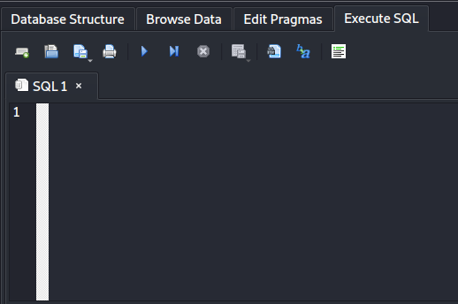
Copy and Paste the SQL Statement from the previous slide into the 1st line and hit the Play button.

Slide 33
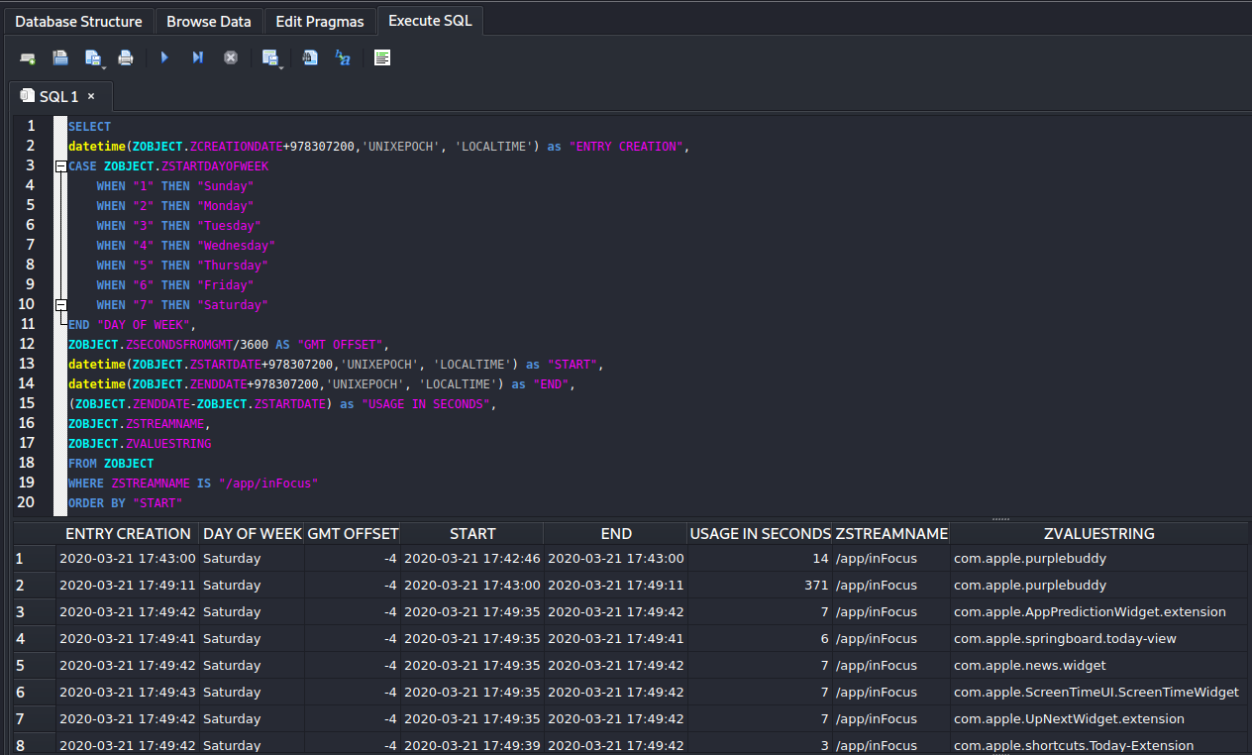
Upon successful execution a smaller, more digestible table will show.
We can determine converted timestamps, ZSTREAM type and ZVALUESTRINGS

Slide 34
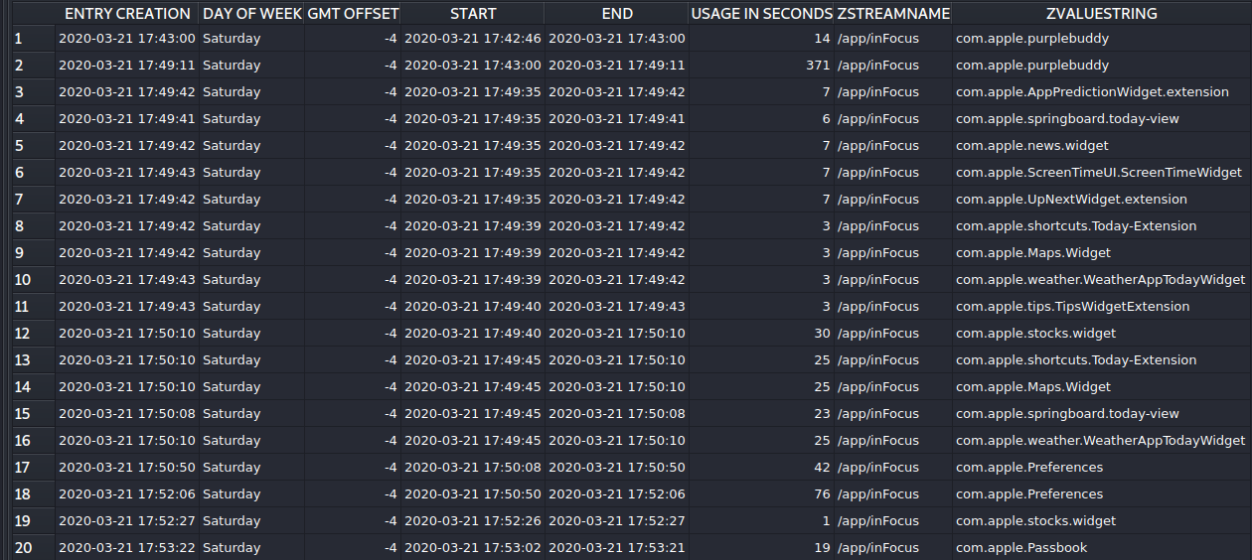
A closer look…
ZSTREAMNAME which reflects what application was in focus (on screen)
Usage in seconds (end timestamp – start timestamp)
ZVALUESTRING which reflects the bundle id of the application on screen
Day of the week and offset from GMT
Start and End timestamp
Timestamp when entry was created, always matches end time.
This table shows us a list from the start of which applications were used and for how long.

Slide 35
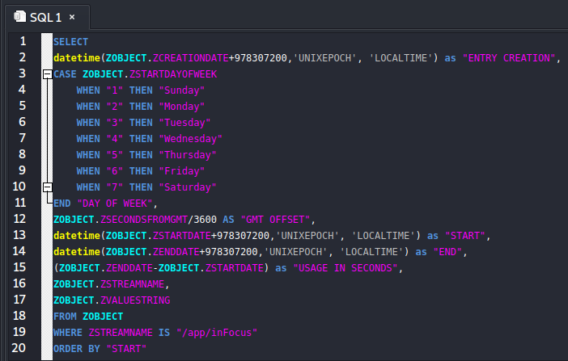
Modifying the Statement
To modify this simple statement - just enter the ZSTREAMNAME for the category you want to investigate.
For instance, this is statement is setup to show only entries that reflect the ZSTREAMNAME “app/inFocus”
If we wanted to see app usage, we would edit line 19 to reflect “app/usage”

Slide 36
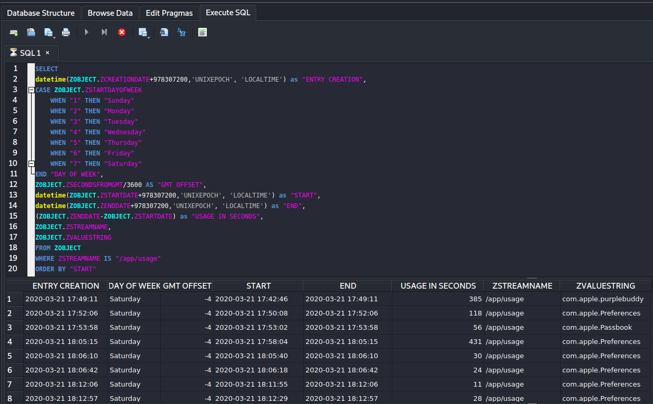
Here we can see the ZSTREAMNAME is now only displaying “/app/usage”
With a simple edit we can point the SQL to different Stream types.
Next, change line 19 ”app/usage” to ”media/nowPlaying”

Slide 37
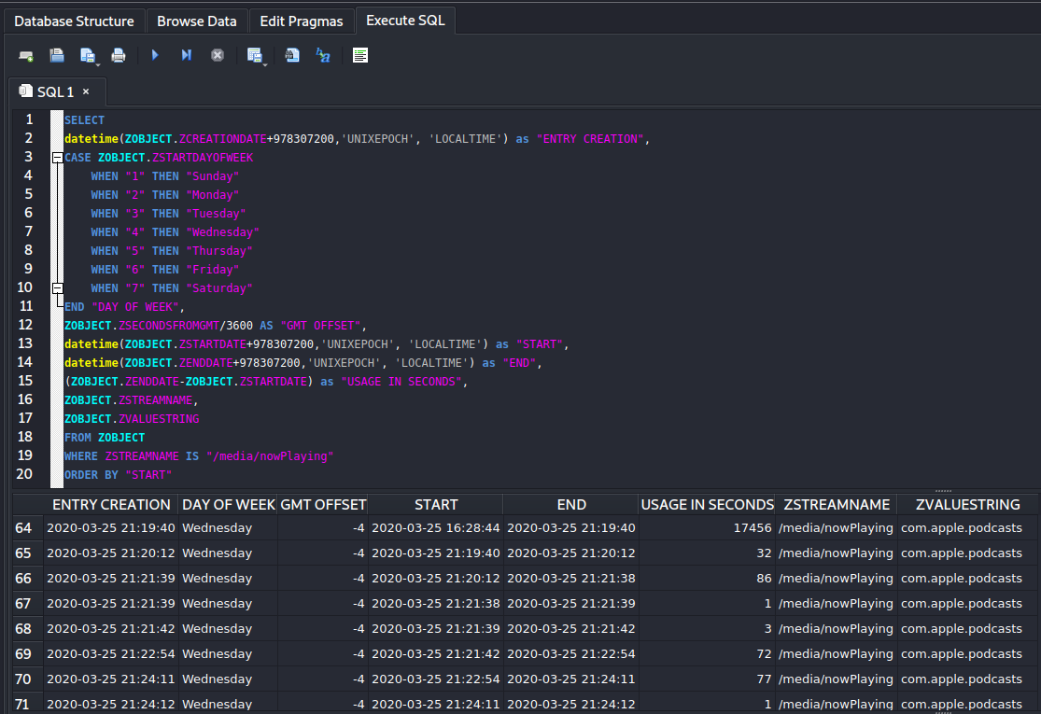
Here we can see what app was playing some kind of music/sound/video etc.
We can tell from the data the user was listening to podcasts on Wednesday 3/25/2020

Slide 38
Advanced SQL Statement
SELECT
datetime(ZOBJECT.ZCREATIONDATE+978307200,'UNIXEPOCH', 'LOCALTIME') as "ENTRY CREATION",
ZOBJECT.ZSECONDSFROMGMT/3600 AS "GMT OFFSET",
CASE ZOBJECT.ZSTARTDAYOFWEEK
WHEN "1" THEN "Sunday"
WHEN "2" THEN "Monday"
WHEN "3" THEN "Tuesday"
WHEN "4" THEN "Wednesday"
WHEN "5" THEN "Thursday"
WHEN "6" THEN "Friday"
WHEN "7" THEN "Saturday"
END "DAY OF WEEK",
datetime(ZOBJECT.ZSTARTDATE+978307200,'UNIXEPOCH', 'LOCALTIME') as "START",
datetime(ZOBJECT.ZENDDATE+978307200,'UNIXEPOCH', 'LOCALTIME') as "END",
(ZOBJECT.ZENDDATE-ZOBJECT.ZSTARTDATE) as "USAGE IN SECONDS",
ZOBJECT.ZSTREAMNAME,
ZOBJECT.ZVALUESTRING,
ZSTRUCTUREDMETADATA.Z_DKAPPLICATIONACTIVITYMETADATAKEY__ACTIVITYTYPE AS "ACTIVITY TYPE",
ZSTRUCTUREDMETADATA.Z_DKAPPLICATIONACTIVITYMETADATAKEY__USERACTIVITYREQUIREDSTRING as "ACTIVITY STRING",
datetime (ZSTRUCTUREDMETADATA.Z_DKAPPLICATIONACTIVITYMETADATAKEY__EXPIRATIONDATE+978307200,'UNIXEPOCH', 'LOCALTIME') as "EXPIRATION DATE"
FROM ZOBJECT
left join ZSTRUCTUREDMETADATA on ZOBJECT.ZSTRUCTUREDMETADATA = ZSTRUCTUREDMETADATA.Z_PK
WHERE ZSTREAMNAME is "/app/activity"
ORDER BY "START"
This section converts the MAC absolute time into a human time, creates the ENTRY CREATION column, and converts the ZSTARTDAYOFWEEK column from numbers to weekdays.
This section creates the, START, END, & USAGE IN SECONDS columns as well as converting the MAC absolute time into a human time.
This section creates the ACTIVITY TYPE, ACTIVITY STRING and EXPIRATION DATE columns as well as converting the MAC absolute time into a human time.
This section performs a “left join” on the ZSTRUCTUREDMETADATA table into the ZOBJECT table which matches the primary keys and foreign keys

Slide 39
Copy and Paste the SQL Statement from the previous slide into the 1st line and hit the Play button.

Slide 40
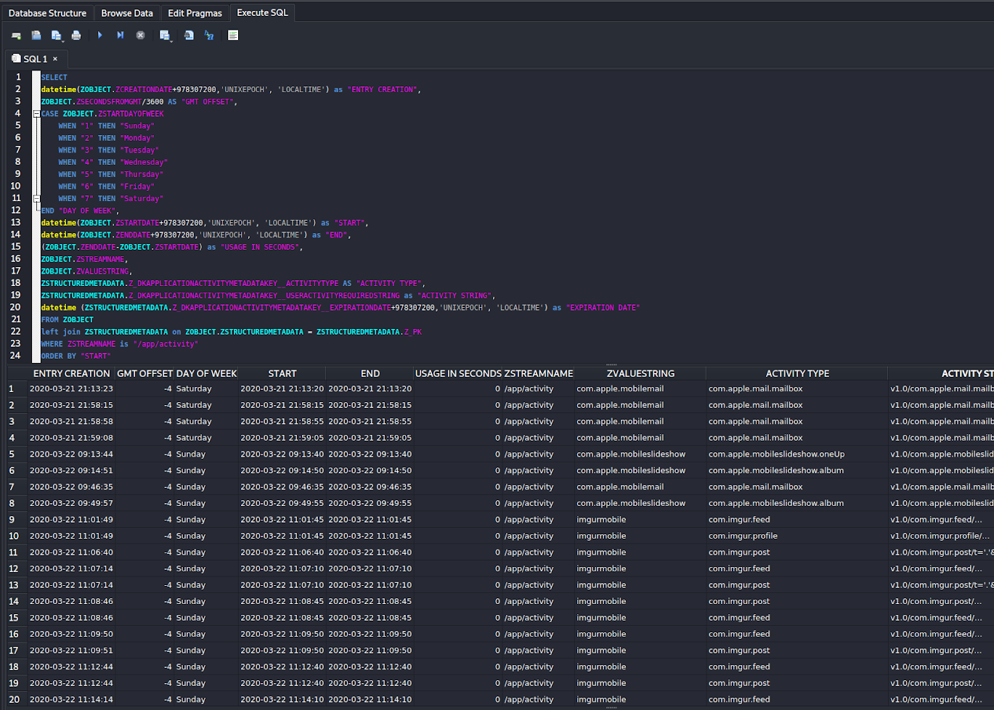
Upon successful execution a slightly larger table than before will show.
Since this statement merges the ZSTRUCTUREDMETADATA table into the ZOBJECT table we will be able to attach the extra metadata stored in ZSTRUCTUREDMETADATA to the entries in ZOBJECT.

Slide 41
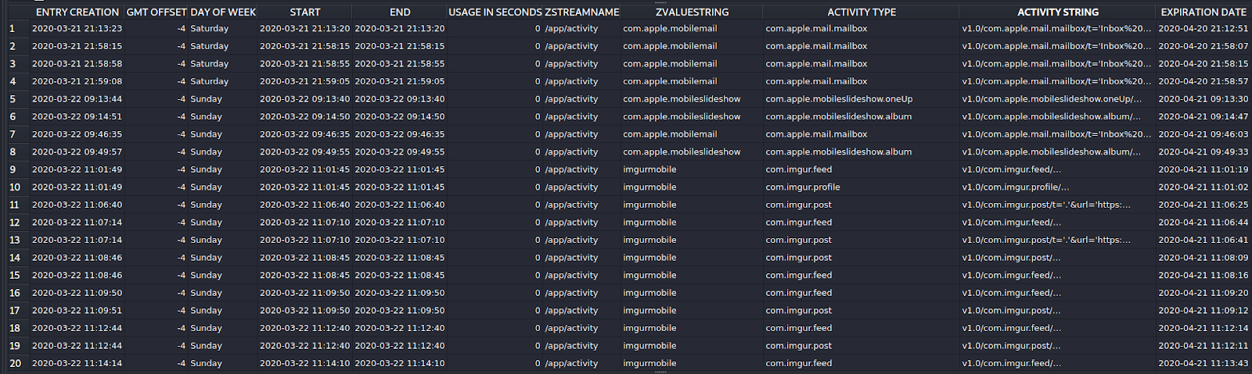
A closer look..
Similar to the previous statement, this new statement adds 3 new columns of metadata, Activity Type, Activity String and Expiration Date.
We can gather extra data from these columns which is useful for an investigation.

Slide 42
Conclusion
KnowledgeC is a powerful and informative database which logs the user's activity on their device.
It can be a goldmine for forensic investigators as it can create a timeline as to what was in use and when.

