Slide 1
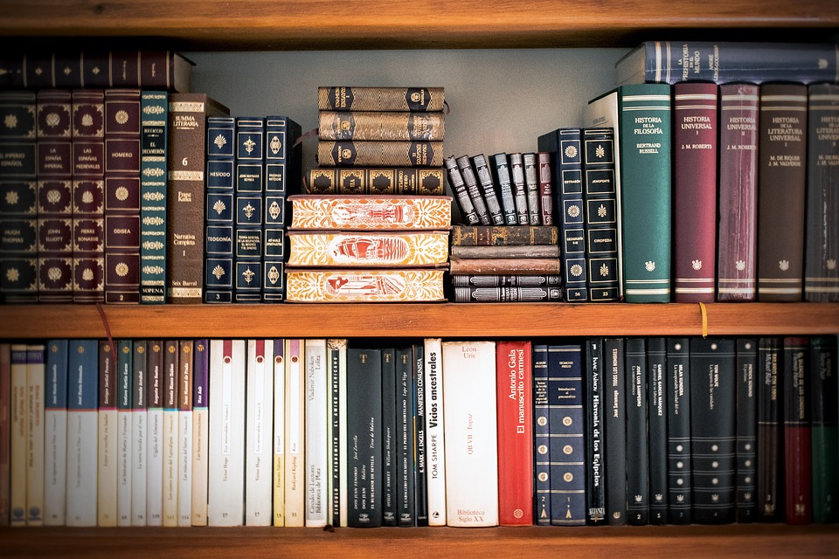
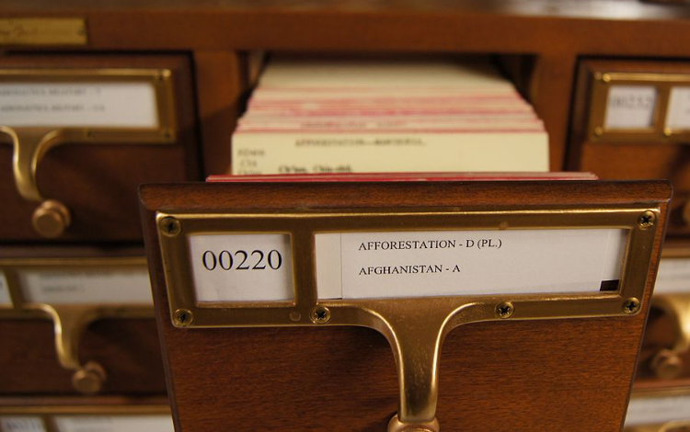
Data Carving
Read a book without an index card

Slide 2
Overview
How file systems retrieve file content?
What is data carving?
Examining image signatures using xxd
Extracting images from a corrupted Word document using bless
carving embedded files
Carving a USB image using scalpel
carving deleted files

Slide 3
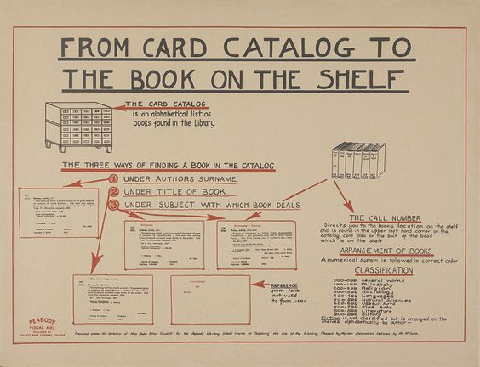

Slide 4
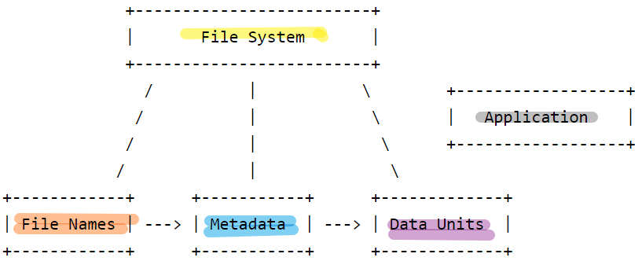
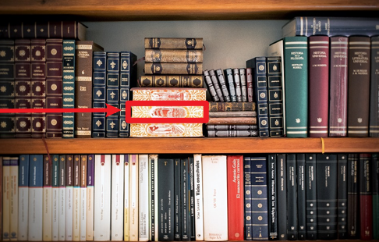
How file systems retrieve file content?

Slide 5
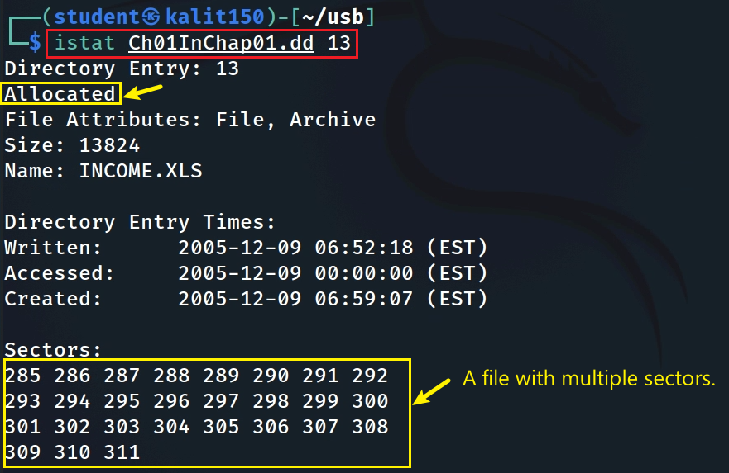
Scenario 1: Show data units (sectors) of a file in a dd image
https://www.dropbox.com/s/nw23q14vzsykyup/Ch01InChap01.dd
27 sector & 512 bytes
Notes:
https://www.dropbox.com/s/nw23q14vzsykyup/Ch01InChap01.dd

Slide 6
Scenario 2: Show data units (blocks) of a file in Kali
Download an image to Kali
sudo apt install imagemagick
if display doesn’t work
Notes:
wget -q https://raw.githubusercontent.com/frankwxu/digital-forensics-lab/main/Basic_Computer_Skills_for_Forensics/file_carving/usb_file/J_ub_law.jpg

Slide 7
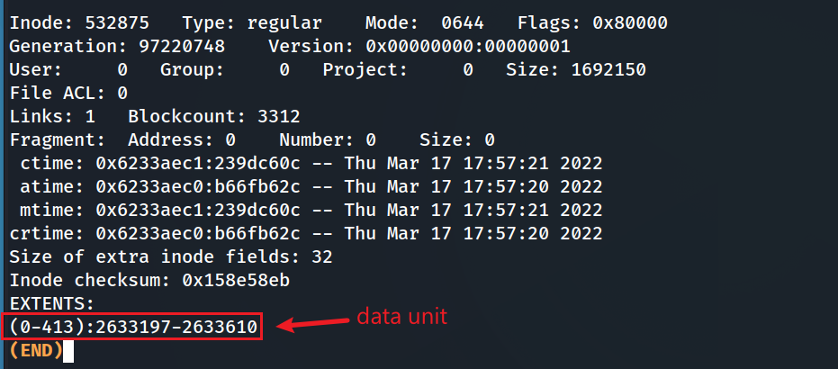
Show data units (blocks) of the image using debugfs
real size (1 block is 4k)
Notes:
sudo tune2fs -l /dev/sda1 | grep Block

Slide 8
Anything can be wrong!

Slide 9
What is data carving?
A well-known computer forensics term
aka file carving
To identify and extract (carve) the file
from unallocated clusters/corrupted file header
without the assistance of the file system that originality created the file.
How to extract files?
based on signature information alone.

Slide 10
Example scenarios
Scenario 1: A file (A) is hidden inside of another file (B). You can’t open the file B because the B’s header is corrupted.
Scenario 2: A suspect deleted files. The files contains an important information. A file occupies a few clusters. Unfortunately, some clusters are reused (overwritten) by new files.
A forensic expert really wants to recover files, even a partial files.

Slide 11
Approach- Search for File signature
The data units is saved independently from
file name and metadata
The content of a file is enclosed by
file signatures (header and tail)
What is file signature?
referred to as a magic number,
a constant numerical/text value
used to identify a file format

Slide 12
Data Unit internal structure
Header signature
content
reference to
Content
istat: Displays the statistics and details about a given meta data structure in an easy to read format.
Tail signature

Slide 13
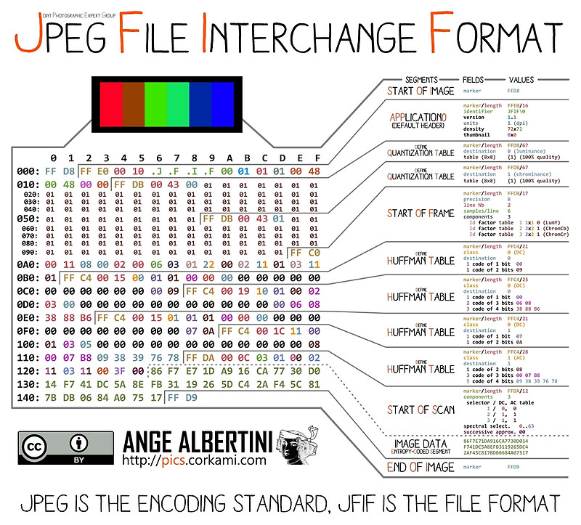
An example of Picture Data Unit
Notes:
https://www.offshoreclippingpath.com/difference-between-jpg-and-jpeg/

Slide 14
Compressed content- Huffman Coding
JPEG Image Compression
Invented by David Huffman
a graduate student at MIT in 1952
as part of his course work.
Huffman coding can be used to compress all sorts of data.
It is an entropy-based algorithm that relies on an analysis of the frequency of symbols in an array.

Slide 15
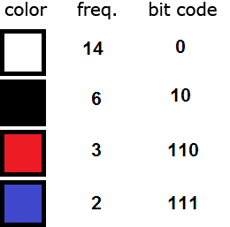
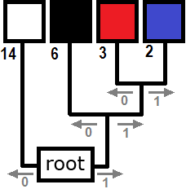
Each pixel requires 14 bits = 2³ (row)+2³ (col)+2⁸ (color)
(000)(100)(11111111)
Total: [6 (position) + 8 (color) ]*25=250
Before compression
sort the colors in order of decreasing frequency.
traverse from root to each color
colors farthest from the root are the least frequent.
Total bits required after compression:
25 x 6 (position)+
14 x 1 + 6 x 2 + 3 x 3 + 2 x 3 (color)
= 150+41 =191
Compression process
After Compression
Notes:
https://www.print-driver.com/stories/huffman-coding-jpeg

Slide 16
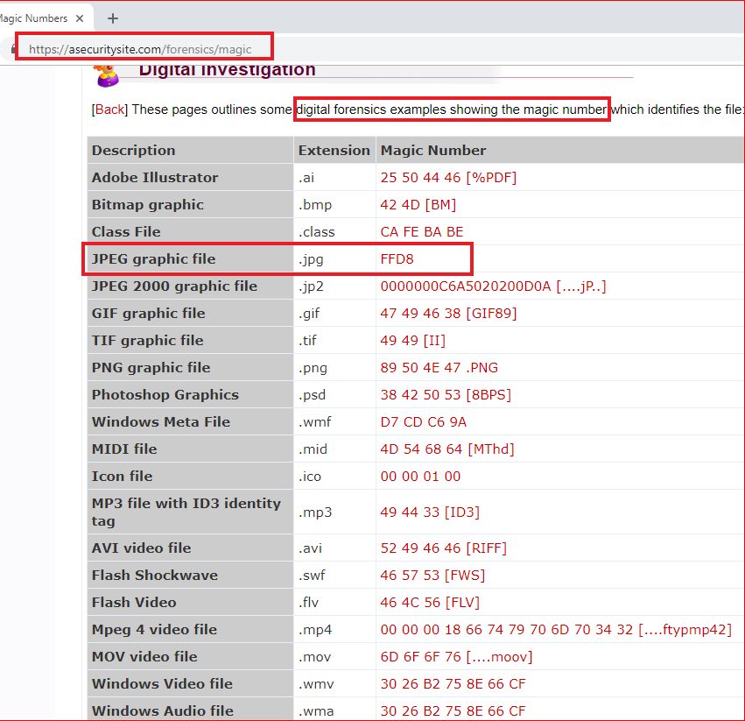
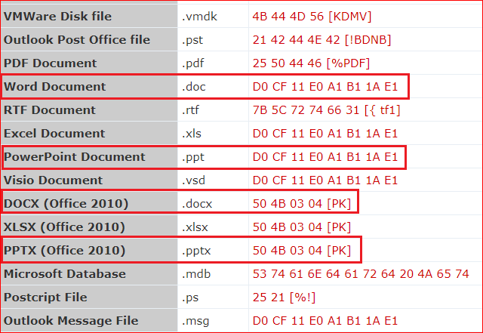

Slide 17
Examining image signatures
using xxd

Slide 18
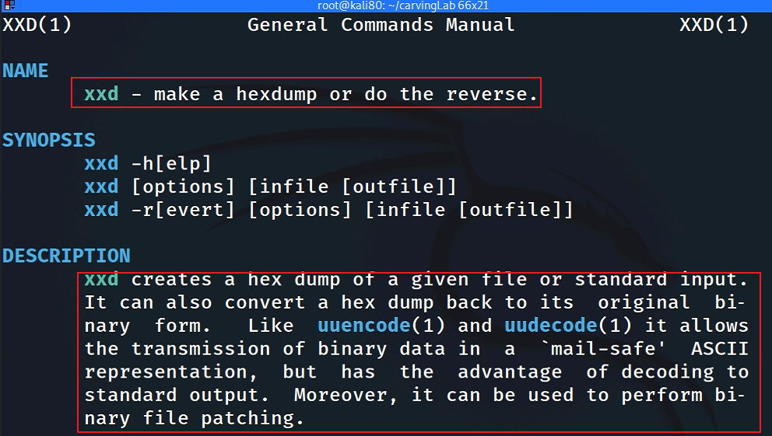
What is xxd?

Slide 19
Get a jpg to show signature
sudo apt install imagemagick
if display doesn’t work
Notes:
wget -q https://raw.githubusercontent.com/frankwxu/digital-forensics-lab/main/Basic_Computer_Skills_for_Forensics/file_carving/usb_file/J_ub_law.jpg

Slide 20
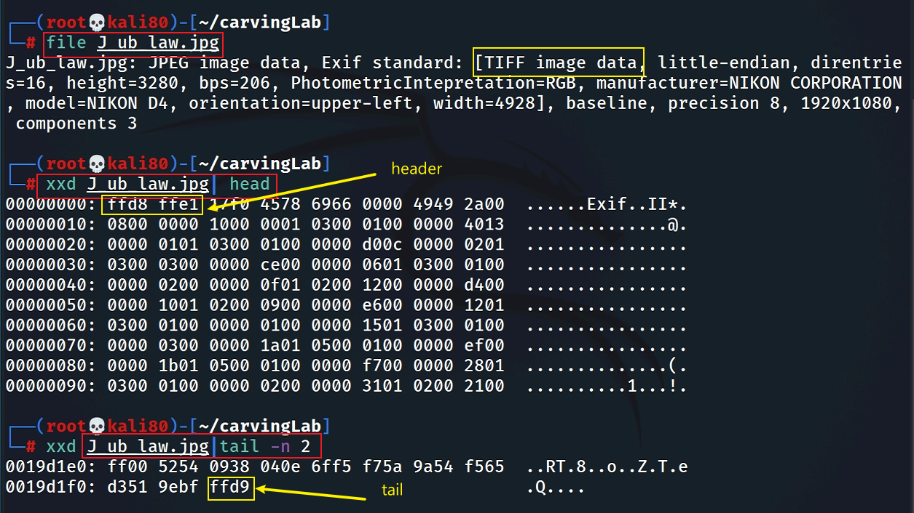
Show JPG header and tail signatures
The picture is taken by NIKON D4

Slide 21
Alternative: Show JPG header and tail signatures
Alternative: Hexdump the first 120 bytes
Alternative: Show hex from a start address

Slide 22
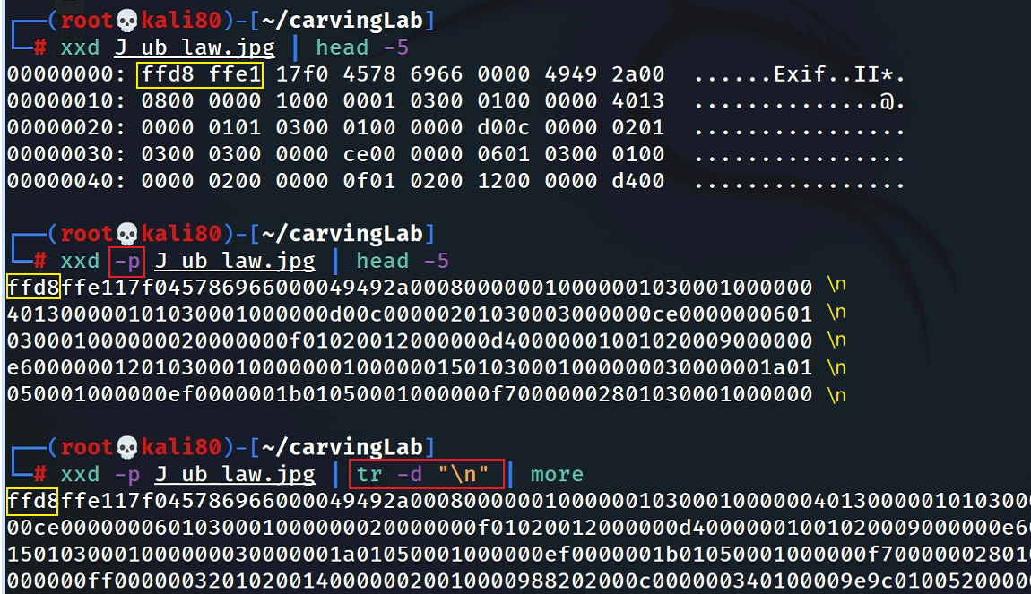
Search signatures in plain hexdump
Convert hexdump to plain hexdump
space causes search problem if we want to search “ffd8ffe1” . Will show it in next slide

Slide 23
Search header in plain hexdump
Search tail in plain hexdump
How to search hex numbers between 2 lines? e.g., 0105?

Slide 24
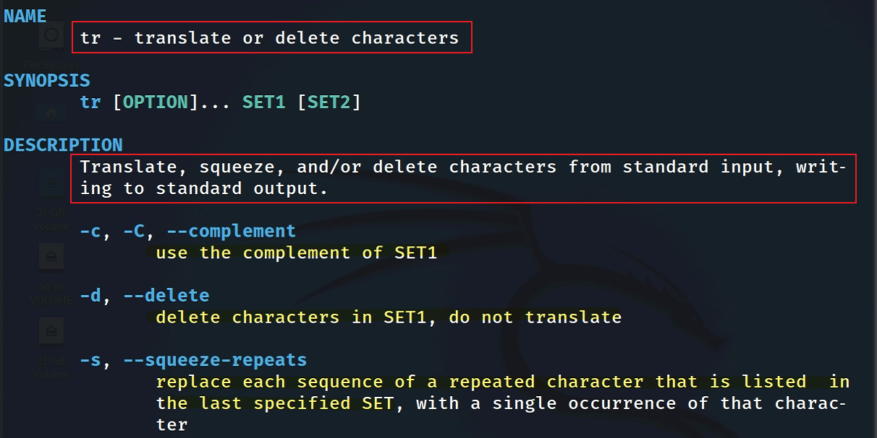
remove newline “\n”
tr command introduction

Slide 25
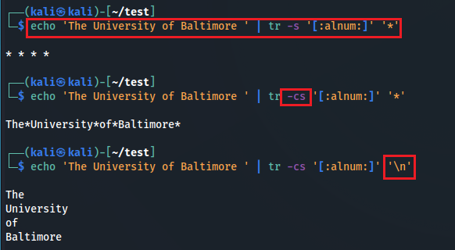
squeeze alphabets and numbers and replace them with *
squeeze NON (alphabets and numbers) and replace them with *
squeeze NON (alphabets and numbers) and replace them with \n
Notes:
echo 'The University of Baltimore ' | tr -s '[:alnum:]' '*’
echo 'The University of Baltimore ' | tr -cs '[:alnum:]' '*’
echo 'The University of Baltimore ' | tr -cs '[:alnum:]' '\n'

Slide 26
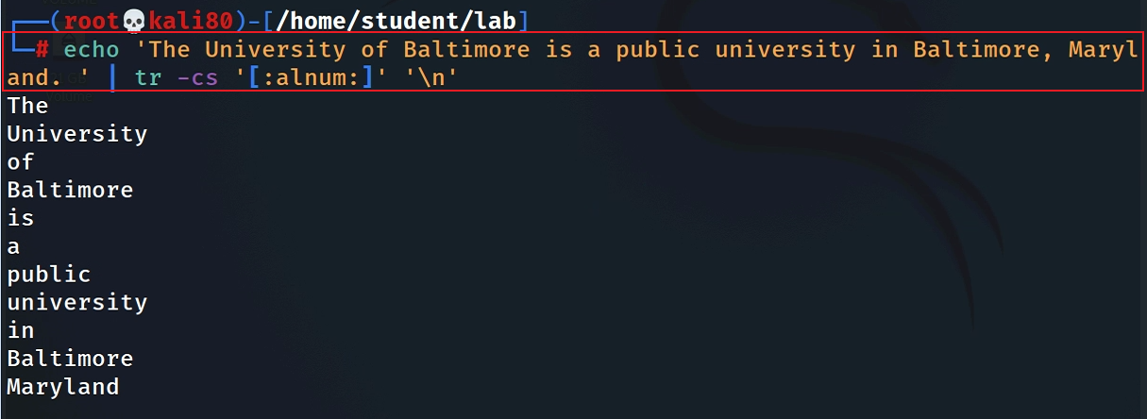
A small tr example: match all non-alphanumerical characters and replace them with a new line
Two tasks:
Squeeze repeated characters listed in a set ‘’
replace squeezed with “\n”
Notes:
echo 'The University of Baltimore is a public university in Baltimore, Maryland. ' | tr -cs '[:alnum:]' '\n'

Slide 27
Dump the content between header and tailer signature
Match plain hexdump between header and tail signature and save the plain hexdump to a textfile
-o
Notes:
xxd -p J_ub_law.jpg | tr -d "\n" | grep - o "ffd8ff.*ffd9" > J_ub_law_hexdump.txt

Slide 28
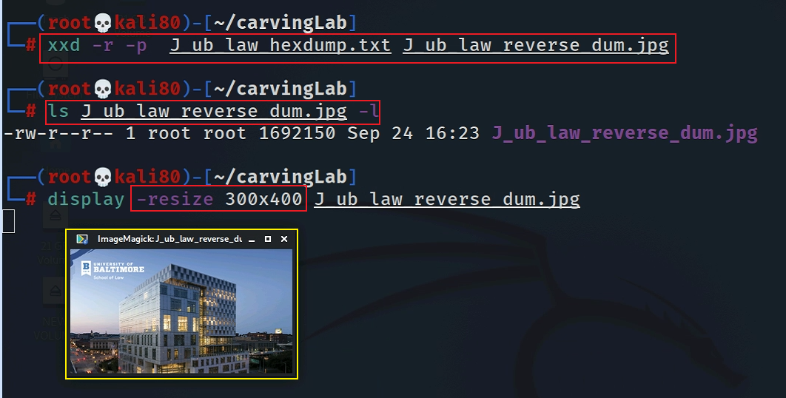
Convert a plain hexdump to back into binary
Notes:
xxd -r -p J_ub_law_hexdump.txt J_ub_law_reverse_dum.jpg

Slide 29
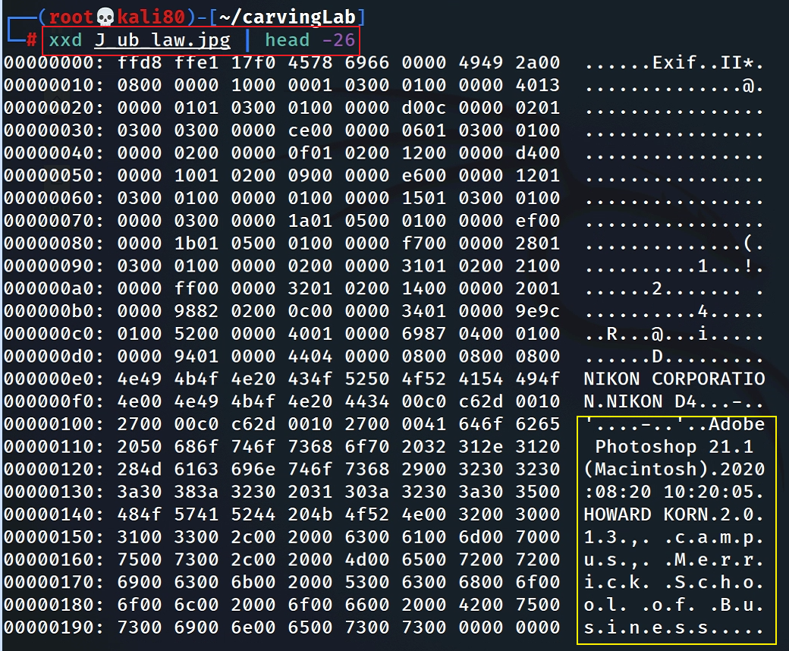
Interesting evidence in file header

Slide 30
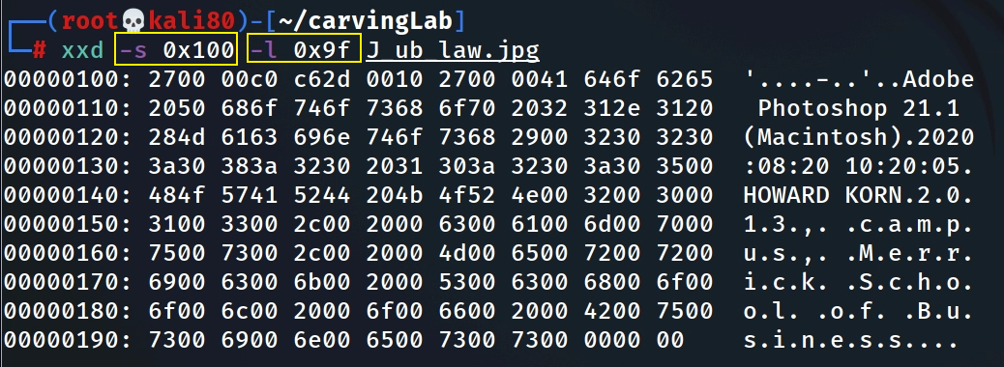
Hexdump Photoshop infor starts from 0x100 and list 0x9f bytes
Hexdum the name
Notes:
xxd -s 0x100 -l 0x9f J_ub_law.jpg

Slide 31
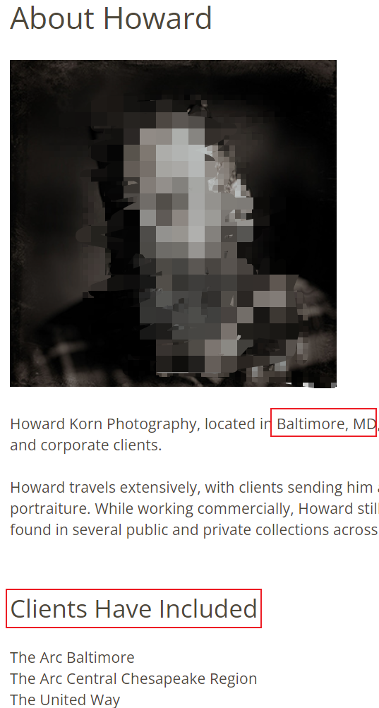
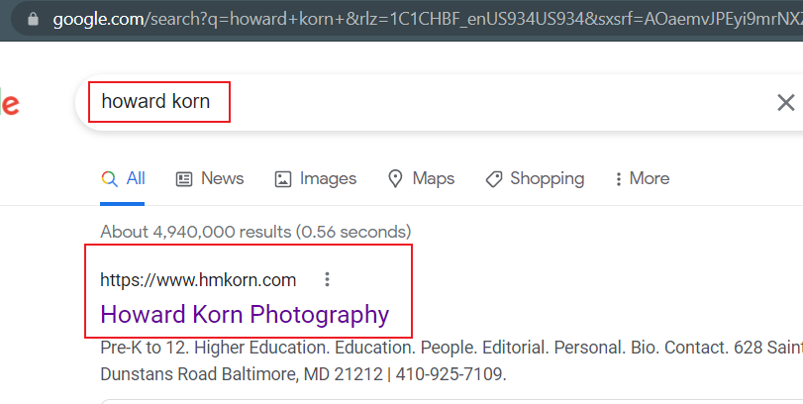
Who is Howard Korn?

Slide 32
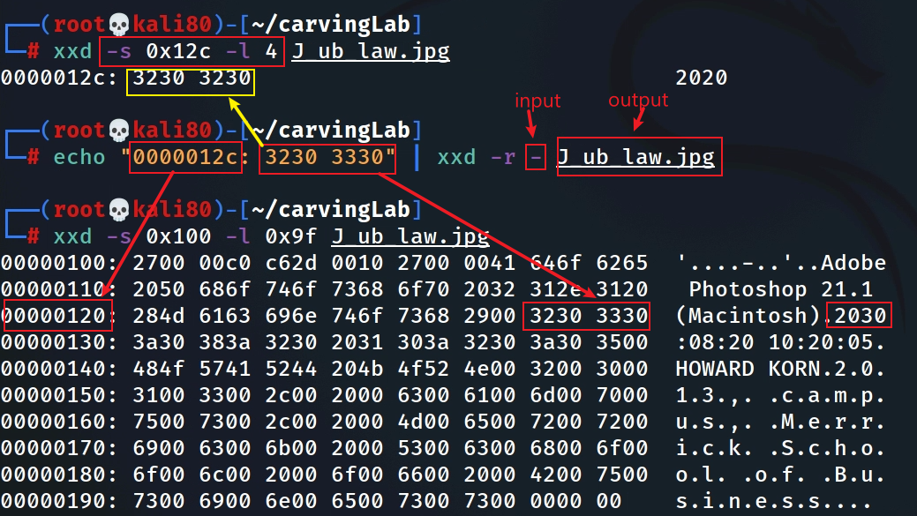
Fake the date (2020 -2030)
Hexdump the year
xxd reverses hexdump to binary (read from standard input. Overwrite 2020 with 2030)
If infile is specified as a `-' character, then input is taken from standard input.

Slide 33
Security implications
Modify software function
1
unlimited resource for games
Bypass security check
2
authentication
Insert malicious code
3
backdoor

Slide 34
Extracting images from a corrupted Word document
using bless

Slide 35
We can’t open the file because the file is corrupted (accidentally or intentionally)!
How to corrupted a file?

Slide 36
Prepare required files for the lab
the file we need
Notes:
wget -q https://raw.githubusercontent.com/frankwxu/digital-forensics-lab/main/Basic_Computer_Skills_for_Forensics/file_carving/File_Carving_Manually/File_carving.docx

Slide 37
View the file in a hex editor

Slide 38
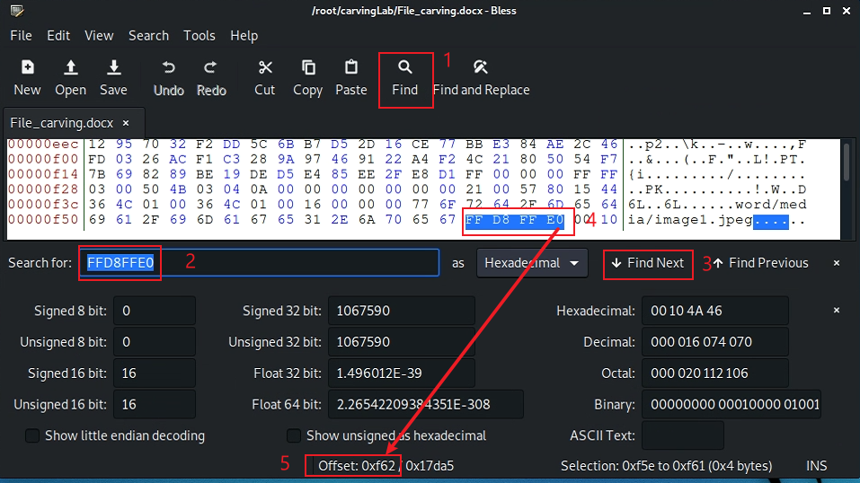
Search file header start offset – 0F5E
after the highlighted position

Slide 39
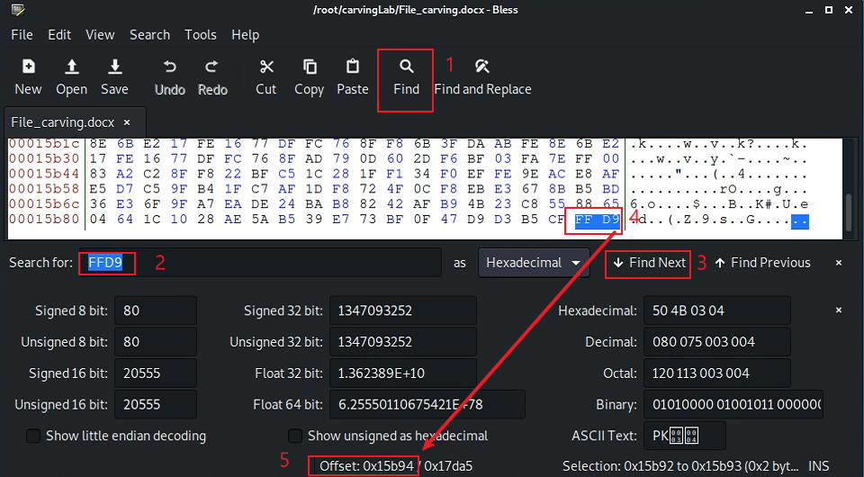
Search file trailer ends offset – 15B93
after the highlighted position

Slide 40
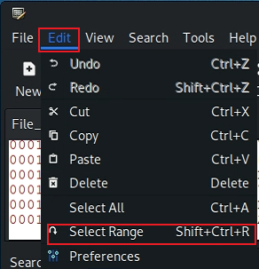
Select hex from header to tail
(0F5E)16=(3934)10
(15B93)16=(88979)10
Notes:
echo $((16#f5e))
echo $((16#15b93))

Slide 41
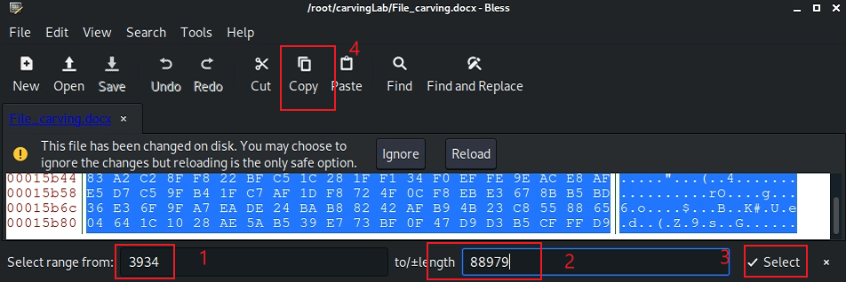
Copy the selection

Slide 42
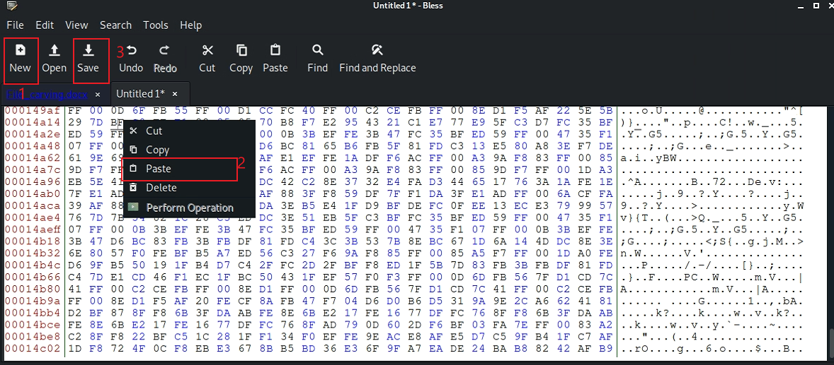
Paste the selection

Slide 43
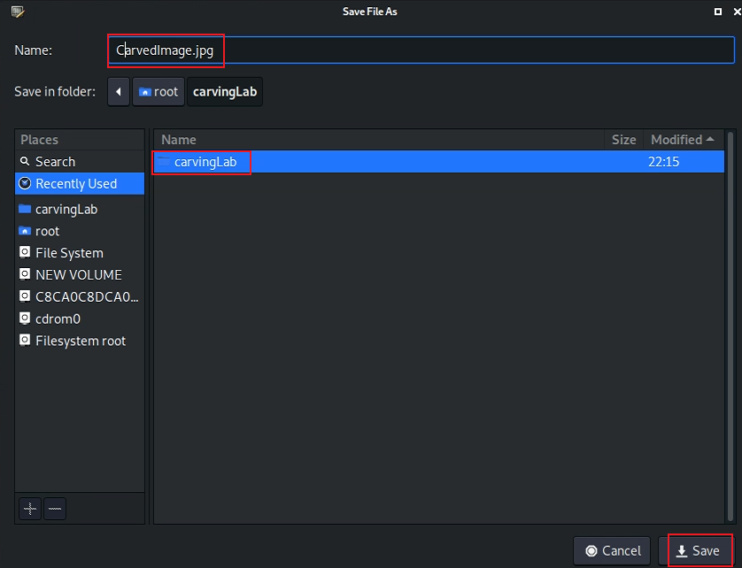
Save the image

Slide 44
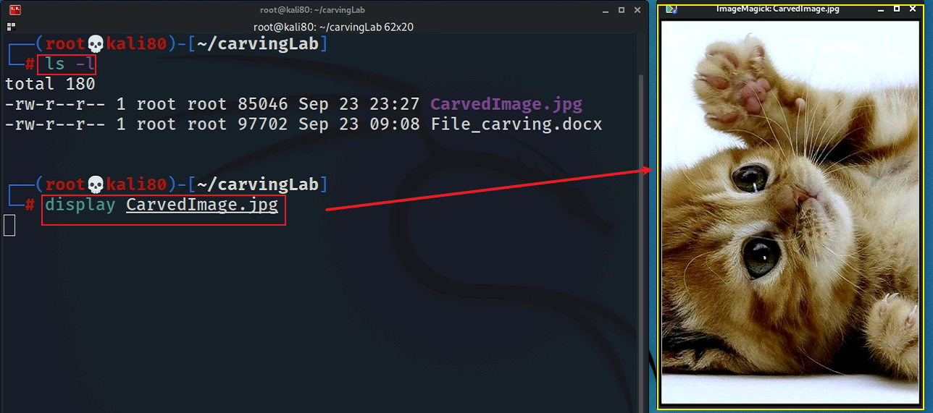
Show the carved image

Slide 45
Alternative 1: using xxd
Must have –p, which tells xxd the input is a plain text
Notes:
xxd -p File_carving.docx | tr -d '\n' | grep -o "ffd8ffe0.*ffd9" | xxd -r -p - CarvedCat.jpg

Slide 47
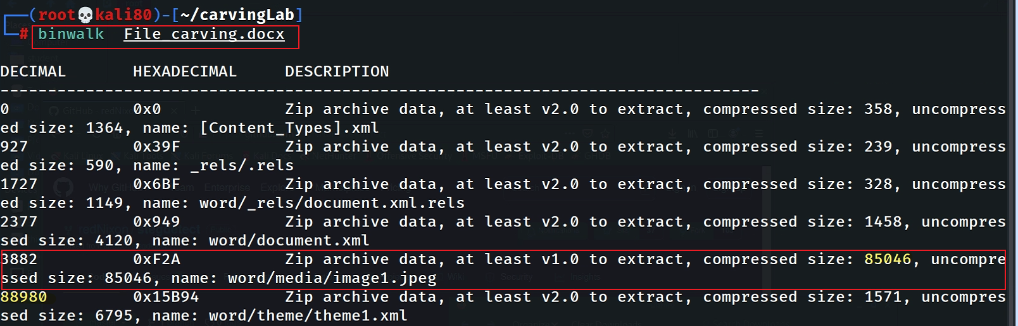
Alternative 2: using binwalk

Slide 48
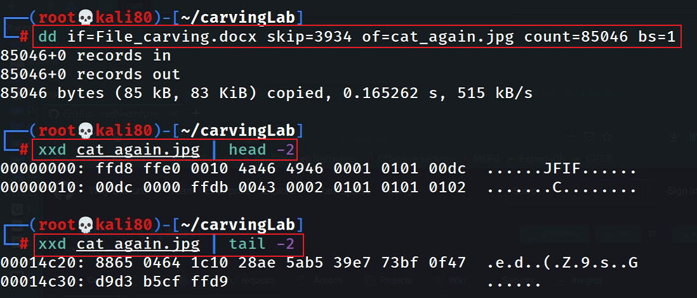
88980-85046=3934
Why not start from 3882? Word includes embedding header (48 bytes).

Slide 49
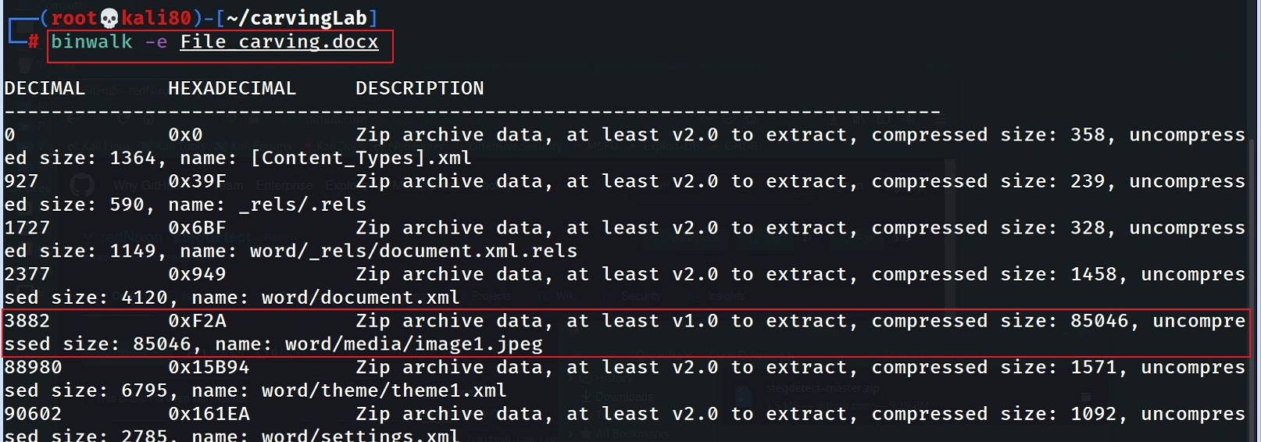
Alternative 3: using binwalk

Slide 50
Carving a USB image
using scalpel

Slide 51
Prepare a USB image for file carving
Download the zipped USB image
Compute hashes
Notes:
wget -q https://raw.githubusercontent.com/frankwxu/digital-forensics-lab/main/Basic_Computer_Skills_for_Forensics/file_carving/usb_image/120M.7z

Slide 52
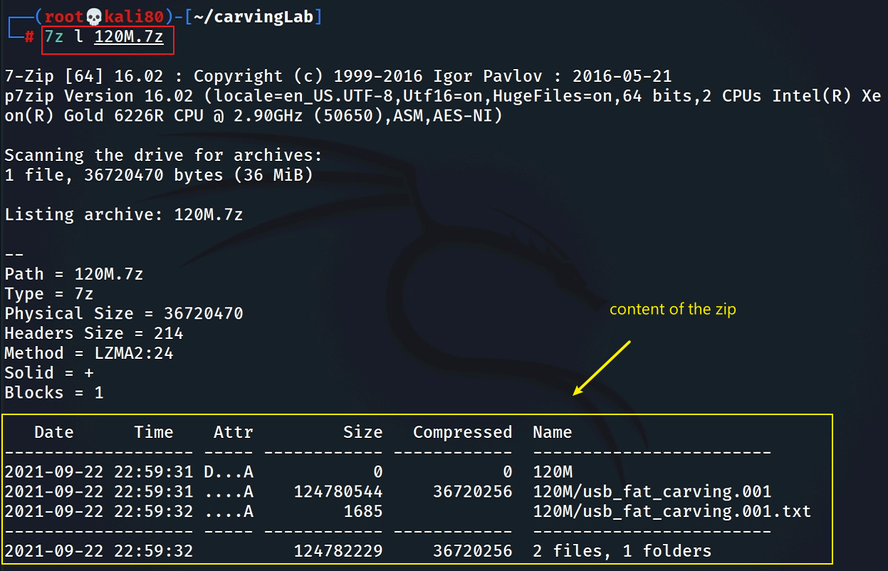
List the content of the zipped file

Slide 53
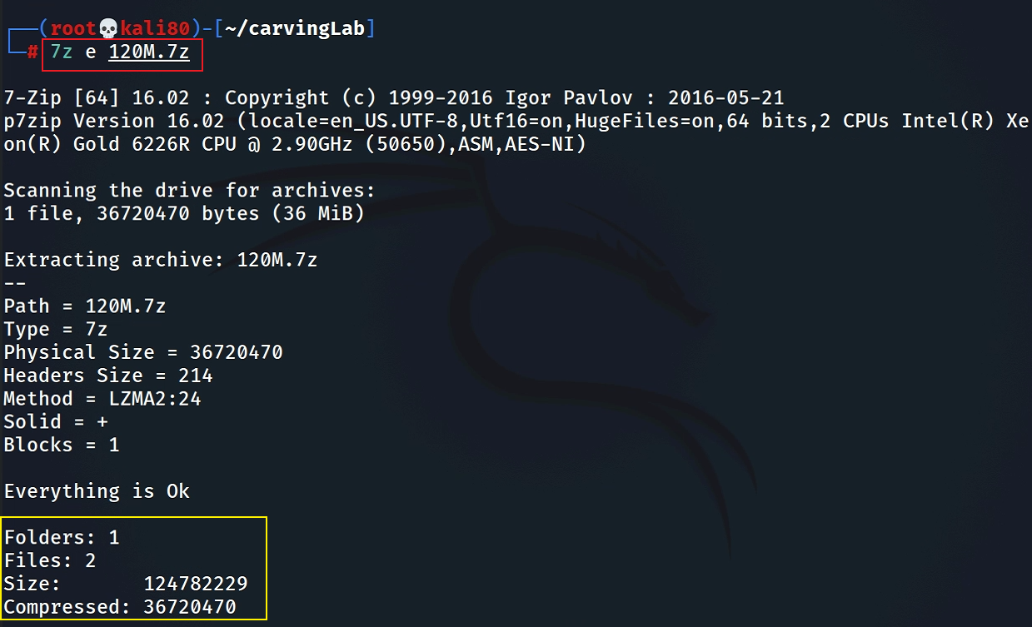
List the content of the zipped file
e : Extract files from archive (without using directory names)

Slide 54
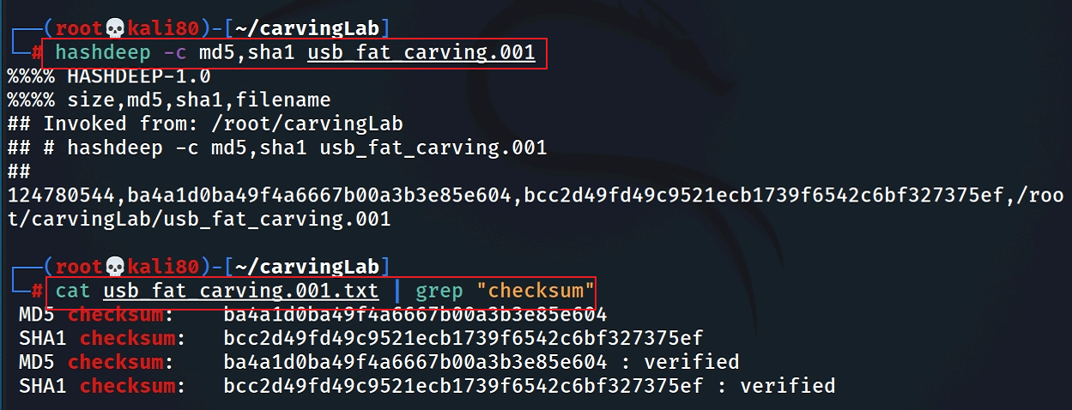
Verify the hashes

Slide 55
Exam the content of the USB
Display partitions

Slide 56
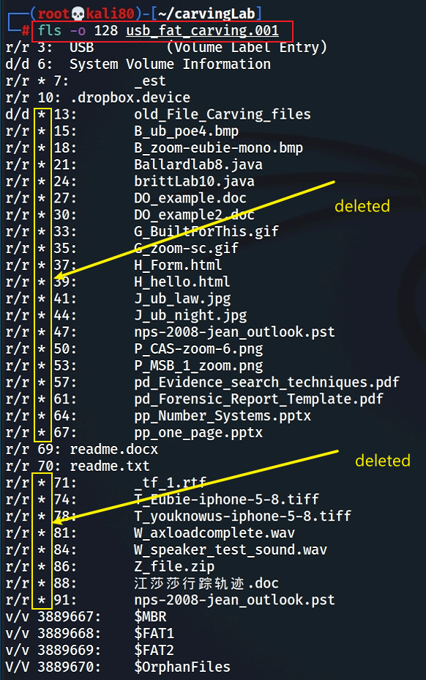
Find deleted files

Slide 57
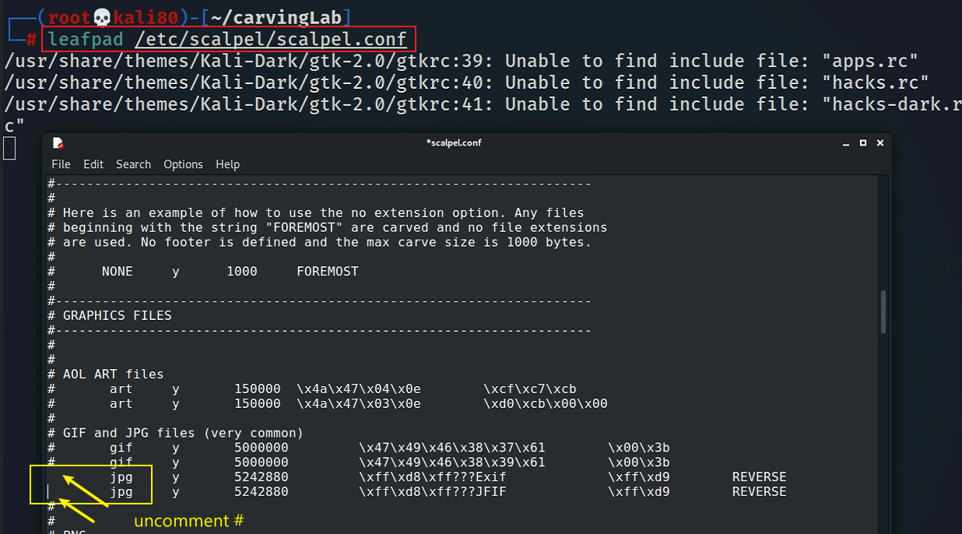
Decide which file types need to carve
Save it and quit!

Slide 58
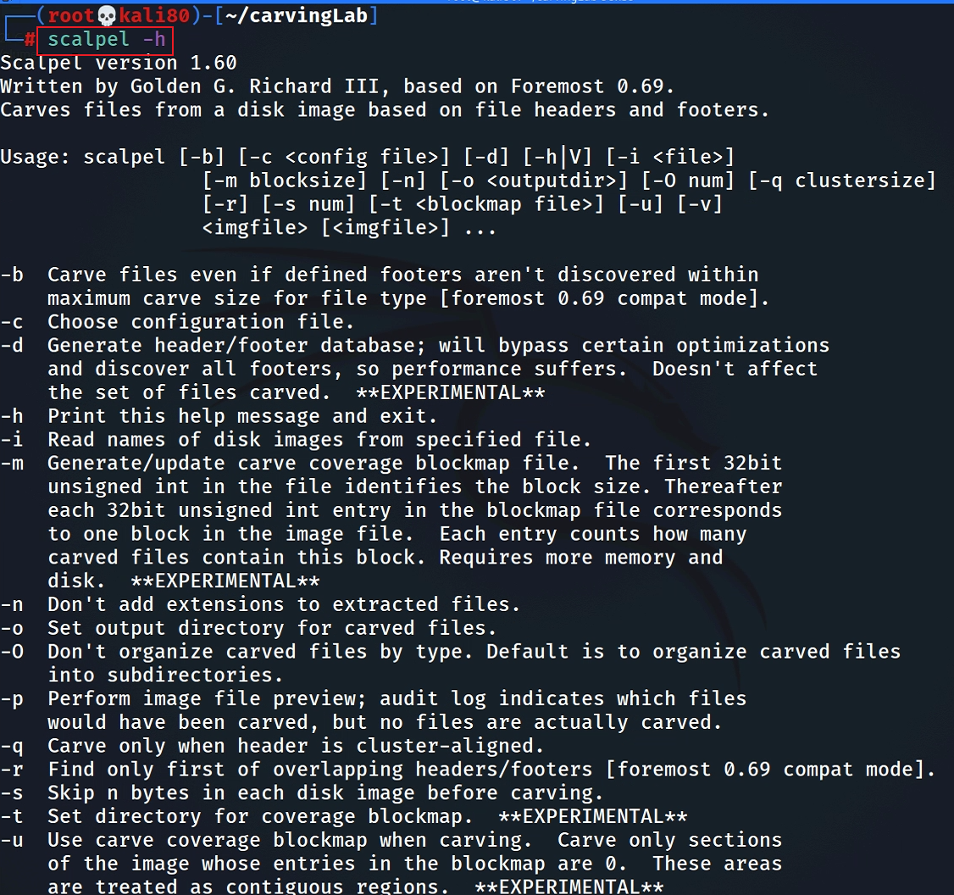
Show help

Slide 59
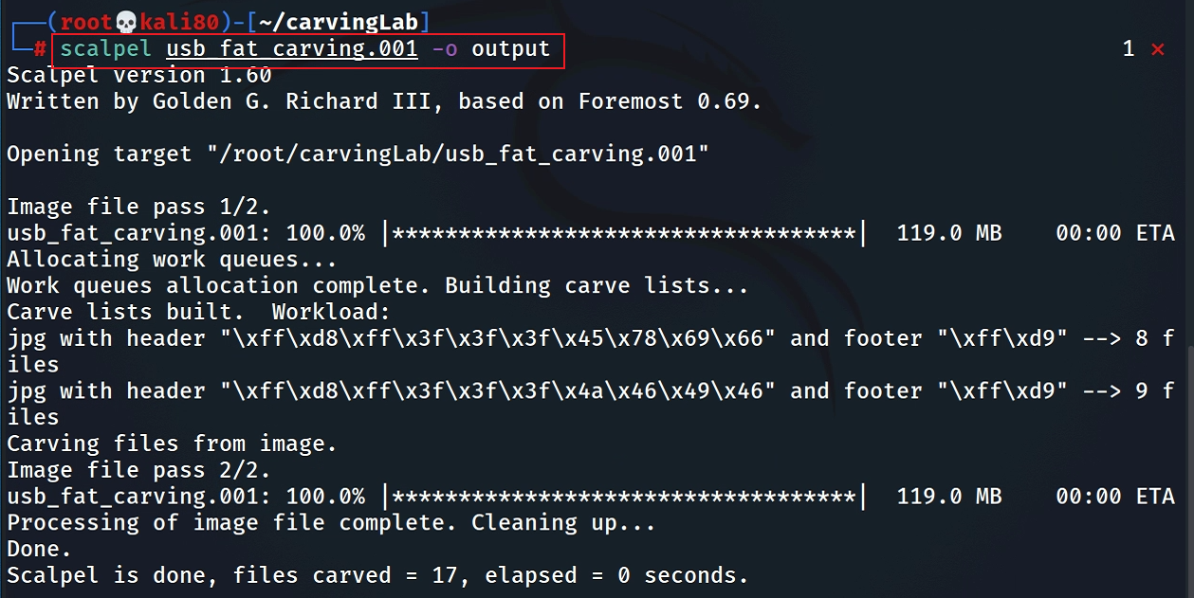
Carving the USB image

Slide 60
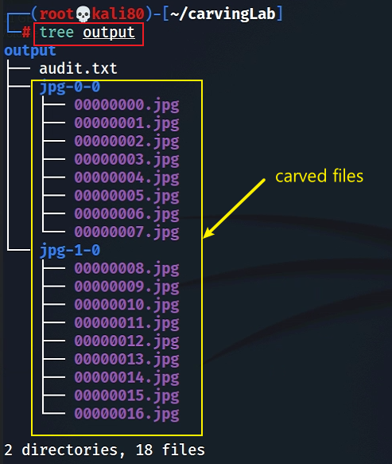
Show carved files

Slide 61
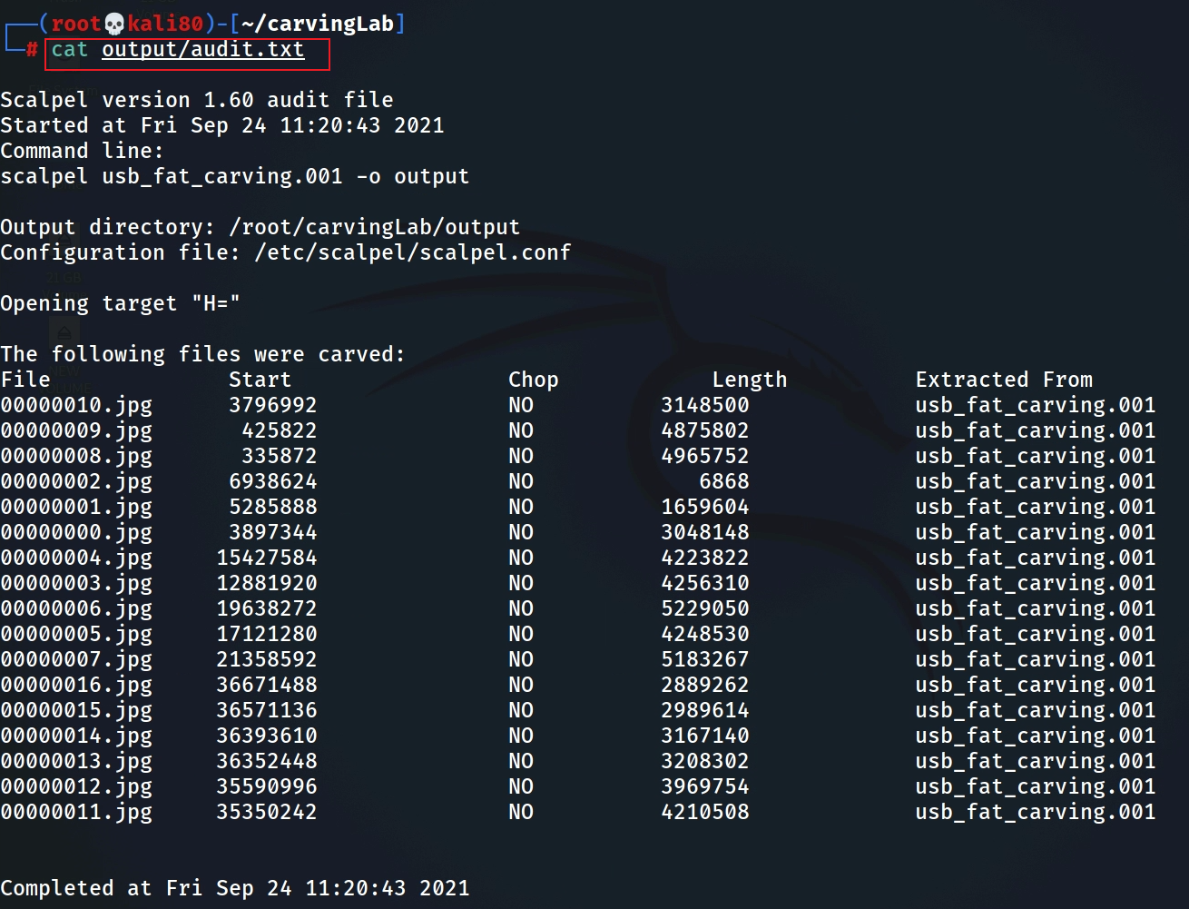
Show audit log

Slide 62
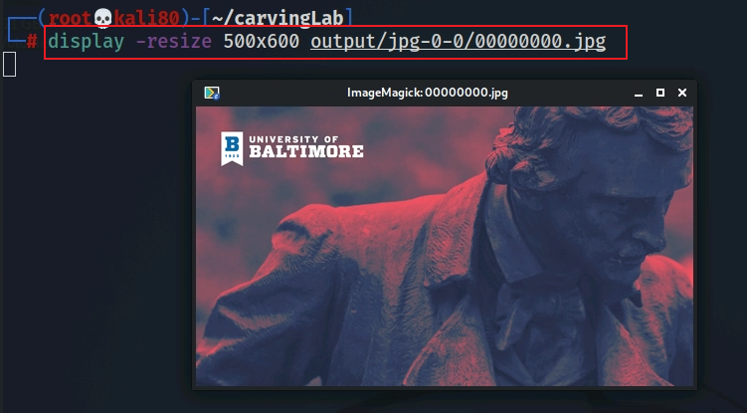
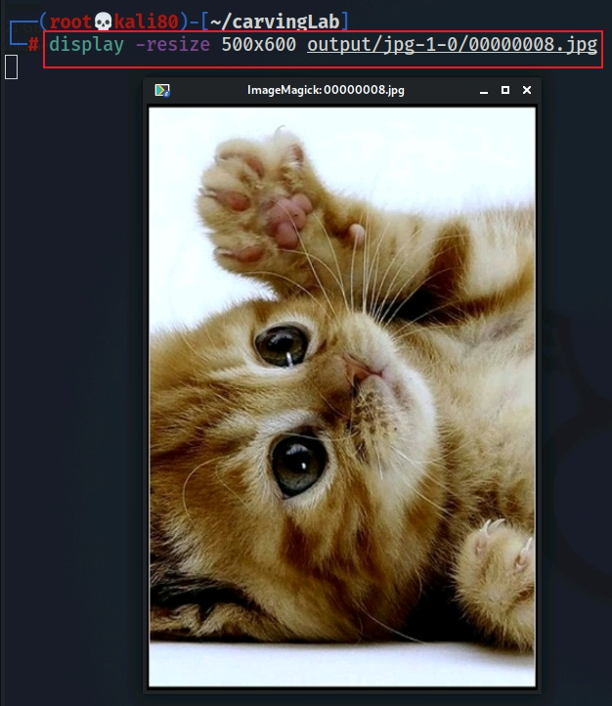
Display two carved jpg image

Slide 63
Summary
File header and tail signatures are used to identify file types
The content of a file is enclosed in header and tail signatures
Many tools can used for carving file content
Note the file names/metadata can’t be retrieved

