Slide 1
Magnet Axiom
iOS 13 Investigation
Notes:
https://digitalcorpora.s3.amazonaws.com/corpora/mobile/ios_13_4_1/ios_13_4_1.zip

Slide 2
Overview
What is Magnet Axiom
Loading the image into Magnet Axiom
Examining data with Magnet Axiom
Reporting with Magnet Axiom
Review Reports

Slide 3
What is Magnet Axiom

Slide 5
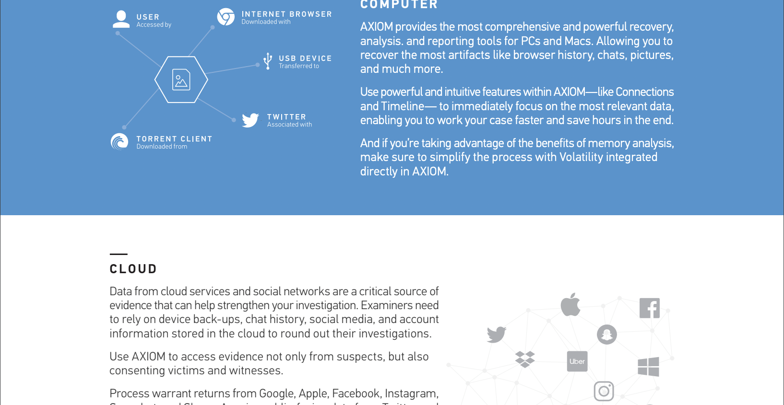

Slide 6
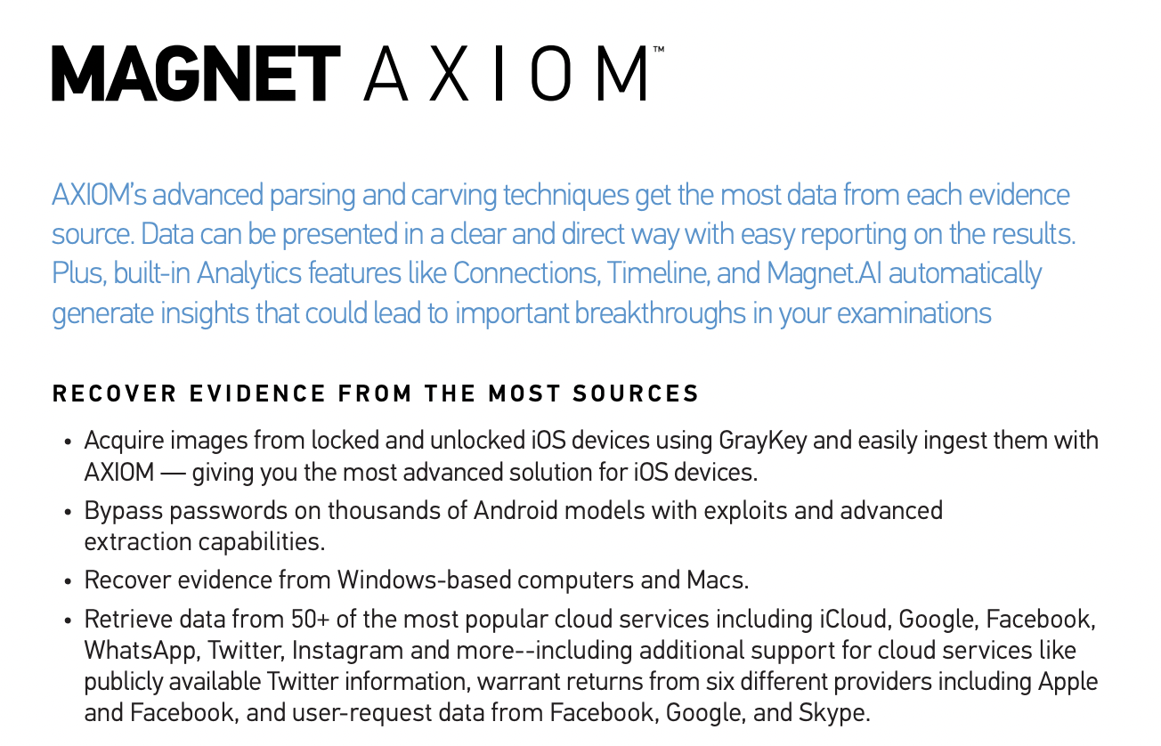

Slide 7
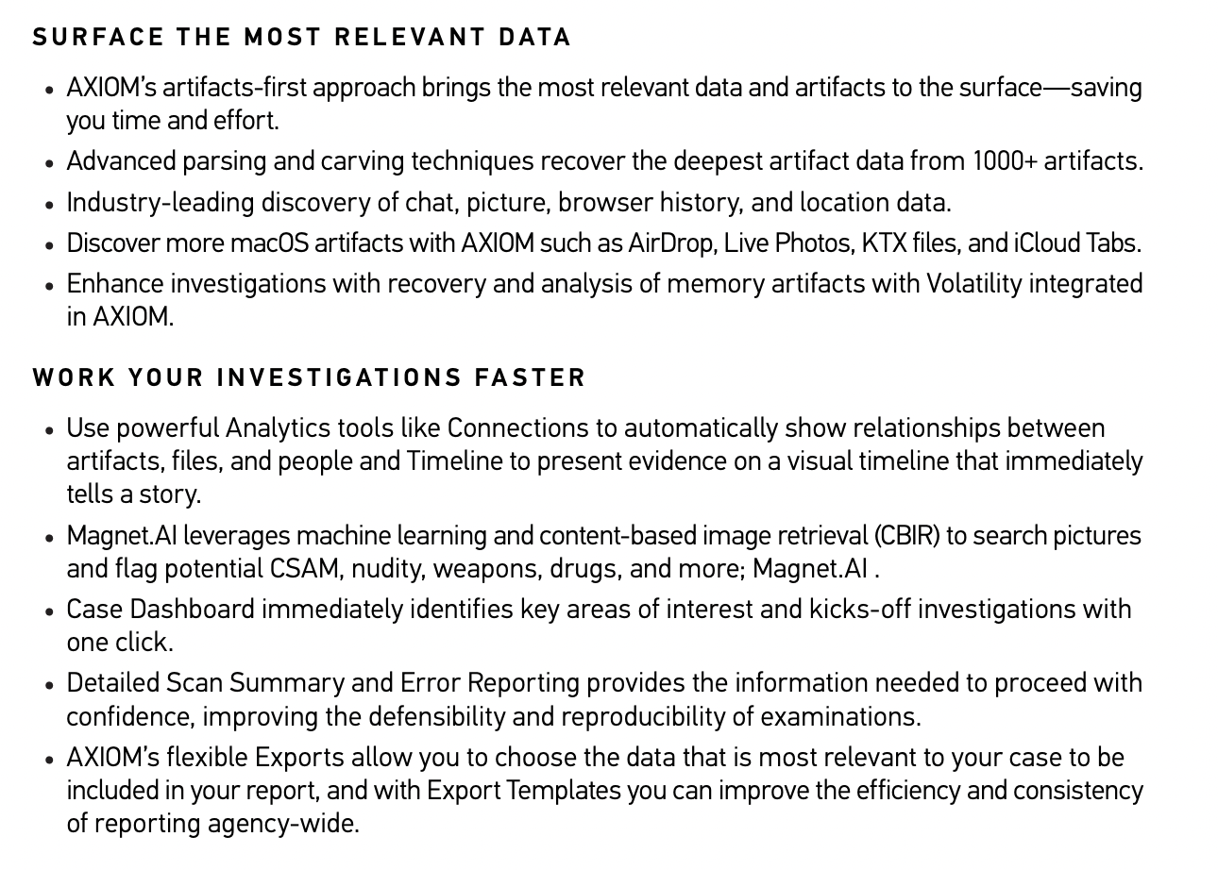

Slide 8
Loading Image into Magnet Axiom
Notes:
https://digitalcorpora.s3.amazonaws.com/corpora/mobile/ios_13_4_1/ios_13_4_1.zip

Slide 9
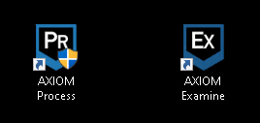
Download and Unzip Image, then open Axiom Process It is a two-step process to load evidence.
Axiom Process is used to select evidence and artifacts, Axiom Examine is used to view the results.

Slide 10
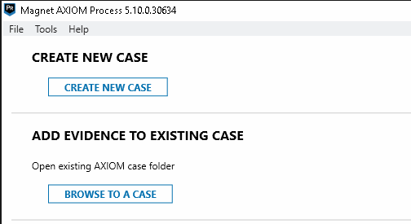
Once Axiom Process is Open Select Create New Case

Slide 11
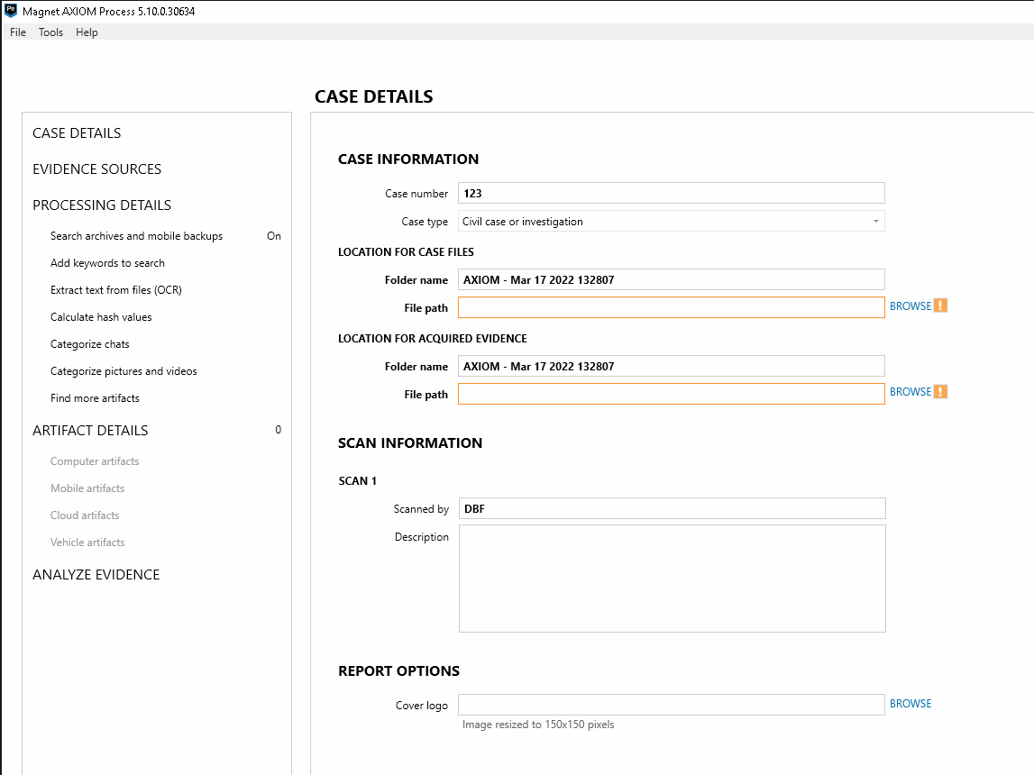
Fill in the Case Details
Case Number
Case Type
Location for Case files to be stored
Location for Acquired Evidence to be stored. (Only if imaging withing Axiom)
Examiner name and Lastly, Report options.

Slide 12
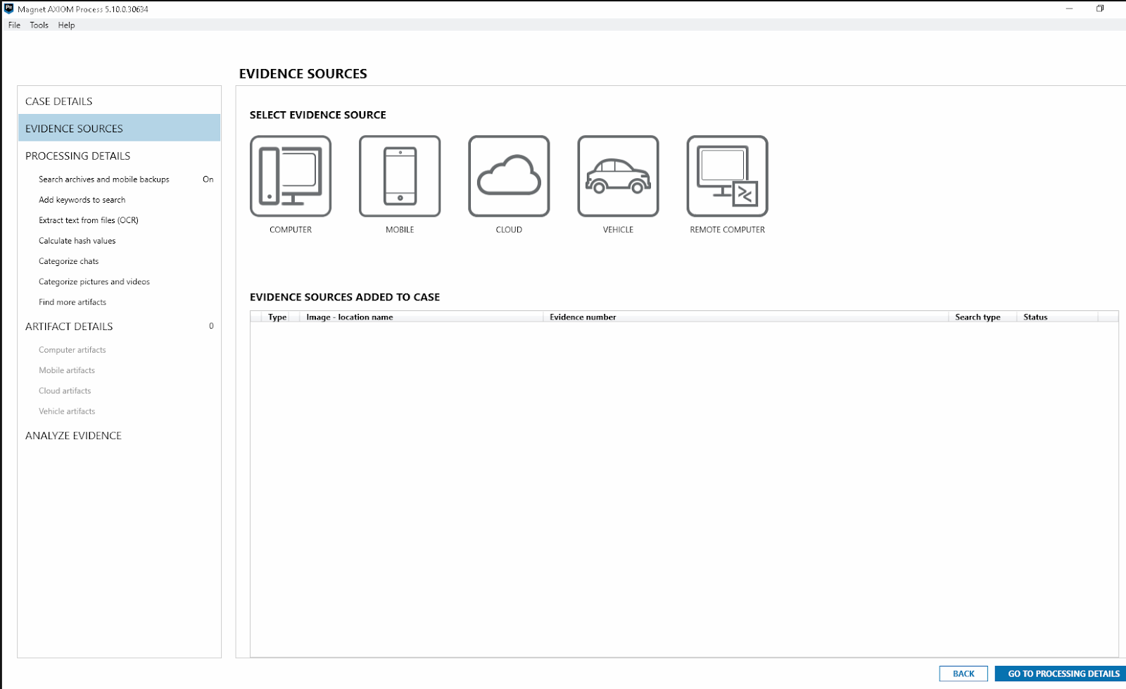
Select the Evidence Source
In this case, Mobile.
Proceed to Processing Details.

Slide 13
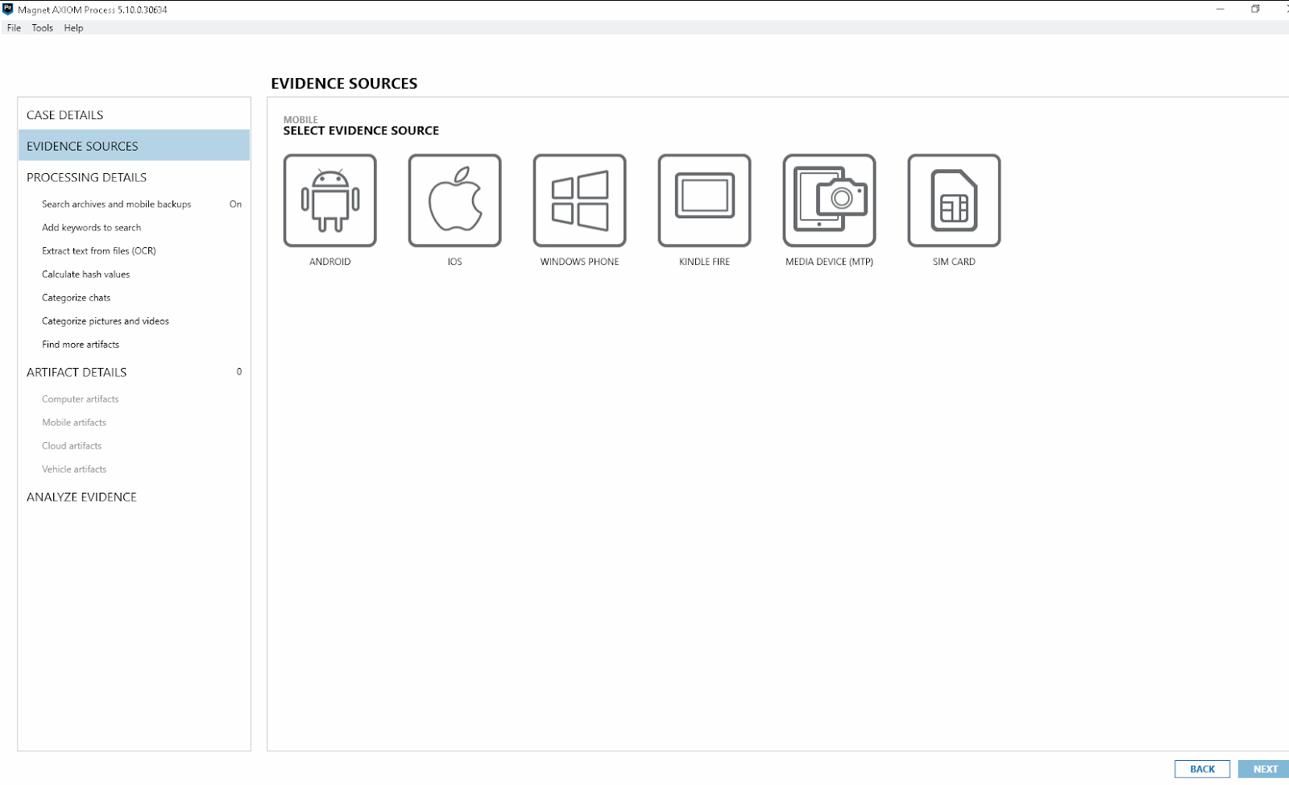
Select the mobile evidence source
In this case – iOS
Proceed with Next.

Slide 14
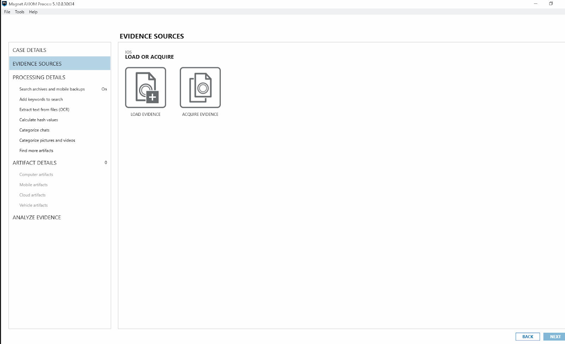
Here, either point Axiom to the Image or Acquire it with Axiom’s built in Imager.
Since we already have the image, we can select Load evidence.
Proceed with Next.

Slide 15
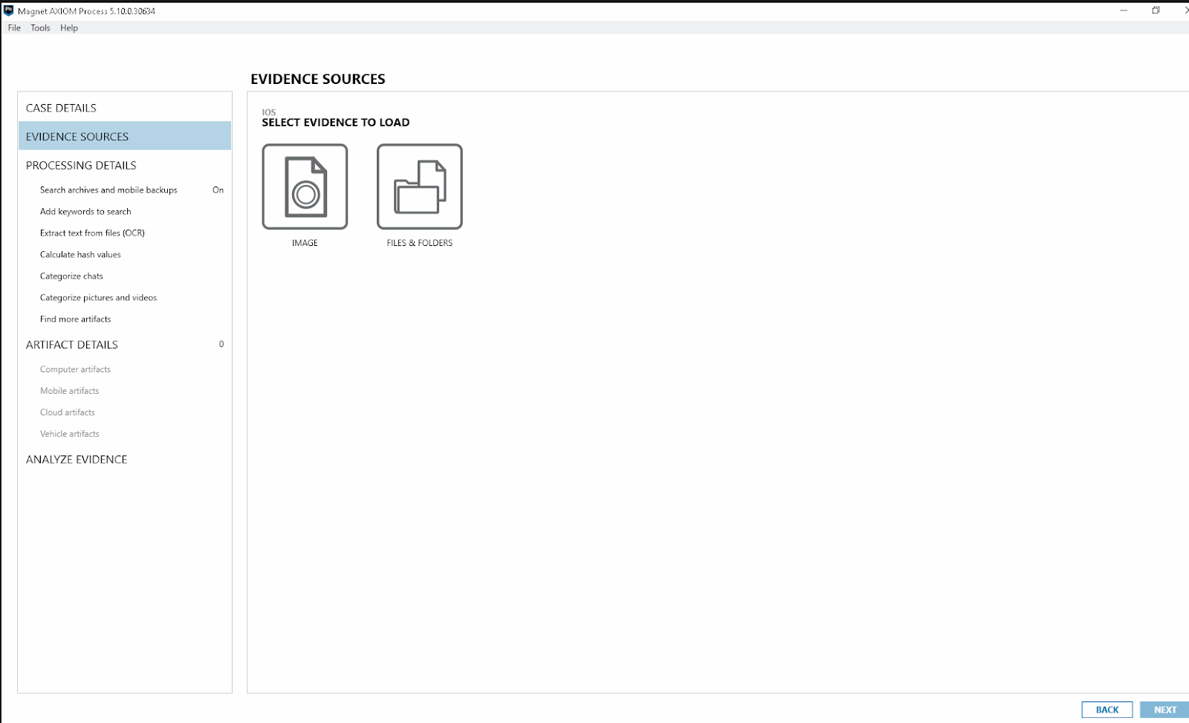
You can either point Axiom at a phone image or a set of files & folders. Since the extraction is in a zip format select Files & Folders.
Proceed with Next.

Slide 16
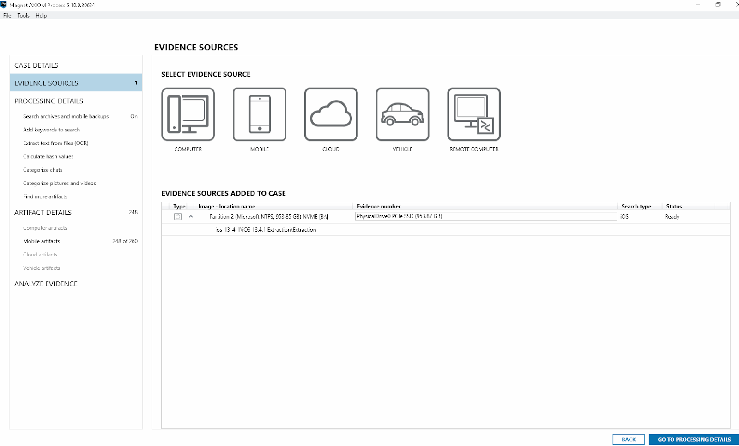
Once Axiom is pointed at the Image file.
Proceed to Processing Details.

Slide 17
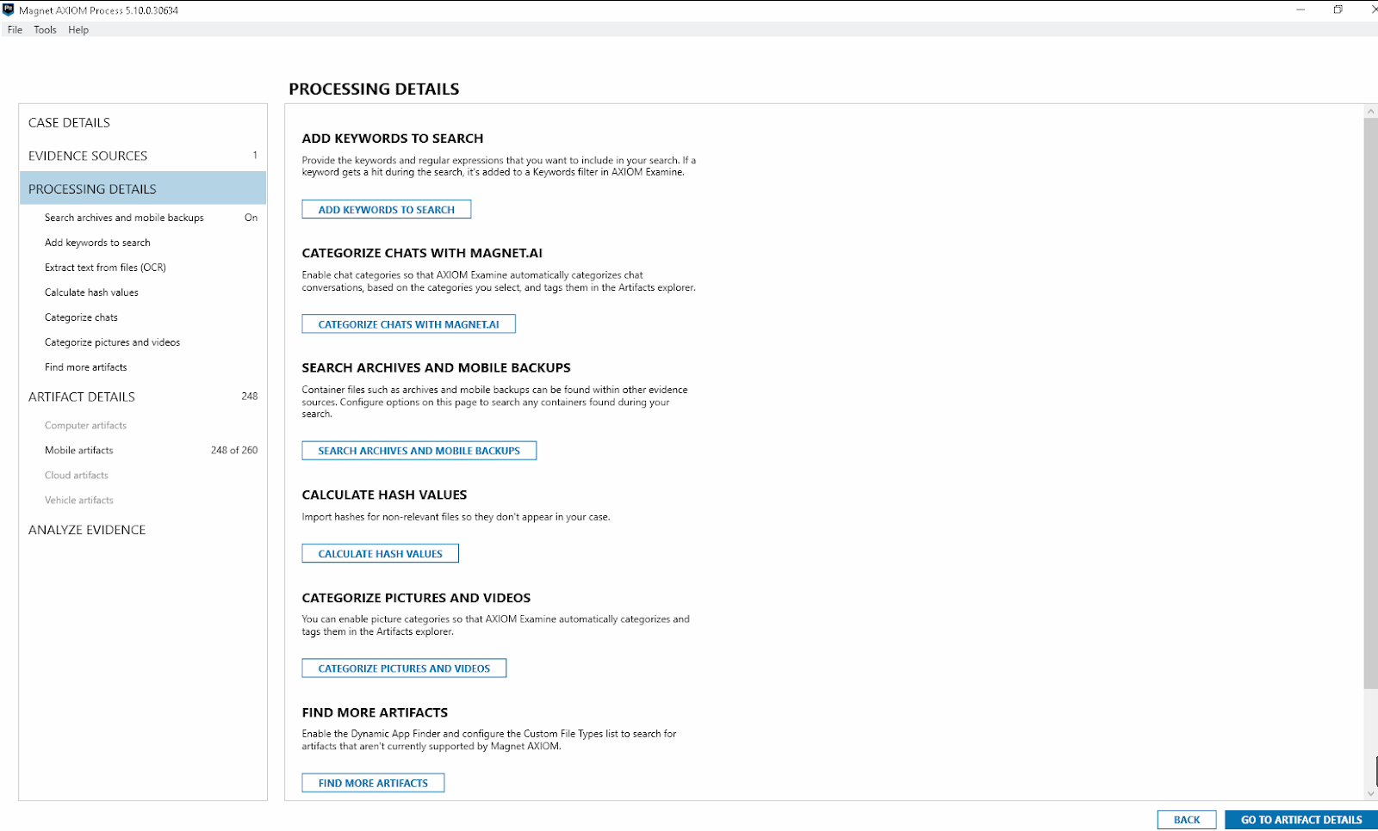
Under Processing Details there are optional settings that can be toggled before ingesting.
Proceed to Artifact details.

Slide 18
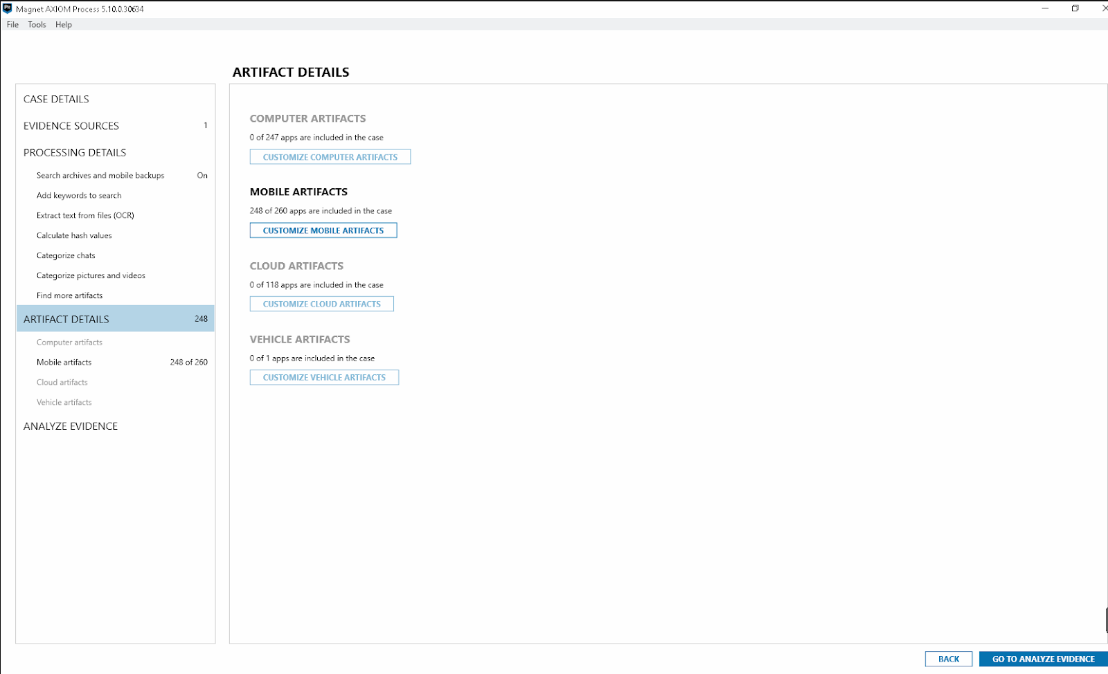
In this menu we can customize which artifacts are parsed. Select customize mobile artifacts.

Slide 19
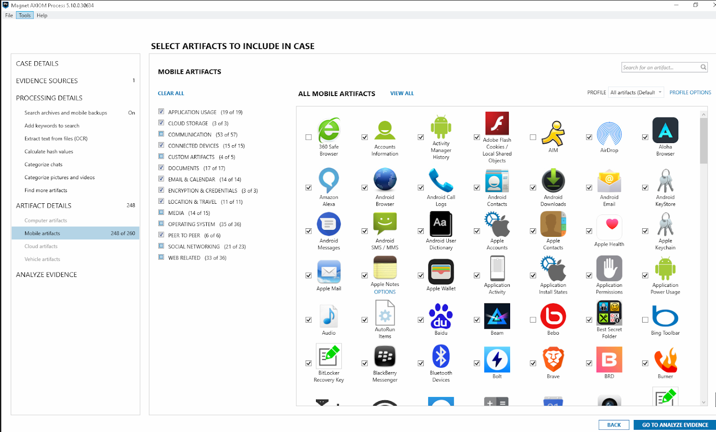
Every icon is referred to an artifact (data type).
Checked artifacts will be ran against the image, unchecked artifacts will not be run against the image.

Slide 20
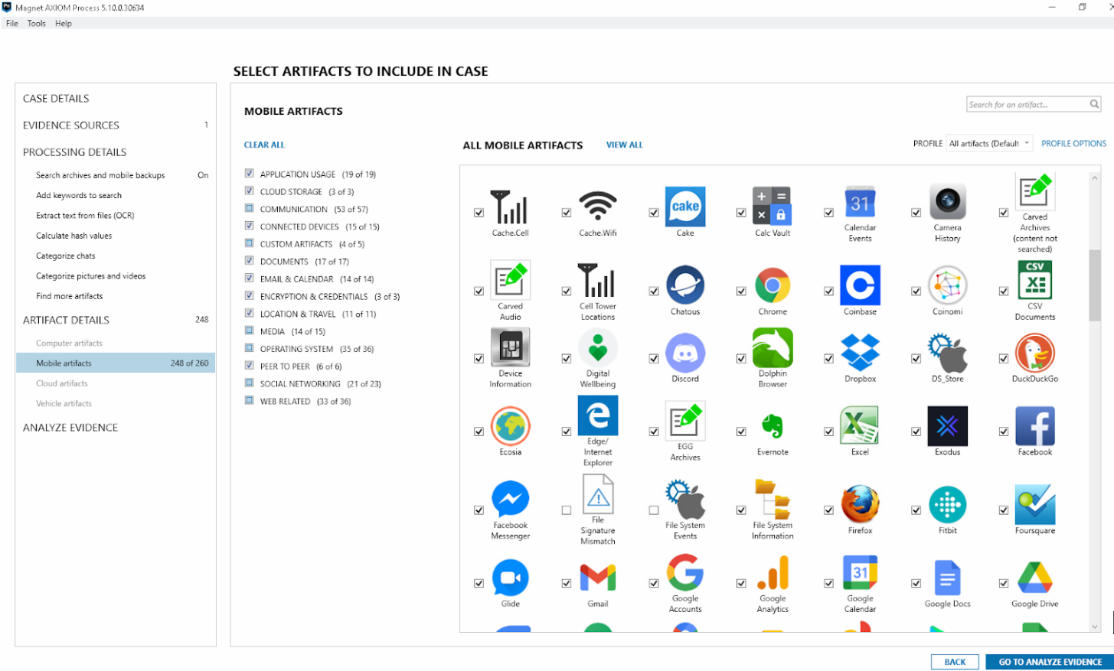
Artifacts – Page 2

Slide 21
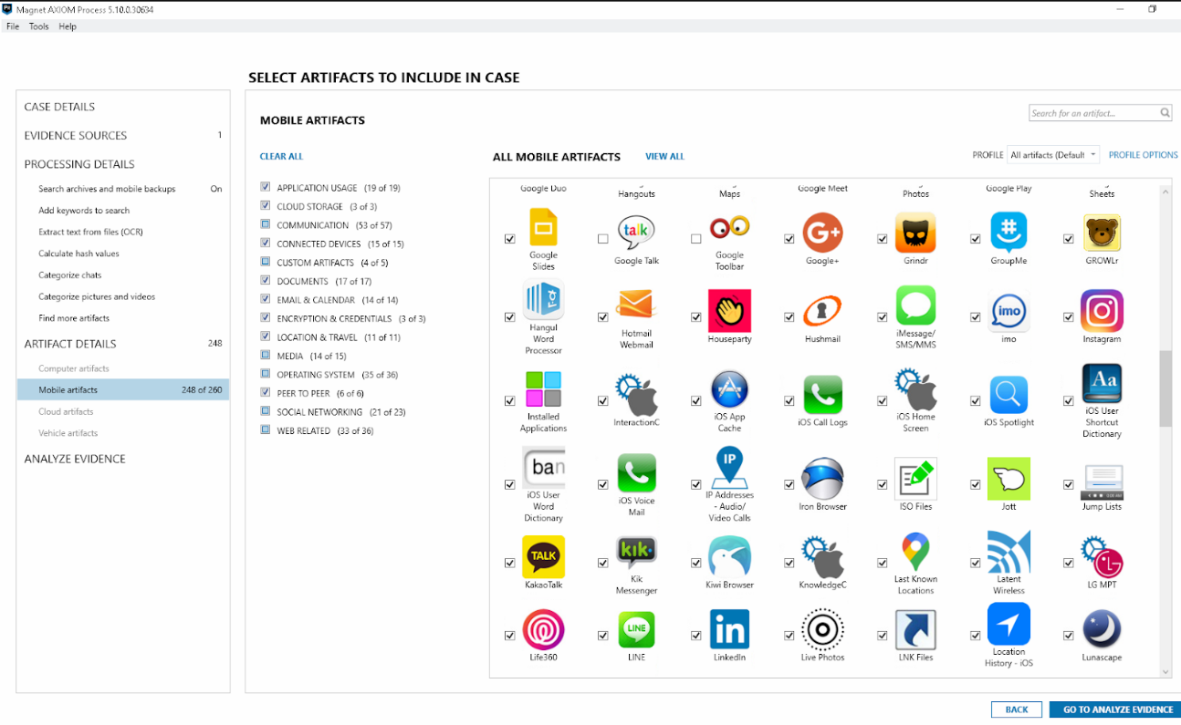
Artifacts – Page 3

Slide 22
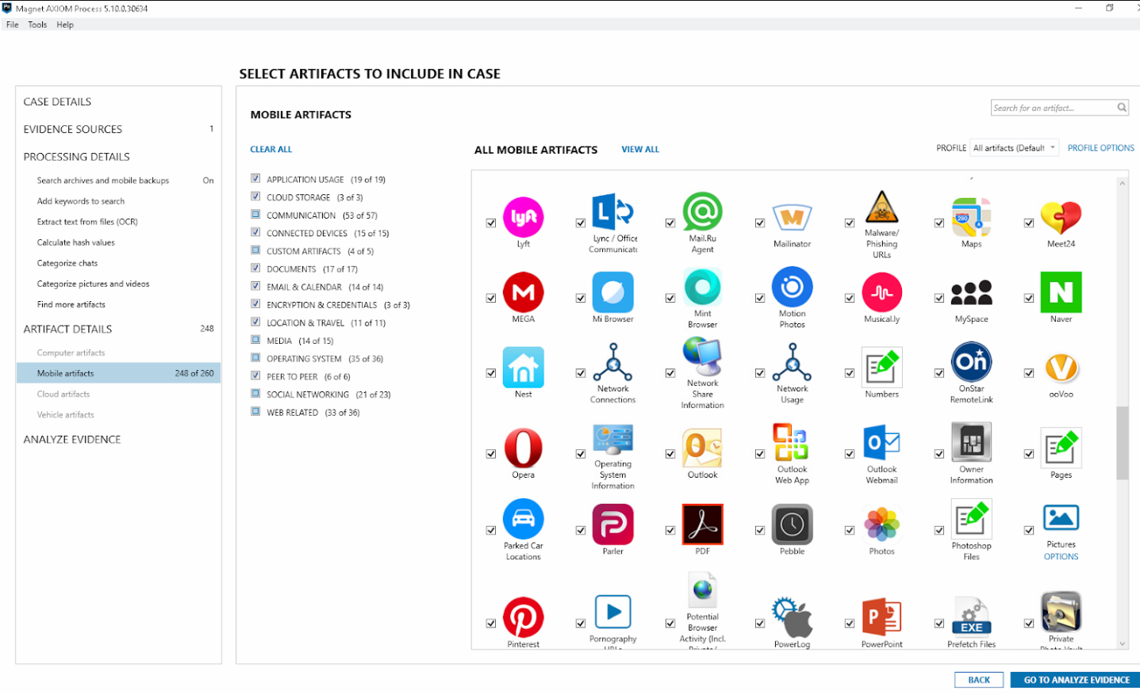
Artifacts – Page 4

Slide 23
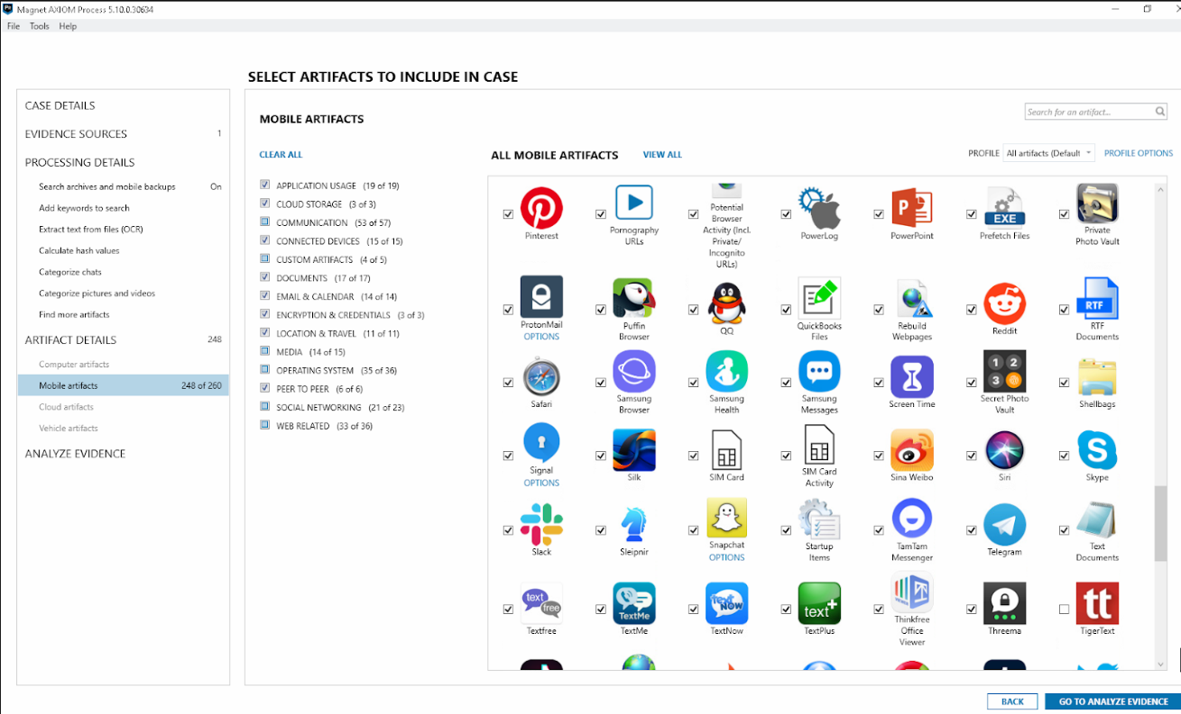
Artifacts – Page 5

Slide 24
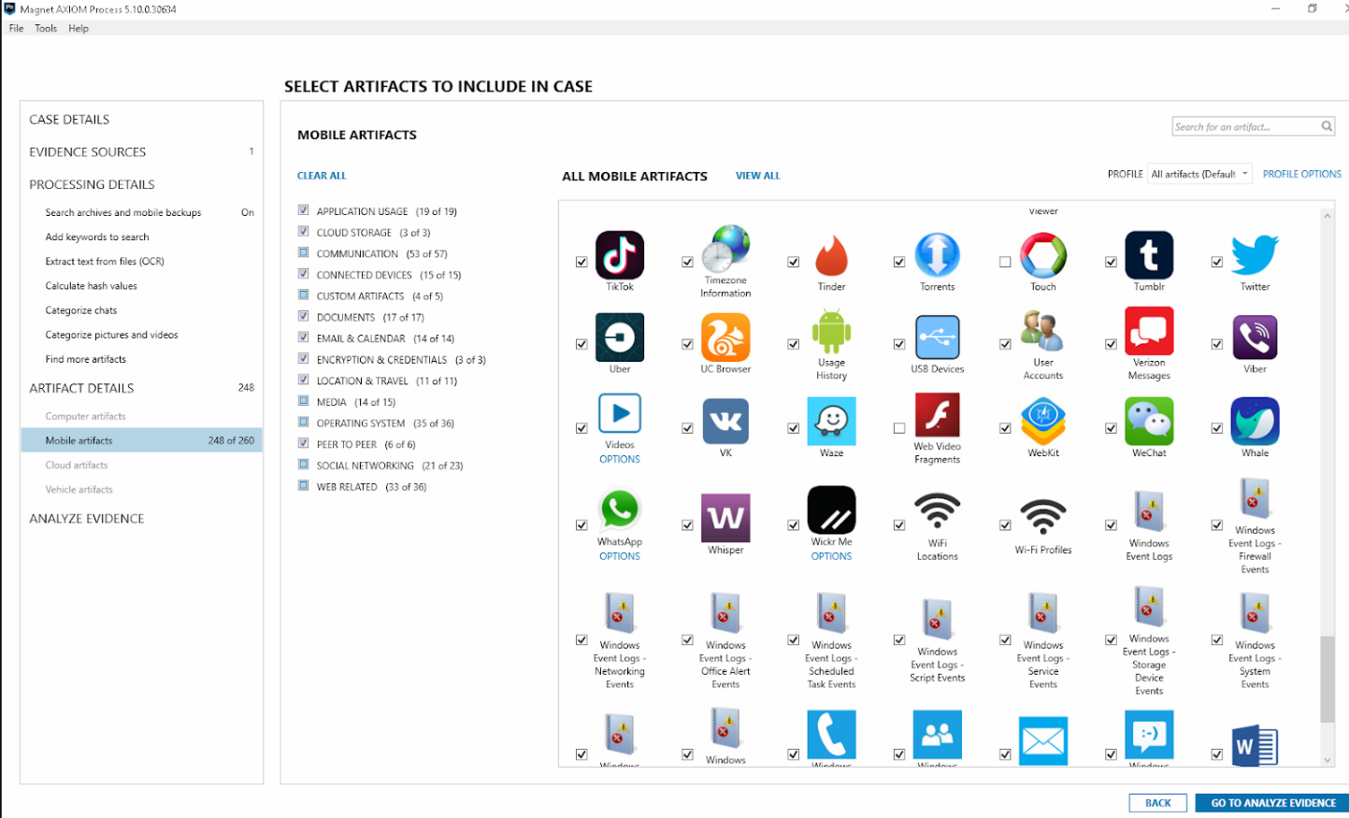
Artifacts – Page 6

Slide 25
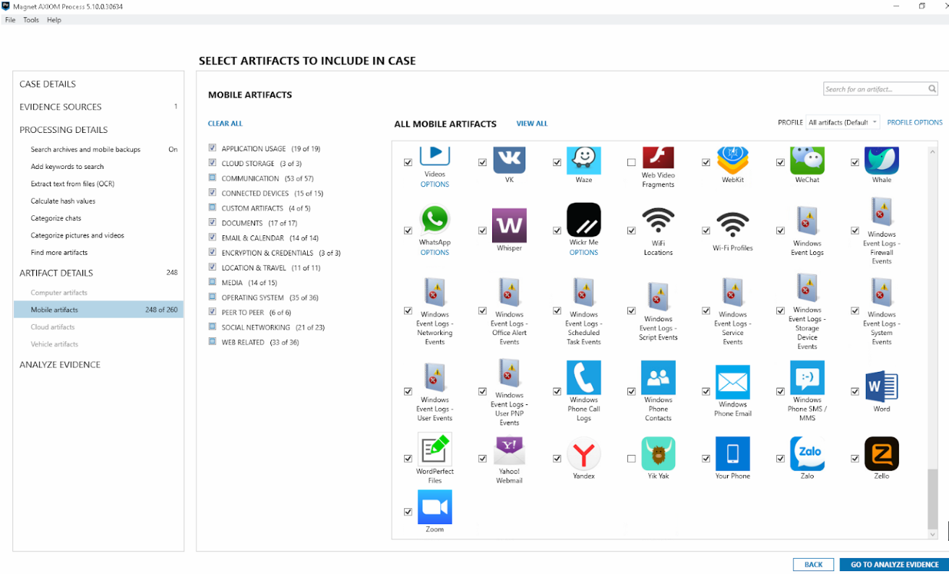
Artifacts – Page 7

Slide 26
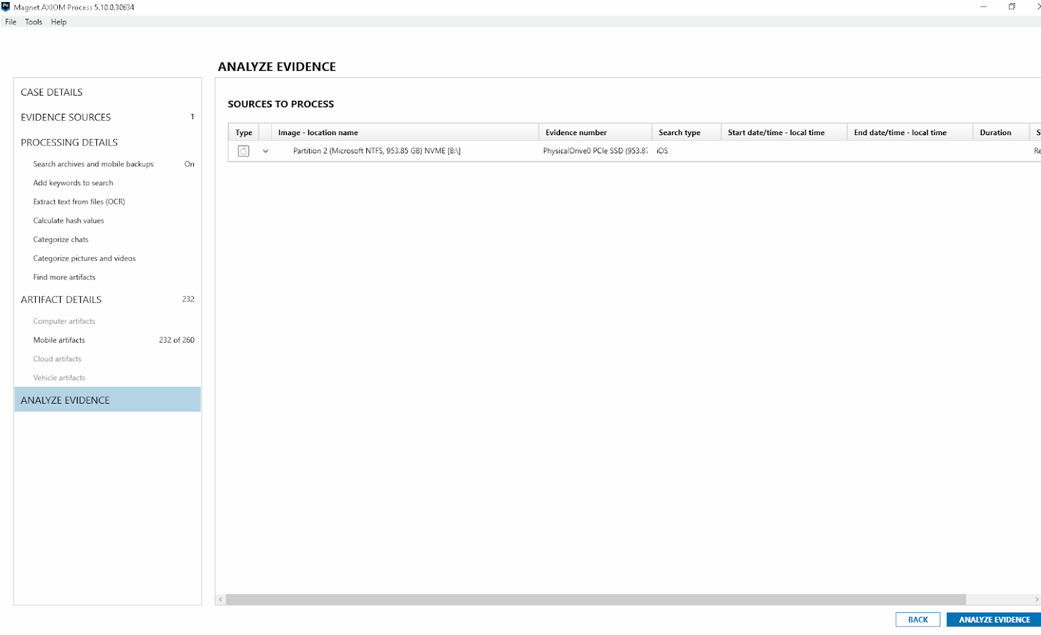
Once all the artifacts are selected, proceed with Analyze Evidence

Slide 27
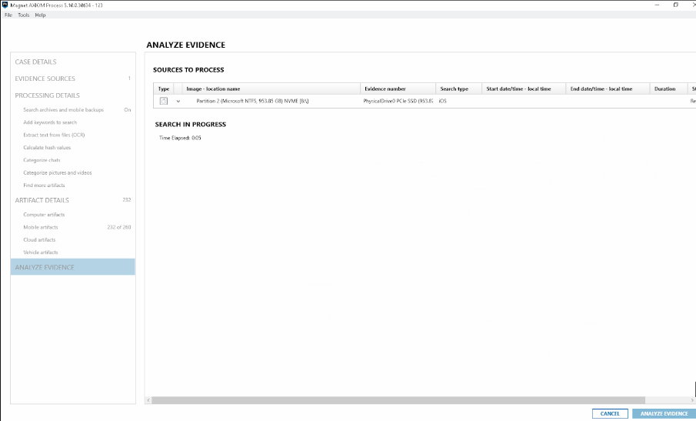
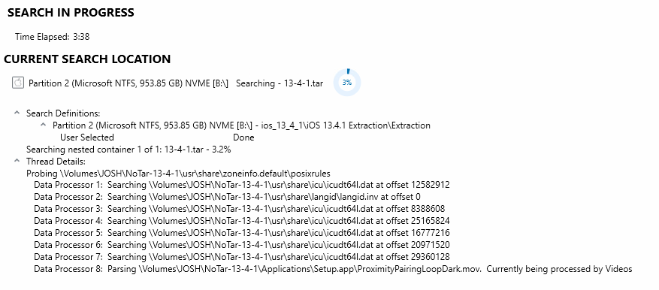
Axiom Process will begin to ingest the data

Slide 28
Once Axiom Process is done parsing through the image, it will automatically open Axiom Examine. From there we can examine the contents of the image.

Slide 29
Examining data with Magnet Axiom

Slide 30
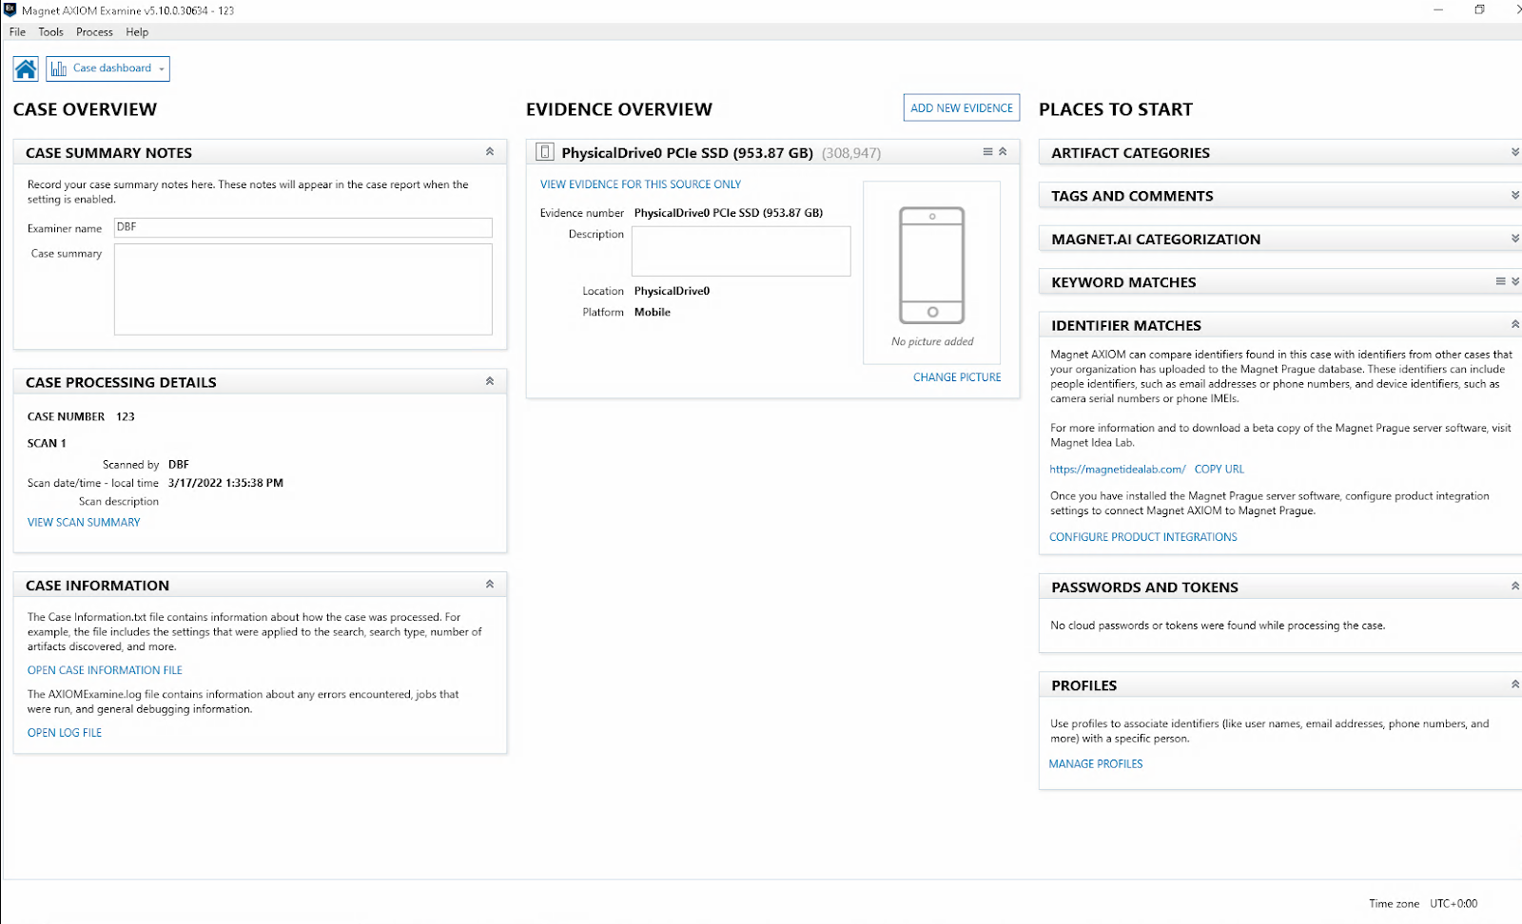
Once the Image is loaded in, the Axiom home page looks like this.
To view the evidence, click on View Evidence For This Source Only.

Slide 31
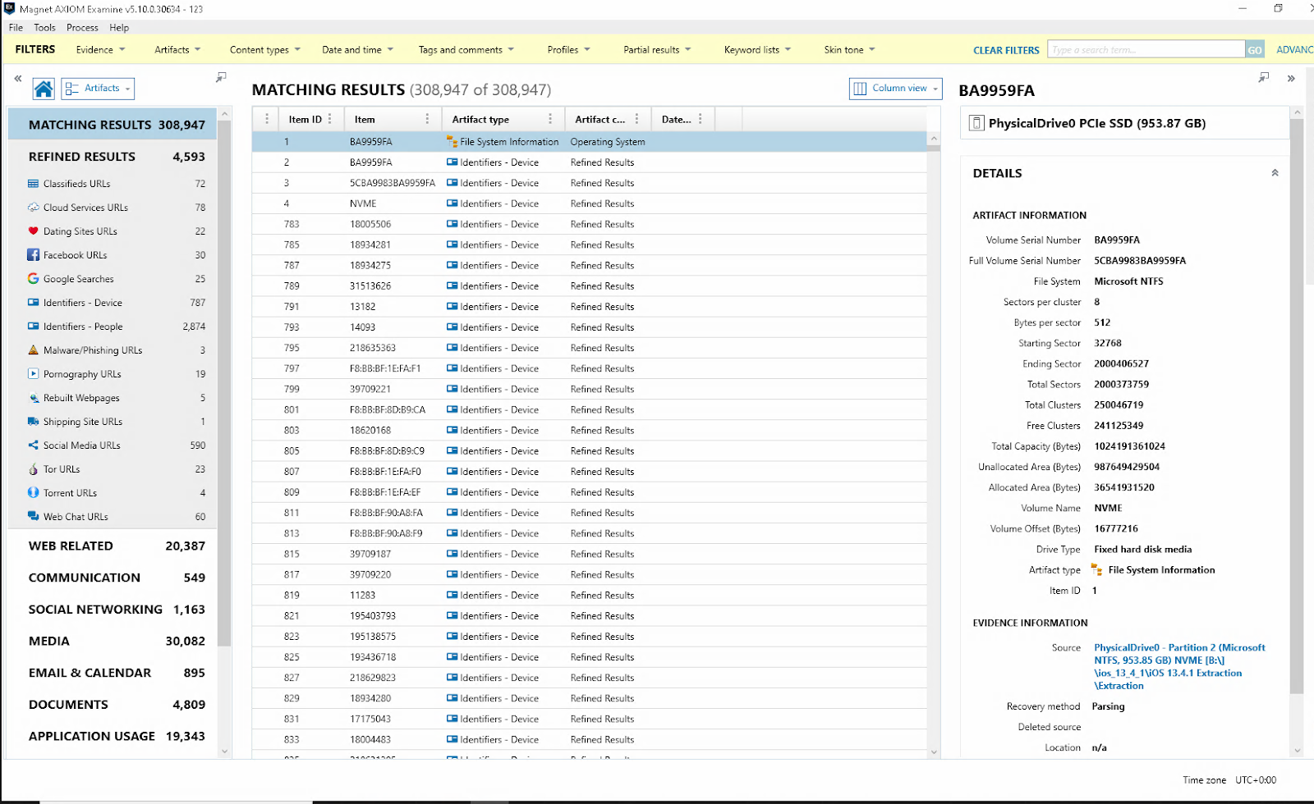
The Axiom UI appears as such;
On the left are Artifact types and Artifacts.
In the middle are each entries for each artifact.
On the right is the Metadata and source information related to each entry.

Slide 32
Reporting with Magnet Axiom

Slide 33
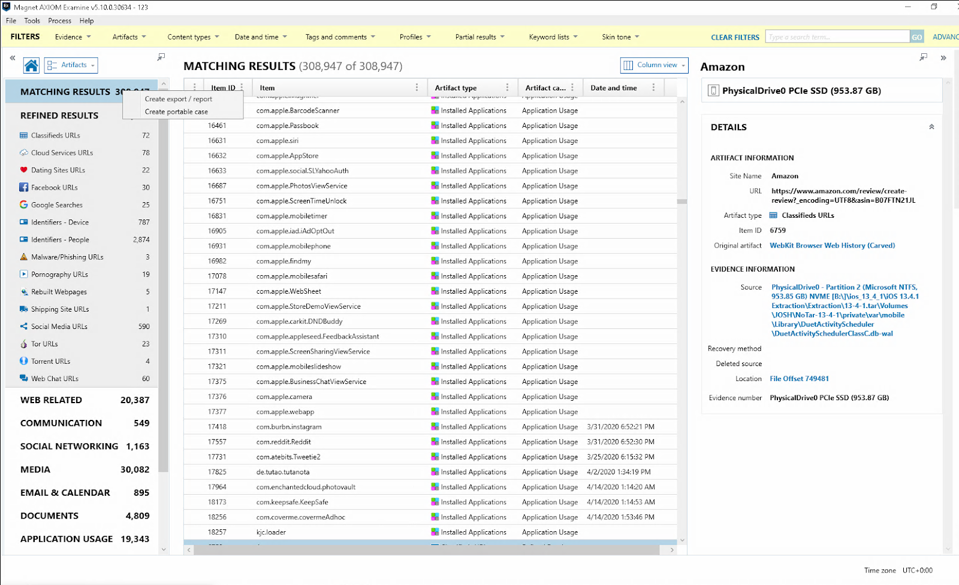
To create a report, right click on the data source and select create export/report.

Slide 34
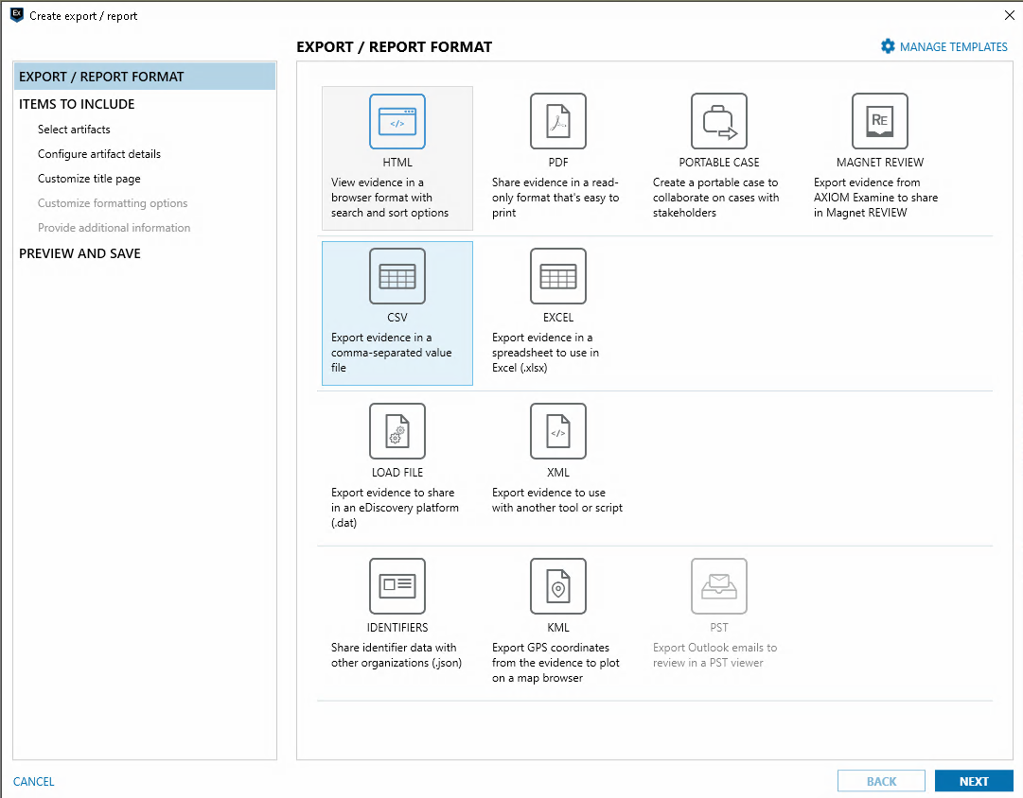
The report wizard will pop up and you can select which format you want your report to be.
For this example, we are going to create a Portable Case. Which emulates Axiom without needing a license.

Slide 35
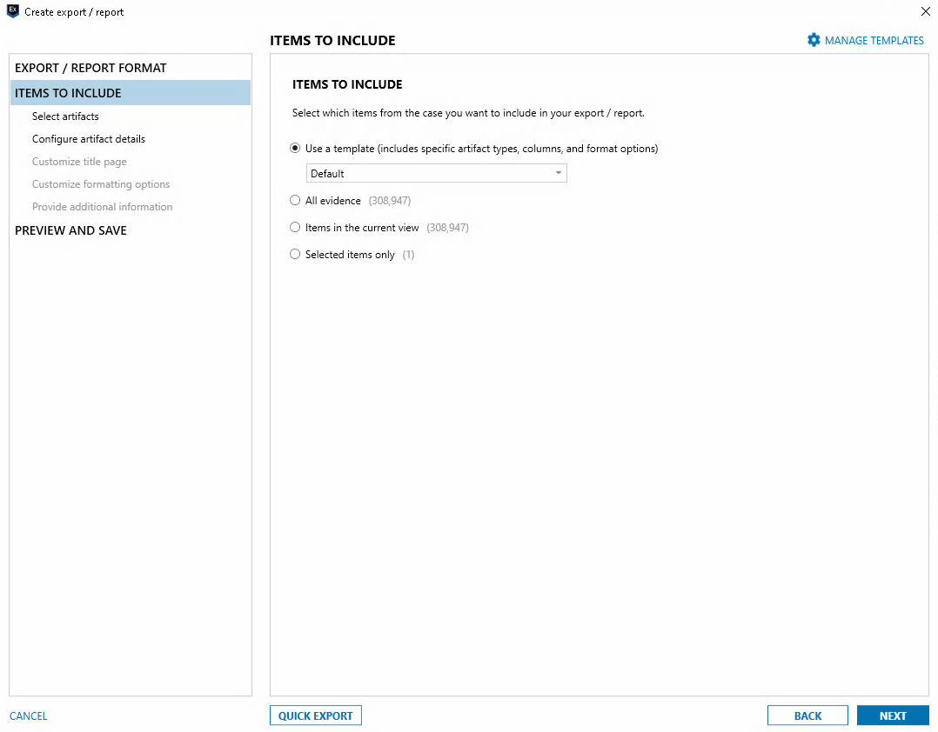
Select what to report on, for this example we are just going to export everything. Select all evidence and proceed with next.

Slide 36
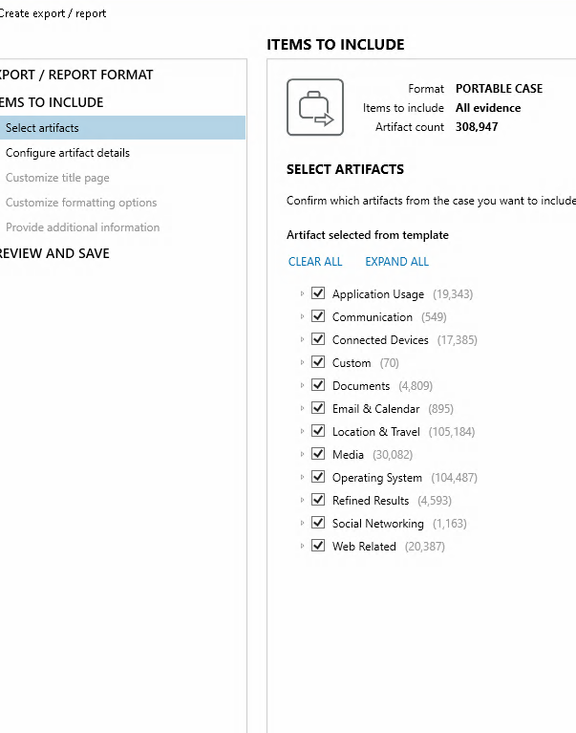
Select or Deselect artifacts here, for this example we are going to leave everything checked.
Proceed with next.

Slide 37
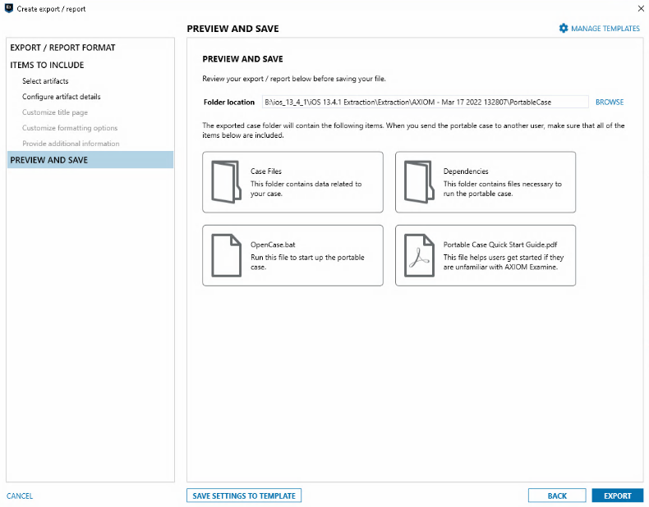
Select the report destination and proceed with export.

Slide 38
Reviewing Magnet Axiom Reports

Slide 39
Download a working copy from OneDrive

Slide 40
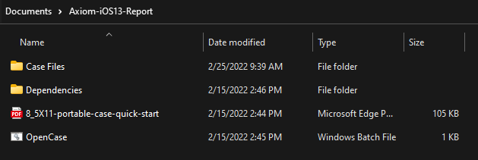
Unzip the report & Run Batch File

Slide 41
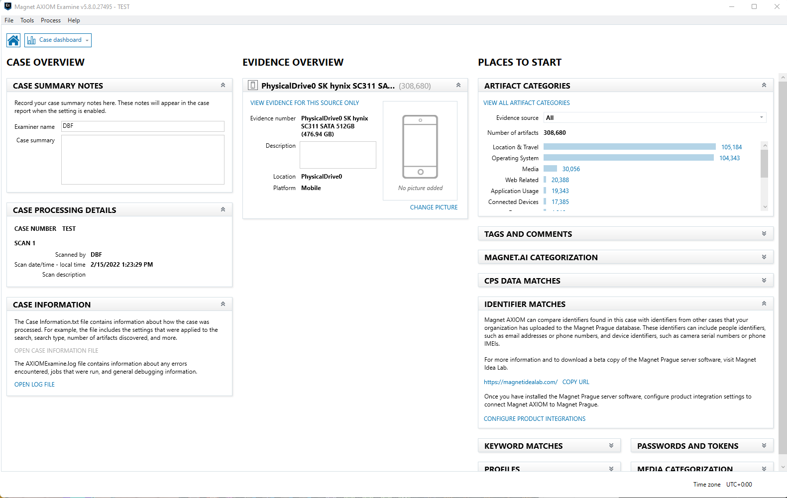
Once the report opens, you land on the home screen. To view the evidence, click on View evidence for this source only

Slide 42
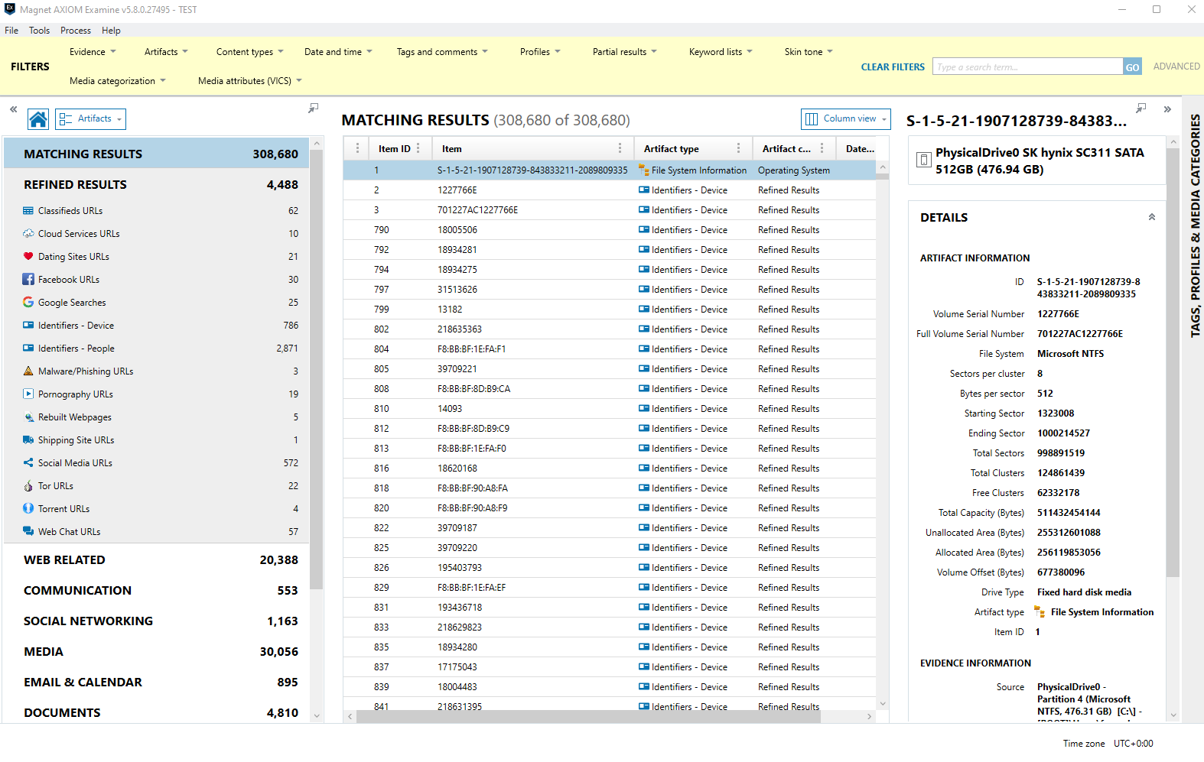
This is what the Axiom UI looks like.
On the left are the artifacts types, they can be expanded to view in finer detail.
In the middle are the entries for that artifact.
Lastly, on the right show's details + metadata for the selected entry.

Slide 43
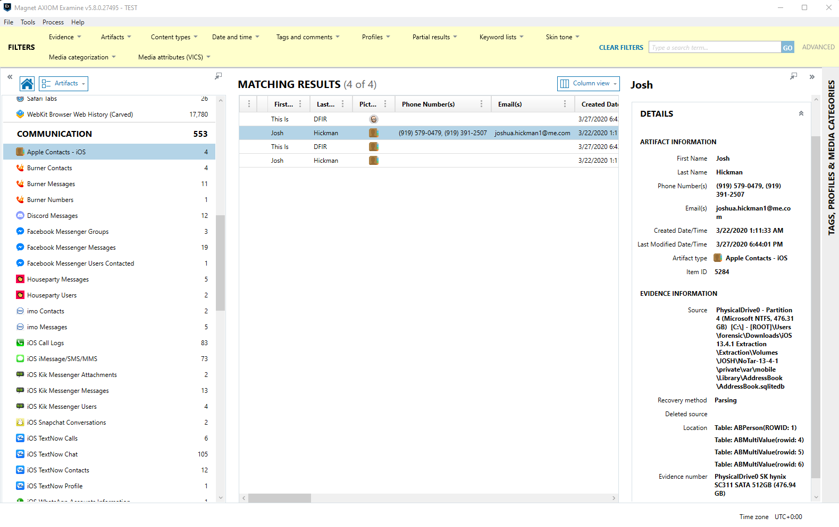
For example, Under the Communication tab, In the Apple Contacts artifact we can see what contacts were saved in the native Contacts app.
The middle shows the number of contact entries on the device.
Lastly, on the right we can see the Metadata attached to the entry.

Slide 44
Filtering
Within the top section of Axiom, you can apply filtering to narrow down results. You can narrow down shown artifacts under the Artifacts tab. Date filters can also be applied under the Date and Time tab. As well as a general search bar on the right side.

