Slide 1
Investigate Data Leakage Case
Keywords: CD burn, $MFT, $MFT log ($LogFile)
Notes:
http://xmlstar.sourceforge.net/doc/UG/

Slide 2
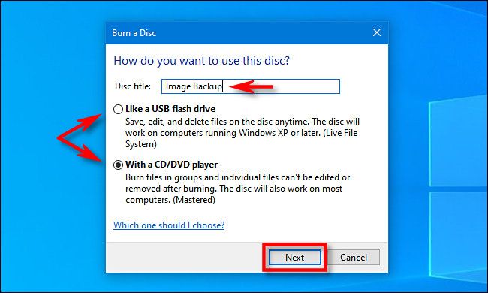
32. What a method (or software) was used for burning CD-R?
33. When did the suspect burn CD-R?
Windows 7+ comes with built in support for burning CD’s and DVD’s.
When insert a blank recordable CD or DVD into your optical drive
Window titled “Burn a Disc” will appear.
This dialog asks you how you want Windows to handle writing the disc.
Notes:
https://secureartisan.wordpress.com/2012/06/04/windows-7-cddvd-burning/#:~:text=Event%20ID%20133.&text=While%20there%20is%20no%20supporting,does%20not%20trigger%20this%20event.

Slide 3
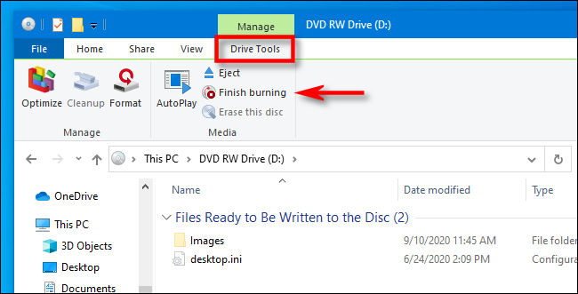
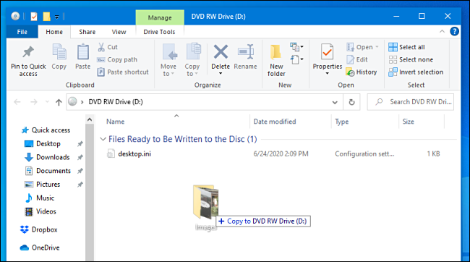
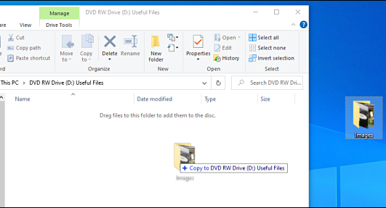
Two options for burning CD-R?
(Type 1) Like a USB flash drive: allows to write and erase files to the disc on-the-fly using a live file system without ever having to finalize or “master” the disc.
(Type 2) With a CD/DVD player: file are temporarily copied to a staging area on your hard disk first, then they are written to the disc all at once when you select “Burn” in File Explorer.
Notes:
https://www.howtogeek.com/689705/how-to-burn-a-cd-or-dvd-on-windows-10/#:~:text=Log%20into%20your%20Windows%20machine,to%20handle%20writing%20the%20disc.

Slide 4
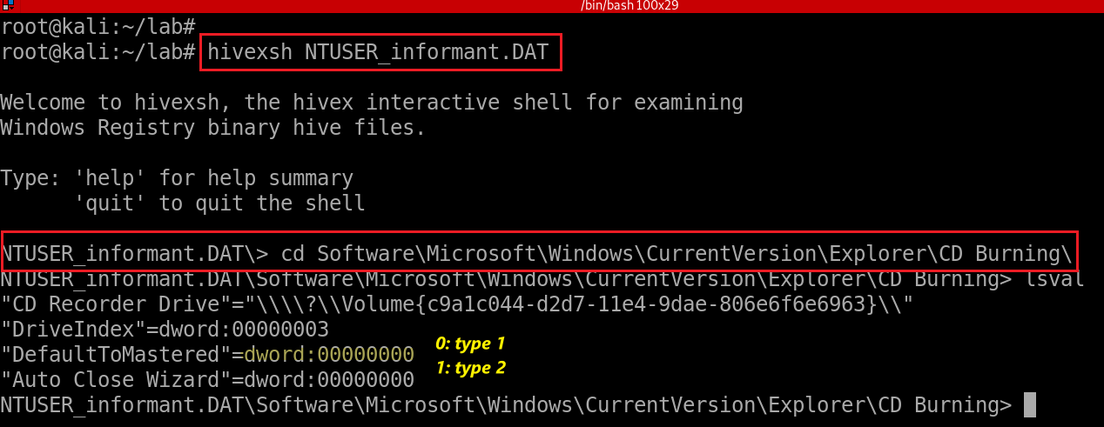
Find Last burning type from registry (type 1)
Check for last burning type from HKU\informant\Software\Microsoft\Windows\CurrentVersion\Explorer\CD Burning\
Notes:
hivexsh NTUSER_informant.DAT
cd Software\Microsoft\Windows\CurrentVersion\Explorer\CD Burning\

Slide 5
Evidence locations (for type 2 only)
System event logs for burning CD
Event IDs for Windows Vista or higher
Event ID 133. Source/Provider Name "cdrom“
Staging area: Default burning directory
\User\informant\AppData\Local\Microsoft\Windows\Burn\Burn
NTFS journal file analysis
\$LogFile
\$Extend\$UsnJrnl·$J (+ $MFT for identifying full paths of files)
DAT#####.tmp, DAT#####.tmp, FIL#####.tmp, POST#####.tmp

Slide 6
System event logs for burning CD
Copy system event to event_log folder
Extract system event
Notes:
cp /media/root/C8CA0C8DCA0C7A48/Windows/System32/winevt/Logs/System.evtx event_log/
evtx_dump.py event_log/System.evtx > event_log/System_evtx.xml
-rw-r--r-- 1 root root 1576272 Nov 23 18:24 event_log/System_evtx.xml

Slide 7
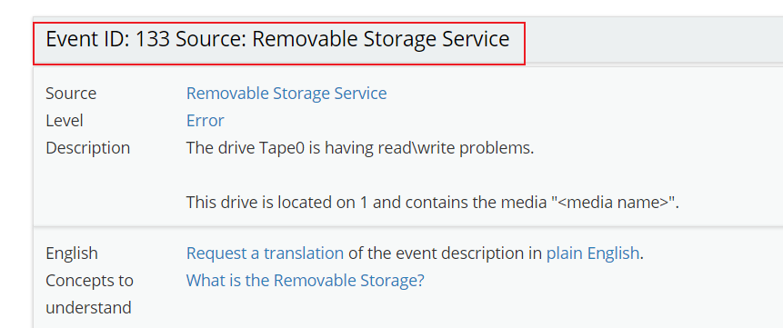
Search for event provider’s name “cdrom”
http://eventid.net/display-eventid-133-source-Removable+Storage+Service-eventno-3918-phase-1.htm
Notes:
grep -P "<Provider Name=\"cdrom\"" event_log/System_evtx.xml -B 1 -A 10 --color

Slide 8
34. What files were copied from PC to CD-R?
Equivalent to trace what files have been deleted from Staging area
Difficult to trace because it is possible that there is no meta data in $MFT:
$MFT is a file containing meta data for all files and directories in NTFS
A periodic garbage collection since Windows 7
In case of SSD, unallocated space is arranged by TRIM operation
Notes:
fls -o 206848 cfreds_2015_data_leakage_pc.dd
http://az4n6.blogspot.com/2015/09/whos-your-master-mft-parsers-reviewed.html

Slide 9
Find staging area in registry
HKEY_CURRENT_USER\Software\Microsoft\Windows\CurrentVersion\Explorer\CD Burning\
Notes:
hivexsh NTUSER_informant.DAT
cd Software\Microsoft\Windows\CurrentVersion\Explorer\CD Burning\StagingInfo\Volume{c9a1c044-d2d7-11e4-9dae-806e6f6e6963}

Slide 10
Show StagingPath
The value "StagingPath" is significant. It shows the folder on the volume that is used to ‘stage’ files prior to committing them to the disc.
Notes:
cd Software\Microsoft\Windows\CurrentVersion\Explorer\CD Burning\StagingInfo\Volume{c9a1c044-d2d7-11e4-9dae-806e6f6e6963}

Slide 11
Show staging folder but nothing there because all files will be deleted after burn
Show deleted staging folder (not completed results, see next questions)
Notes:
ls /media/root/C8CA0C8DCA0C7A48/Users/informant/AppData/Local/Microsoft/Windows/Burn/Burn/
fls -rdF -o 206848 cfreds_2015_data_leakage_pc.dd | grep -P "/Burn"

Slide 12
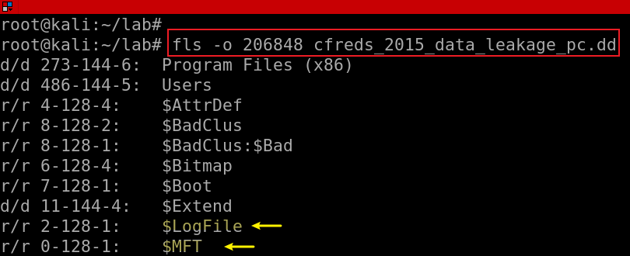
New analysis plan
$MFT (a different method to find staging area information)
provides only last modified/access time of a file
Each $MFT entry = a file with attributes
$Extend$UsnJrnl·$J
using bit flags
$LogFile: transaction log of NTFS for data integrity
Save a few hours of activity recorded in a $LogFile.
$LogFile associate with $MFT and $UsnJrnl
$LogFile : journal that records the metadata transactions
The creation of file/directory
The deletion of file/directory
Moving File/Directory
The modification of $data
The modification of MFT entry
Notes:
fls -o 206848 cfreds_2015_data_leakage_pc.dd
http://az4n6.blogspot.com/2015/09/whos-your-master-mft-parsers-reviewed.html

Slide 13
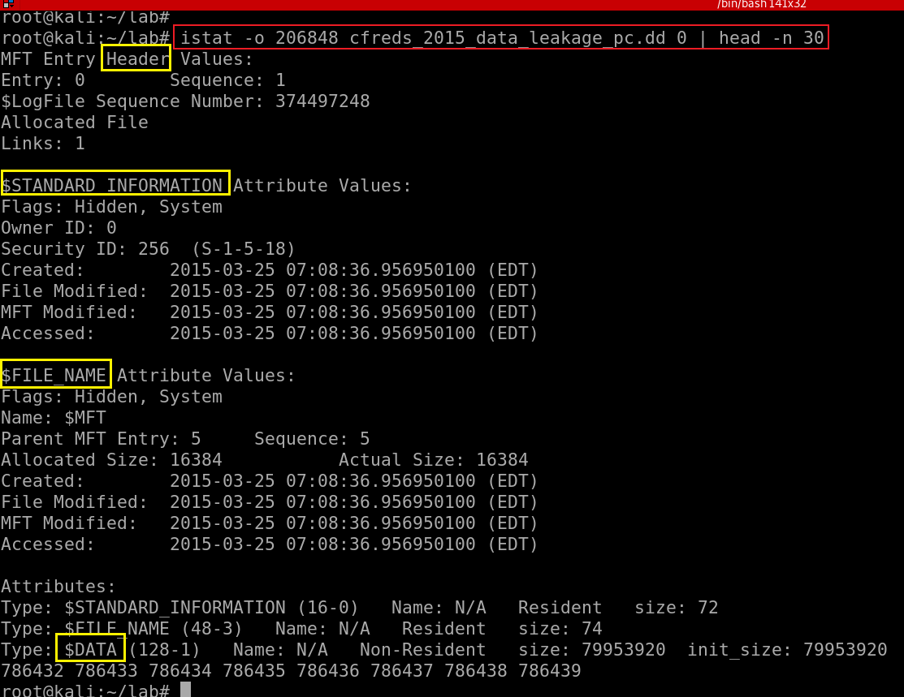
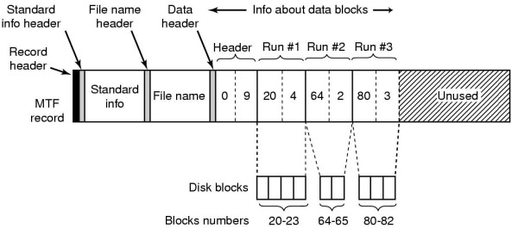
34.1 $MFT (Master File Table) Entry
0: Entry number (the $MFT itself)
One MFT entry = one file (Except file content)
Each entry size = 1K
first 16 MFT entries for special metadata files
M – Modified : When the contents of a file were last changed.
A – Accessed : When the contents of a file were accessed/read.
C – Created : When the file was created.
E – Entry Modified : When the MFT record associated with the file changed.
Notes:
https://countuponsecurity.com/2015/11/10/digital-forensics-ntfs-metadata-timeline-creation/
https://flatcap.org/linux-ntfs/ntfs/attributes/standard_information.html

Slide 14
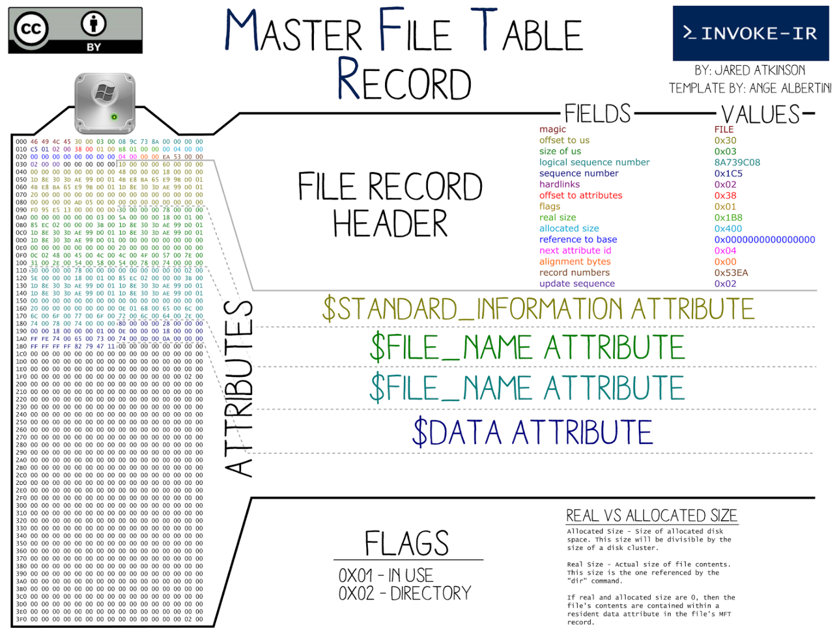

Slide 15
Find Burn/Burn MFT entry ID using analyzeMFT
analyzeMFT is designed to fully parse the MFT file from an NTFS filesystem
present the results in multiple formats.
Extract $MFT (entry 0) from DD image
Notes:
icat -o 206848 cfreds_2015_data_leakage_pc.dd 0 > mft/mft.bin

Slide 16
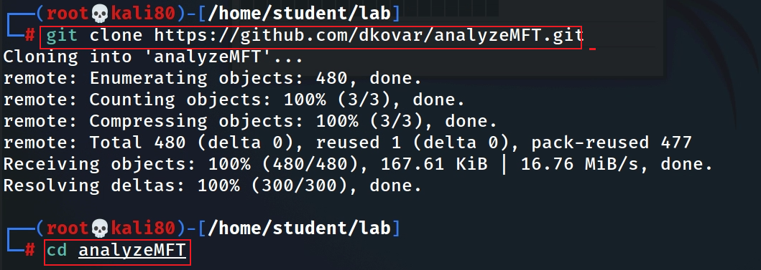
Install $MFT analyze tool
Download from github
install analyzeMFT
analyzeMFT only supports python2.x. So, we have to point the current Python environment to python2.7
use unalias to remove the alias
Notes:
git clone https://github.com/dkovar/analyzeMFT.git
cd analyzeMFT

Slide 17
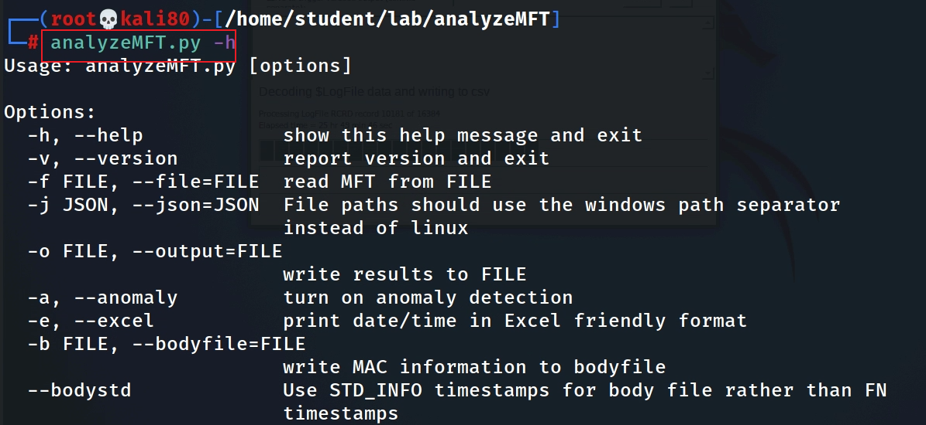
Test MFT analyze tool
Notes:
pip install analyzeMFT

Slide 18
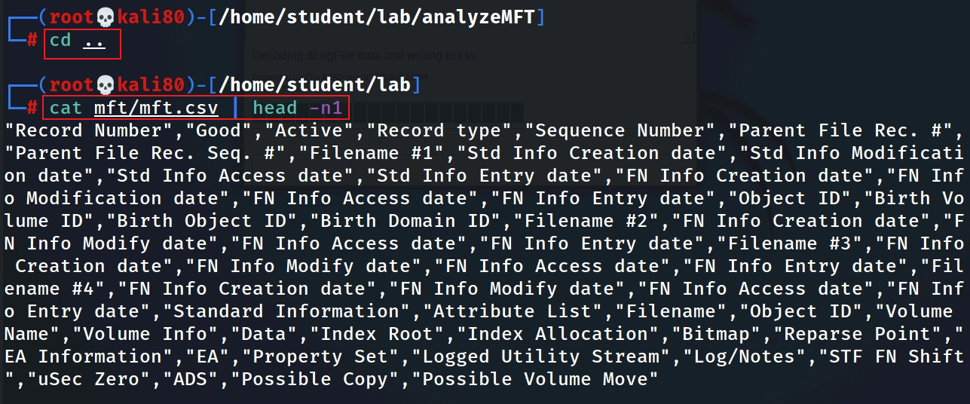
Convert $MFT to .csv
https://www.dropbox.com/s/6sjdecon9c1f7rl/mft.csv
https://raw.githubusercontent.com/frankwxu/digital-forensics-lab/main/NIST_Data_Leakage_Case/NIST_Answers/lab_generated_file/mft.zip
Show $MFT column names
1,4,6,8,11
Notes:
awk -e '$1 ~/informant.*\/Burn/ {print $1}' mft/mft.csv
"Record Number","Good","Active","Record type","Sequence Number","Parent File Rec. #","Parent File Rec. Seq. #","Filename #1","Std Info Creation date","Std Info Modification date","Std Info Access date","Std Info Entry date","FN Info Creation date","FN Info Modification date","FN Info Access date","FN Info Entry date","Object ID","Birth Volume ID","Birth Object ID","Birth Domain ID","Filename #2","FN Info Creation date","FN Info Modify date","FN Info Access date","FN Info Entry date","Filename #3","FN Info Creation date","FN Info Modify date","FN Info Access date","FN Info Entry date","Filename #4","FN Info Creation date","FN Info Modify date","FN Info Access date","FN Info Entry date","Standard Information","Attribute List","Filename","Object ID","Volume Name","Volume Info","Data","Index Root","Index Allocation","Bitmap","Reparse Point","EA Information","EA","Property Set","Logged Utility Stream","Log/Notes","STF FN Shift","uSec Zero","ADS"

Slide 19
awk '{split($0, a, “,“ ) }’
^^ ^ ^
| | |
string | fieldsep
|
array to store results
Show fields 1: Record # (Entry #), 4: record type, 6: Parent File #
Search for Burn folder
$MFT entry 21921, which indicates the folder …/Burn/Burn
8: Filename #1",“
11:Std Info Access date
Notes: we can’t find any deleted files here, however, we can find entry ID (21921).
We will search for ID in $UsnJrnl·$J . Any files with the ID as the parent entry ID are deleted files (copied to CD).
Notes:
cat mft/mft.csv | head -n1 | awk '{split($0,a,","); print a[1],a[4],a[6]}‘
awk '/informant.*\/Burn/ {split($0,a,","); print a[1],a[4],a[6],a[8], a[11]}' mft/mft.csv

Slide 20
34.2 $Extend$UsnJrnl·$J
the name is confusing: it is MFT entry ID
Offset|FileName|USN|Timestamp|Reason|MFTReference|MFTReferenceSeqNo|MFTParentReference|MFTParentReferenceSeqNo|FileAttributes|MajorVersion|MinorVersion|SourceInfo|SecurityId
https://www.dropbox.com/s/cbxcx1276udxrnn/UsnJrnl_2020-11-28_12-15-14.csv
Search for directories/files associated with entry ID /Burn/Burn 21921 in $UsnJrnl·$J
Your file name is different
the rest of screenshot is omitted. See next slide for summarized info
Notes:
grep -P "\|21921\|" UsnJrnl2Csv/UsnJrnl_2020-11-28_12-15-14.csv –color
https://docs.microsoft.com/en-us/windows/win32/api/winioctl/ns-winioctl-usn_record_v2?redirectedfrom=MSDN

Slide 21
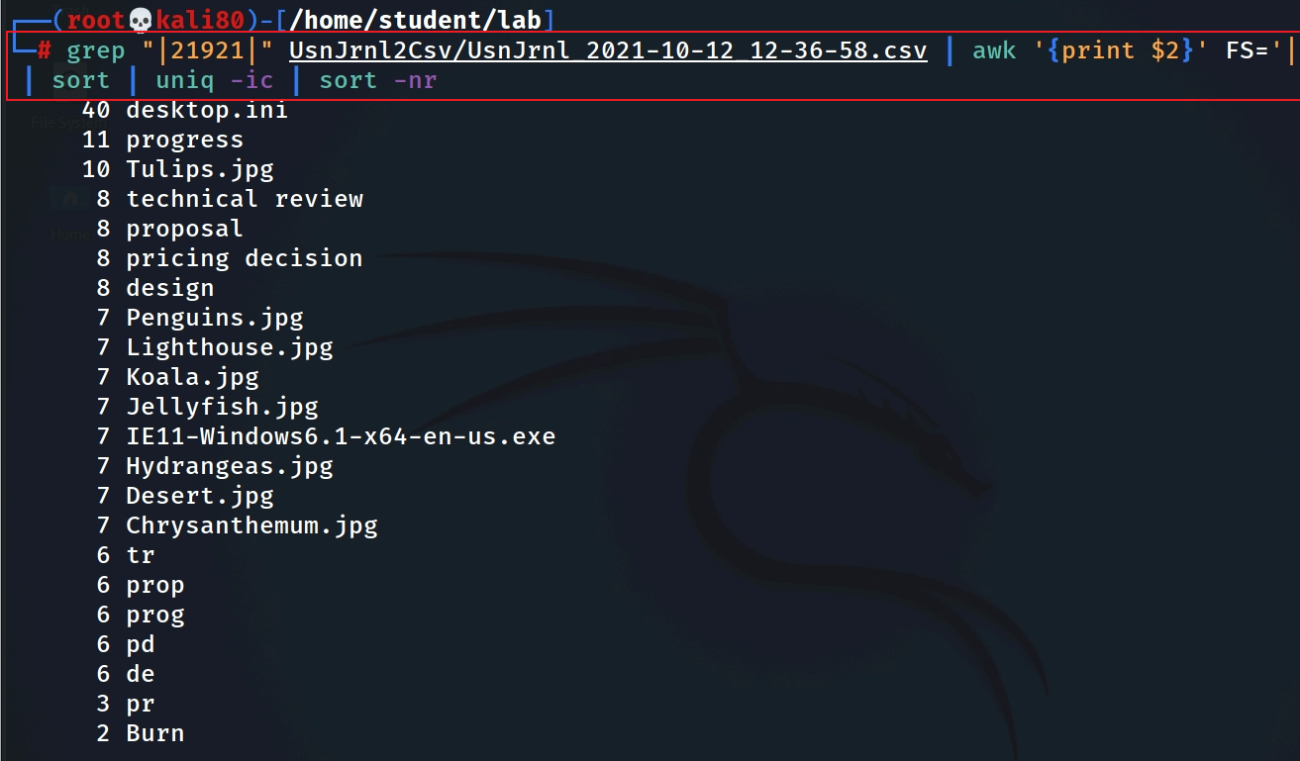
Find all directories/files under the folder …/Burn/Burn, those files are copied to CD
Your file name is different
directory/file name
$MFT entry 21921, which indicate the folder …/Burn/Burn
sort: -n , --numeric-sort
-r, --reverse
Notes:
grep "|21921|" UsnJrnl2Csv/UsnJrnl_2021-10-12_12-36-58.csv | awk '{print $2}' FS='|' | sort | uniq -ic | sort -nr

Slide 22
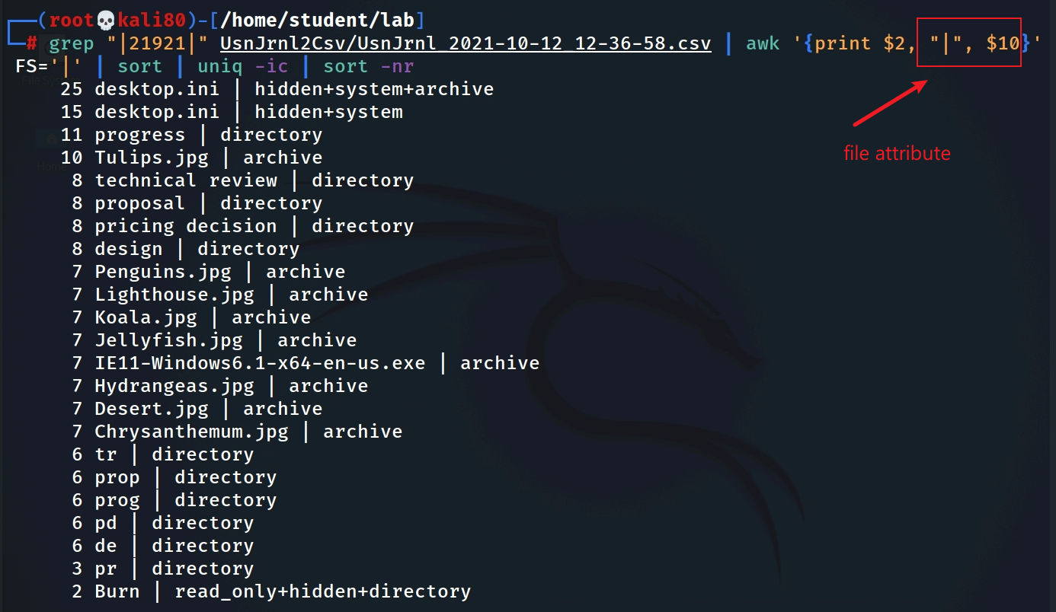
Identify directory or file and file activities
conclusion:
../Burn/Burn contains folder (tr, prop, prog, pd, de, pr, technical review…) and files (*.jpg)
These files are copied to CD
Notes:
grep "|21921|" UsnJrnl2Csv/UsnJrnl_2021-10-12_12-36-58.csv | awk '{print $2, "|", $10}' FS='|' | sort | uniq -ic | sort -nr

Slide 23
Assignment
There is a subfolder under the ../Burn/Burn
Find these deleted files

Slide 24
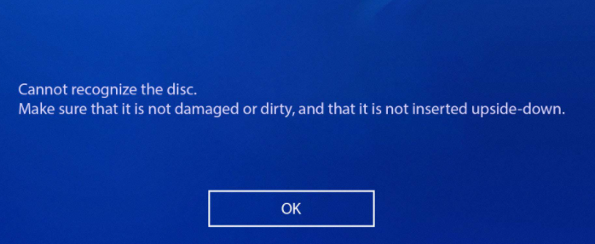
34.3 $LogFile: transaction log file of NTFS
Microsoft wanted to improve the reliability of NTFS
recover the status of file system in case of unexpected system shutdown due to power error or critical system failure
avoid corruption / keep a clean state during NTFS transactions
What is clean state?
one transaction has multiple operations
either complete all scheduled operations of a transaction or abandon all in-completed operations of a transaction
Atomicity property of transaction (all occurs, or nothing occurs)
Keep the following transactions in a clean state
The creation of file/directory
The deletion of file/directory
The modification of $data (write data)
Modification of MFT entry
Notes:
http://forensicinsight.org/wp-content/uploads/2013/06/F-INSIGHT-NTFS-Log-TrackerEnglish.pdf

Slide 25
A transaction = N operations
A transaction (create, del, ren) is consisted of multiple operations sequentially
Create a resident file (Redo/Undo)
SetBitsInNonresidentBitMap/ClearBitsInNonresidentBitMap
Noop/DeallocateFileRecordSegment
AddIndexEntryAllocaton/DeleteIndexEntryAllocaton
InitializeFileRecordSegment/Nood
Delete a file
…
DeleteIndexEntryAllocation: In NTFS file system, an index of all files & directories are stored in $I30 attribute of an $MFT entry.
DeallocateFileRecordSegment: change data
…
Rename
…
DeleteAttribute
CreateAttribute
…
Notes:
https://alexsta-cybersecurity.com/what-happens-when-a-file-is-deleted-on-a-windows-system/

Slide 26
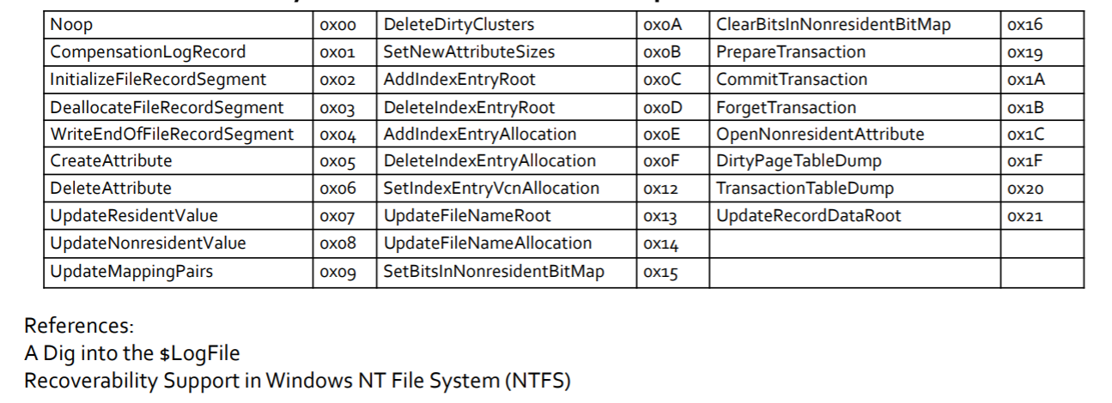
Redo/Undo Operation Code
Notes:
https://digital-forensics.sans.org/summit-archives/DFIR_Summit/File-System-Journaling-Forensics-Theory-Procedures-and-Analysis-Impacts-David-Cowen-with-Matthew-Seyer.pdf

Slide 27
How are transaction operations recorded?
NTFS records all NTFS operations-> journaling of NTFS
Multiple transaction operations are recorded sequentially
each transaction operation recorded is called a transaction record
Three types of transaction records needed for maintain a clean state
Check Point Record : the start record of transaction
after previous commit
Update Record (updates have not performed yet): the middle records of transaction
information about any metadata updates before/about they happen
e.g., scheduled operations we mentioned earlier
Commit Record : the last record of transaction
when updates have been performed

Slide 28
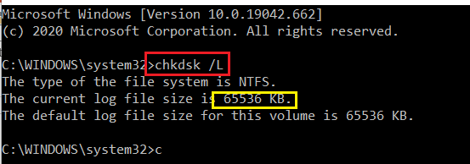
$LogFile overview
delete a file
Each record has LSN($LogFile Sequence Number).
This LSN information increase sequentially.
LFS restart area
Logging Area
NTFS restart (metadata of Logging Area)
Log File Records (64 MB, 2 ~ 3 hours of activities)
…
LSN
100
LSN
101
LSN
102
LSN
103
LSN
104
…
LSN
117
Can be resized

Slide 29
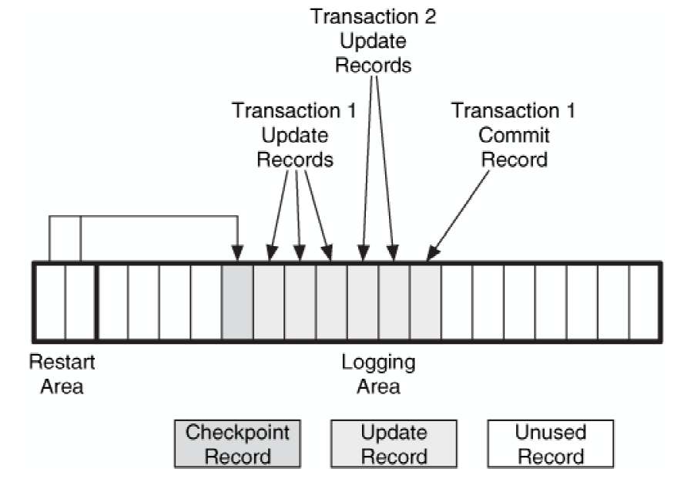
An example $LogFile with two transactions after the last checkpoint record. One
of the transactions did not commit.
In case of any unexpected system shutdown, OS checks $LogFile
Transaction 1 has a commit record
we use the 'redo' to ensure that the disk is correct.
Transaction 2 does not have a commit record
we use the 'undo' to ensure that none of the proposed changes exist.
void a corrupted state
File System Forensic Analysis 1st Edition

Slide 30
The workflow when error recovery is executed
Check Point Record
Update Record
Update Record
Update Record
Commit Record
LSN (102)
LSN(103)
LSN (104)
…
LSN (117)
Transaction 1 : if a commit record presents
Previous LSN
Previous LSN
Previous LSN
…
Previous LSN
Redo Data
Redo Data
Redo Data
…
Redo Data
Undo Data
Undo Data
Undo Data
…
Undo Data
Transaction 2: if a commit record is missing

Slide 31
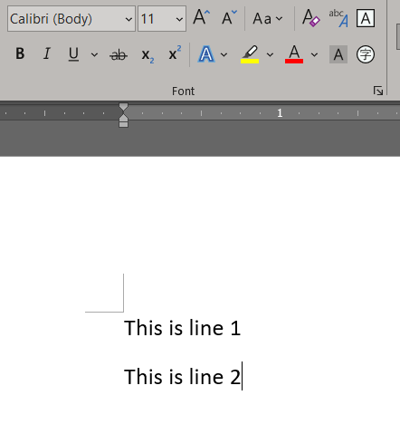
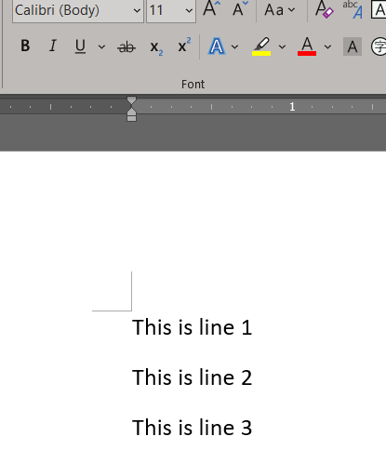
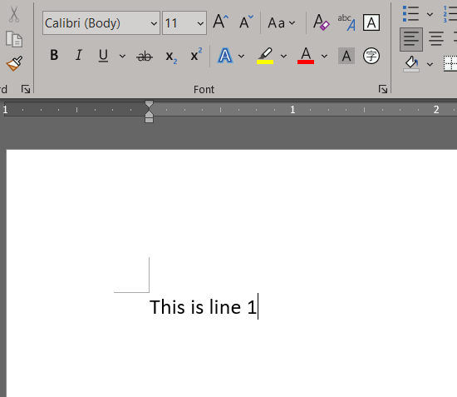
4. undo (This is line2)
3. undo (This is line 3)
1
2
Update Resident Value”
5. redo (This is line2)
6. redo (This is line 3)
Undo Data : the data before modification
Redo Data : the data after modification

Slide 32
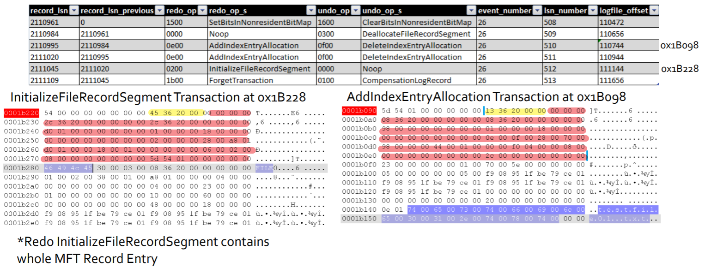
Creation testfile01.txt records
Credits: David Cowen, Matthew Seyer, G-C Partners, LLC /

Slide 33
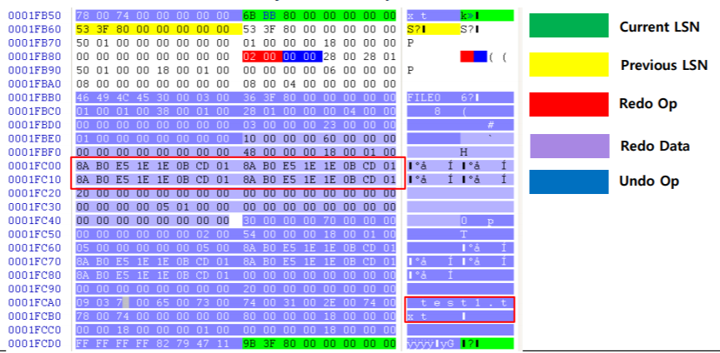
Initialize File (test1.txt) Record Segment
Notes:
http://forensicinsight.org/wp-content/uploads/2013/06/F-INSIGHT-NTFS-Log-TrackerEnglish.pdf

Slide 34
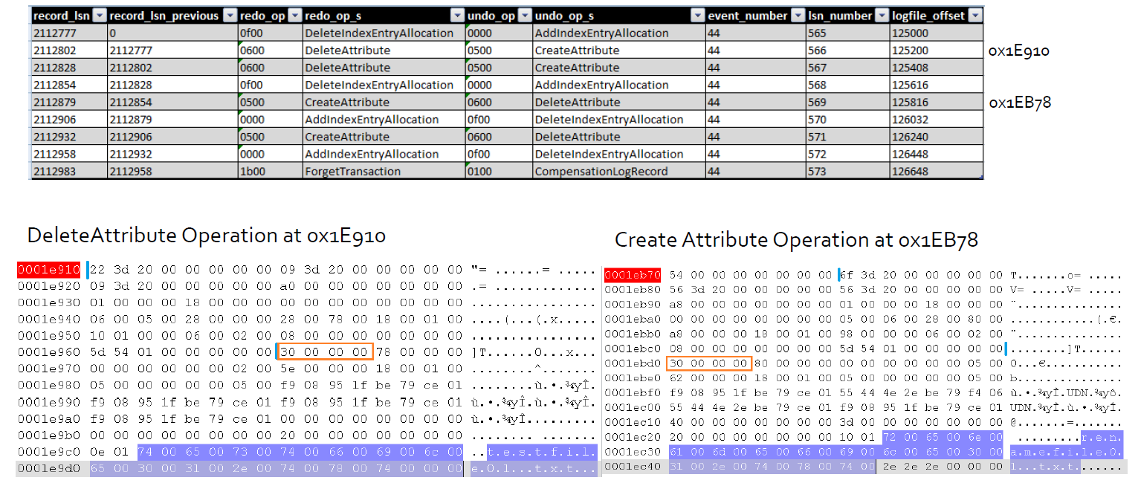
Rename testfile01.txt records

Slide 35
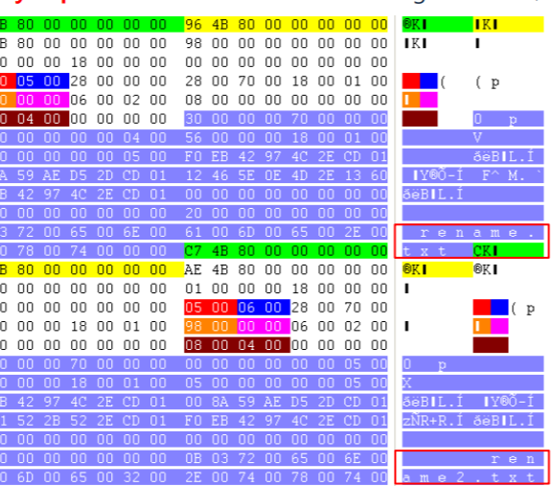
Delete Attribute(0x06) / Create Attribute(0x05)

Slide 36
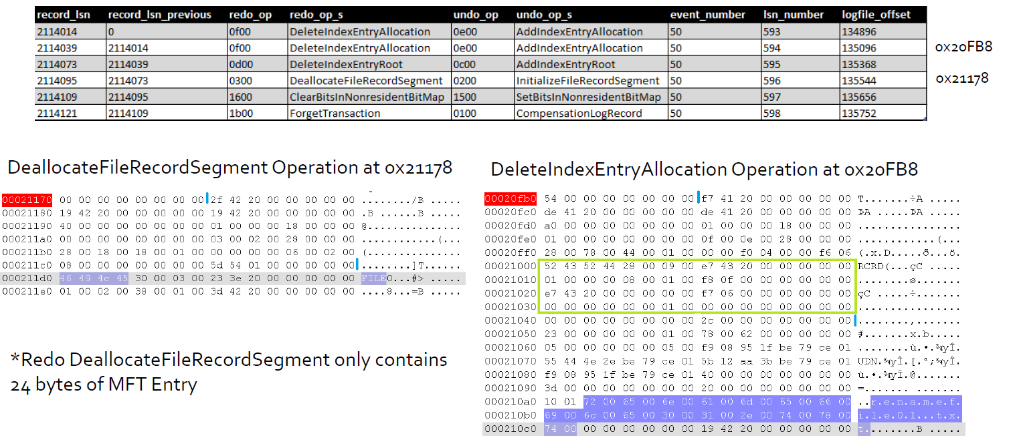
Delete renamefile01.txt records

Slide 37
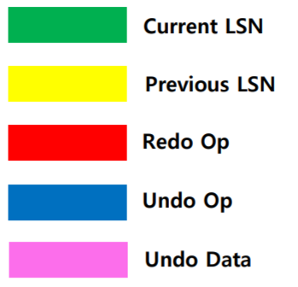
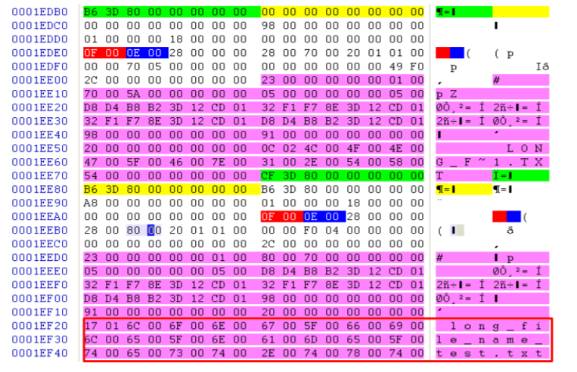
Delete Index Entry Allocation/Add Index Entry Allocation/

Slide 38
Analysis deleted file evidence in $LogFile
The most important Operations
DeleteIndexEntryAllocation: contains MFT file name and the MFT entry ID before delete operation
Approach
Find the file name in DeleteIndexEntryAllocaton
Find MFT entry ID
Find the parent MFT entry ID (folder) of the entry ID
from $UsnJrnl
If the parent folder contains the deleted file, the file has been deleted

Slide 39
Lab: Analyze $LogFile
Install using LogFileParser
1
Extract $LogFile
2
Parse logfile.bin extracted from $Logfile
3
Analyze extracted .csv
4

Slide 40
a) Install LogFileParser
Notes:
git clone https://github.com/jschicht/LogFileParser.git
wine LogFileParser/LogFileParser.exe -h

Slide 41
b) Extract $LogFile

Slide 42
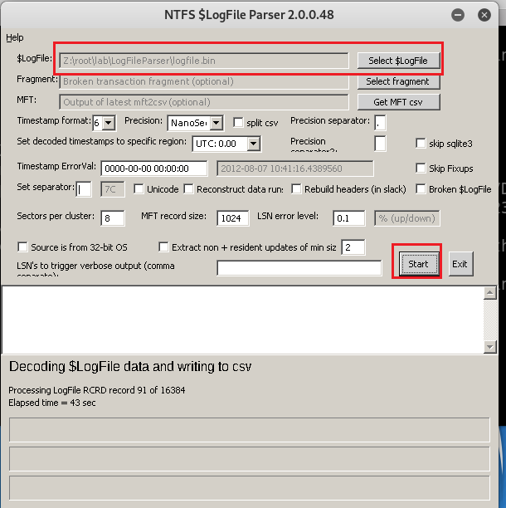
c) Parse logfile.bin extracted from $Logfile
MUST select the logfile.bin extracted from last slide
Any improvements? Have to run it in Windows.
Take over 10 hour

Slide 43
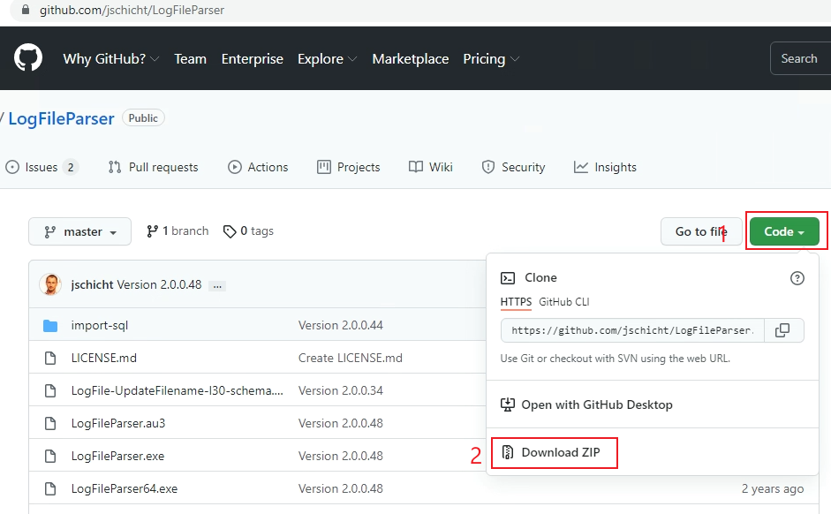
Run LogFileParser in Windows (better performance)
Notes:
https://github.com/jschicht/LogFileParser

Slide 44
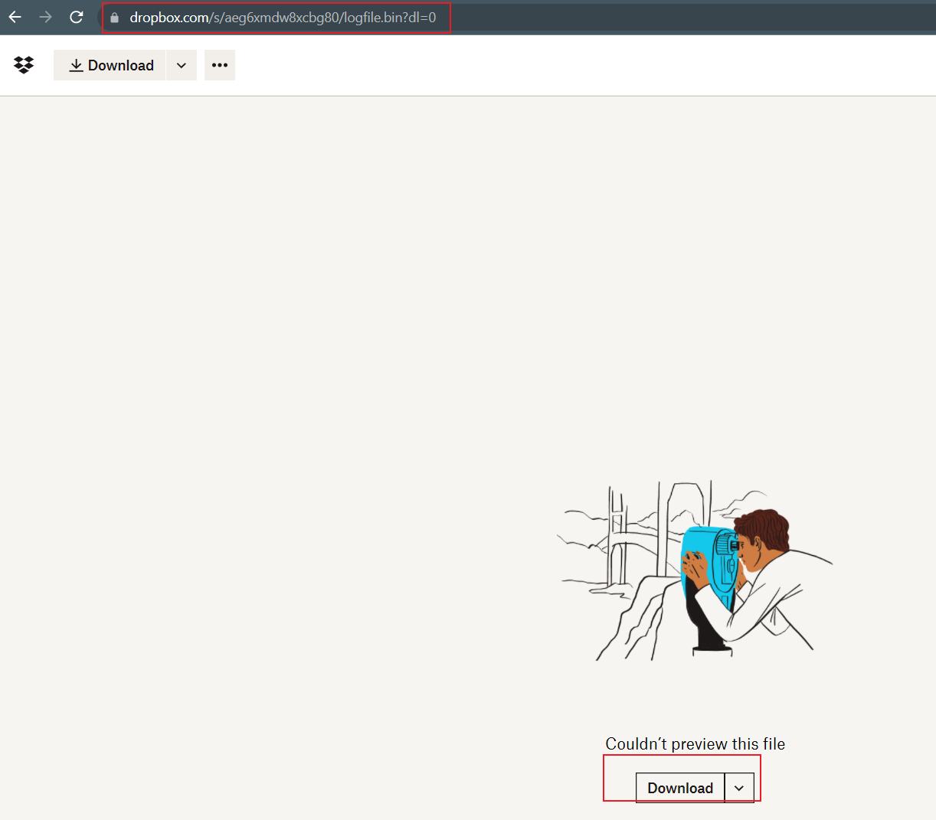
Download $logFile
remember the downloading folder
Notes:
https://www.dropbox.com/s/aeg6xmdw8xcbg80/logfile.bin?dl=0
https://www.dropbox.com/s/6sjdecon9c1f7rl/mft.csv?dl=0

Slide 45
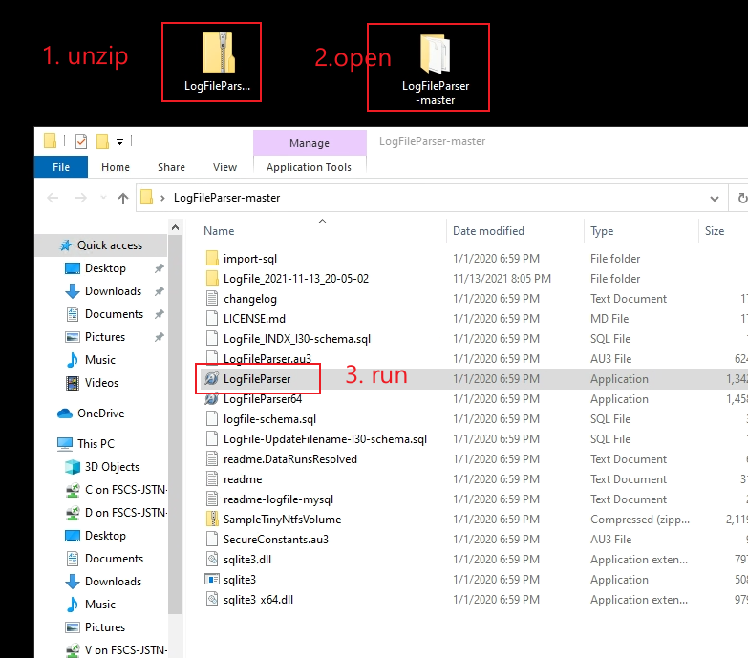
Download $logfile parser and execute it

Slide 46
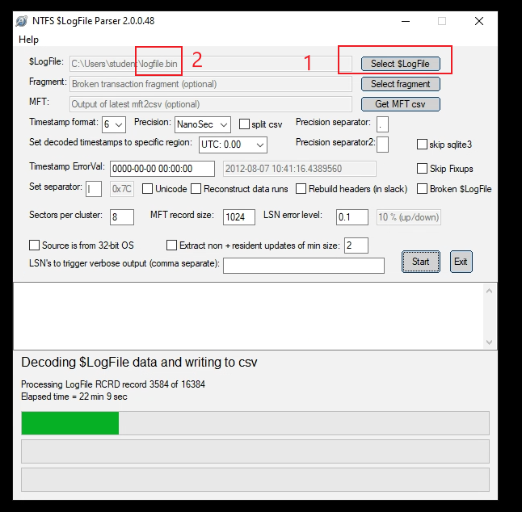
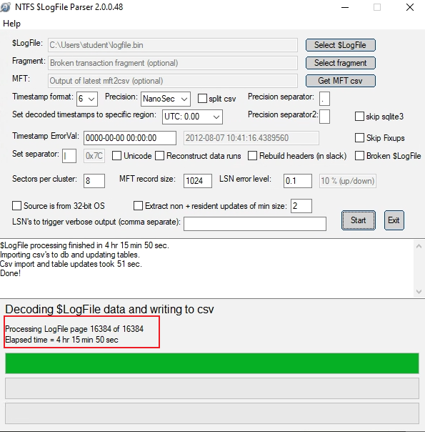
Parsing may take 4+ hours
3

Slide 47
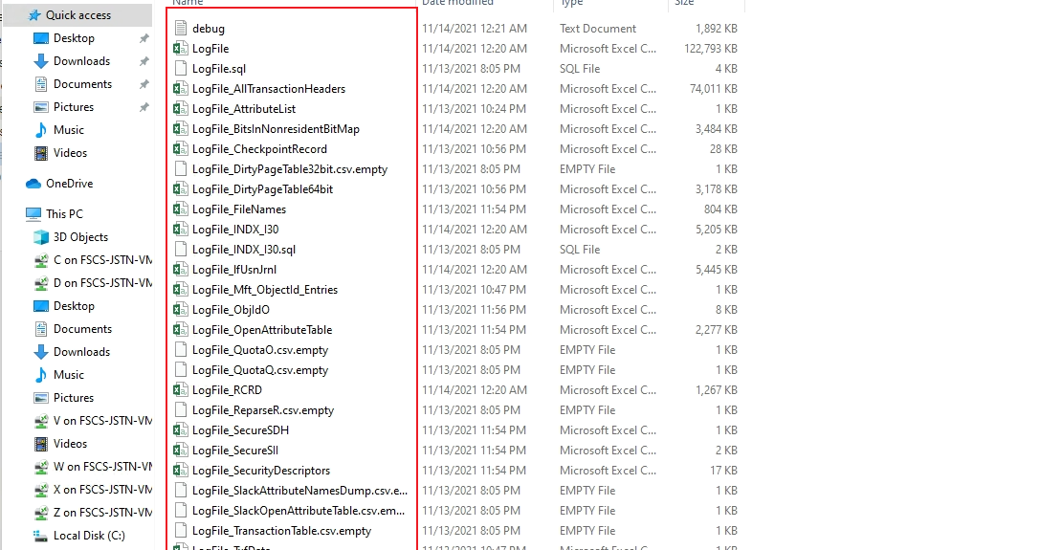

Slide 48
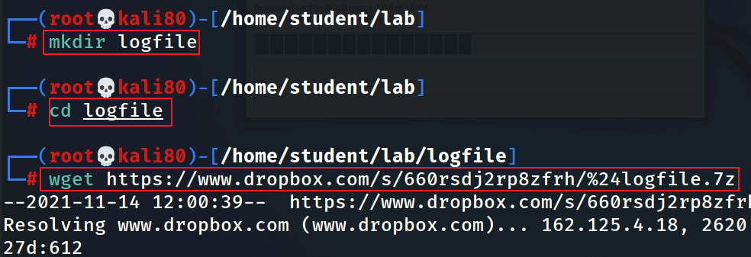
Since the parsing process may take more than 4 hours, we can download the results directly from our dropbox.
https://www.dropbox.com/s/660rsdj2rp8zfrh/%24logfile.7z
Notes:
https://www.dropbox.com/s/660rsdj2rp8zfrh/%24logfile.7z
https://github.com/frankwxu/digital-forensics-lab/blob/main/NIST_Data_Leakage_Case/NIST_Answers/lab_generated_file/LogFile.zip

Slide 49
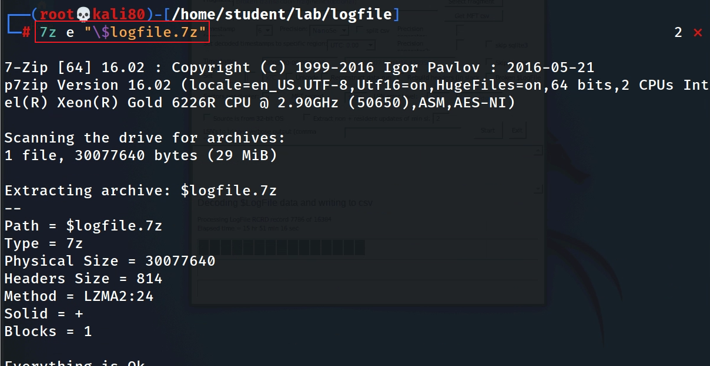

Slide 50
d) Analyze extracted .csv
$2:lf_MFTReference (?)
$7: lf_RedoOperation
$10:lf_FileName
$12:lf_TextInformation(MFT entry ID (ref),MFT Seq #) (matches MFT entry id in mft.csv)
$13:lf_UsnJrnlFileName
$14: lf_UsnJrnlMFTReference
$15: lf_UsnJrnlMFTParentReference
Notes:
lf_Offset|lf_MFTReference|lf_RealMFTReference|lf_MFTBaseRecRef|lf_LSN|lf_LSNPrevious|lf_RedoOperation|lf_UndoOperation|lf_OffsetInMft|lf_FileName|lf_CurrentAttribute|lf_TextInformation|lf_UsnJrnlFileName|lf_UsnJrnlMFTReference|lf_UsnJrnlMFTParentReference|lf_UsnJrnlTimestamp|lf_UsnJrnlReason|lf_UsnJrnlUsn|lf_SI_CTime|lf_SI_ATime|lf_SI_MTime|lf_SI_RTime|lf_SI_FilePermission|lf_SI_MaxVersions|lf_SI_VersionNumber|lf_SI_ClassID|lf_SI_SecurityID|lf_SI_QuotaCharged|lf_SI_USN|lf_SI_PartialValue|lf_FN_CTime|lf_FN_ATime|lf_FN_MTime|lf_FN_RTime|lf_FN_AllocSize|lf_FN_RealSize|lf_FN_Flags|lf_FN_Namespace|lf_DT_StartVCN|lf_DT_LastVCN|lf_DT_ComprUnitSize|lf_DT_AllocSize|lf_DT_RealSize|lf_DT_InitStreamSize|lf_DT_DataRuns|lf_DT_Name|lf_FileNameModified|lf_RedoChunkSize|lf_UndoChunkSize|lf_client_index|lf_record_type|lf_transaction_id|lf_flags|lf_target_attribute|lf_lcns_to_follow|lf_attribute_offset|lf_MftClusterIndex|lf_target_vcn|lf_target_lcn|InOpenAttributeTable|FromRcrdSlack|IncompleteTransaction

Slide 51
Goal
Determine if a deleted file belongs to /Burn/Burn
only use jpg as an example
Approach
Find MFT entry IDs which jpg file names from DeleteIndexEntryAllocaton
Repeat for each jpg file
Pick one file
Find the parent MFT entry ID (folder) of the file entry ID/name
Check if the parent MFT entry ID is 21921 (/Burn/Burn)
if Yes: the jpg is deleted from /Burn/Burn

Slide 52
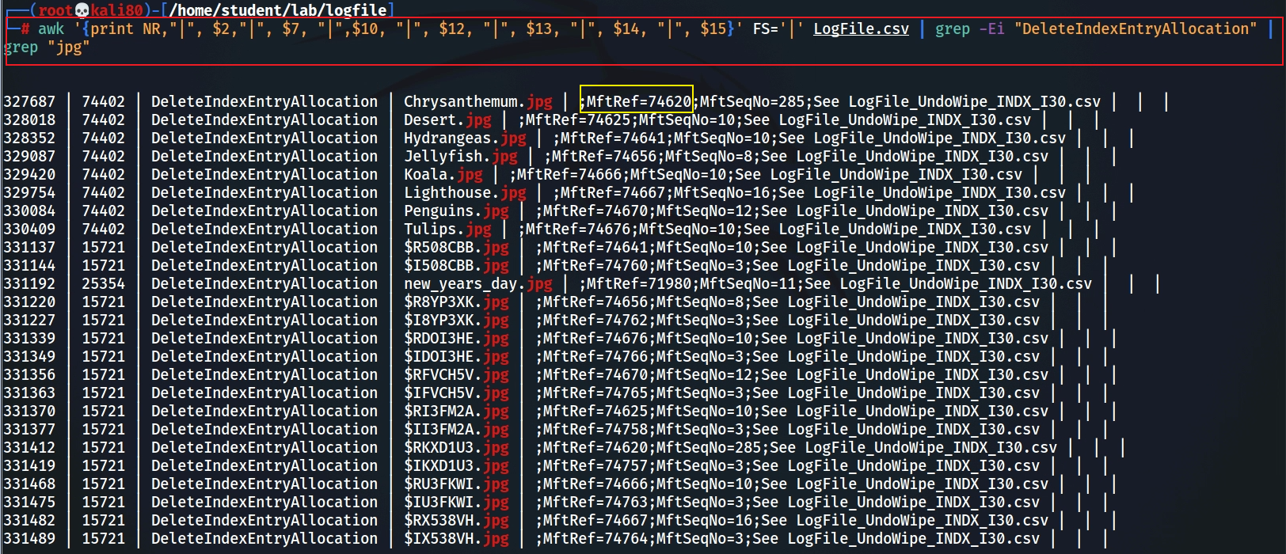
is one transaction of delete operation
Search “DeleteIndexEntryAllocation” transaction record
Notes:
awk '{print NR,"|", $2,"|", $7, "|",$10, "|", $12, "|", $13, "|", $14, "|", $15}' FS='|' LogFile.csv | grep -Ei "DeleteIndexEntryAllocation" | grep "jpg"

Slide 53
Find the parent MFT entry ID (folder) of the file name based on mft entry ID 74620 and the file name. We only demonstrate one example here, e.g., Chrysanthemum.jpg
The jpg file appears in two different folders, 74402 and 21921
$MFT entry 21921, which indicates the folder …/Burn/Burn
Conclusion: Chrysanthemum.jpg is the one file deleted from the folder
Notes:
grep "|74620|" ../UsnJrnl2Csv/UsnJrnl_2021-10-12_12-36-58.csv | grep "Chrysanthemum.jpg"

Slide 54
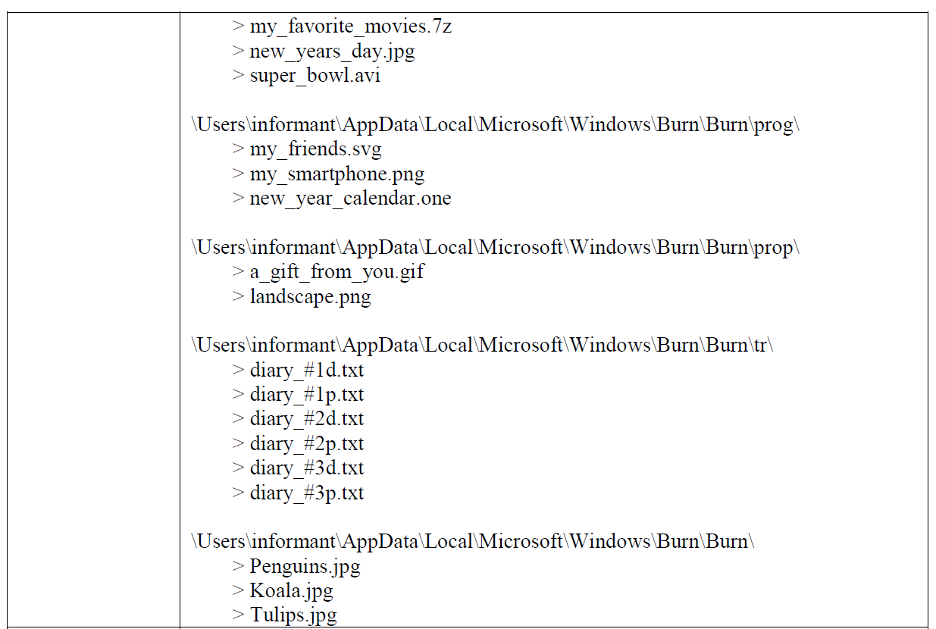

Slide 55
Remark 1: $LogFile can’t not be used for file recovery
The log does not contain user data that is non-resident and stored in a cluster
It does store the content of resident attributes, so it can be used to recover recent changes
e.g., when modify a file content , if changes are small and can fit in resident $DATA

Slide 56
Remark 2: Only $UsnJrnl contains parents' folder information
$Logfile has deleted file names and $MFT entry IDs
We rely on $UsnJrnl to determine if a deleted file was resided in a specific folder

Slide 57
35. What files were opened from CD-R?
The mounted CD device is D:\
rip.pl –r SYSTEM –o mountdev
Recently opened file accessed using .lnk
\User\informant\AppData\Roaming\Microsoft\Windows\Recent\*.lnk
Jumplist
\User\informant\AppData\Roaming\Microsoft\Windows\Recent\AutomaticDestinations

Slide 58
Recently accessed .lnk1
List all recently accessed .lnk

Slide 59
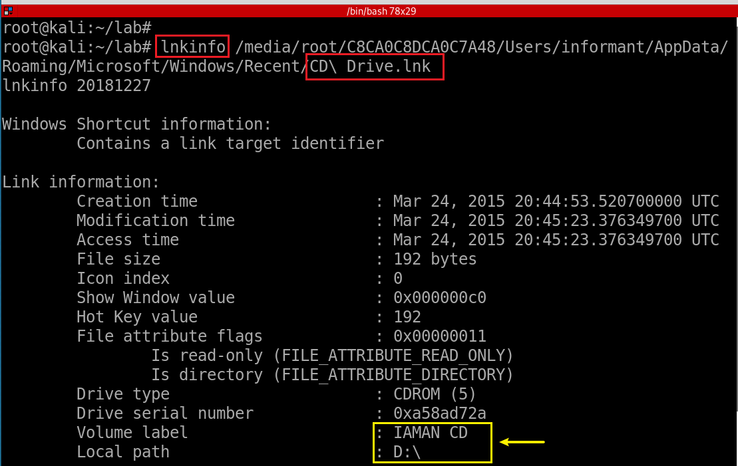
Check one of .lnk

Slide 60
Search for changed files with D:\
Need to repeat for each .lnk in the folder

Slide 61
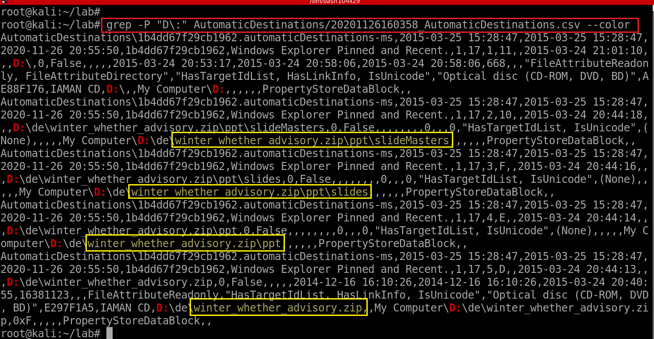
Jumplist
Notes:
grep -P "D\:" AutomaticDestinations/20201126160358_AutomaticDestinations.csv --color

